Slide 1
Evaluating nurse-staffing levels in perianesthesia care units using discrete event simulation
Sauleh Siddiqui, Elizabeth Morse, Scott Levin
Sara Cronin

Slide 2
Our Project
Patient flow simulation and staff scheduling for medical-surgical unit
Working to develop the patient census simulation
Will use this to create a program the creates schedules that ensure adequate staffing while minimizing costs

Slide 3
Paper Selection
The paper was co-authored by our mentor Dr. Siddiqui
Gives background of the value of modeling patient flow
Explains methods that will be a good reference/starting point for the creation of our simulation
Discusses some of the possible uses of a patient flow simulation

Slide 4
Paper Summary
The objective of this study was to create a discrete event simulation to model patient flow through a perioperative unit to create a new and more accurate way of estimating nurse staffing requirements.

Slide 5
Background
There is a lot of uncertainty involved the movement of a patients through a perianesthesia unit
Sources of uncertainty include fluctuation patient conditions post-surgery that are difficult to predict and variation in the number of surgeries performed day to day
Typically staffing methods use historical data to predict the expected number of patients combined with nurse-to-patient ratios to determine a staffing level
They also rely on the judgement and experience of a nurse manager who ultimately creates the schedule
Notes:
Just using npr doesn’t capture the true requirement

Slide 6
Background
In the past, analysis methods have not taken into account some of the complexities of nurse and patient matching
These include the limit on the number of patient handoffs and the necessity for a time-varying model to accurately model patient flow
This study looked to address these shortcomings and create an improved method for estimating staff requirements

Slide 7
Study Data
Data Used:
4 months of patient data with 3926 PREP/PACU patient encounters
4 PREP/PACU units of 1059 bed urban medical center
Analyses focused on one unit serving 15 ORs
Simulation Inputs:
Surgery durations, preparation and recovery times, patient demographics: age, gender, inpatient or outpatient status
Notes:
PACU- post-anaesthesia care unit
Patients simulated: chosen from distribution- not linked

Slide 8
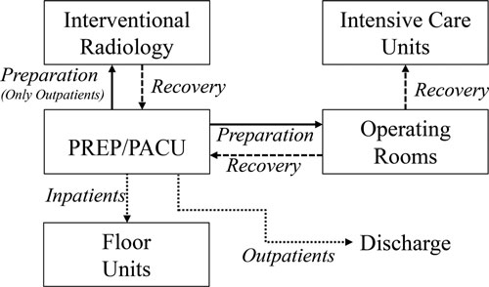
Simulation Design
Simulated patients were created based on the historical distributions
They were moved through the different areas according to predetermined durations

Slide 9
Nursing Assignment
The simulated patients are queued and each hour a set of patients is introduced to the simulation
When a patient enters the unit they are assigned to a nurse based on a series of rules
Patients are broken into phases based on the length of time spent on the unit
These phase assignments combined with the acuity measure determine which nurse the incoming patient is assigned to
If there is no existing nurse available a new nurse is added to the simulation
Notes:
A nurse can only have 1 high acuity patient and up to 3 patients total at any time

Slide 10
Simulation Output
The number of patients in the PREP/PACU was determined over one year of simulated time with 11,237 patient encounters
The corresponding nurse staffing estimates for the PREP/PACU area were determined

Slide 11
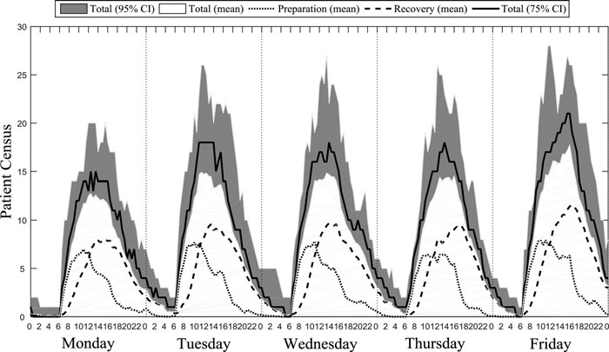
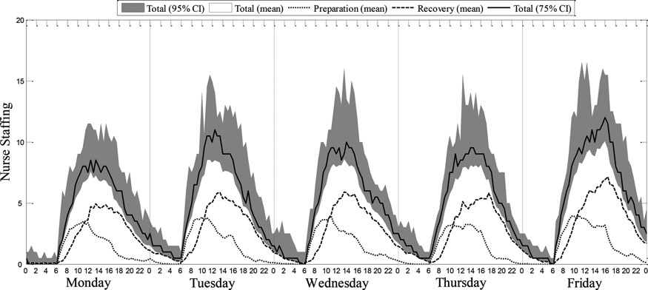
Study Results
Both a patient census and nurse staffing estimate were generated for the one year time period
These were shown to be consistent across simulation iterations and in line with the historical data available
Notes:
Simulation replicated 20 times to ensure consistency.
Also compared to historical data to ensure that the patient census generated was realistic.

Slide 12
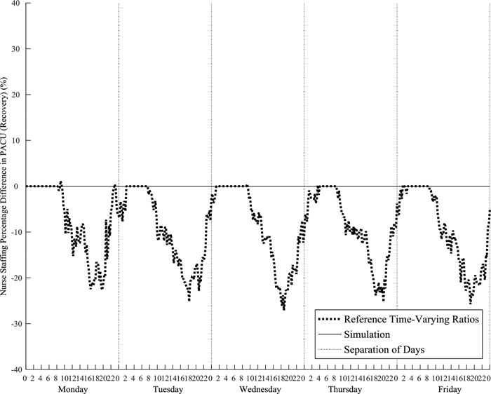
Simulation Analysis
The simulation staffing output (taken to be the true staffing requirement) was compared to the more common method of multiplying the number of patients by the corresponding nurse-to-patient ratio
This showed an staff underestimation of over 20% towards the end of the day
Notes:
Reason: Handoffs Example situation: 2 nurses- 1 with 3 low acuity patients, 1 with 1 high acuity patient; new high acuity patients enters; NPR: 5 patients total 2 nurses needed
Simulation Based: No handoffs possible so new nurse needed

Slide 13
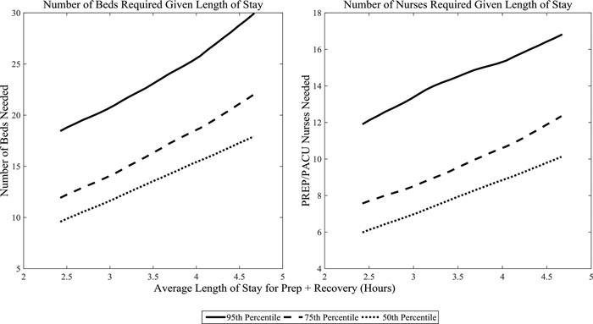
Simulation Analysis
The simulation was also used to test the effect of changes to the unit
The average length of stay was varied to determine the impact on the number of beds and number of nurses required
Notes:
Historical Data- 3.8 average time in PREP/PACU
Linear relationship

Slide 14
Discussion and Further Work
The output of a patient flow simulation could help better inform both shorter term staffing decisions as well as more long term ones concerning hiring
A simulation of this type could be used to test additional interventions to patient flow and staffing on the unit
It discusses the possibility of converting the staffing level output into a schedule that provide an adequate number of nurses while minimizing cost
Proposes further investigation into which percentile of staffing level generated by the simulation should be used for scheduling
Notes:
Additional interventions: lower OR times, fewer patients with high acuity

Slide 15
Assessment
Pros
The study demonstrates a clear improvement in accurately predicting the number of nurses necessary to handle the patient population on the unit
The usefulness of a simulation in testing out proposed changes is discussed and shown
Cons
The simulated patient parameters are chosen from the distributions independently, so preparation, OR, and recovery times are not linked
Uses a random acuity assignment rather than basing it on patient attributes
Uses limited patient data so analyses involving a change in patient composition are not as feasible

Slide 16
Relevance for Our Project
The first stage of our project will involve creating a patient flow simulation
The unit we are simulating is more general and has influx and efflux of patients to and from a wider range of areas so having a groundwork to build upon will be helpful
We will look to the validation techniques used in the study to verify that our simulation accurately models attributes of the unit
The issue raised of the ideal staffing level is something that we are going to investigate when creating the optimization problem

Slide 17
Citation
Sauleh Siddiqui , Elizabeth Morse & Scott Levin (2017): Evaluating nurse staffing levels in perianesthesia care units using discrete event simulation, IISE Transactions on Healthcare Systems Engineering, DOI: 10.1080/24725579.2017.1346729
Notes:
IISE Institute of Industrial and Systems Engineers

