Slide 1
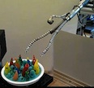
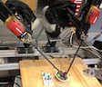
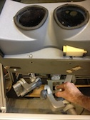
Sensors
Adaptive friction estimator
Prior anatomic model
The World
Wrench estimator
Slave Robot
Fusion
SLAM
Robot state, force, stiffness
Corrected environment model
Environment and advanced state estimation
Multi-mode lower level controller
Intelligent Higher-Level Control
Task tracking
Task-specific virtual fixtures
Telemanipulation
Recursive exploration of shape/stiffness
Task and control mode specification
Slave robot state
Commanded motion and local compliance
Master manipulator state
Master Manipulator Controller (impedance controller)
Sensory substitution and display
Master local impedance map

Slide 2
Older versions after here

Slide 3
Sensors
Adaptive friction estimator
Prior anatomic model
The World
Wrench estimator
Slave Robot
Fusion
SLAM
Robot state, force, stiffness
Corrected environment model
Environment and advanced state estimation
Multi-mode lower level controller
Intelligent Higher-Level Control
Task tracking
Task-specific virtual fixtures
Telemanipulation
Recursive exploration of shape/stiffness
Task and control mode specification
Slave robot state
Commanded motion and local compliance
Master manipulator state
Master Manipulator Controller (impedance controller)
Sensory substitution and display
Master local impedance map

Slide 4
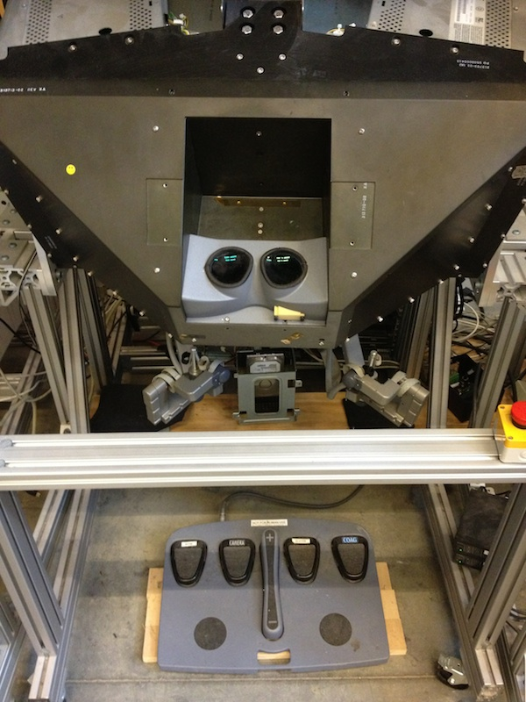
Sensors
Adaptive friction estimator
Prior anatomic model
The World
Wrench estimator
Slave Robot
Fusion
SLAM
Robot state, force, stiffness
Corrected environment model
Environment and advanced state estimation
Multi-mode lower level controller
Intelligent Higher-Level Control
Task tracking
Task-specific virtual fixtures
Telemanipulation
Recursive exploration of shape/stiffness
Task and control mode specification
Slave robot state
Commanded motion and local compliance
Master manipulator state
Master Manipulator Controller (impedance controller)
Sensory substitution and display
Master local impedance map

Slide 5
Sensors
Adaptive friction estimator
Prior anatomic model
The World
Wrench estimator
Slave Robot
Fusion
SLAM
Robot state, force, stiffness
Corrected environment model
Environment and advanced state estimation
Multi-mode lower level controller
Intelligent Higher-Level Control
Task tracking
Task-specific virtual fixtures
Telemanipulation
Recursive exploration of shape/stiffness
Task and control mode specification
Slave robot state
Commanded motion and local compliance
Master manipulator state
Master Manipulator Controller (impedance controller)
Sensory substitution and display
Master local impedance map

Slide 6
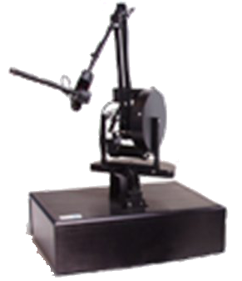
Sensors
Adaptive friction estimator
Wrench estimator
Prior anatomic model
The World
Joint
information
Slave Robot
Fusion
SLAM
Robot state, force, stiffness
Corrected environment model
Environment and advanced state estimation
State
Multi-mode lower level controller
Slave robot state
Intelligent Higher-Level Control
Task tracking
Task-specific virtual fixtures
Telemanipulation
Recursive exploration of shape/stiffness
Task and control mode specification
Commanded motion and local compliance
Master manipulator state
Master Manipulator Controller (impedance controller)
Sensory substitution and display
Master local impedance map

Slide 7
Sensors
Adaptive friction estimator
Wrench estimator
Prior anatomic model
The World
Joint
information
Slave Robot
Fusion
SLAM
Robot state, force, stiffness
Corrected environment model
Environment and advanced state estimation
State
Slave robot commanded motion and local compliance
Intelligent Higher-Level Control
Task tracking
Task-specific virtual fixtures
Telemanipulation
Recursive exploration of shape/stiffness
Task and control mode specification
Multi-mode lower level controller
Master manipulator state
Master Manipulator Controller (impedance controller)
Sensory substitution and display
Master local impedance map

Slide 8
Sensors
Adaptive friction estimator
Wrench estimator
Prior anatomic model
The World
Joint
information
Slave Robot
Fusion
SLAM
Robot state, force, stiffness
Local environment impedance
Environment and advanced state estimation
State
Consistent desired speed and force
Intelligent Higher-Level Control
Task tracking
Task-specific virtual fixtures
Telemanipulation
Recursive exploration of shape/stiffness
Task specification S_{v}, S_{m}, v_{d}, w_{d}
Control mode specification
Multi-mode lower level controller
Master manipulator state
Master Manipulator Controller (impedance controller)
Sensory substitution
Master local impedance map

Slide 9
Sensors
Prior anatomic model
The World
Environment and advanced state estimation
[Nabil, Howie]
Slave Robot [Nabil]
Sensors
State
Slave Robot Controller (multi-level impedance controller) [Nabil]
Intelligent Higher-Level Control [Russ]
Task tracking
Task-specific virtual fixtures
Telemanipulation
Master Manipulator Controller (impedance controller)

Slide 10
Sensors
Prior anatomic model
The World
Environment and advanced state estimation
[Nabil, Howie]
Slave Robot [Nabil]
Sensors
State
Slave Robot Controller (multi-level impedance controller) [Nabil]
Intelligent Higher-Level Control [Russ]
Task tracking
Task-specific virtual fixtures
Telemanipulation
Master Manipulator Controller (impedance controller)

Slide 11
Sensors
Adaptive friction estimator
Wrench estimator
Prior anatomic model
The World
Joint
information
Slave Robot
Fusion
SLAM
Robot state, force, stiffness
Local environment impedance
Environment and advanced state estimation
State
Consistent desired speed and force
Intelligent Higher-Level Control
Task tracking
Task-specific virtual fixtures
Telemanipulation
Recursive exploration of shape/stiffness
Task specification S_{v}, S_{m}, v_{d}, w_{d}
Control mode specification
Multi-mode low level controller
Commanded velocity
Master Manipulator Controller (impedance controller)
Impedance scaling (scalar)
Sensory substitution
Desired impedance directions (matrix)

Slide 12
Sensors
Adaptive friction estimator
Wrench estimator
Prior anatomic model
The World
Joint
information
Slave Robot
Fusion
SLAM
Robot state, force, stiffness
Local environment impedance
Environment and advanced state estimation
State
Slave robot commanded motion and local compliance
Intelligent Higher-Level Control
Task tracking
Task-specific virtual fixtures
Telemanipulation
Recursive exploration of shape/stiffness
Task specification S_{v}, S_{m}, v_{d}, w_{d}
Control mode specification
Multi-mode lower level controller
Master manipulator state
Master Manipulator Controller (impedance controller)
Sensory substitution
Master local impedance map

Slide 13
Sensors
Adaptive friction estimator
Wrench estimator
Prior anatomic model
The World
Joint
information
Slave Robot
Fusion
SLAM
Robot state, force, stiffness
Corrected environment model
Environment and advanced state estimation
State
Slave robot commanded motion and local compliance
Intelligent Higher-Level Control
Task tracking
Task-specific virtual fixtures
Telemanipulation
Recursive exploration of shape/stiffness
Task specification S_{v}, S_{m}, v_{d}, w_{d}
Control mode specification
Multi-mode lower level controller
Master manipulator state
Master Manipulator Controller (impedance controller)
Sensory substitution
Master local impedance map

