Slide 1
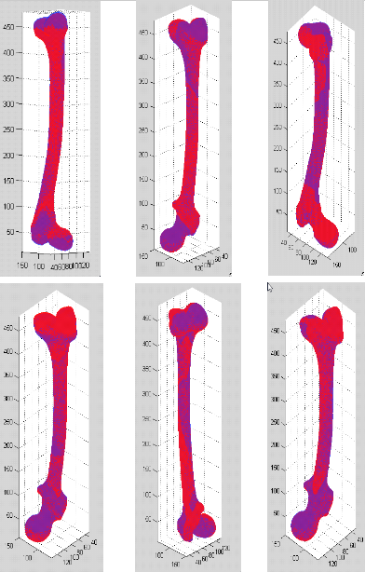
Statistical Atlas of the Human Knee Team members: Ceylan Tanes, Murat Bilgel Mentors: Xin (Ben) Kang, Dr. Russell Taylor
Goals:
Automate the statistical atlas building pipeline developed by Dr. Chintalapani
Build statistical atlases of the femur and tibia
Significance:
Automated pipeline speeds up the atlas construction process and reduces human error
Knee atlas can be used for ACL surgery evaluations
Results:
Subjects used for atlas construction are estimated with an error of less than 2 mm
Left and right femur are similar enough to be represented by one atlas and its mirror image
Mean + 3σ_{i} Mode_{i}
Mean – 3σ_{i} Mode_{i}
Mode 1 Mode 2 Mode 3

