Slide 1
Tracking of Orthopaedic Instruments in 3D Camera Views Literature review by Jie Ying

Slide 2
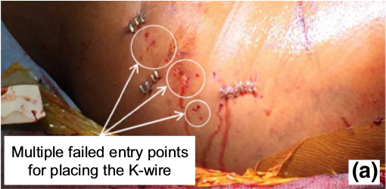
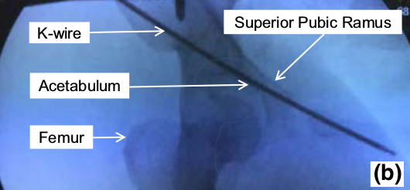
Background
K-wire insertion currently requires many X-rays
Misplacement could damage important structures in the body
Current tracking solutions are ineffective for K-wire
Traditional computer vision solutions fail
Trackers cannot be placed on it
Propose to use convolutional neural network trained on RGB images
Multiple entry wounds
X-ray image of hip region in pelvic surgery
Images from Fischer, Marius, et al. "Preclinical usability study of multiple augmented reality concepts for K-wire placement." International Journal of Computer Assisted Radiology and Surgery 11.6 (2016): 1007-1014.

Slide 3
Tool tip prediction paper
Diotte, B., Fallavollita, P., Wang, L., Weidert, S., Thaller, P. H., Euler, E., & Navab, N., “Radiation-Free Drill Guidance in Interlocking of Intramedullary Nails,” in Medical Image Computing and Computer-Assisted Intervention – MICCAI 2012, 2012, pp. 18–25.
Intramedullary nail placement in a phantom and the augmented drill position overlay
X-ray images of intramedullary nails in a fractured tibia
Image from Diotte et al. MICCAI 2012
Images from Wikimedia Commons

Slide 4
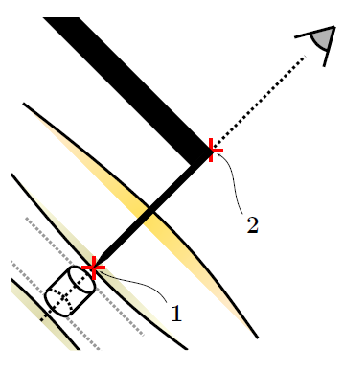
Motivation
Tibial fractures are common and treated with intramedullary nailing
Can require 48 x-rays for one placement
Propose radiation-free guidance based on optical marker tracking
Augment projected tip position on the patient
C-arm source
Align C-arm with hole
Skin incision
Pre-notch on bone surface
Align tip of drill with hole
Drill
Place screw
Drill Guide
Bone Surface
Skin Surface
Implant Hole
Workflow of intramedullary nailing
Desired alignment between drill and hole
Image from Diotte et al. MICCAI 2012

Slide 5
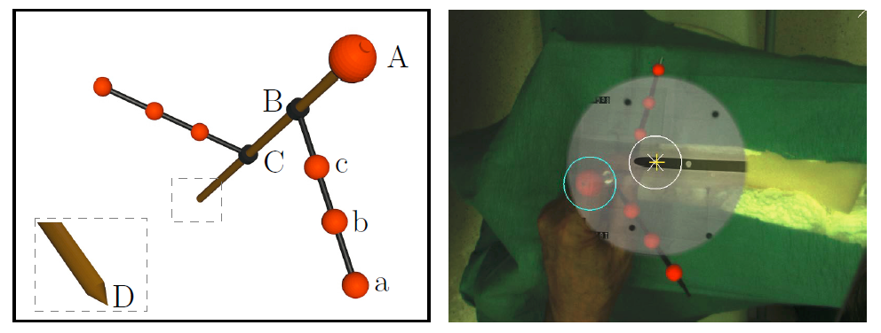
Method
Proposed optical marker to track the drill (left) and the augmentation that it provides (right). The tracked position of the top ball of the marker is circled in blue and the target drill position is circled in white. Estimated tip position is marked by the yellow cross.
Images from Diotte et al. MICCAI 2012
Notes:
Spheres are different sized on upper and lower branch
Fluorescent coated
Use OpenCV to detect balls
Largest is probable location of A, least square line fitting for B and C positions and least variation in ball size
Registration from optical to X-ray image

Slide 6
Experimental setup and results
Print circle 5mm (size of nail hole)
Fix the drill tip to the center of the circle
Compare with estimated circle
200 trials over 30°cone angle rotation
Mean error: 1.72 ± 0.7 mm
57% of the samples were below the mean
98% below 4mm
Marker image from Diotte et al. MICCAI 2012

Slide 7
Phantom experiment setup and results
Phantom setup: dry bone fixed to a box with a 10mm Titanium Femoral Nail
Fluoroscopic pre-drill image and one x-ray to confirm screw placement
3 surgeons – 2 experts and 1 resident – insert screw with marker guidance
Success if they inserted the screw
93% success rate, 56/60 cases
Failures attributed to resident and poor phantom setup
 | Without guidance on real patient | With guidance on phantom
Num. of X-rays | 48 | 2
Average time to completion | 13.7 min | 2 min
Image from Diotte et al. MICCAI 2012
Notes:
One failure was due to nail shifting, doesn’t happen in real life cuz fixed with rigging
Other 3 from resident, not notching deep enough

Slide 8
Limitations
Requires a large fixture to the drill
Requires line of sight, mostly solved by mounting the camera on the C-arm
Simpler problem here, only one correct placement
More detailed algorithms needed
No discussion on registration algorithms
May contribute to errors in notching
More detailed results would be nice
How many procedures were performed by experts vs. resident
How do timing vary between groups
What is the distribution of procedure time
Notes:
Can’t place on K-wire – would get in way of drill, no pre-notching procedure.
Want to do the same with bands on the K-wire, not applicable to all
Show that an augmented solution can help and reduce need for X-rays

Slide 9
Deep Learning Paper – Residual Learning
K. He, X. Zhang, S. Ren, and J. Sun, “Deep Residual Learning for Image Recognition,” Proceedings of CVPR, 2016, pp. 770–778.
Image from D. Akagi, “A Primer on Deep Learning,” DataRobot, 19-May-2014. [Online]. Available: https://www.datarobot.com/blog/a-primer-on-deep-learning/.

Slide 10
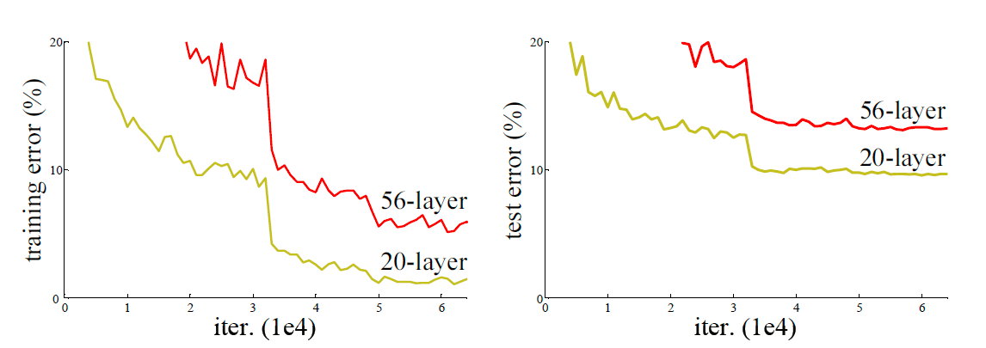
Training a deep net
Weight layers are expensive to learn
Deeper nets have shown better performance but then degrades
Inspiration: deepen a shallow network by padding with identity mapping
Current solver cannot find do as well as or better than this construction
Training (left) and test (right) errors on CIFAR-10[1] with 20 and 56 layer “plain” (non-residual) networks. Even on training data, the deeper network has higher error.
[1] A. Krizhevsky and G. Hinton, “Learning multiple layers of features from tiny images ,” 2009.
Image from K. He, X. Zhang, S. Ren, and J. Sun, CVPR 2016.
Notes:
Unlike traditional learning, this is not from overfitting, think it’s from difficulty in learning
Reduce need for parameters

Slide 11
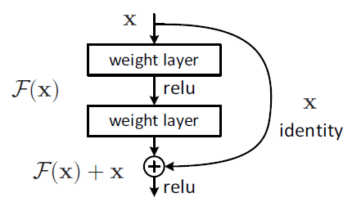
Simplify the task
Suppose we have a filter
$$ℋ\left(x\right)$$
where x is the input to a layer
Instead of learning $ℋ\left(x\right)$, learn
$$ℱ\left(x\right):=ℋ\left(x\right)−x \\ ℋ\left(x\right)=ℱ\left(x\right)+x$$
Easy to learn identity mapping
$$ℱ\left(x\right) →0$$
No additional weights from the skip-ahead path since it is just identity
Image from K. He, X. Zhang, S. Ren, and J. Sun, CVPR 2016.

Slide 12
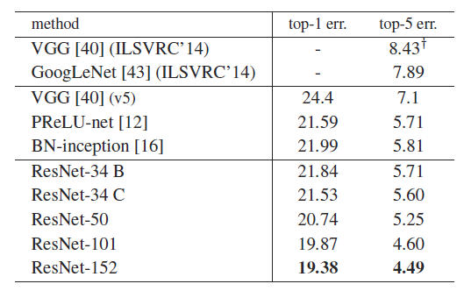
Results
Deeper residual nets do better
Comparing plain (top) and residual (bottom) networks of different depths trained and tested on ImageNet[1] . Thin lines show training error and bolded lines show test error.
[1] O. Russakovsky et al., “ImageNet Large Scale Visual Recognition Challenge,” Int J Comput Vis, Dec. 2015.
Image from K. He, X. Zhang, S. Ren, and J. Sun, CVPR 2016.
Notes:
We see that now deeper nets behave better
Unclear why the training error is higher than test error.
Unclear ResNet converges faster

Slide 13
Results
Training (dashed) and test (solid) errors on CIFAR-10 [1] dataset. We see that deeper residuals networks do better, while deeper plain nets do not. The advantage of additional layers diminish quickly though.
Image from K. He, X. Zhang, S. Ren, and J. Sun, CVPR 2016.
[1] A. Krizhevsky and G. Hinton, “Learning multiple layers of features from tiny images,” 2009.
Notes:
CIFAR-10 only has 60k 32x32 images (50k training, 10k validation), we would be collecting on similar scale
10 classes, we only have two

Slide 14
Limitations
Output and input must be the same size – solve by projective mapping
Unclear why this works, rarely need to learn identity mapping
Maybe just better initialization
Later paper claims the backpropagation works better
Solves vanishing gradients
Object identification, not fully convoluted for pixel level labelling
Claim faster convergence but no training time results
Dropout often reduces training complexity – none used here

