Slide 1
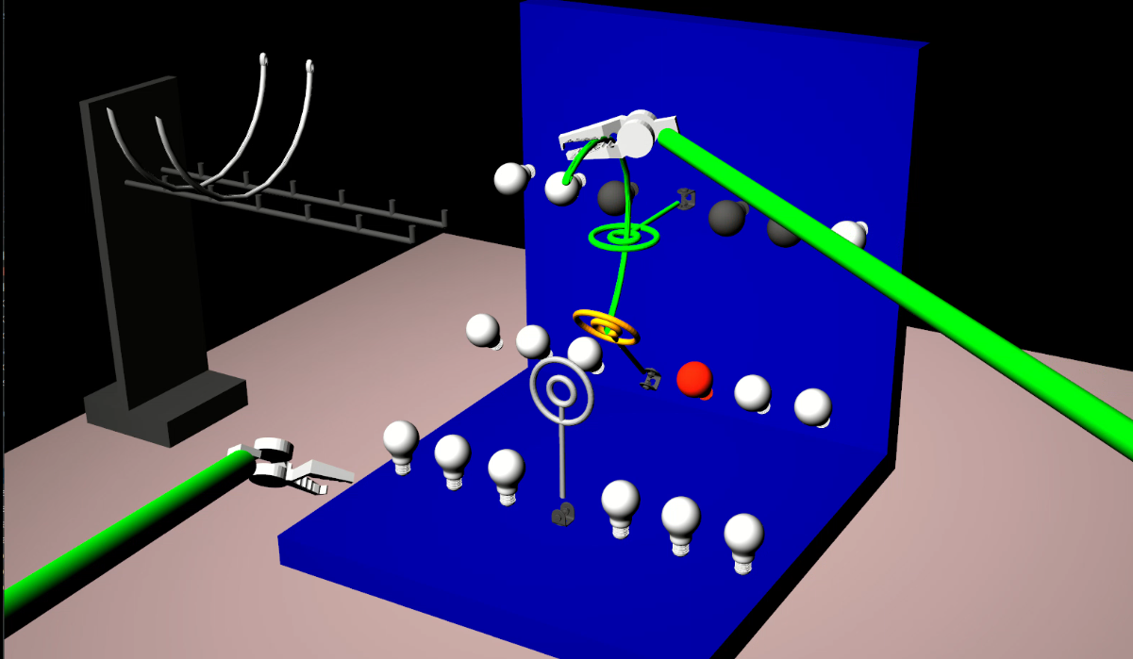
Augmentation of Haptic Guidance into Virtual-Reality Surgical Simulators
Goal
Investigating the effect of haptic guidance (and brain stimulation) on motor learning in VR surgical simulators
What Students Will Do
Calculating the task-space error between needle curvature and the desired curvature (curvature passing through the inner rings)
Generating force fields (guidance and repulsive) based on the task-space error
Augmenting the force fields
Into the da Vinci Research Kit
(dVRK)’s controller
Evaluating the approach in a
pilot user study

Slide 2
Deliverables
Minimum: Implementing repulsive and guidance force fields for the needle-driving task on the dVRK system
Expected: Evaluating the approaches in a pilot user study
Maximum: Evaluating the effectiveness of haptic guidance in the absence and presence of brain stimulation in a pilot user study
Group Size: 1-2
Skills: Programming skills such as C++ and ROS, knowledge of robotics, familiarity with the dVRK is a plus
Mentors: Dr. Mahya Shahbazi, Dr. Jeremy Brown, Guido Caccianiga
Contact: mahya.sh@jhu.edu, jdelainebrown@jhu.edu, gcaccia1@jhu.edu

