Slide 1
TEP Insufflator
Rahul Modi
Mentor: Dr. Jeremy Richmon
Project #10
April 1, 2014

Slide 2
Agenda
Problem Overview
Project Goal
Deliverables
Pictures
Dependencies
Management Plan
Assessment and Misc.
Key Dates
Technical Summary of Approach
Questions

Slide 3
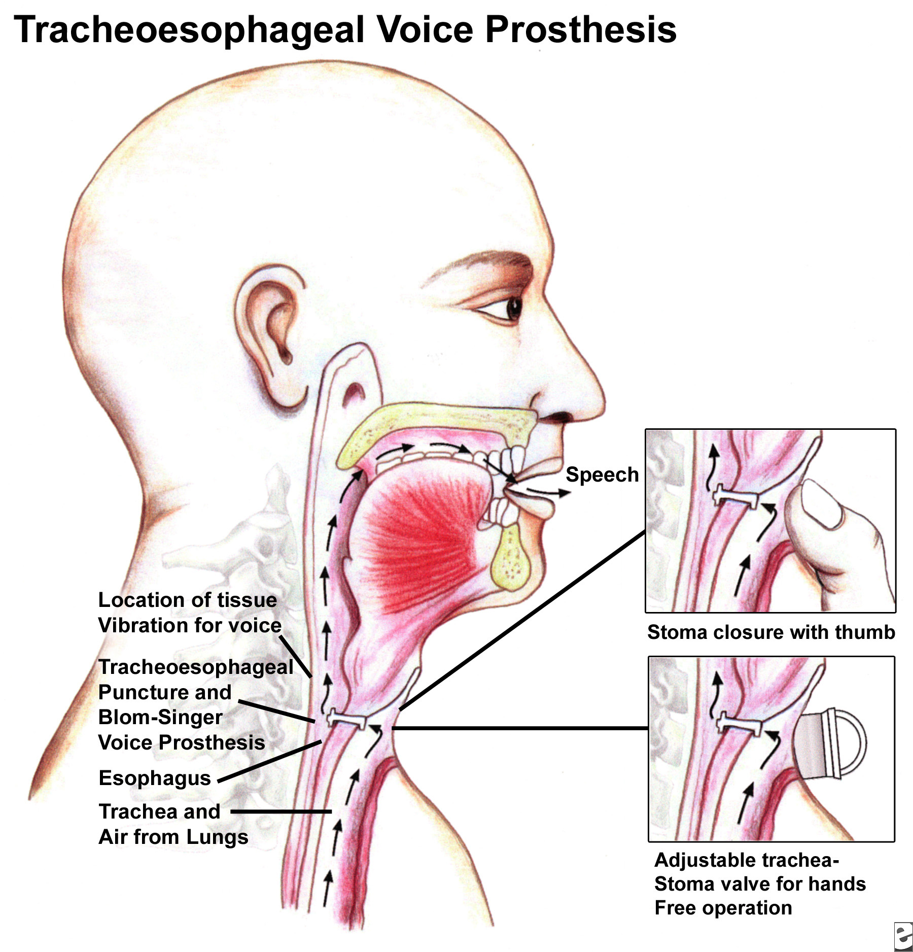
http://emedicine.medscape.com/article/2145329-overview

Slide 4
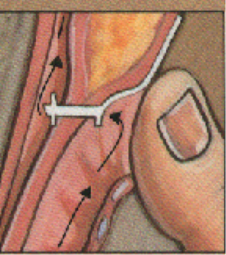
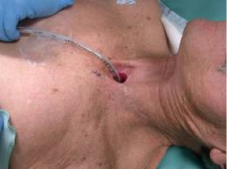
Problem Overview
Patient’s face difficulty for numerous reasons
Patient must cover the stoma when speaking. This has a social stigma and is uncomfortable
Food can easily travel into trachea causing issues
http://www.evmsent.org/trachesoph.asp

Slide 5
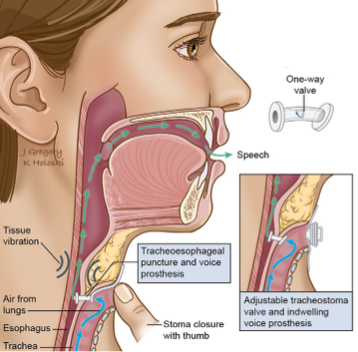
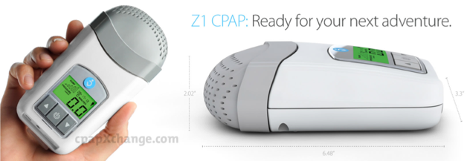
Project Goal and Next Steps
Develop an insufflator to allow patients to speak hands-free
This requires a constant air flow; hence, we will implement a CPAP device
Create a single on/off method for patient to enable/disable airflow
http://en.wikipedia.org/wiki/Laryngectomy
http://www.cpapxchange.com/cpap-machines-bipap-machines/z1-travel-cpap-machine-human-design-medical-hd60-1005.jpg

Slide 6
Deliverables
Minimum: create a method of attaching the CPAP device to the voice prosthesis
Expected: the minimum plus a method of constraining air flow via a valve on the CPAP device
Maximum: the expected plus a method of controlling the valve wirelessly

Slide 7
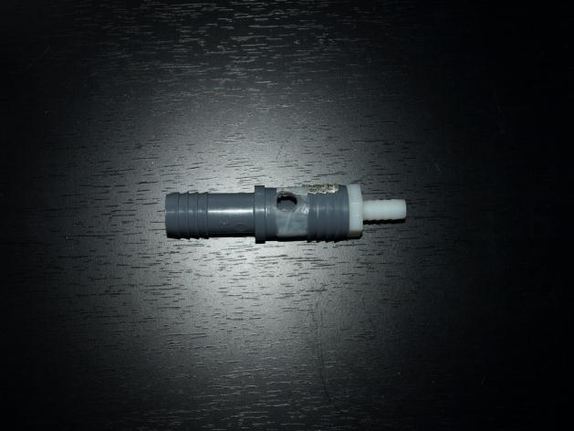
Pictures

Slide 8
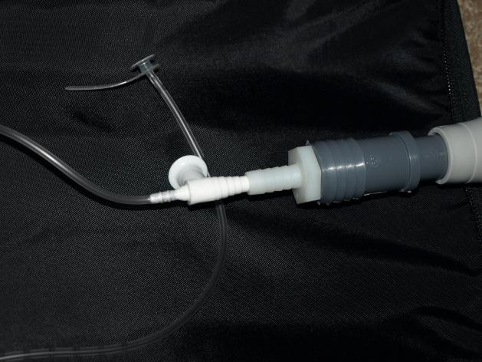
Pictures

Slide 9
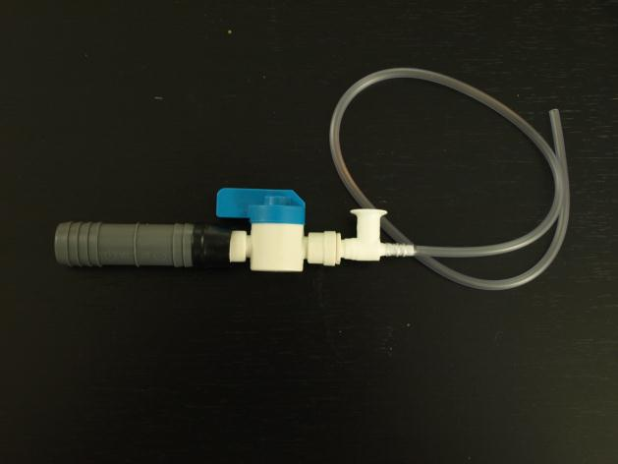
Pictures

Slide 10
Dependencies
Dependencies
Access to mentor
Feedback from clinical trials on patients
Supplies
Connection adapters to connect CPAP to voice prosthesis
Purchased and completed
Suction catheters
Sizing will depend on patient
Provided by Dr. Richmon
Money
Provided by Dr. Richmon

Slide 11
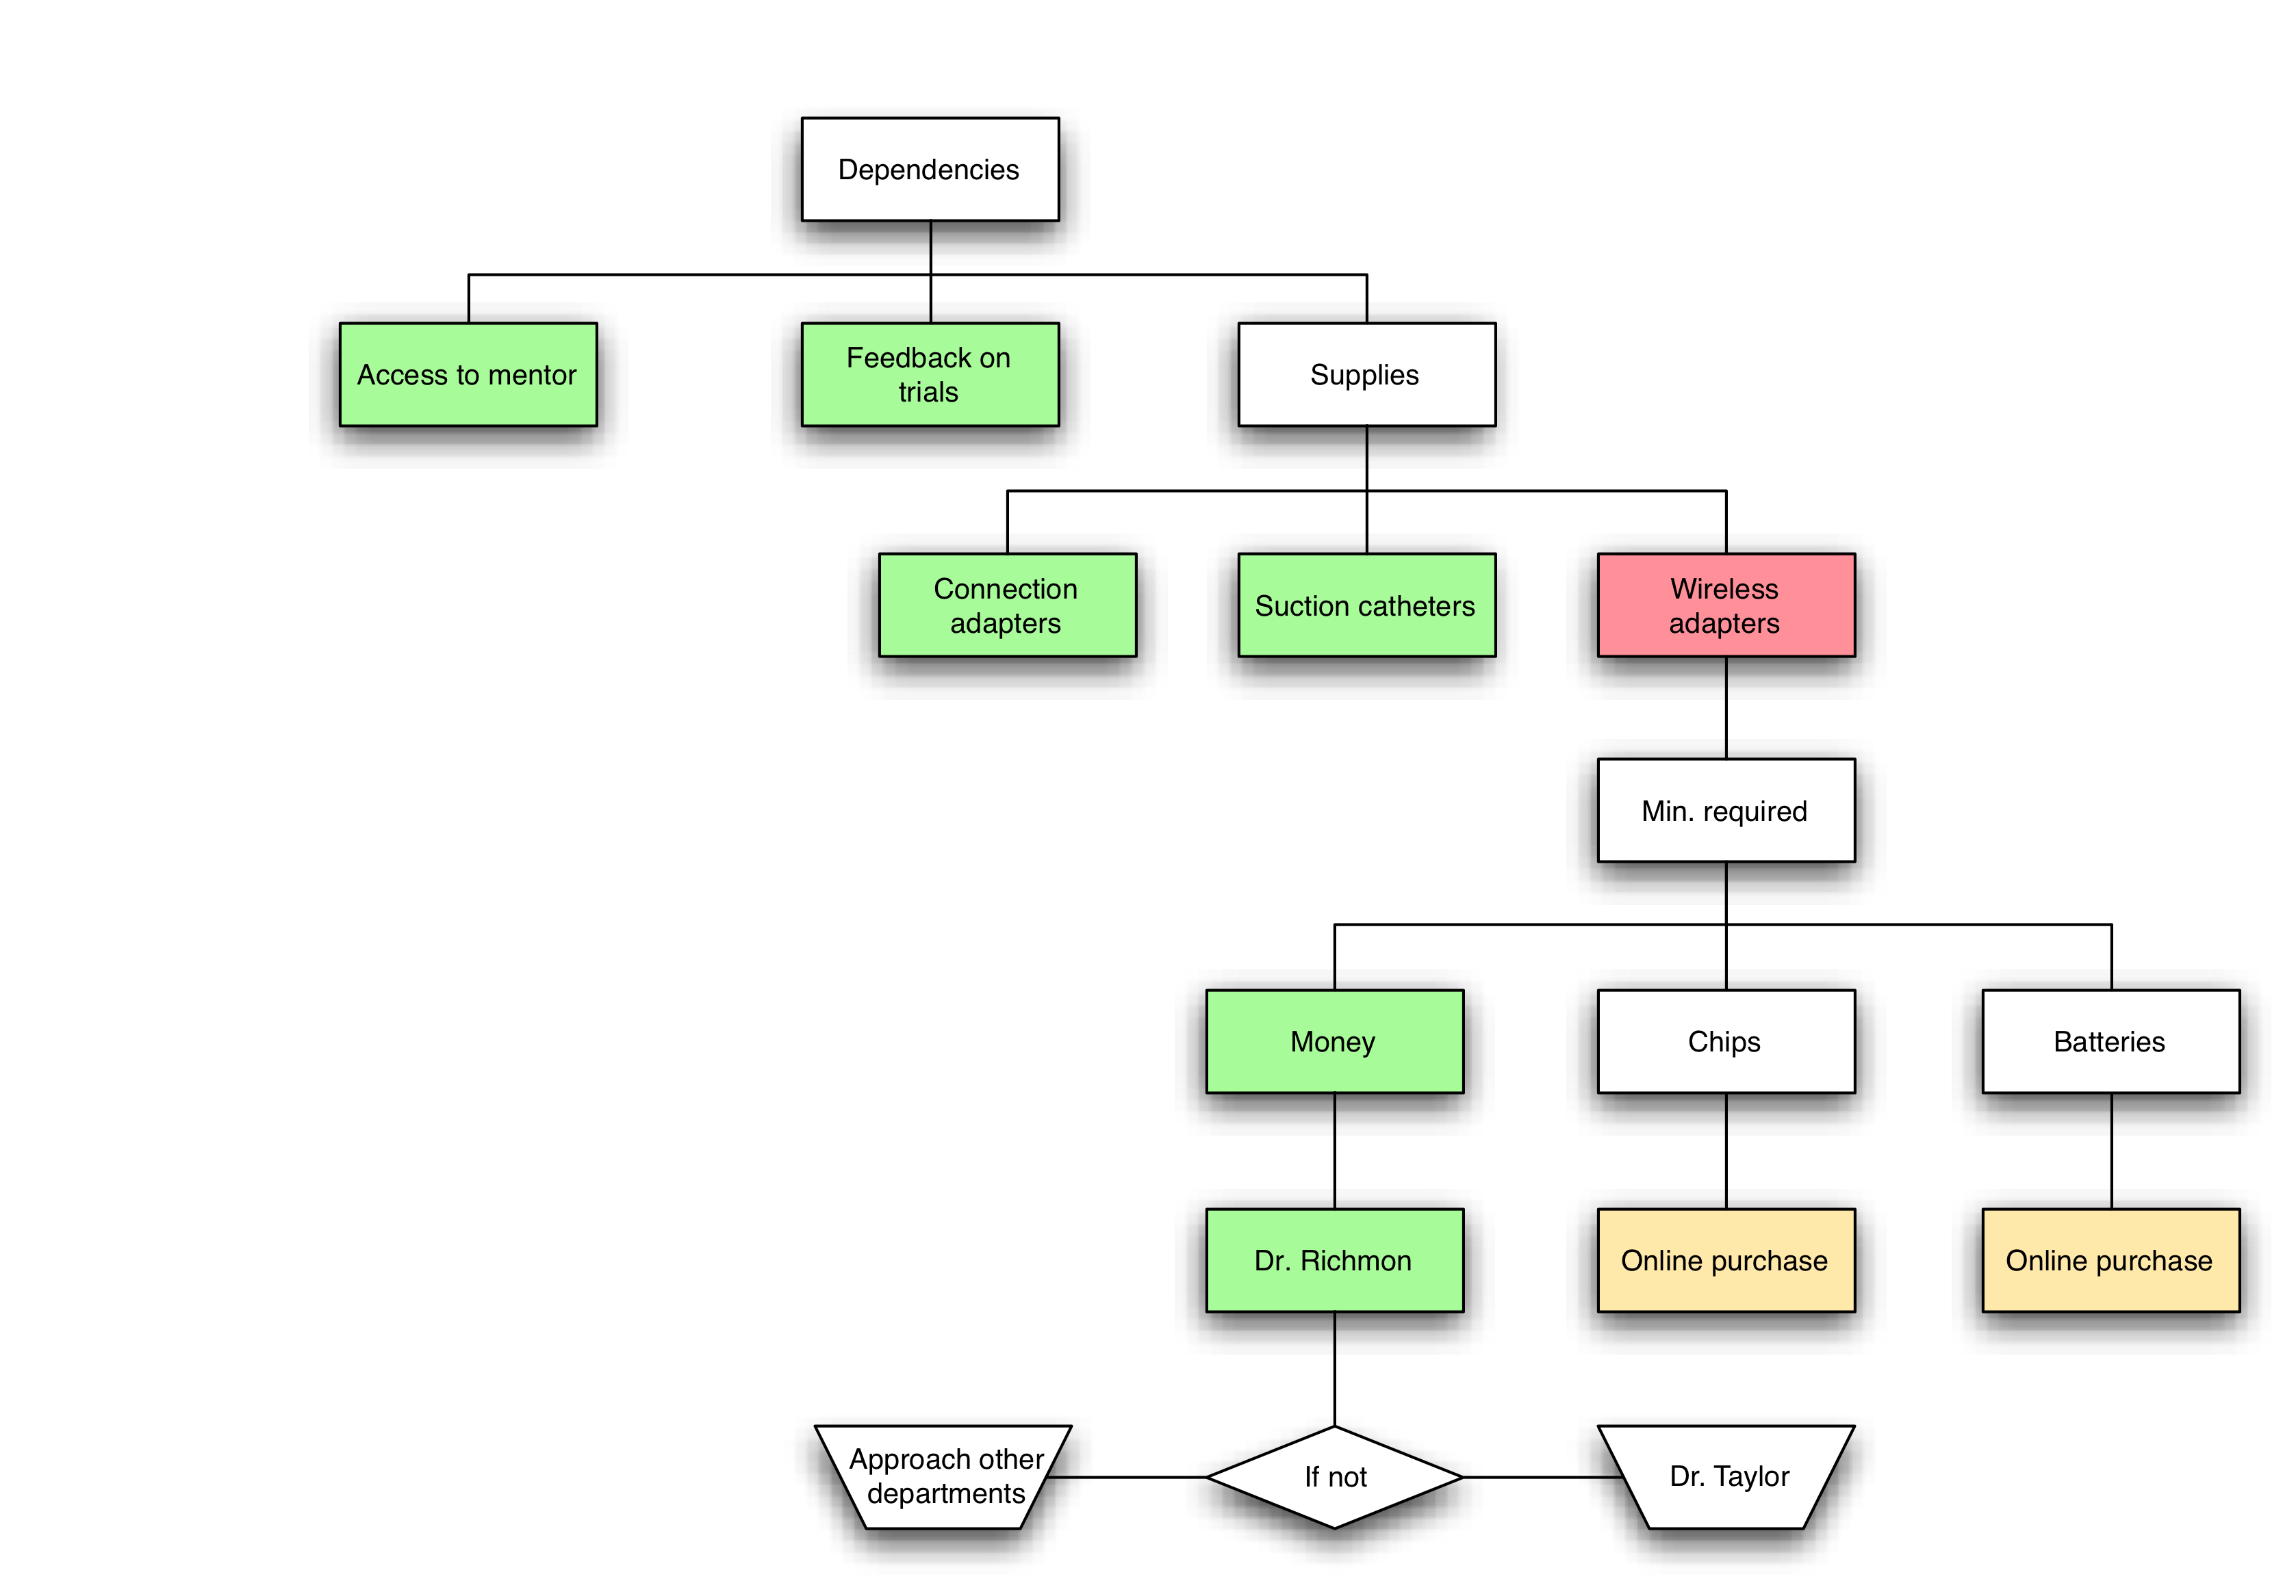
Dependencies

Slide 12
Management Plan
Weekly/bi-weekly meetings with Dr. Richmon
Clinical tests will allow for modifications
Adjustments to machine based on feedback
Completed
The minimum and expected deliverable
In process
The maximum deliverable

Slide 13
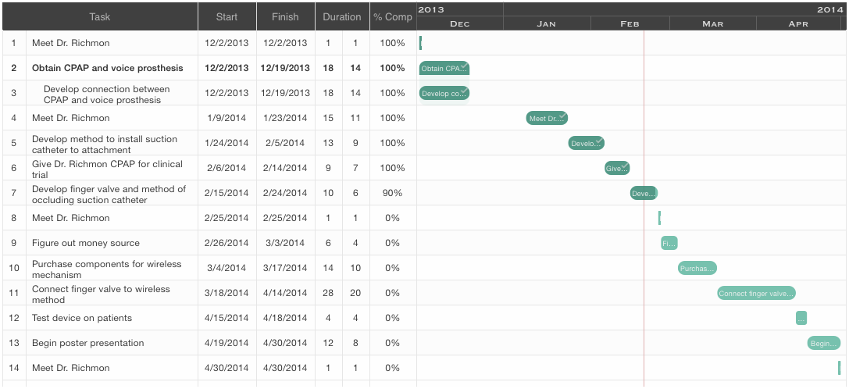
Key Dates

Slide 14
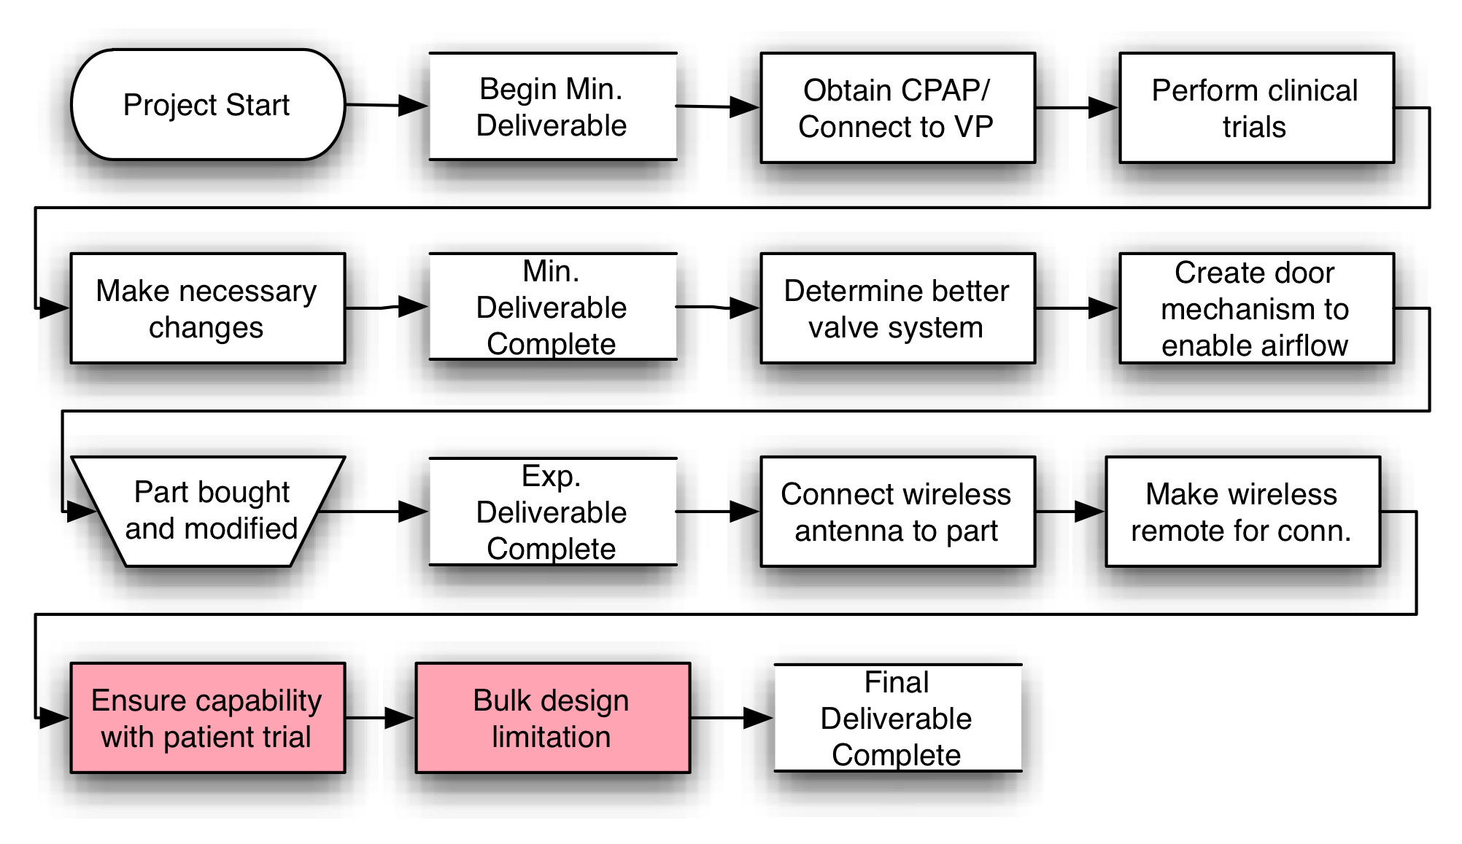
Technical Summary

Slide 15
Questions

