Slide 1
Patient Flow and Staff Scheduling in Medical/Surgical Care
Members: Sara Cronin, Evelyn Yeh
Mentor: Dr. Sauleh Siddiqui
Notes:
E

Slide 2
Project Overview
Use historical data to create a model of patient flow in a medical/surgical unit
Create simulated patients and track flow in and out of unit and keep track of corresponding nursing need
Improve nurse scheduling
Test results of incremental changes in nursing levels based on patient census
Develop a program that outputs an optimized nurse schedule based on predicted patient movement
Notes:
E
This is what we will be working on to help achieve the overarching project goals.

Slide 3
Updated Deliverables
Minimum - Completed | Develop an algorithm to predict patient acuity Build a simulation for patient flow that utilizes historical data
Expected | Create an optimization algorithm for staff scheduling Integrate the algorithm with the simulation and output optimized staff schedules from simulation output Develop a patient census model from the simulation that can output an hourly projected patient census for the unit - In progress Develop a program that can convert the patient census to staffing requirements- In progress
Maximum | Make simulation adaptable to account for various hospital systems and room setups Verify simulation accuracy for other medical unit setups Create a model that incrementally increases or decreases staff based on the state of the unit
Notes:
E
Changes:
Based on the unit we’re looking at and advice from our mentors, other factors were more relevant to model - time of arrival, day of week, age of patient, etc (linked distribution) we decided not to model acuity, but look into other factors
After speaking with mentors we decided to focus more on the patient census model making it include more patient attributes and creating a more accurate and robust model
Because we made the expected deliverable more extensive we are working towards a more feasible maximum deliverable
New maximum-> analyzing results of applying different nursing levels given a patient census

Slide 4
Completed Milestones
Segmented patient information based on relevant factors- season, day of the week, time of arrival, age of patient
Created a prediction model based on patient attributes for use in simulation
Developed simulation
Notes:
E/S

Slide 5
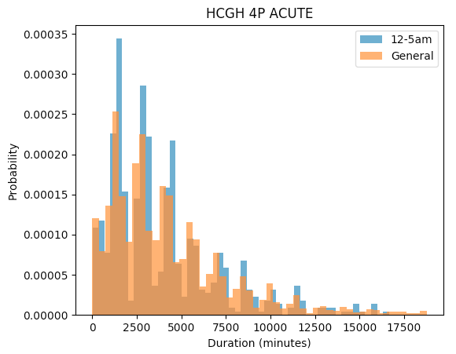
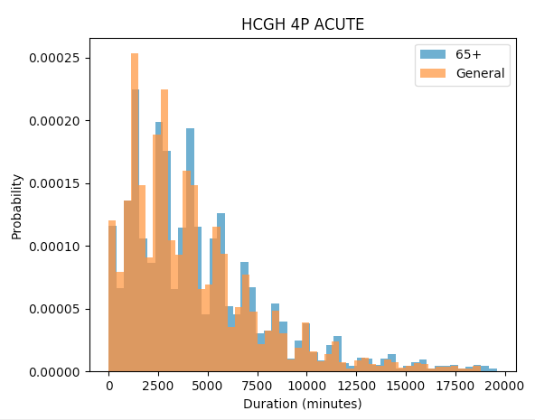
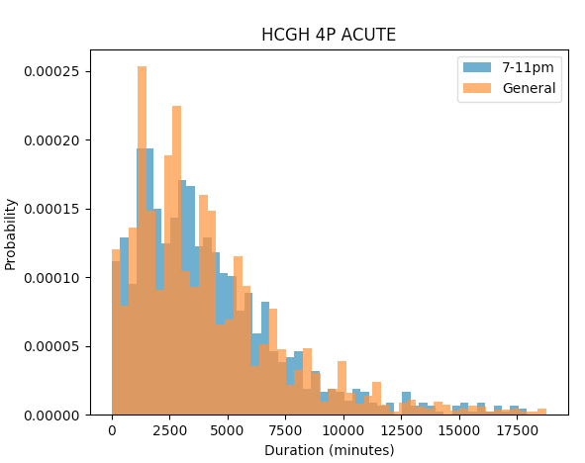
Outputs
Notes:
S-
Start with time attributes from simulation (time of arrival, day of week, season) from there choose age, gender, etc probabilistically, sample from this a specific duration distribution.
This will pass the duration to the simulation which will use this to create a patient census.

Slide 6
Future Milestones
4/17- Alter simulation to match focus single unit and finish patient length of stay predictor based on time parameters
4/20- Finalize census model
4/27- Implement nurse matching to patient census
5/4- Create program to analyze effects of proposed schedules
5/11- Validate results
Notes:
S

Slide 7
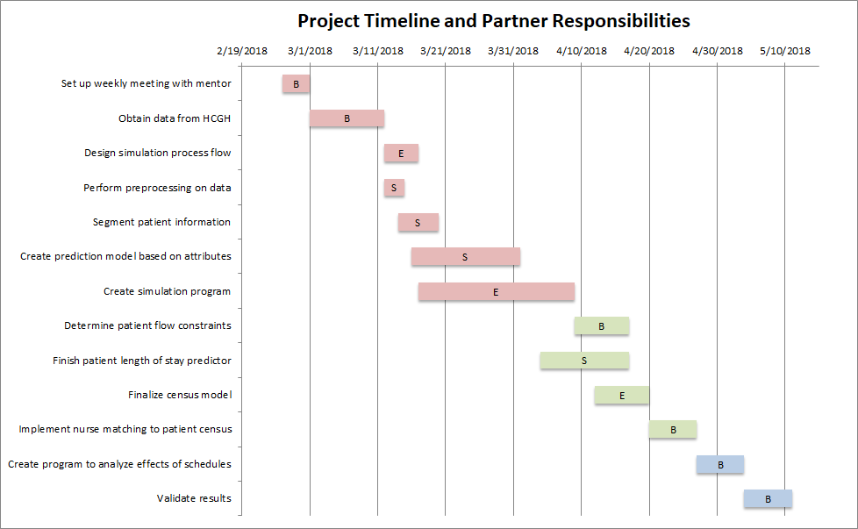
Notes:
S

Slide 8
Dependencies Status
Dependency | Solution | Progress | Contingency
Obtain data from HCGH | Contact HCGH staff | Completed | Use older data from Dr. Siddiqui
Choose machine learning/optimization software | Find packages compatible with MATLAB | Completed | Use machine learning packages in Python
Determine nurse matching and scheduling constraints | Visit HCGH and speak to staff | In progress - visit scheduled for Tuesday 4/17 | Contact through e-mail
Notes:
S
-In person meeting scheduled on Tuesday to get the unit NM’s perspective and knowledge about patient attributes and conditions of the simulation, we will also find out the nurse matching technique for the specific unit

Slide 9
Responsibilities of each partner
Sara: analyzing historical data to define and classify patients based on relevant features, creating probability distributions to sample from for the simulation
Evelyn: developing and implementing the simulation structure
Evelyn will test the accuracy of the simulation results and create the patient census model
Sara will implement nurse matching and formulate the staffing interventions
Notes:
E

Slide 10
Management Plan
Weekly meetings with Dr. Siddiqui on Fridays
Code stored and shared on Github
Our documentation is up to date on a Google Doc
Weekly meetings (Sara & Evelyn) on Tuesday evenings to recap progress and confirm that documentation is up to date
Notes:
E

Slide 11
Reading List and Bibliography
Sauleh Siddiqui , Elizabeth Morse & Scott Levin (2017): Evaluating nurse staffing levels in perianesthesia care units using discrete event simulation, IISE Transactions on Healthcare Systems Engineering, DOI: 10.1080/24725579.2017.1346729
Elina Kontio, Antti Airola, Tapio Pahikkala, Heljä Lundgren-Laine, Kristiina Junttila, Heikki Korvenranta, Tapio Salakoski, Sanna Salanterä, Predicting patient acuity from electronic patient records, Journal of Biomedical Informatics, Volume 51, 2014, Pages 35-40, ISSN 1532-0464, https://doi.org/10.1016/j.jbi.2014.04.001.
Lee J, Maslove DM, Dubin JA (2015) Personalized Mortality Prediction Driven by Electronic Medical Data and a Patient Similarity Metric. PLoS ONE 10(5): e0127428. doi:10.1371/journal. Pone.0127428
Rajeswari M, Amudhavel J, Pothula S, Dhavachelvan P. Directed Bee Colony Optimization Algorithm to Solve the Nurse Rostering Problem. Computational Intelligence and Neuroscience. 2017;2017:6563498. doi:10.1155/2017/6563498.
Sir, M. Y., Dundar, B., Barker Steege, L. M., & Pasupathy, K. S. (2015). Nurse–patient assignment models considering patient acuity metrics and nurses’ perceived workload doi:https://doi.org/10.1016/j.jbi.2015.04.005

