Slide 1
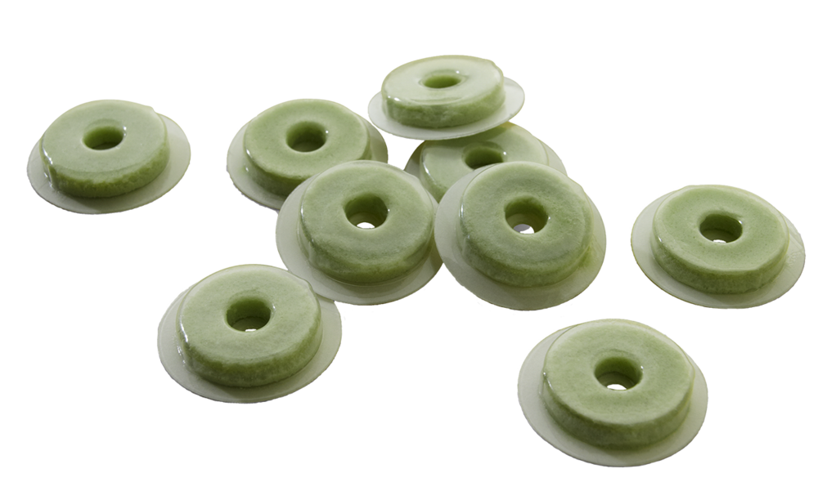
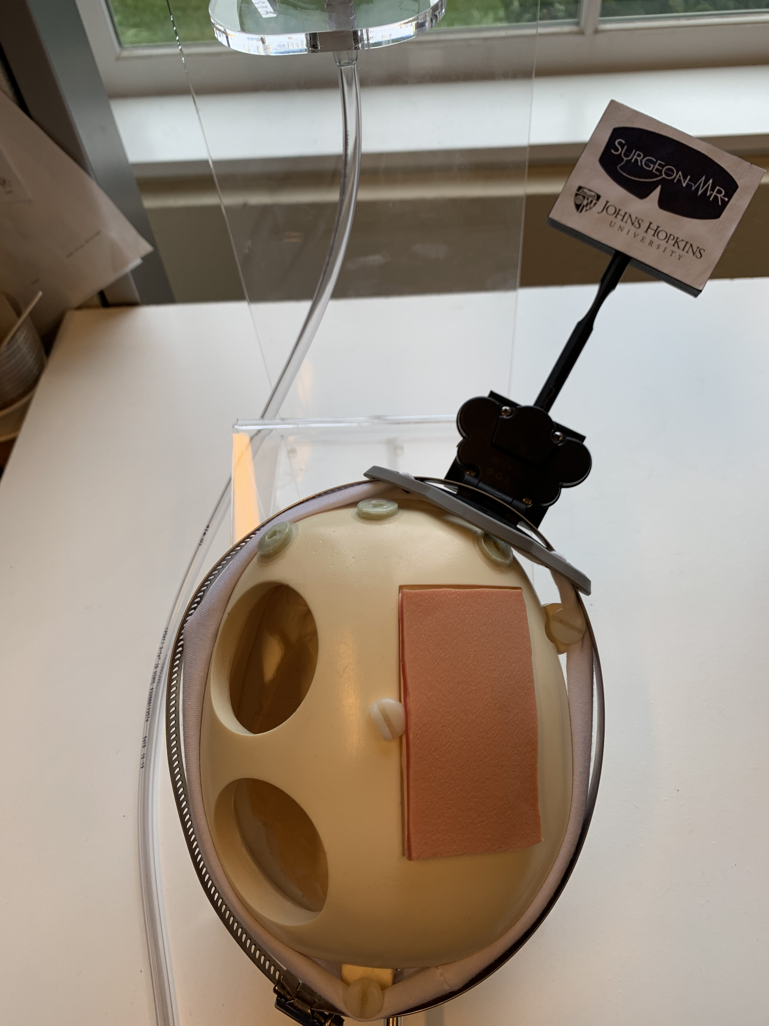
Fast Registration for Image-Guided Neurosurgery
Many neurosurgical procedures use skin fiducials that are digitized using a tracked pointer.
Using computer vision to localize the fiducials would lead to faster registration.
What Students Will Do:
Develop computer vision method to recognize fiducials using camera(s) on HMD (possibly using multiple images)
Evaluate accuracy of method

Slide 2
Fast Registration for Image-Guided Neurosurgery
Deliverables:
Computer vision software to localize fiducials, using HMD mono, stereo and/or depth camera; will probably need to combine multiple views to see all fiducials
Registration software that does not require a priori point correspondence
Results of accuracy study that compares developed computer vision method to tracked pointer and ground truth
Size group: 1-2 students
Skills: Computer vision, registration, accuracy evaluation
Mentors: Ehsan Azimi (eazimi1@jhu.edu), Peter Kazanzides (pkaz@jhu.edu)

