Slide 1
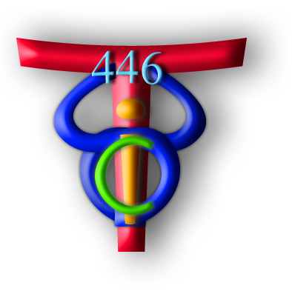
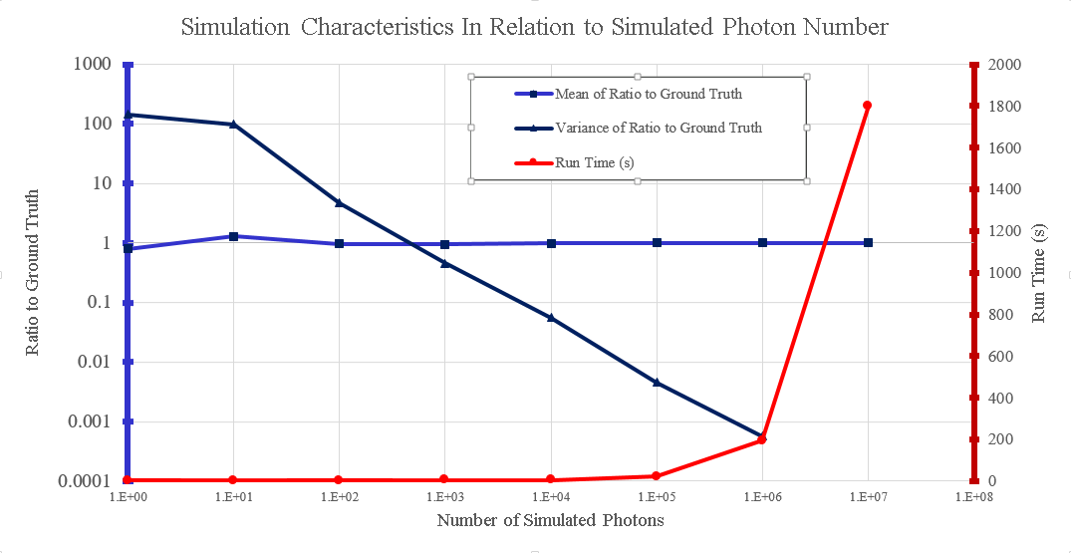
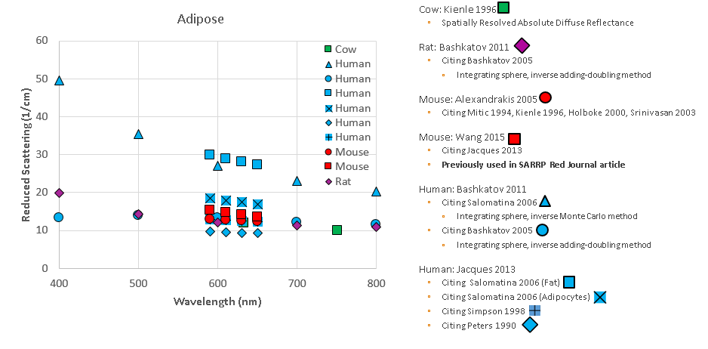
Optical Properties for Bioluminescence Tomography in Mice Computer Integrated Surgery II Spring, 2016 Alan Cham, under the auspices of Drs. Ken Wang and Bin Zhang
Introduction
Tabulated tissue-specific optical properties (absorption μ_{a} and reduced scattering μ_{s}’ ) from literatures
Six organs (adipose, heart, kidney, liver, lung, stomach)
Four wavelengths 590, 610, 630 and 650 nm.
Produced code to convert simulation results from open source Monte Carlo software, Molecular Optical Simulation Environment (MOSE), to Nirfast files for use in existing home-built bioluminescence tomography (BLT) implementation.
Experimentally determined optimal number of photons to simulate in homogeneous medium for convergence of results.
Performed BLT reconstruction experiments along midline in heterogeneous mouse mesh using forward-simulated surface transmittance
The Problem
BLT has been implemented in the Small Animal Radiation Research Platform (SARRP) for purpose of localizing targets with low CT contrast in small animal models via 2D bioluminescence imaging.
Previous experiments using the SARRP primarily explored localization of targets in regions of mouse that are relatively optically homogeneous (i.e. abdomen).
Localization of targets in heterogeneous regions requires segmentation of organs as well as knowledge of optical properties to assign to those regions in reconstruction
Literature values for mouse organ optical properties are relatively sparse and have large variations, depending on:
Method of measurement.
Physiological conditions.
It is useful to describe the target (e.g. tumor) localization uncertainty introduced of the SARRP BLT’s reconstruction in an optical heterogeneous environment.
Top: COM error as function of position along mouse midline axis. Middle: Projection of mesh organs onto midline axis. Bottom: anterior-posterior and lateral views of all source positions.
The Solution
Obtained optical properties for use in simulation and reconstruction by calculating using Alexandrakis’ empirical model after evaluation in context of other sources (see ‘top’ and ‘bottom left’ figures below).
Developed workflow to produce forward simulation data and reconstruct with BLT.
Assigned optical properties to segmented mouse mesh in MOSE
Experimented for optimal photon count for simulation (see ‘middle’ figure below). Used 1e6 due to runtime considerations. Results from 1e7 used as ‘ground truth’.
Code to adapt MOSE simulation outputs for reconstruction in home-built BLT implementation
Recorded COM error along heterogeneous mouse midline
Outcomes and Results
Demonstrated inherent increase in localization uncertainty, even when provided complete knowledge of optical properties and organ segmentations in simulated condition (see above figures).
COM error consistently <1 mm in homogeneous mesh regions, in agreement with prior expectations
Peak COM error near position Y=50 mm deemed higher than prior expectations and warrants additional exploration.
Errata
Forward simulation results were obtained using a labeled mesh, in which lung, liver, and kidney labels were swapped
Future Work
Future work will address correction of the above errata by performing BLT reconstruction using same workflow and corrected mesh
Note single point at position Y=50 mm plotted above, obtained with corrected mesh
Top: optical properties used in simulation and reconstruction.
Middle: surface transmittance convergence with respect to simulated photon count.
Bottom left: example of gathered literature values.
Bottom right: example transmittance map at wavelengths 590, 610, 630, and 650 nm.
Lessons Learned
Clarity of presentation can be as important as the material presented
Even code/calculations from credible sources should be verified
On several occasions, found likely errors in published optical property calculations and also in mesh labelling
Credits
Alan Cham was the sole student partner in this project, under the guidance of Drs. Ken Wang and Bin Zhang.
Publications
At this time, no submissions for publication are planned for the above-described work.
Support by and Acknowledgements
Thanks to Drs. Ken Wang and Bin Zhang for their kind mentorship.
Thanks to Alexis Cheng and Dr. Russell Taylor for organizing and managing this opportunity and course in CIS.
Engineering Research Center for Computer Integrated Surgical Systems and Technology

