Slide 1
Robot System Control for Automating Mosquito Microdissection
Group 03: Project Update
Team Member: Zhuohong (Zooey) He zhe17@jhu.edu
Mentors: Dr. Simon Leonard sleonard@jhu.edu
Dr. Russell Taylor rht@jhu.edu
Industry Partners: Dr. Kim Lee Sim Sanaria Inc.
Sumana Chakravarty Sanaria Inc.
Date: February 9th, 2021
**The information in this presentation is strictly confidential

Slide 2
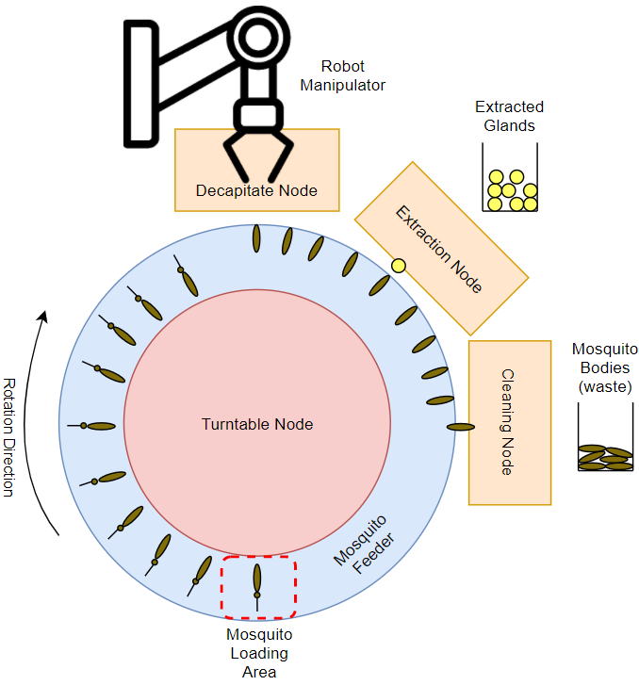
Project Summary
Problem: Sanaria needs to increase the production rate of Plasmodium falciparum sporozoites (PfSPZ) from infected mosquito glands to help produce a promising malaria vaccine.
Overall Goal: Automate the gland dissection process using a robot system. Our goal is to dissect 600 mosquitoes per hour (mph).
CIS Project Goal: To develop a robot system control algorithm that introduces parallel processes, error checking, and error recovery.
Robot Control for Mosquito Dissection
**The information in this presentation is strictly confidential

Slide 3
Accomplished Works
Turntable Node
Fully Implemented.
Testing on physical system using manual calls to node.
Mosquito Pick, Place, and Decapitate Node (MPPD)
Fully Implemented (with potential bugs).
Testing stalled (Arduino/Galil connection error -> followed up).
Cleaning and Extraction Nodes
Partially Implemented
No testing
Robot Control for Mosquito Dissection
**The information in this presentation is strictly confidential

Slide 4
Turntable Node
Hardware
MPPD Node
Caller ID: 1
Extraction Node
Caller ID: 2
Turntable Node
Topic: turntable/goal
Message:
goal_code: INCREMENT
goal_id: 102931840
caller_id: 1
Cleaning Node

Slide 5
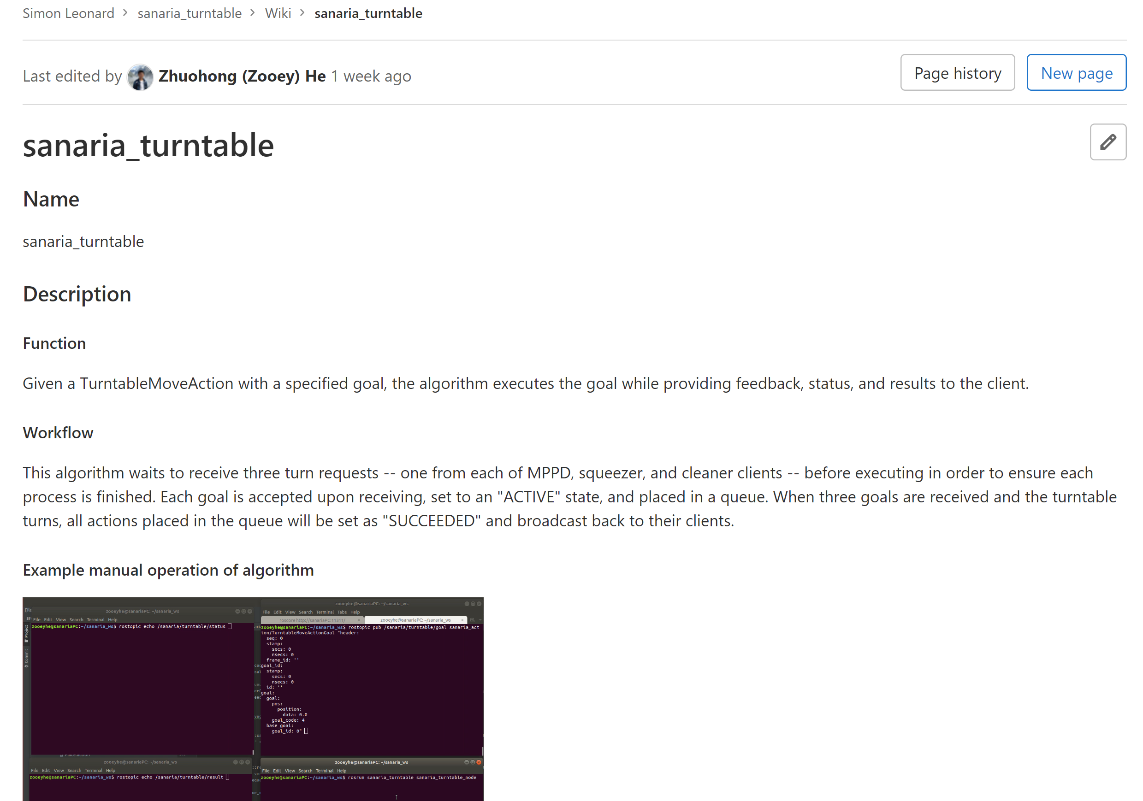
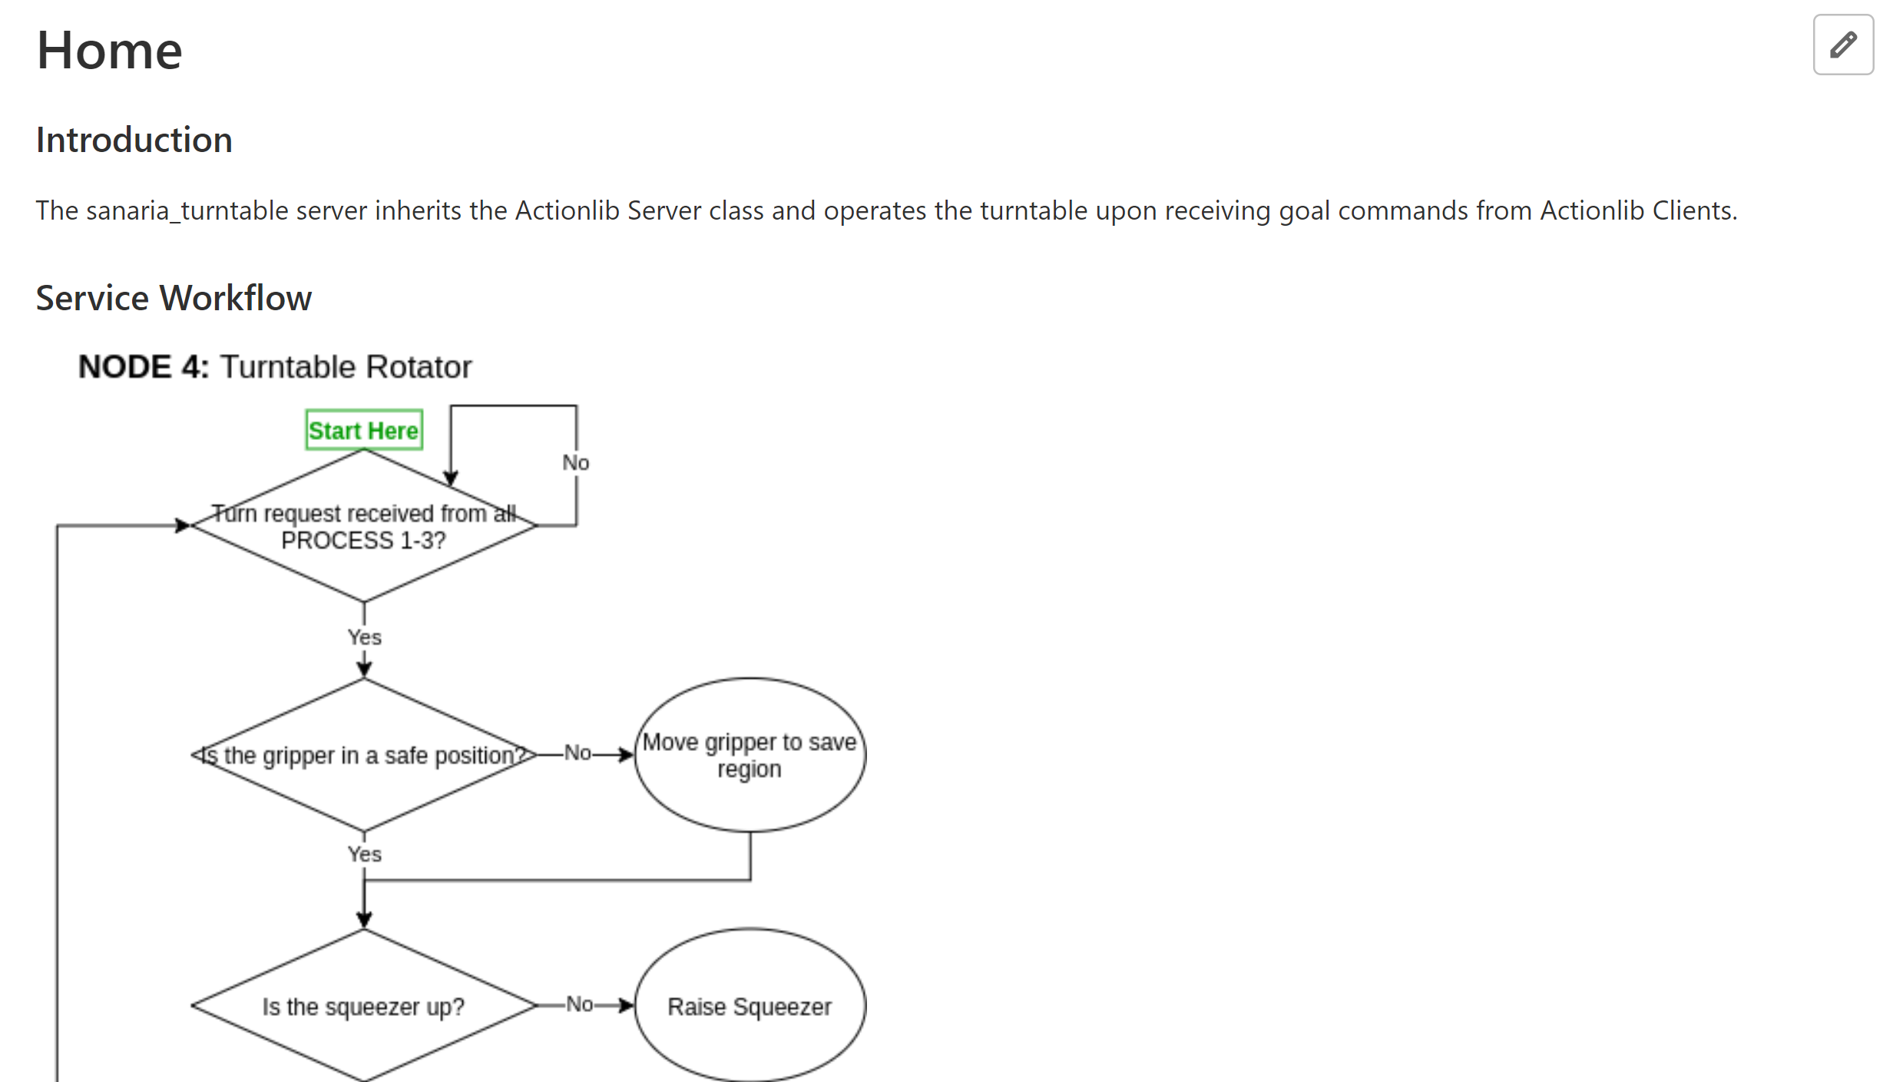
Documentation
Wiki page for turntable: https://git.lcsr.jhu.edu/sleonar7/sanaria_turntable/-/wikis/home
Robot Control for Mosquito Dissection
**The information in this presentation is strictly confidential

Slide 6
Timeline
Currently about one week behind schedule
On track to deliver minimum by 4/12, expected by 4/26
Figure: Proposed Timeline (Outline) vs Actual Timeline (Completed: Grey Shading, Expected: Green Shading)

Slide 7
Unforeseen Challenges
Turntable: needed to go beyond simple Client/Server structure.
Solved: Inherited from base ROS client/server instead of simple client/server
MPPD: physical testing had several challenges (Arduino), require help.
In progress: Meeting with Dr. Leonard tonight
Simulation Testing: collaborator within lab busy with paper.
Cancelled: after conversation with mentor (Dr. Leonard)
Robot Control for Mosquito Dissection
**The information in this presentation is strictly confidential

Slide 8
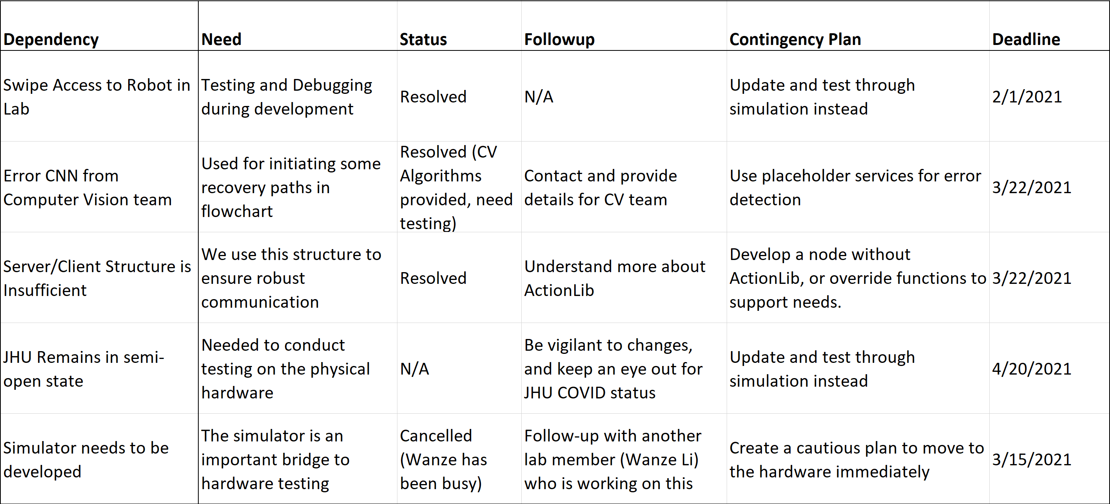
Dependency Updates
Robot Control for Mosquito Dissection
**The information in this presentation is strictly confidential

Slide 9
Testing Plan
Level 1: Component Testing (On-going)
Manually send goals to the component to observe reaction. Attempt to break / trick node.
Level 2: System Testing (April 5th to April 19th)
Test the system on 100 mosquitoes.
Determine throughput speed, success rate, and others.
Level 3: Error Simulation and Recovery
Simulate errors by hard-coding error throws. Observe error recovery by system.
Robot Control for Mosquito Dissection
**The information in this presentation is strictly confidential

Slide 10
Thank You
Questions?
Robot Control for Mosquito Dissection

