Slide 1
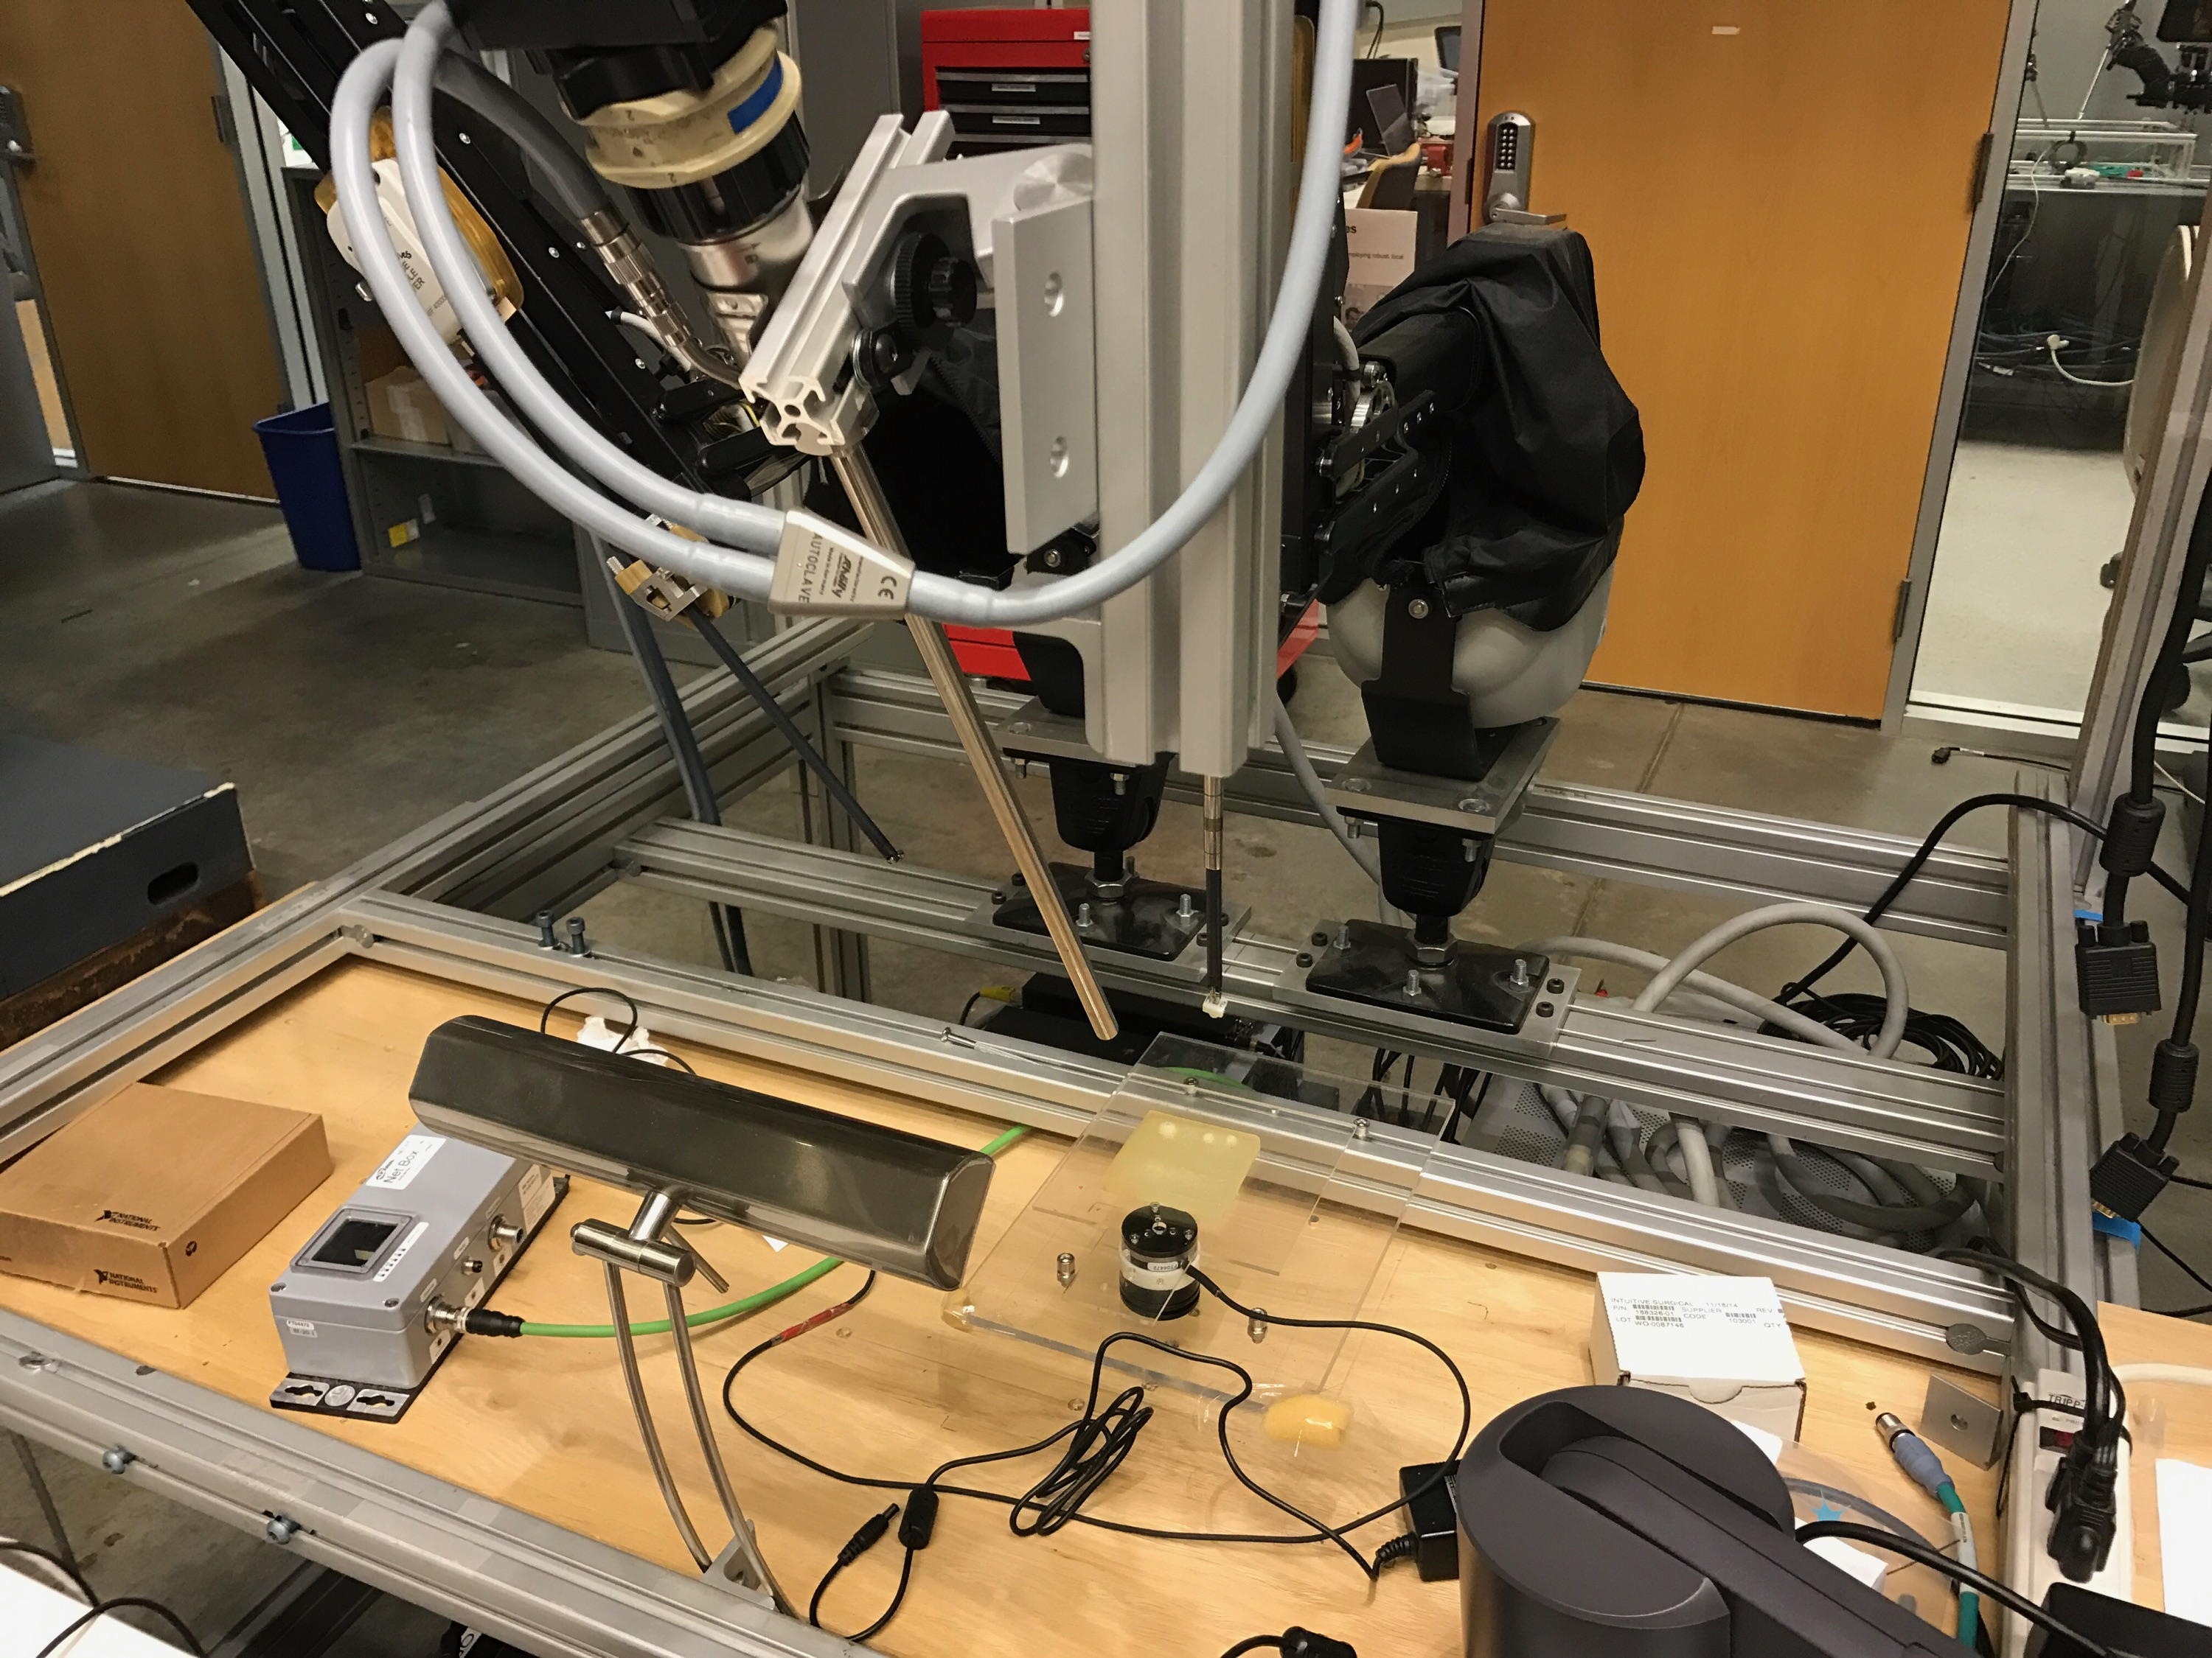
DVRK stereo camera calibration and model registration
Project Goal: Phantom placed in the camera view needs to be registered with the PSM robot.
First perform a hand-eye calibration to know the relationship between the camera and the robot.
Detect the phantom model in the camera view and register the model to the camera.
Final get the registration between the robot and the model.
Size group: 1-2
Skills:
C++, Matlab/Python.
Knowledge of ROS would be very helpful.
Image processing, Registration, Hand-Eye calibration
Mentors:
Preetham Chalasani (pchalas1@jhu.edu)
Anton Deguet (anton.deguet@jhu.edu)

