Slide 1
Visual Annotation of Clinically Important Anatomical Landmarks for VitreoRetinal Surgery
Project Update
Vincent Ng

Slide 2
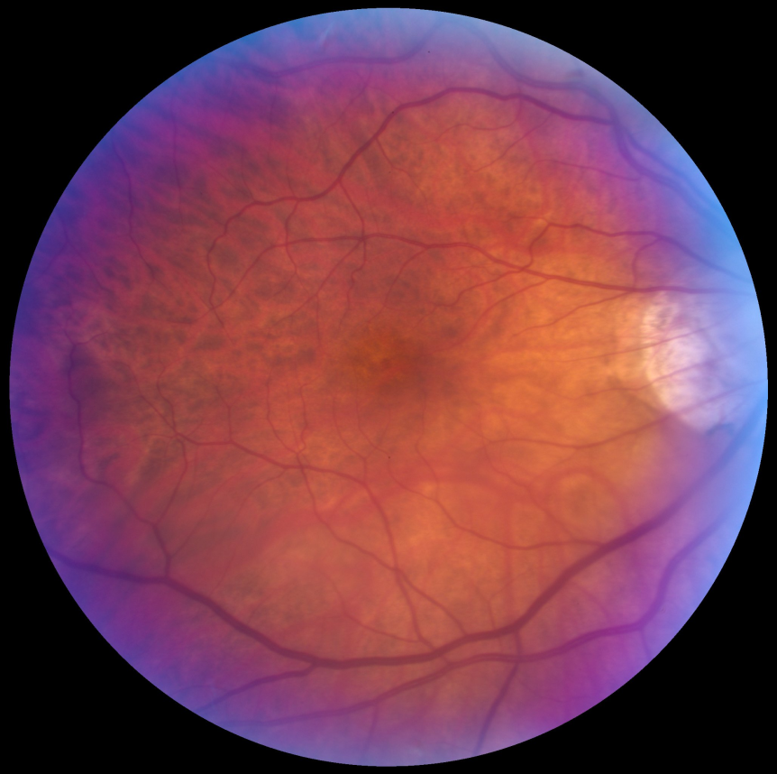
Retina Project Overview
Registration
Preoperative images to intraoperative images
Overlay of landmarks on live microscopic feed
Requirements
Image Matching/Tracking
Images courtesy of Rogerio Richa

Slide 3
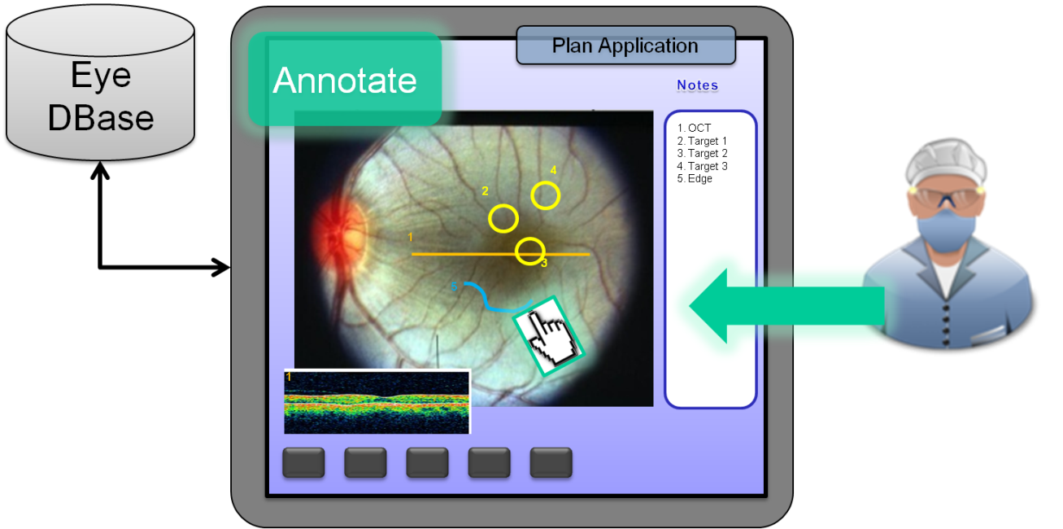
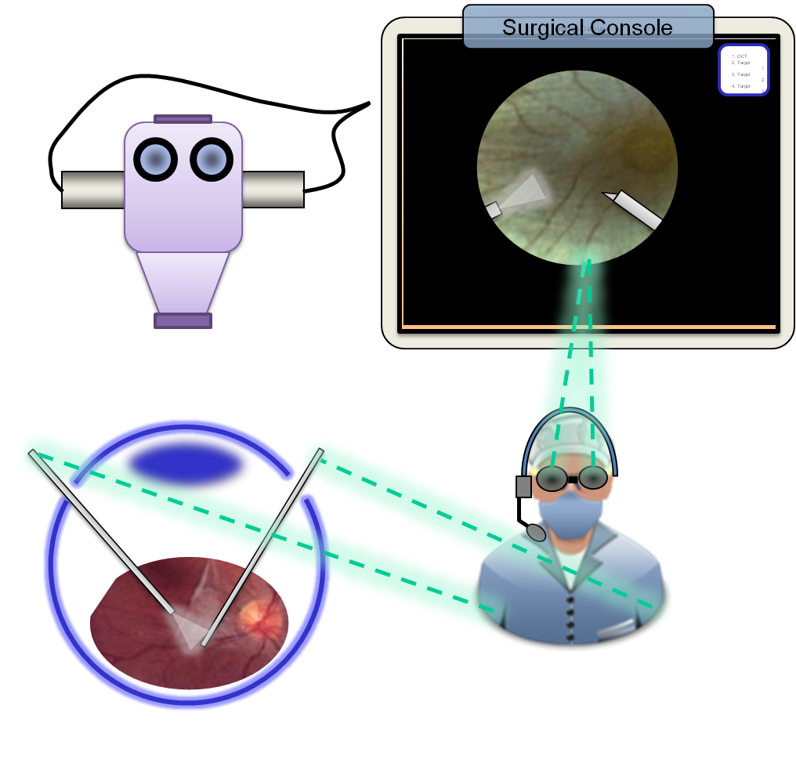
Relevance
Surgeon annotates preoperative image
Problem:
Mentally track notes & locations during surgery, adding significant load to the already challenging surgical task.
3
Solution:
Annotations overlay on video
Slide taken from Rogerio Richa’s presentation
Notes:
Surgeon annotates preoperative image
Problem:
Mentally track notes & locations during surgery, adding significant load to the already challenging surgical task.

Slide 4
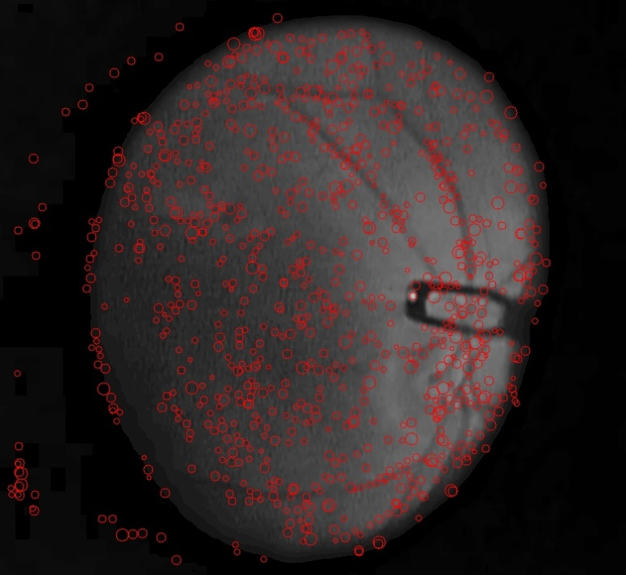
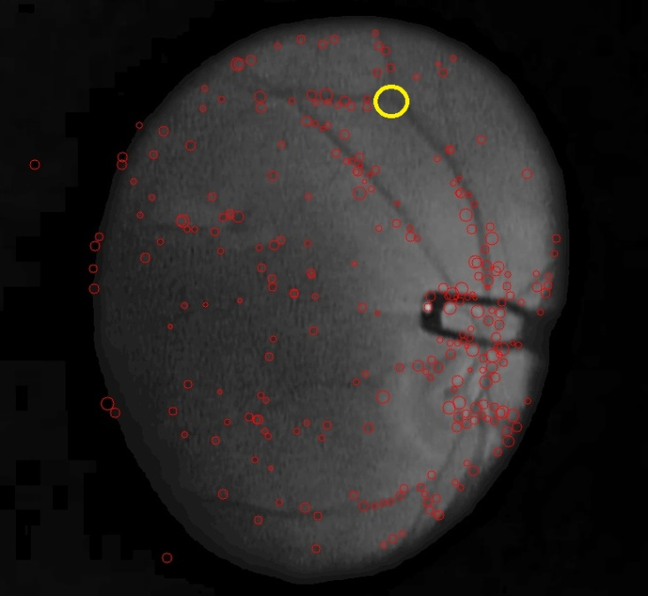
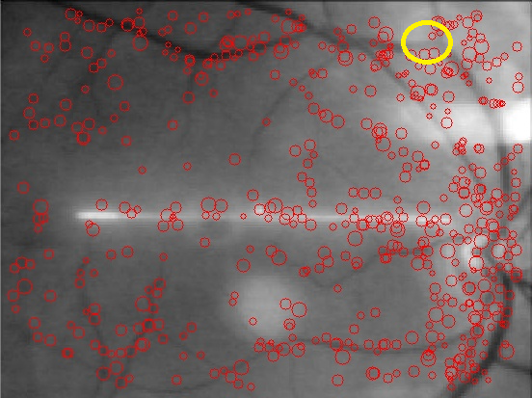
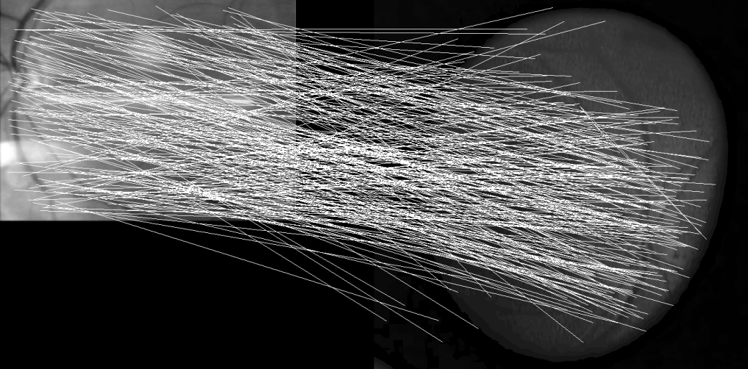
Process
SURF Feature Extraction – 50ms
Overlay Result
Match Features using NCC – 50-500ms
RANSAC/Homography – 25 – 200ms

Slide 5
Milestones & Progress
Working SURF detection/matching program, preop/intraop processing
Validation using test/non-surgical data
Integrating program onto platform
Validation using real intra-operative data | Week of April 25th
Real-time tracking through speedup | Week of April 25th
Week of March 14th
Week of March 28th

Slide 6
Dependencies
Access to platform (machine, microscope)
Fundus image for phantom
Intraoperative data from surgeons

Slide 7
Results/Video

Slide 8
Next steps / Plan Updates
Speedup
Image size reduction
Phantom/Real data testing
Algorithm Updates
NCC
Takes too long
Homography (planar projection)
Too many degrees of freedom
Determine optimal settings
SURF Hessian threshold
NCC threshold
Number of SURF feature points per landmark

Slide 9
Updated Timeline Below
Task | 21-Feb | 28-Feb | 7-Mar | 14-Mar | 21-Mar | 28-Mar | 4-Apr | 11-Apr | 18-Apr | 25-Apr | 2-May
Presentation and Proposal
Feature detection and Matching
Validation
Intra-Intra image processing
Preop Image Processing
Annotation registration
GUI
Hardware Acceleration
Final Poster
Documentation
Task | 21-Feb | 28-Feb | 7-Mar | 14-Mar | 21-Mar | 28-Mar | 4-Apr | 11-Apr | 18-Apr | 25-Apr | 2-May
Presentation and Proposal
Feature detection and Matching
Validation
Intra-Intra image processing
Preop Image Processing
Annotation registration / GUI
Updates to Algorithm
Hardware Acceleration
Final Poster
Documentation

Slide 10
Difficulties so far/future
Validation
How?
Sensitivity of tracking to change?
Speed
200ms – slow ?
Real data

Slide 11
What’s Next
Working SURF detection/matching program, preop/intraop processing
Validation using test/non-surgical data
Integrating program onto platform
Validation using real intra-operative data | Week of April 25th
Real-time tracking through speedup | Week of April 25th
Week of March 14th
Week of March 28th

Slide 12
What’s Next: Deliverables
Minimum
Utilize, understand and implement SURF
Test/Validate program using manually picked annotations as ground truth
Data: Surgical and non-surgical
Expected
Simple GUI that marks annotation for surgeon
Initial Image processing for real surgery data
Maximum
Deploy solution into OR.
Integrate fundus/OCT data to surgeon’s screen

Slide 13
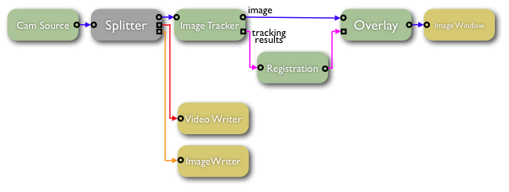
Documentation
Updates to the wiki
Documented Code
Comments
Well structured, portable (CISST Filters)
Image taken from CISST website
https://trac.lcsr.jhu.edu/cisst/wiki/cisstStereoVisionTutorial

Slide 14
Questions?
Thank You

