Slide 1
Robotic Ultrasound Needle Placement and Tracking: Robot-to-Robot Calibration
Computer Aided Medical Procedures
Project 17: Christopher Hunt & Matthew Walmer

Slide 2
Background
Motivation
There are many medical procedures which depend on precise needle placement, including biopsy, targeted drug administration, brachytherapy, and ablation. Oftentimes, ultrasound imaging is used to guide a needle towards a target region identified through preoperative images. However, this methodology is often hampered by the need for skilled ultrasound technicians, the limited field of view, and the difficulty of tracking the needle trajectory and target.
Goal
Develop a method for safe, quick, and precise needle placement for several medical procedures.
Background | Plan | Deliverables | Dependencies | Management | Time Table | Readings
Friday, 29. August 14

Slide 3
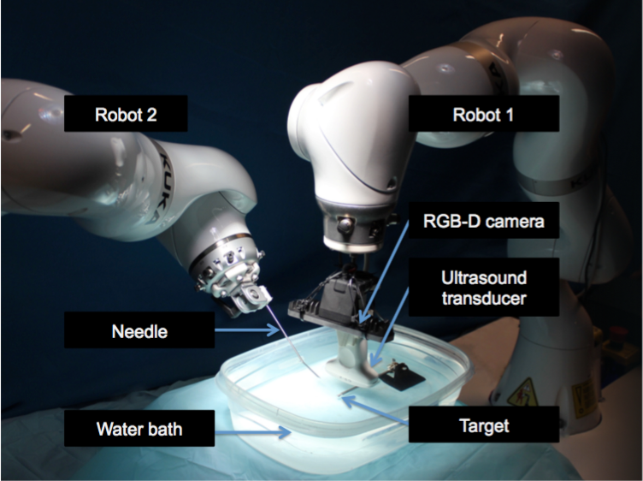
Proposed Solution
CONFIDENTIAL
A novel dual-robot framework for robotic needle insertions which integrates impedance-controlled ultrasound image acquisition, preoperative and intraoperative image registration, visual servoing, target localization, and needle tracking.
Background | Plan | Deliverables | Dependencies | Management | Time Table | Readings

Slide 4
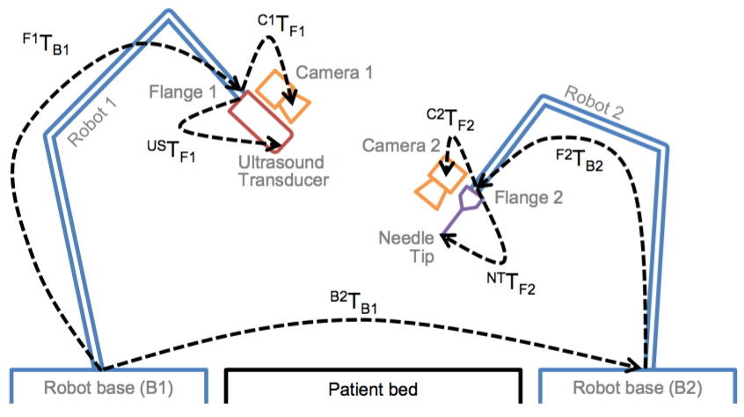
Previous Work
CONFIDENTIAL
Background | Plan | Deliverables | Dependencies | Management | Time Table | Readings
Friday, 29. August 14

Slide 5
Previous Work
CONFIDENTIAL
Initialization
A) Preoperative imaging and definition of region of interest
B) Robot-robot calibration
Ultrasound Volume
Acquisition and Processing
Ultrasound-Guided Needle Insertion
1) Surface scan of patient and planning of robotic ultrasound acquisition
2) Ultrasound acquisition and volume compounding
4) Positioning of transducer (for observation of region of interest) and needle
5) Ultrasound-based tracking of region of interest and needle
3) Registration and transfer of interest to robot
6) Update needle trajectory
Background | Plan | Deliverables | Dependencies | Management | Time Table | Readings
Friday, 29. August 14

Slide 6
Mission Statement
Develop and validate a variety of
robot-to-robot calibration algorithmic plugins for use with dual-robotic surgeries and experiments.
Background | Plan | Deliverables | Dependencies | Management | Time Table | Readings

Slide 7
Algorithm #1: Checkerboard
CONFIDENTIAL
Using a precisely machined checkerboard whose dimensions are known, it is possible to determine camera intrinsics (focal length, axis skew, principal point offset) for the RGB-D cameras.
Using the camera intrinsics, it is possible to create a local 3D scene reconstruction using a set of 2D image snapshots at arbitrary orientations.
A byproduct of this reconstruction is the 3D transformation from camera to checkerboard.
Using these transformations in conjunction with the known camera-to-base transformation, we can compute the base-to-base transformation.
Background | Plan | Deliverables | Dependencies | Management | Time Table | Readings

Slide 8
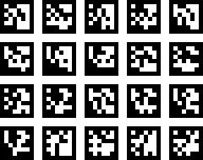
Algorithm #2: ARToolKit Calibration
CONFIDENTIAL
ARToolKit is a computer vision framework that is often used for augmented reality applications.
It provides a host of visually distinctive markers as well as recognition algorithms for use in identifying spatial relationships.
We plan on testing if ARToolKit is a viable system for robot calibration.
We wish to optimize the amount, position and variety of markers to minimize complication and error.
Background | Plan | Deliverables | Dependencies | Management | Time Table | Readings

Slide 9
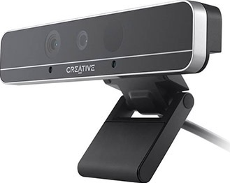
Algorithm #3: RGB-D Depth and Feature Information
CONFIDENTIAL
The Intel RGB-D cameras provide traditional RGB images along with approximated depth information using structured light deformation.
Using Speeded Up Robust Features (SURF), we can generate two-dimensional point sets for each frame. From frame to frame, features are tracked between these sets using an exhaustive nearest neighbor search.
After outlier rejection, 3D coordinates for the set of valid features can be estimated using two-dimensional coordinates in conjunction with the interpolated depth information.
Once we have 3D coordinates for each feature and have created a correspondence of features from each camera’s viewpoint, it is easy to compute the base-to-base transformation.
Background | Plan | Deliverables | Dependencies | Management | Time Table | Readings

Slide 10
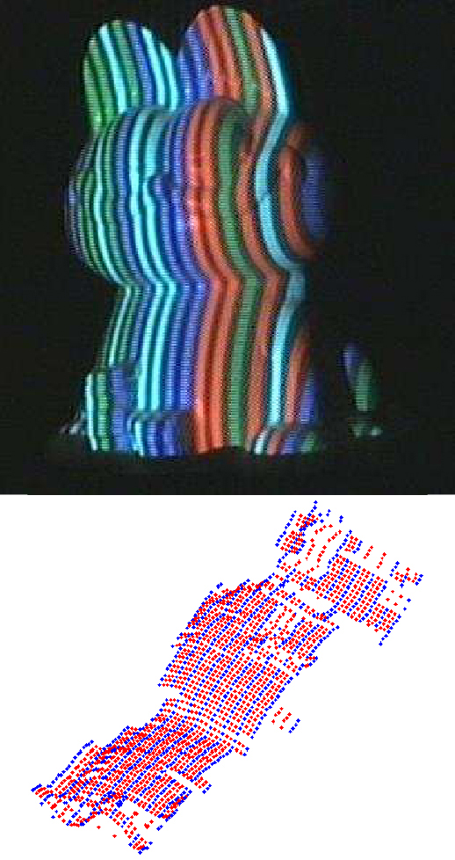
Algorithm #4: RGB-D Depth Only
CONFIDENTIAL
As a maximum deliverable, we are going to experiment with a non-feature based calibration that relies on solely the depth information of the RGB-D cameras.
This is applicable in cases where there is no distinct contrast of colors or brightnesses to generate features from. An example of this would be in the OR when a tarp is placed over the patient.
This method would use a form of ICP to align the uniform point clouds generated from the depth information. However, because the robots are viewing surfaces from very different angles, it requires a more robust ICP algorithm.
Background | Plan | Deliverables | Dependencies | Management | Time Table | Readings

Slide 11
Deliverables
Minimum Deliverables
Hand-eye calibration algorithm/plugin for camera frame transform
Plugin for robot-robot calibration using checkerboard registration
Interface and validation experiments for plugins
Expected Deliverables
Plugin for ARToolKit calibration
Plugin for RGB-D depth and feature calibration
Interface and validation experiments for both plugins
Maximum Deliverables
Plugin for RGB-D depth only calibration
Interface and validation experiments for plugin
Needle tracking experiments in real tissue
Background | Plan | Deliverables | Dependencies | Management | Time Table | Readings
Freitag, 26. Februar 2016

Slide 12
Dependencies
Hardware
KUKA iiwa dual robotic system ✓
3D-printed Intel camera mounts ✓
Access to Mock-OR and Robotorium ✓
Calibration checkerboard ✓
ARToolKit markers (printable)
Other calibration objects (mentor/3D print in Wyman)
Software
ROS, ImFusion, PCL, ARToolKit ✓
KUKA ROS Module ✓
Intel RGB-D Camera SDK ✓
Bitbucket for version management ✓
Other (only under max deliverable)
Risto’s needle tracking algorithm ✓
Tissue samples for ultrasound testing (mentor/available from butcher)
Background | Plan | Deliverables | Dependencies | Management | Time Table | Readings
Freitag, 26. Februar 2016

Slide 13
Management
Meetings
Weekly online meetings with mentors:
Risto: Tuesdays @ 9AM
Oliver and Salvatore: Schedule as needed
Ben and Javad: Schedule as needed
CAMP lab meetings – Wednesdays @ 9AM
Group meetings – Wednesdays and Saturdays @ 3PM
Team Members
Christopher Hunt
Background: BME Instrumentation focus, Robotics minor
Responsibilities: RGB-D feature calibration, Depth-only calibration
Matthew Walmer
Background: BME Comp Bio focus, CS and Mathematics minors
Responsibilities: ARToolKit, Needle tracking in real tissue
Shared Responsibilities:
ROS, Hand-eye Calibration, Checkerboard Calibration
Background | Plan | Deliverables | Dependencies | Management | Time Table | Readings
Freitag, 26. Februar 2016

Slide 14
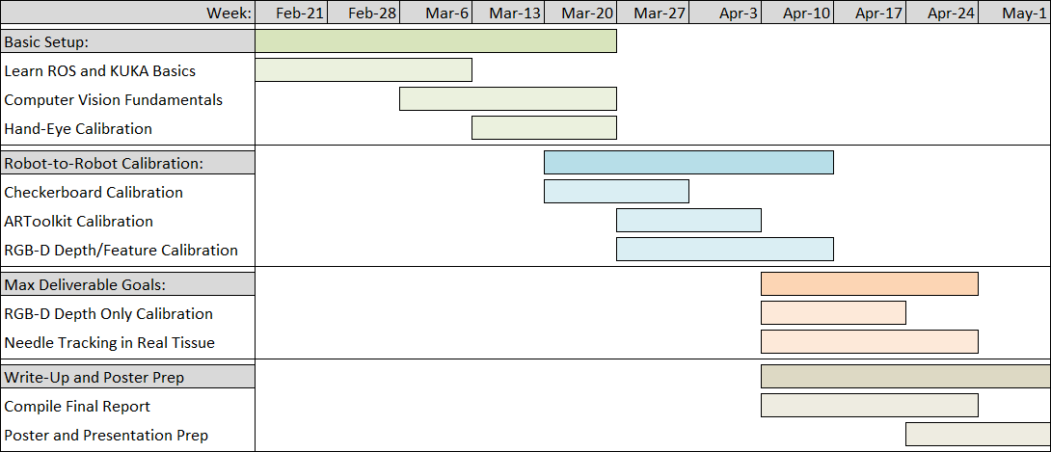
Time Table
Checkpoints
March 26th: Have a strong background in ROS and the computer vision skills necessary to implement these algorithms. This will be verified by a functioning implementation of a hand-eye calibration algorithm.
April 16^{h}: Have developed and tested plugins (with completed interfaces) for the 3 robot-robot calibration methods
April 30th: Have explored depth only RGB-D calibration method and if time allows tested needle tracking in real tissue samples.
Background | Plan | Deliverables | Dependencies | Management | Time Table | Readings
Freitag, 26. Februar 2016

Slide 15
Readings
R. Kojcev, B. Fuerst, O. Zettinig, J.Fotouhi, C. Lee, R.Taylor, E. Sinibaldi, N. Navab, "Dual-Robot Ultrasound-Guided Needle Placement: Closing the Planning-Imaging-Action Loop," Unpublished Manuscript.
O. Zettinig, B. Fuerst, R. Kojcev, M. Esposito, M. Salehi, W. Wein, J. Rackerseder, B. Frisch, N. Navab, "Toward Real-time 3D Ultrasound Registration-based Visual Servoing for Interventional Navigation," IEEE International Conference on Robotics and Automation (ICRA), Stockholm, May 2015.
B. Fuerst, J. Fotouhi, and N. Navab. "Vision-Based Intraoperative Cone-Beam CT Stitching for Non-overlapping Volumes." Lecture Notes in Computer Science Medical Image Computing and Computer-Assisted Intervention -- MICCAI 2015 (2015): 387-95. Web.
K. Daniilidis. "Hand-Eye Calibration Using Dual Quaternions." The International Journal of Robotics Research 18.3 (1999): 286-98. Web.
D. Tan, F. Tombari, S. Ilic, N. Navab, "A Versatile Learning-based 3D Temporal Tracker: Scalable, Robust, Online," The IEEE International Conference on Computer Vision (ICCV), 2015, pp. 693-701.
G. Caron, E. Mouaddib, E. Marchand. "Single Viewpoint Stereoscopic Sensor Calibration." 2010 5th International Symposium On I/V Communications and Mobile Network (2010). Web.
R. Hartley, and A. Zisserman. "Projective Geometry and Transformations of 2D." Multiple View Geometry in Computer Vision. 2nd ed. Cambridge, UK: Cambridge UP, 2003. 25-62. Print.
Background | Plan | Deliverables | Dependencies | Management | Time Table | Readings
Freitag, 26. Februar 2016

