Slide 1
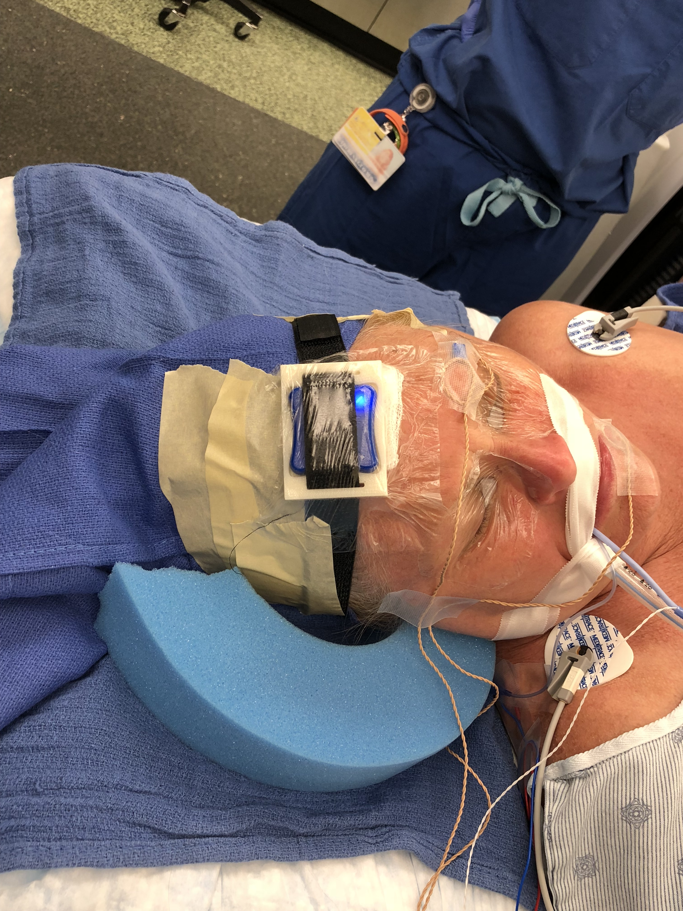
Analysis of Head Motions during ENT Surgery Using IMUs
What Students Will Do
Develop an algorithm to extract head motions of patients during ENT surgeries using 2 IMU sensors:
One on the patient’s forehead
One attached to the bed to
take into account the bed motions
Perform a validation study by using EM
trackers or optical trackers as ground truth
Evaluating the algorithm through a pilot
user study
Using the algorithm to analyze data
collected during actual surgeries in OR

Slide 2
Deliverables:
Minimum: development of the algorithm and validation through ground truth data
Expected: Evaluating the algorithm through a pilot user study
Maximum: Using the algorithm to analyze data from actual surgical cases
Group Size: 1-2
Skills:
Programming skills such as C++ and Python/MATLAB
Knowledge of signal processing
some design skills for simple attachments of measuring apparatus is a plus
Mentors: Dr. Mahya Shahbazi, Dr. Russell Taylor, Dr. Francis Creighton, Dr. Chris Razavi
Contact: mahya.sh@jhu.edu, rht@jhu.edu, francis.creighton@jhmi.edu, crazavi1@jhmi.edu

