Slide 1
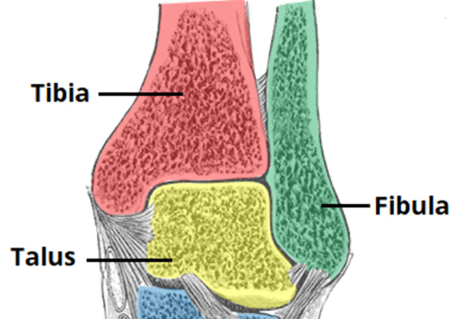
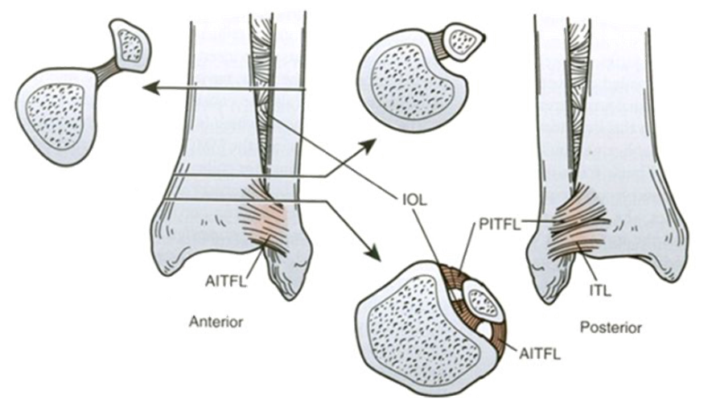
3D Imaging, Analysis, and Guidance for Robotic-Assisted Ankle Fracture / Dislocation Surgery
Motivation:
Ankle fractures with syndesmotic injury:
are COMMON (100,000 / year)
subject to POOR OUTCOMES (osteo-arthr)
are CHALLENGING (cannot assess 3D morphology from 2D radiographs)
Tibia
Fibula
Talus

Slide 2
3D Imaging, Analysis, and Guidance for Robotic-Assisted Ankle Fracture / Dislocation Surgery
Pertinent Anatomy:
Bones: Tibia, fibula, and talus
Ligaments: AITFL, PITFL, IOL, and ITL
A Complex Space: the syndesmosis
Very challenging to assess the 3D morphology of the syndesmosis from 2D projection views
→ 3D imaging and guidance
Tibia
Fibula
Talus

Slide 3
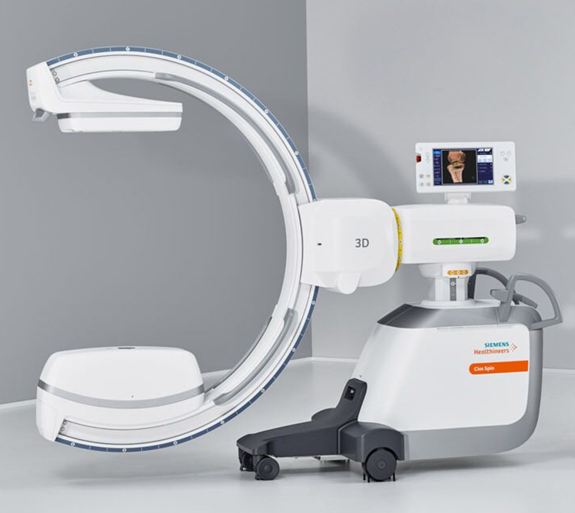
3D Imaging, Analysis, and Guidance for Robotic-Assisted Ankle Fracture / Dislocation Surgery
Overall Project Goals:
Develop a robot-assisted system for ankle reduction.
Use intraoperative 3D imaging in concert with 2D radiographs (3D-2D registration) to guide reduction.
Develop automated 3D image segmentation and analysis to precisely analyze the syndesmotic space.

Slide 4
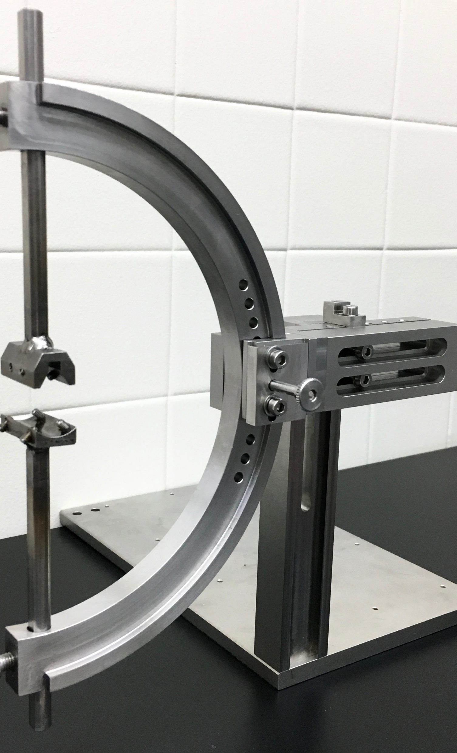
3D Imaging, Analysis, and Guidance for Robotic-Assisted Ankle Fracture / Dislocation Surgery
What Students Will Do: Aim 1
Design and build a jig for controlled disruption of the syndesmosis.
Minimum: Manual mechanical motion
Expected: Motorized control 1 DoF
Maximum: Motorized control 3 DoF
Turn away if squeamish.
Cadaver Setup
Imaging + Controlled Disruption
of Syndesmosis
Prototype Jig
Controlled Motion
(x,y,θ_{z}) of Fibula

Slide 5
3D Imaging, Analysis, and Guidance for Robotic-Assisted Ankle Fracture / Dislocation Surgery
What Students Will Do: Aim 1
Design and build a jig for controlled disruption of the syndesmosis.
Minimum: Manual mechanical motion
Expected: Motorized control 1 DoF
Maximum: Motorized control 3 DoF
What Students Will Do: Aim 2
Develop automatic image segmentation and analysis of 3D ankle morphology.
Minimum: Test existing (ASM) method in C-arm CBCT
Expected: Develop more robust segmentation (using deep learning)
Maximum: Combine with multi-body 3D-2D registration to guide reduction

Slide 6
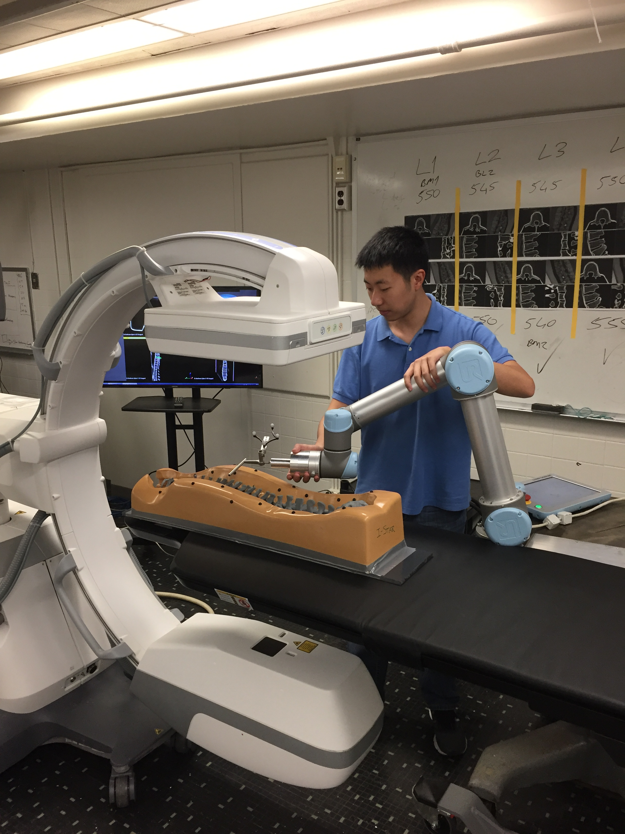
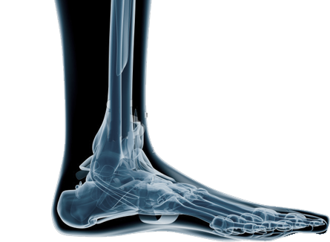
3D Imaging, Analysis, and Guidance for Robotic-Assisted Ankle Fracture / Dislocation Surgery
What Students Will Do: Aim 1
Design and build a jig for controlled disruption of the syndesmosis.
Minimum: Manual mechanical motion
Expected: Motorized control 1 DoF
Maximum: Motorized control 3 DoF
What Students Will Do: Aim 2
Develop automatic image segmentation and analysis of 3D ankle morphology.
Minimum: Test existing (ASM) method in C-arm CBCT
Expected: Develop more robust segmentation (using deep learning)
Maximum: Combine with multi-body 3D-2D registration to guide reduction
What Students Will Do: Aim 3
Characterize performance in laboratory experiments.
Minimum: Measure accuracy of planned and executed motion (Aim 1)
Expected: Measure accuracy of segmentation (Aim 2)
Maximum: Integrate systems from Aims 1-2 to prescribe motion pattern for robot-assisted reduction of the syndesmosis.

Slide 7
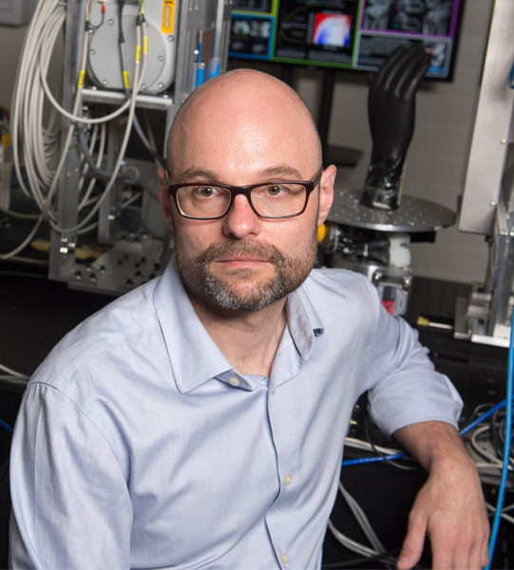
3D Imaging, Analysis, and Guidance for Robotic-Assisted Ankle Fracture / Dislocation Surgery
Size group: 2–3
Skills:
Machining / instrumentation (ankle jig)
Programming skills (e.g., Matlab and Python)
Basic knowledge in machine learning (e.g., TensorFlow/PyTorch)
Mentors:
Dr. Jeffrey H. Siewerdsen (jeff.siewerdsen@jhu.edu)
Dr. Wojtek Zbijewski (wzbijewski@jhu.edu)
Superior ramus

