Slide 1
Constructing a Model of the Cochlea From OCT Images
Students: Paul Wilkening and Emily Daggett
Mentors: Russell Taylor and Jin Kang
Notes:
Paul

Slide 2
Presentation Outline
Overview
Project Goals
Technical Summary
Project Management
Bibliography
Project Goals
Technical Summary
Project Management
Bibliography
Overview
Notes:
Emily

Slide 3
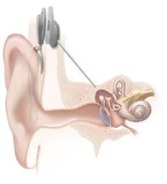
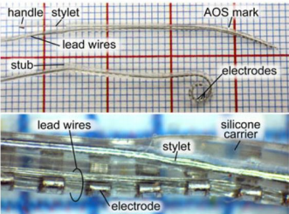
How does the cochlea work?
Parts of a cochlear implant
How do cochlear implants correct hearing loss?
Photo Credit: NIH
External parts of system
Microphone
Speech Processor
Transmitter
Internal System
Receiver/stimulator
Electrode array
Photo Credit: Kratchman et al.
Project Goals
Technical Summary
Project Management
Bibliography
Overview
Notes:
Emily

Slide 4
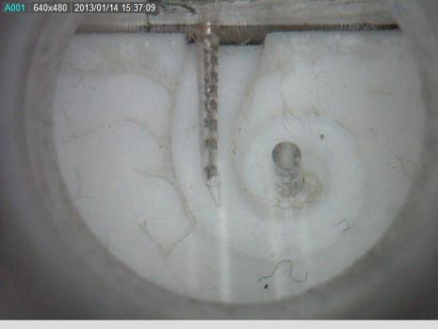
Standard practice for cochlear implant electrode array insertion
Problems with standard practice
Visibility
Required precision
Sensitivity of cochlea
Hand tremor
Our Project Goal
Photo Credit: Paul Wilkening
Project Goals
Technical Summary
Project Management
Bibliography
Overview
Notes:
Paul -
Emily – our goal to solve problems through imaging to solve the visibility problem, increased precision, tremor reduction

Slide 5
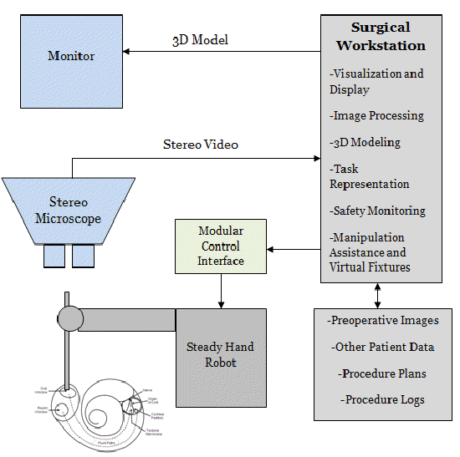
Overview of robot-assisted surgical system
EyeRobot2
Stereo Microscope
Monitor
Surgical Workstation Computer
CISST & eyeSAW Libraries
Image cochlea in 2 ways (OCT)
What is OCT?
Side-viewing Probe
Bulk Scanner
Create a Model
Create Virtual Fixtures Based on Model
Photo Credit: Paul Wilkening
Project Goals
Technical Summary
Project Management
Bibliography
Overview
Notes:
Paul – overview of system up to OCT
Emily – 2 different types of OCT imaging, what are virtual fixtures (imaginary boundaries that constrain the motion of the robot)

Slide 6
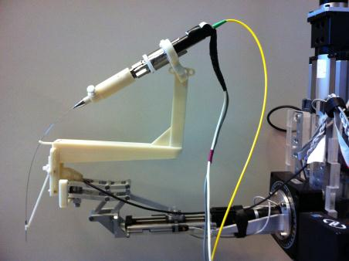
Side-viewing Probe
Probe mounted to robot
Parts
Motor
Trocars
Stainless Steel Tube
Glass Fiber
Infrared laser
How it works
A-Scans
B-Scans
Photo Credit: Berk Gonenc
Confidential
Project Goals
Technical Summary
Project Management
Bibliography
Overview
Notes:
Emily – thousands of A-Scans per B-Scan

Slide 7
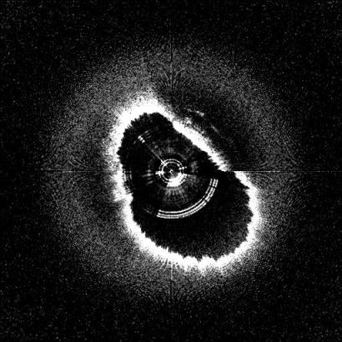
Side-view Probe Data
Pulse from robot
Contour data from B-scans
Multiple B-scans at different depths into the cochlea
Model
Virtual Fixture
Photo Credit: Saumya Gurbani
Project Goals
Technical Summary
Project Management
Bibliography
Overview
Notes:
Paul

Slide 8
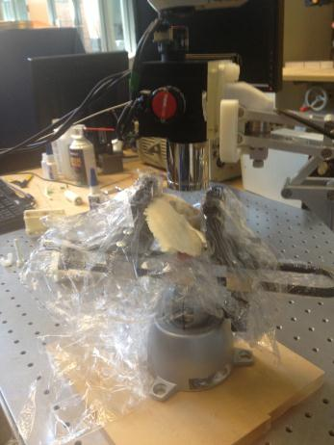
Bulk Scanner
Scanner mounted to robot
How it works
A-Scans
B-Scans
Volumes
Photo Credit: Emily Daggett
Confidential
Project Goals
Technical Summary
Project Management
Bibliography
Overview
Notes:
Emily – volumes 50mm below lens (5x5x5)

Slide 9
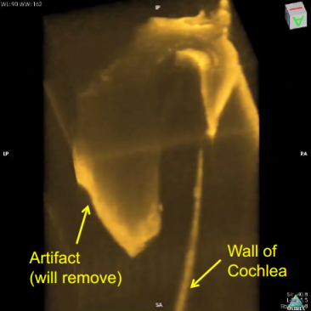
Bulk Scanner Data
Volumes stitched together
Model
Basal turn identified
Virtual Fixture
Photo Credit: Mingtao Zhao
Project Goals
Technical Summary
Project Management
Bibliography
Overview
Notes:
Paul – combined model

Slide 10
Project Management
Deliverables
Project Goals
Technical Summary
Project Management
Bibliography
Overview
Notes:
Talk about combined model

Slide 11
Project Management
Dependencies
Project Goals
Technical Summary
Project Management
Bibliography
Overview

Slide 12
Project Management
Project Goals
Technical Summary
Project Management
Bibliography
Overview

Slide 13
Project Management
Project Goals
Technical Summary
Project Management
Bibliography
Overview

Slide 14
Bibliography
Coulson, C. J., Reid, A. P., Proops, D. W., & Brett, P. N. (2007). ENT challenges at the small scall. The International Journal of Medical Robotics and Computer Assisted Surgery, (3), 91-96.
Kavanaugh, K. T. (1994). Applications of image-directed robotics in otolaryngologic surgery. The Laryngoscope, (104), 283-293.
Kratchman, L. B., Schurzig, D., McRackan, T. R., Balachandran, R., Noble, J. H., Webster, R. J. I., & Labadie, R. F. (2012). A manually operated, advance off-stylet insertion tool for minimally invasive cochlear implant surgery. IEEE Transactions on Biomedical Engineering, 59(10), 2792-2800.
Lin, J., Staecker, H., & Jafri, M. S. (2008). Optical coherence tomography imaging of the inner ear: A feasibility study with implications for cochlear implantation. Annals of Otology, Rhinology & Laryngology, 117(5), 341-346.
Majdani, O., Rau, T. S., Baron, S., Eilers, H., Baier, C., Heimann, B., . . . Leinung, M. (2009). A robot-guided minimally invasive approach for cochlear implant surgery: Preliminary results of a temporal bone study. International Journal of Computer Assisted Radiology and Surgery, (4), 475-486.
NIH Publication No. 11-4798 (2011-03-01). “Cochlear Implants”. National Institute on Deafness and Other Communication Disorders.
Pau, H. W., Lankenau, E., Just, T., Behrend, D., & Hüttmann, G. (2007). Optical coherence tomography as an orientation guide in cochlear implant surgery? Acta Oto-Laryngologica, (127), 907-913.
Rau, T. S., Hussong, A., Leinung, M., Lenarz, T., & Majdani, O. (2010). Automated insertion of preformed cochlear implant electrodes: Evaluation of curling behaviour and insertion forces on an artificial cochlear model. International Journal of Computer Assisted Radiology and Surgery, (5), 173-181.
Zhang, J., Wei, W., Ding, J., Roland, J. T. J., Manolidis, S., & Simaan, N. (2010). Inroads toward robot-assisted cochlear implant surgery using steerable electrode arrays. Otology & Neurotology.
Project Goals
Technical Summary
Project Management
Bibliography
Overview

Slide 15
Questions?

