Slide 1
Paper Seminar Presentation Image Processing for Video-CT Registration in Sinus Surgery
Group 11
Calvin Zhao

Slide 2
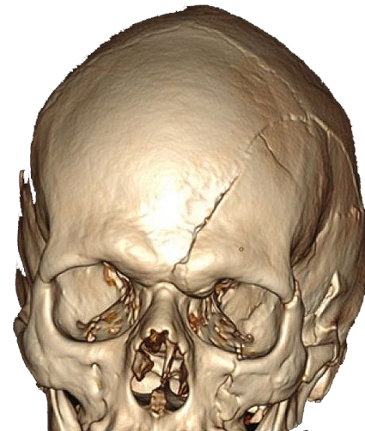
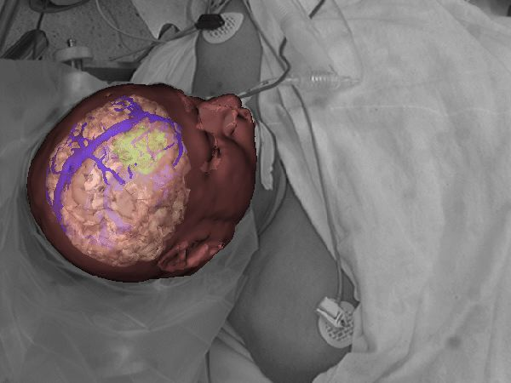
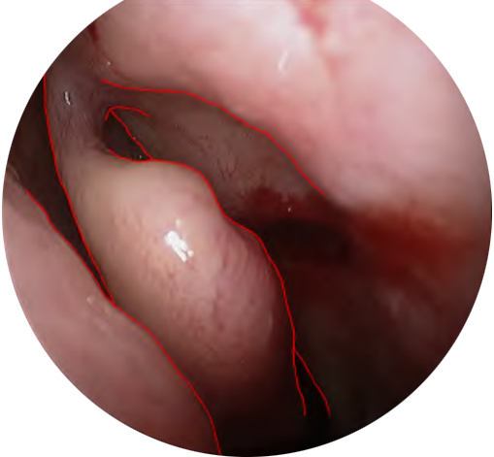
Project Review
The goal of this project is to be able to enhance magnetic tracker registration and surgical tool position by utilizing CT data with occluding contours extracted from the endoscopic video feed.
Notes:
Part of a larger project
Our goal is to…
Distinguish between texture and edges

Slide 3
Paper Selection
Contour Detection and Hierarchical Image Segmentation
University of California at Berkeley
Arbelaez, P., Maire M., Fowlkes C., Malik, J., Contour Detection and Hierarchical Image Segmentation. IEEE Transactions on Pattern Analysis and Machine Intelligence, 2011
Notes:
4 authors

Slide 4
Paper Relevance
Canny Edge Detection
Gaussian filter
Discontinuities in Brightness
Nonmaximum suppression
Double Threshold
Hysteresis thresholding
Weaknesses:
High noise
Notes:
Edge Detection is Hard
Canny:
Filter out noise
Perform double threshold for weak and strong edges
Canny weaknesses:
Hysteresis: weak edge connected to strong edge
Does not examine the picture globally for patterns
Does not consider segementation
Other edge detection methods

Slide 5
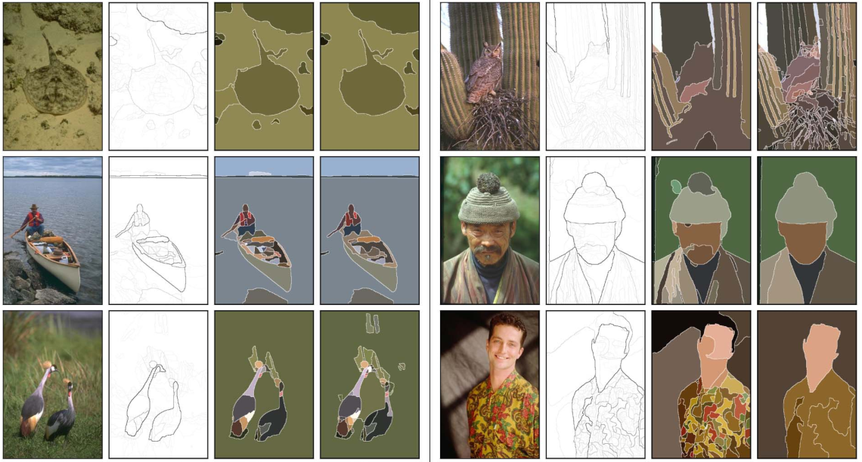
Results
“This paper…Provides a means of coupling our system to recognition applications”
Notes:
Clearly defined contours

Slide 6
Key Advantages
More refined contour detection based off directional gradient
Examines the picture globally for patterns
Segmentation provides guaranteed closed contours

Slide 7
Paper Structure
Previous Work
Overview of Contour Detection
Overview of Segmentation
Benchmarks
Their Work
Contour detection
Image segmentation
Final Results
Notes:
Edge classifier
Contour continuity
Stochastic processes
Filter-based
Fitting mixture models
Mode-finding
Graph partitioning
But I will not go into these

Slide 8
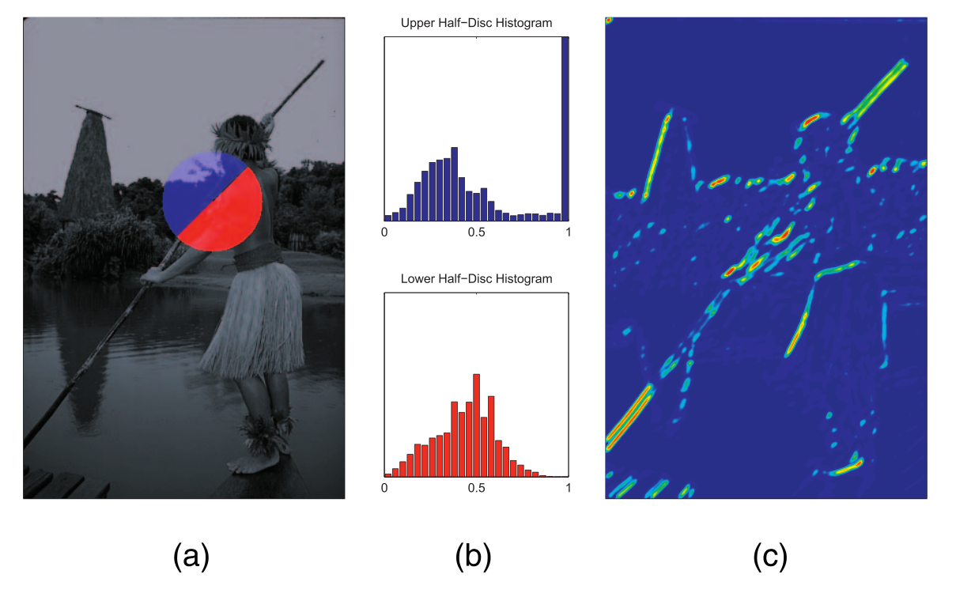
Probability of Boundary (Pb)
Oriented Gradient Signal:
Gradient Magnitude:
Notes:
5px

Slide 9
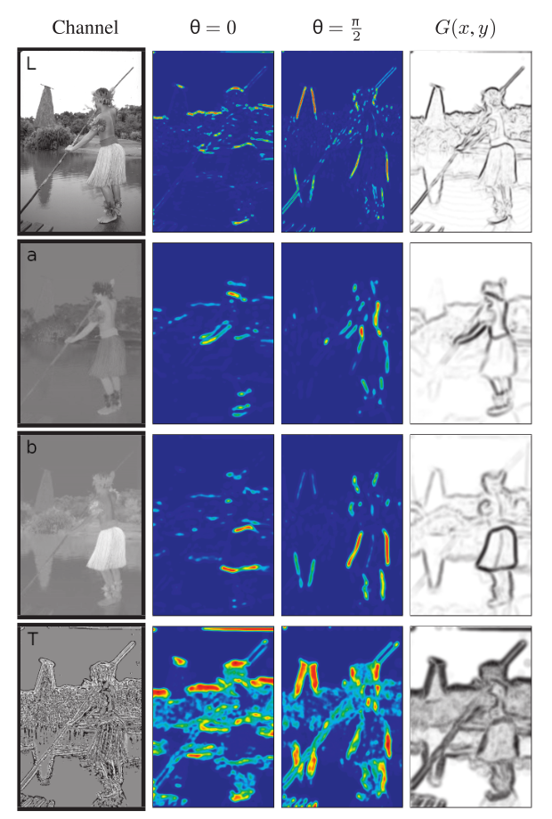
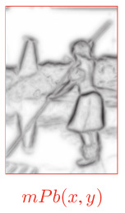
Multiscale Pb (mPb)
Intensity
8 Pb samples from 4 categories with θ in
Color A
Color B
Texton
Notes:
Gaussian derivative filters
Textons are pixels that are clustered based off
17 dimensional vector used with K means
See appendix for k means

Slide 10
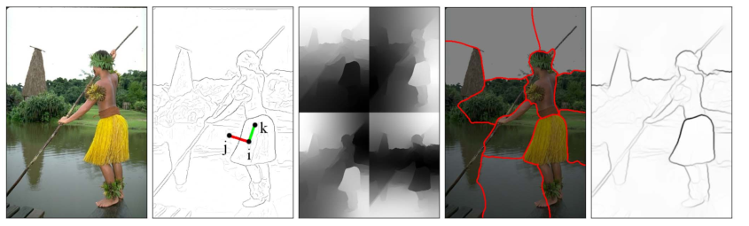
Spectral Pb (sPb)
Connect all pixels i and j within a radius r to each other
Define and solve
Partition image using K-means
Notes:
Rho is a constant
R = 5 in this case
Solve for n+1 smallest eigenvalues
Information from different eigenvectors is combined
Convolve with Gaussian directional derivative filters at multiple orientations to get oriented signals
Vectors are weighed by their eigenvalues
Interpretation of a mass-spring system

Slide 11
Global Pb (sPb)
sPb highlights most salient curves
mPb tries to find all edges
Notes:
Solved using 16 eigen values

Slide 12
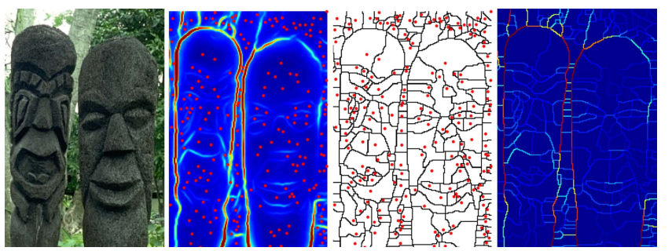
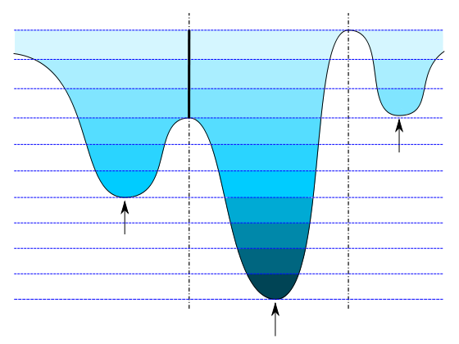
Segmentation
Maximal response of a contour detector for each pixel:
Oriented Watershed Transform is performed
Notes:
Highest contour detail
Reginal minima as seed locations for homogeneous segments

Slide 13
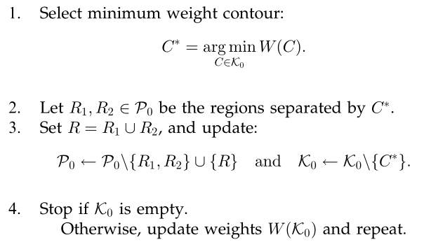
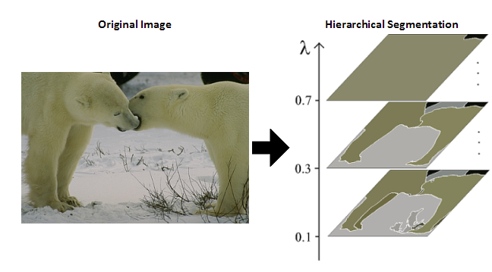
Segmentation
Notes:
Guaranteed closed contours
Various levels of segmentation

Slide 14
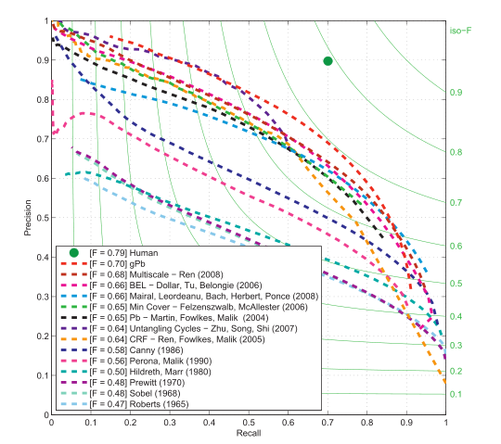
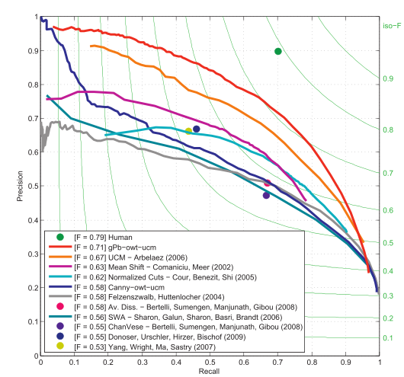
Benchmarks
Contour: Segmentation
Notes:
300 and 500 image data sets

Slide 15
Issues/Critique
Terminology not clearly defined
sPb, mPb, Pb, etc.
Tedious introduction and background overview
Insufficient explanations
Texton Gaussian convolutions
sPb equation rationale
Segmentation and Contour detection segments were disjoint
Notes:
Avoided explaining rationale behind computing eigenvalues and vectors so actual mathematical relevance is unclear
Almost seemed it was too hard for audience to understand

Slide 16
Conclusion
Paper showed a clear advantage and was well proven on large data sets
However, contour detection algorithm is very slow
Computation of eigenvalues and vectors
Multiple θ
We can incorporate their segmentation algorithms into our project to eliminate noise
However, our images may not have clear closed boundaries
Our images are mostly monochromatic, eliminating key mPb categories
Notes:
300 and 500 image data sets
Appendix includes an “efficient computation” section but still does not solve issues

Slide 17
Appendix
Textons:
Image is convolved with:
Pixels are clustered using K-means
Each pixel is assigned to closest cluster [1,K]
K-means:
Where k is number of clusters, x is observations, μ is mean of points in a cluster

