Slide 1
Integration of LARS and Snake Robots (LARSnake) & System Development
600.446 – Computer Integrated Surgery II
H. Tutkun Şen
Mentor:
Paul Thienphrapa
Project Update and Paper Presentation
March 10, 2011

Slide 2
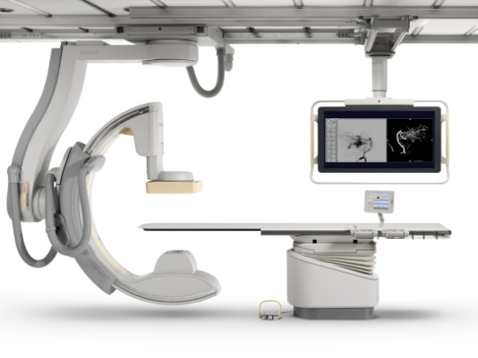
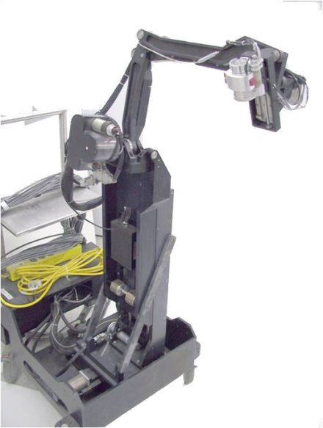
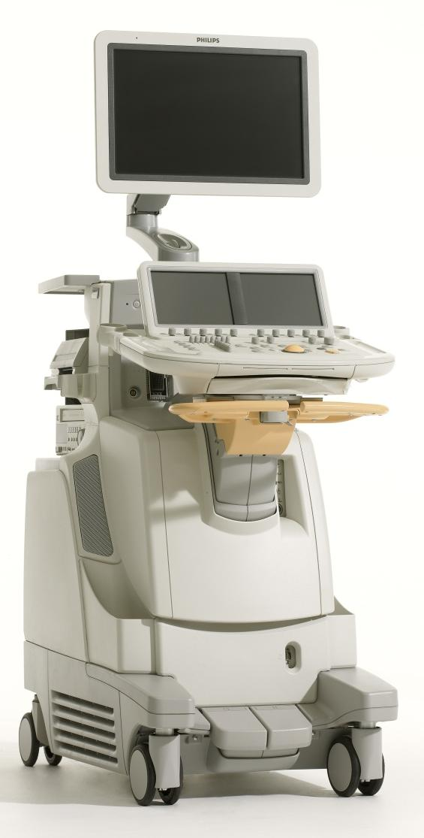
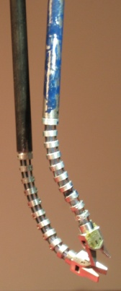
Where were we??
Main Focus
Workstation
Computer(s)
TCP/IP
TCP/IP
?
Trigger(s)?
Ultrasound
System
C-arm
Linux RTAI
TCP/IP
FireWire
LARS + Snake Robot
Probe
Snake
Water Tank

Slide 3
Project Timeline
We are Here
1
2
3
Task | 14-Feb | 21-Feb | 28-Feb | 7-Mar | 14-Mar | 21-Mar | 28-Mar | 4-Apr | 11-Apr | 18-Apr | 25-Apr | 2-May
Project Proposal Presentation | DONE |  |  |  |  |  | SPRING BREAK
Come Speed with CISST Library |  | DONE | DONE
Come Speed Snake and LARS Robot Control |  | DONE | NOT YET
Devise Schemes of Integration |  |  |  | DONE
Kinematics Analysis of the Overall System
Software Integration
System Debugging
Medica School Experiments
Documentation
Final Presentation

Slide 4
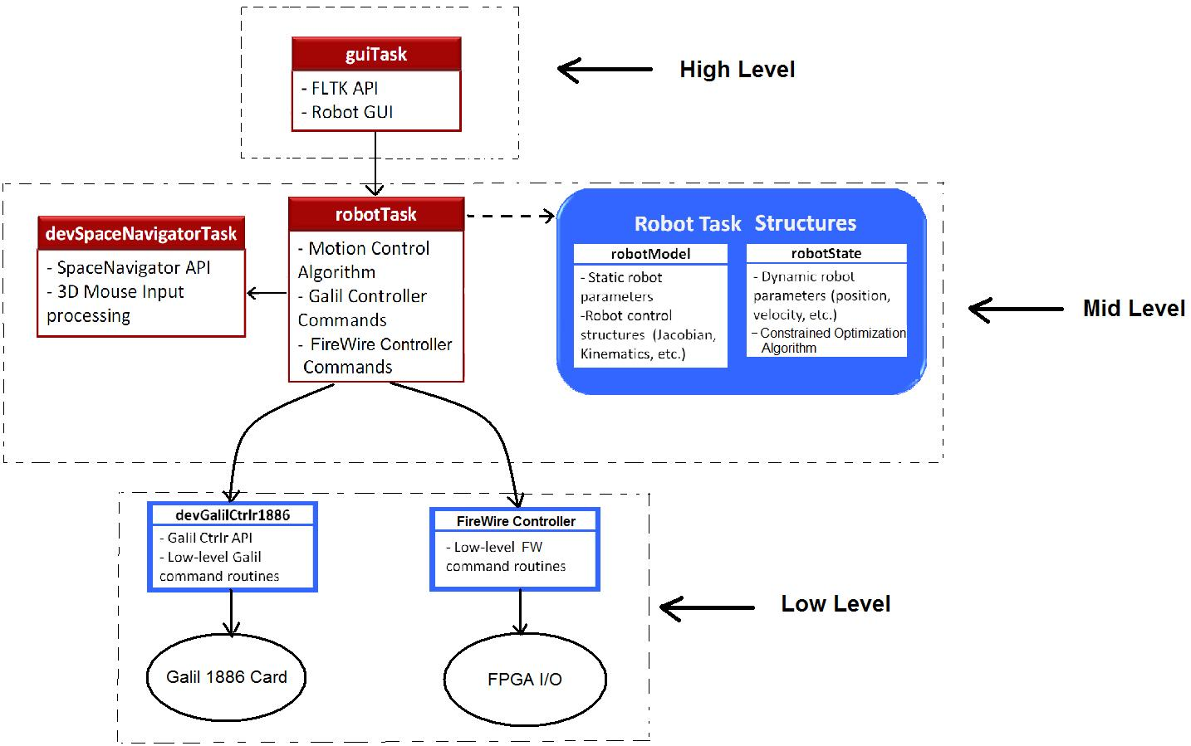
Class Hierarchy

Slide 5
Integration Scheme
All code will be gathered in a single environment and worked through a single program.
The system will run on Linux operating system. Depending on the availability of Galil drivers (.dll), the system may shift to RTAI Linux.

Slide 6
Dependencies
Paul will update the low level portions of the Snake code.
Linux computer access.
Paul’s Linux Computer.
Access of the robots to derive its kinematic relations.
Assembly of the system.
Paul will help the assembly.
Phantom Omni access.
Permission will be sought from Anton.

Slide 7
Goals & Deliverables (updated)
Minimum
Working robot with separate snake computer as a "black box", so you can set the joints over the network but you don't need to know what version of CISST it is using.
Expected
Working robot with “some” updated snake code.
Maximum
Working robot with full updated snake code.

Slide 8
Near Future Job..
Until Paul prepares the code, working on Constrained Cartesian Motion Control of LARSnake will be the next thing to do starting from the next slide.

Slide 9
Today’s Papers
J. Funda, R. Taylor, B. Eldridge, S. Gomory, and K. Gruben, "Constrained Cartesian motion control for teleoperated surgical robots," IEEE Transactions on Robotics and Automation, vol. 12, pp. 453-466, 1996.
A. Kapoor, M. Li, and R. Taylor. Constrained Control for Surgical Assistant Robots. IEEE Int’l Conf. on Robotics and Automation. pp. 231-236. May 2006.

Slide 10
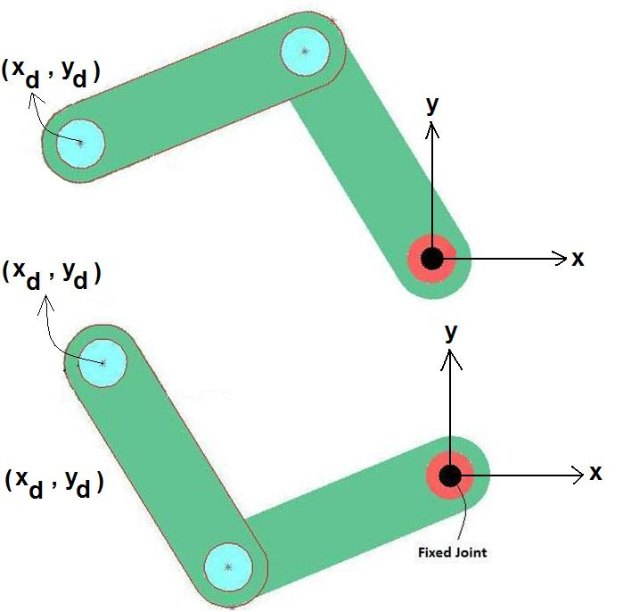
Motivation and Significance of Optimization
For a 2 link mechanism in order to reach the destination point (xd, yd) there are two possible configurations.

Slide 11
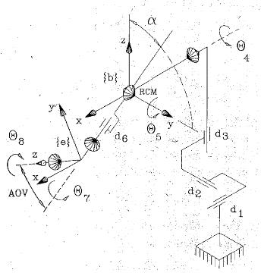
Motivation and Significance of Optimization
How about for such complicated 7 degree of freedom(dof) system.
How many different configurations satisfy the desired final destination?

Slide 12
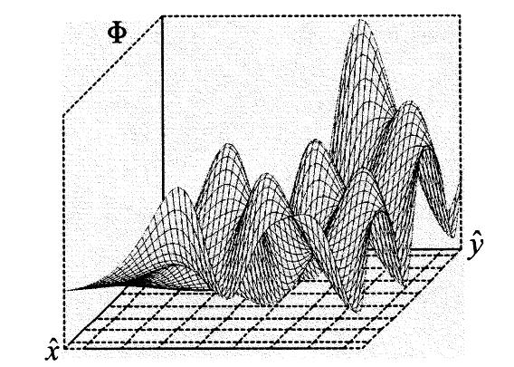
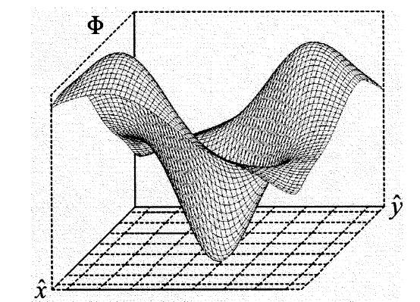
Motivation and Significance of Optimization
For such systems there are many solutions satisfying the requirement.
This is where optimization (constrained or not) plays an important role in choosing the most suitable configuration.
LARSnake has 7+4= 11 dof, so there are many options in reaching to a sample destination point.

Slide 13
Current Methods
Inverse Jacobian Method:
Depending on the deficiency or redundancy of dof (task-deficiency or task redundacncy), pseudo inverse can be used in taking the inverse of the Jacobian.
Gradient protection techniques:
where ‘z’ is an arbitrary vector in the null-space of the Jacobian.
Setting allows specification of couple of secondary performance criteria like joint limit avoidance.
And many others..

Slide 14
“Constrained Cartesian motion control for teleoperated surgical robots “ (1st Paper)
In this method desired motion is formulated as sets of task goals in different task frames, optionally subject to additional linear constraints in each of the task frames.
Then, using the quadratic optimization solution technique, the kinematic control problem is solved using a Real Time PC.

Slide 15
Nomenclature
{e} ---> end- effector frame (coordinate frame of the tip of the laparoscope)
{c} ---> camera frame (frame whose origin is at the optical center of projection of the laparoscopes optics)
{g} ---> gaze frame (frame whose origin is coincident with the 3D point on the patient’s anatomy appearing in the center of 2D camera image)

Slide 16
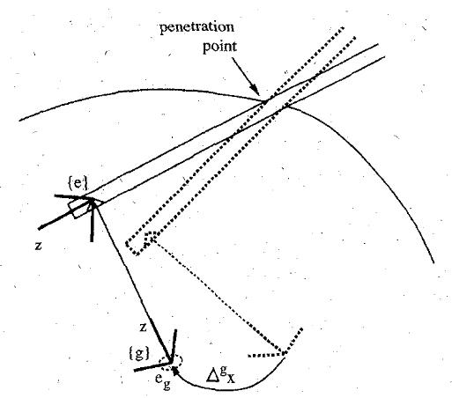
Theory Implementation Example
Changing the position of a laser beam with Cartesian displacement of the gaze frame by an amount of .
‘q’ denotes the joint variables and ‘x’ denotes the state variables under concern such that:

Slide 17
Theory Implementation Example: Setting Constraints and Frame Objective Functions
Laser beam hitting the target location within
desired tolerance ‘ε’.
Above equation may be
approximated in this form.
..and it can be more simplified into this form.
Minimizing the rotational error about the viewing ‘z’ axis, which is the same as minimizing ∆x[6] - ∆xd [6]
Putting linear constraints on the motion of the end effector where ‘He’ and ‘he’ can be defined as below.

Slide 18
Theory Implementation Example: Setting Constraints and Frame Objective Functions
Minimizing extraneous motion of the instrument
Putting joint limits on actuators
Above relation can be rewritten in this form such that ‘Hj’ and ‘hj’ can
be defined below.
Minimizing the total motion of the joints of the surgical manipulator.

Slide 19
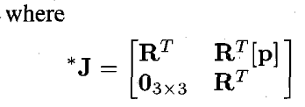
Theory Implementation Example: Setting Constraints and Frame Objective Functions
To travel between different frames, this relation can be used.
The rotation minimization can be represented in terms of joint variables.
The above relation can be represented in this general form.

Slide 20
Theory Implementation Example: Combining all the constraining relations
Subject to the constraint:
The final form of the problem turns out to be :

Slide 21
Theory Implementation Example: Choosing weighting factor
In the minimization relation in the total motion of the
joints of the surgical manipulator the choice of the weighting factors is
important.
If not chosen properly undesired dynamics may dominate the
optimization process.
The weighting constants compose of two terms:
u[i] is the relative importance of that particular joint, and v[f] takes care of unit conversion between linear and rotational axis movements.

Slide 22
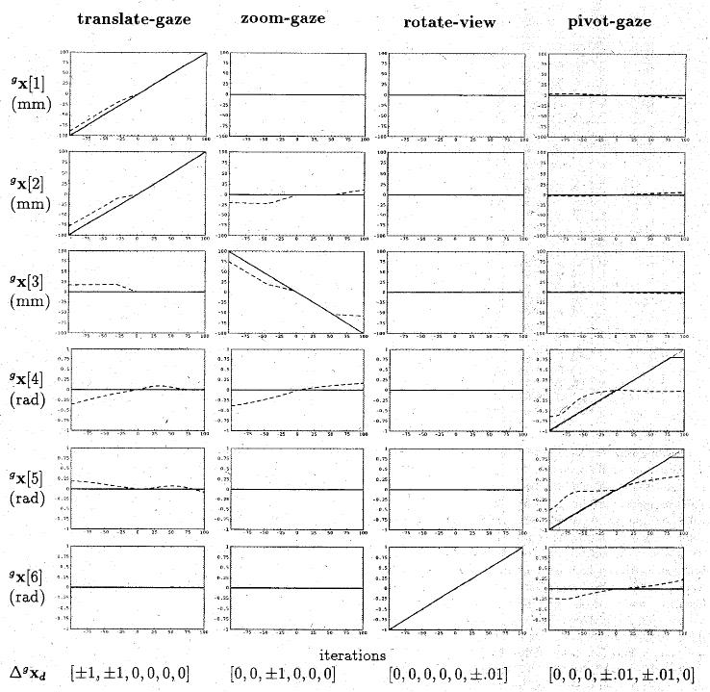
Experimental Evaluation and Results
Results for 4 different motion types listed at the top of the table.
Dashed lines are for task-deficient system whereas the solid lines are for task-redundant system

Slide 23
Critical Summary & Significance
It is good to show, how the algorithm worked for task-redundant and task-deficient dof systems.
But it needs a good initial guess which I can achieve by homing the LARSnake at the beginning of the procedure.
User must be careful in task-deficient operations as in the case of RCM mode operations because the required position may not be achievable with such constraints.

Slide 24
“Constrained Control for Surgical Assistant Robots“ (2nd Paper)
Using a weighted multi-objective linear and non-linear constrained optimization framework, formalizing virtual fixture libraries for different tasks.
Introduction of ‘soft’ tissue concept for virtual fixtures is established.

Slide 25
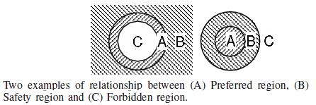
Theory
What do we mean by virtual fixtures?
Safety region can be thought of as ‘soft’ fixture.

Slide 26
Theory
The most general form of the constrained optimization problem:
Where is the objective function , and
represents the constraint condition. The inclusion of ‘s’, which is a vector of slack
variables, provides a means of implementing ‘soft’ constraints.
For complicated fixtures, which includes many sub fixture tasks, the above relation can be written as below.

Slide 27
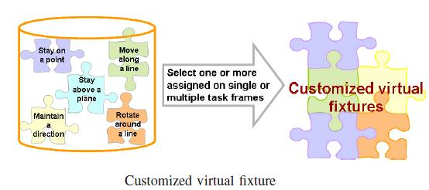
Formation of Different Tasks
Stay on a point
Maintain a direction
Move along a line
Rotate along a line
Stay above a plane.

Slide 28
Constrained Control Algorithm
Objective function
Step 1:Describe an incremental motion based on the input
Step 2: Decompose the task into task primitives
Step 3: Use the robot and the task kinematic equations and form the new constrained optimization problem.
Step 4: Solve the problem using linear or non linear numerical techniques.

Slide 29
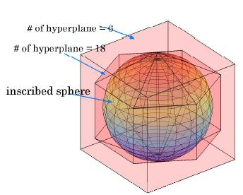
Linear Approximations and Sequential Programming
Use linear constrains of the form :
In staying on a point case, we can think of each linear constraint as an hyper plane shrinking the conversion region.

Slide 30
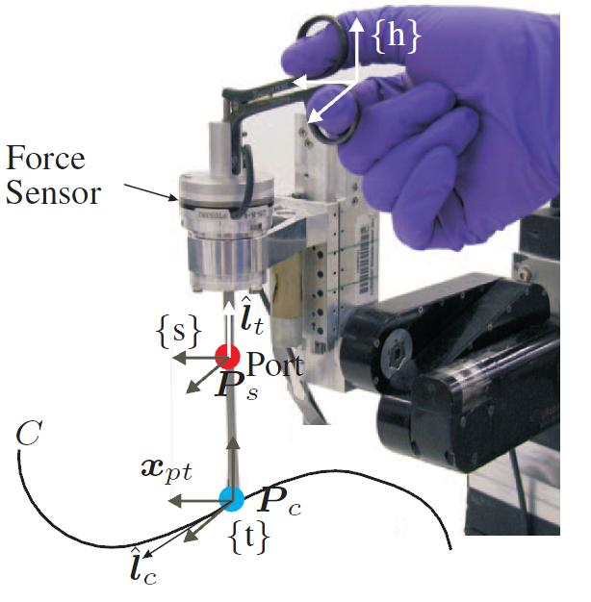
Experiments
The task to guide a tool that passes through a port to follow a path.

Slide 31
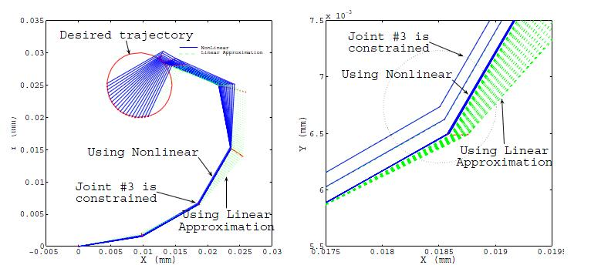
Results
Trajectory of a planar 6 link robot with 3rd joint is restricted at a point.

Slide 32
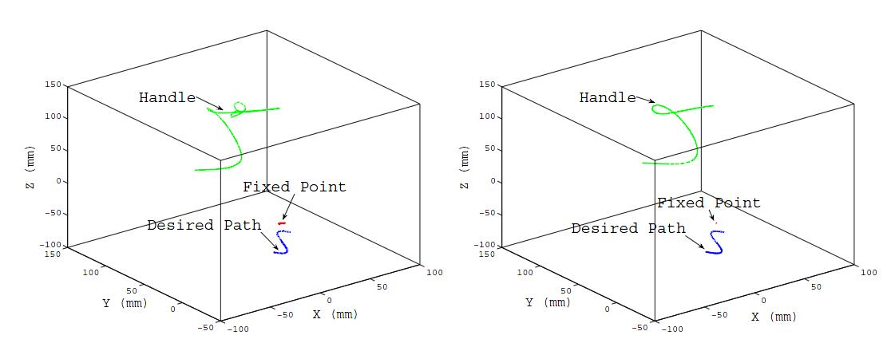
Results
Trajectory points on robot :
‘soft’ fixture for w = 1000
‘hard’ fixture for w=0.001

Slide 33
Critical Summary & Significance
It is gives an insight about the trade-offs in results between linear and nonlinear constraint formations.
In motion planning for future work, I may benefit dividing the task at hand into subtasks and giving weights to each task in reaching a solution.
Compared to the previous paper, it suggests a solution to initial ‘good guess’ requirement: using linear approximation results.

Slide 34
THANK YOU FOR LISTENING!!
QUESTIONS??

