Slide 1
Integration of LARS and Snake Robots (LARSnake) & System Development
600.446 – Computer Integrated Surgery II
H. Tutkun Şen
Mentor:
Paul Thienphrapa
Checkpoint Presentation
April 5, 2011

Slide 2
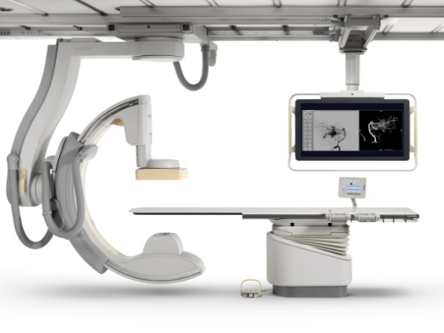
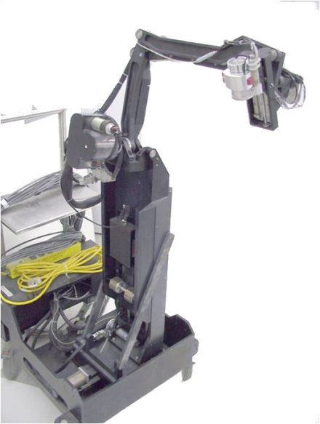
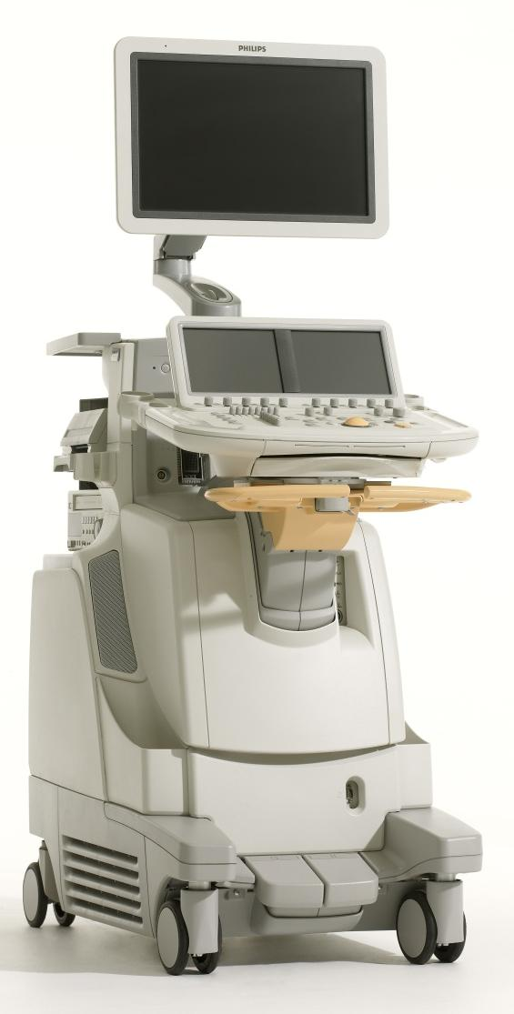
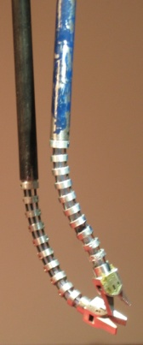
Where were we??
Main Focus
Workstation
Computer(s)
TCP/IP
TCP/IP
?
Trigger(s)?
Ultrasound
System
C-arm
Linux RTAI
TCP/IP
FireWire
LARS + Snake Robot
Probe
Snake
Water Tank

Slide 3
Project Timeline
We are Here
are
1
2
3
Task | 14-Feb | 21-Feb | 28-Feb | 7-Mar | 14-Mar | 21-Mar | 28-Mar | 4-Apr | 11-Apr | 18-Apr | 25-Apr | 2-May
Project Proposal Presentation | DONE |  |  |  |  |  | SPRING BREAK
Come Speed with CISST Library |  | DONE | DONE
Come Speed Snake and LARS Robot Control |  | DONE | DONE
Devise Schemes of Integration |  |  |  | DONE
Kinematic integration of the Overall System |  |  |  |  | DONE
Software Integration
System Debugging
Documentation
Final Presentation

Slide 4
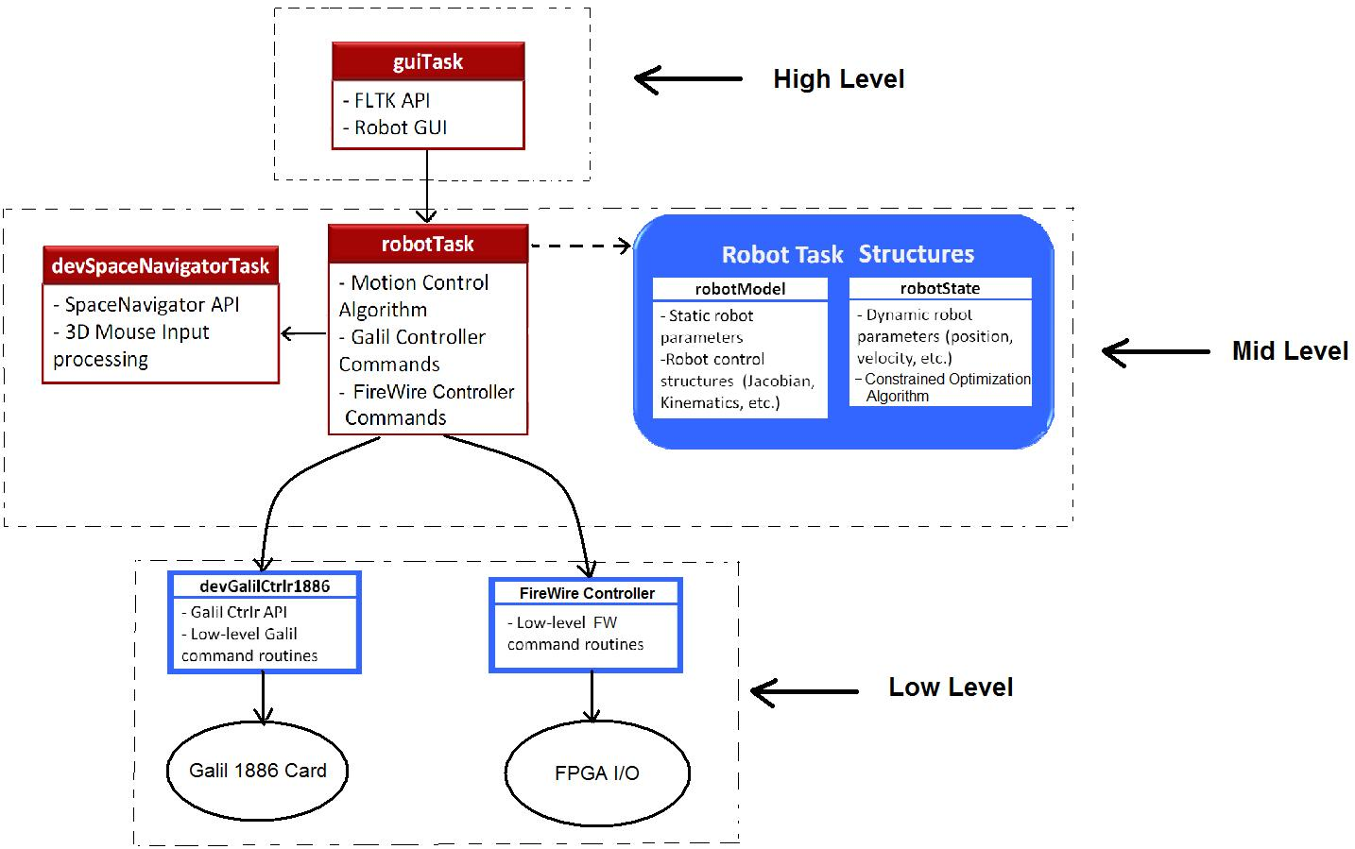
Class Hierarchy (Old Version)

Slide 5
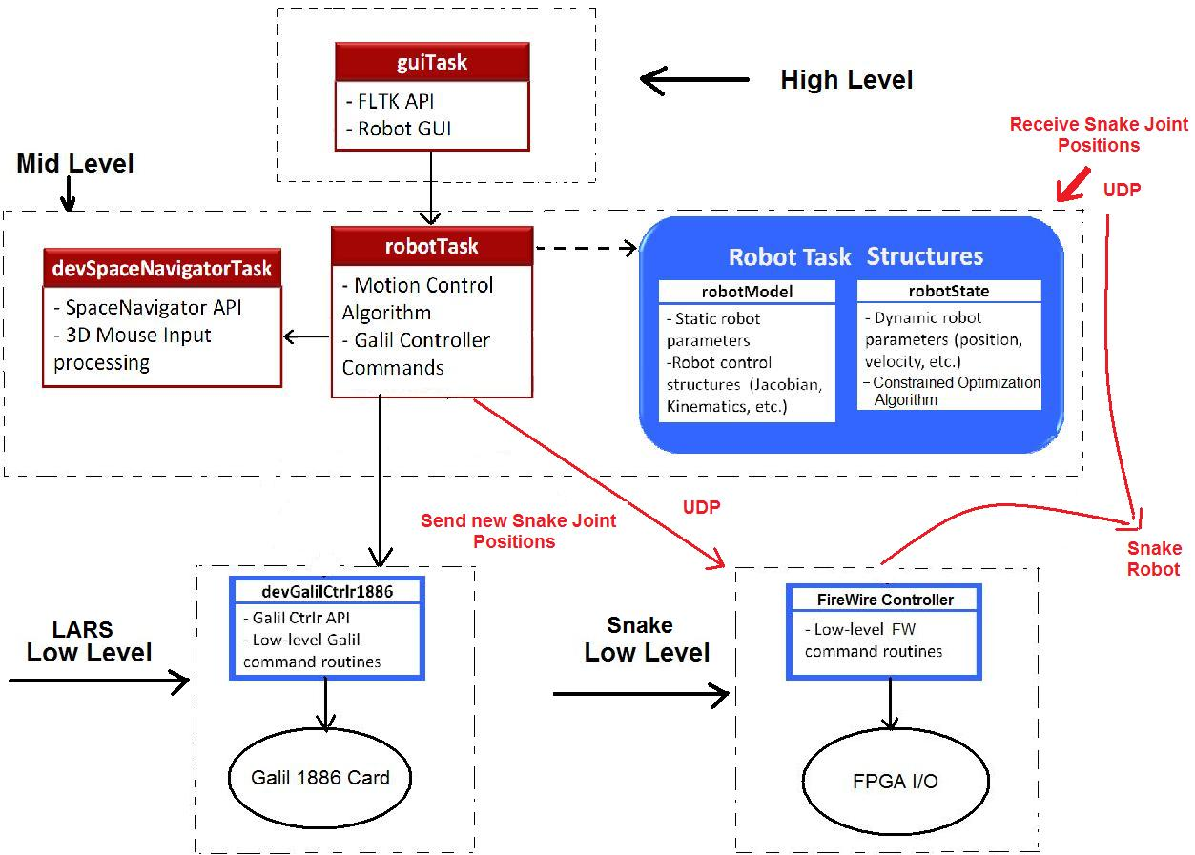
Class Hierarchy (Updated)

Slide 6
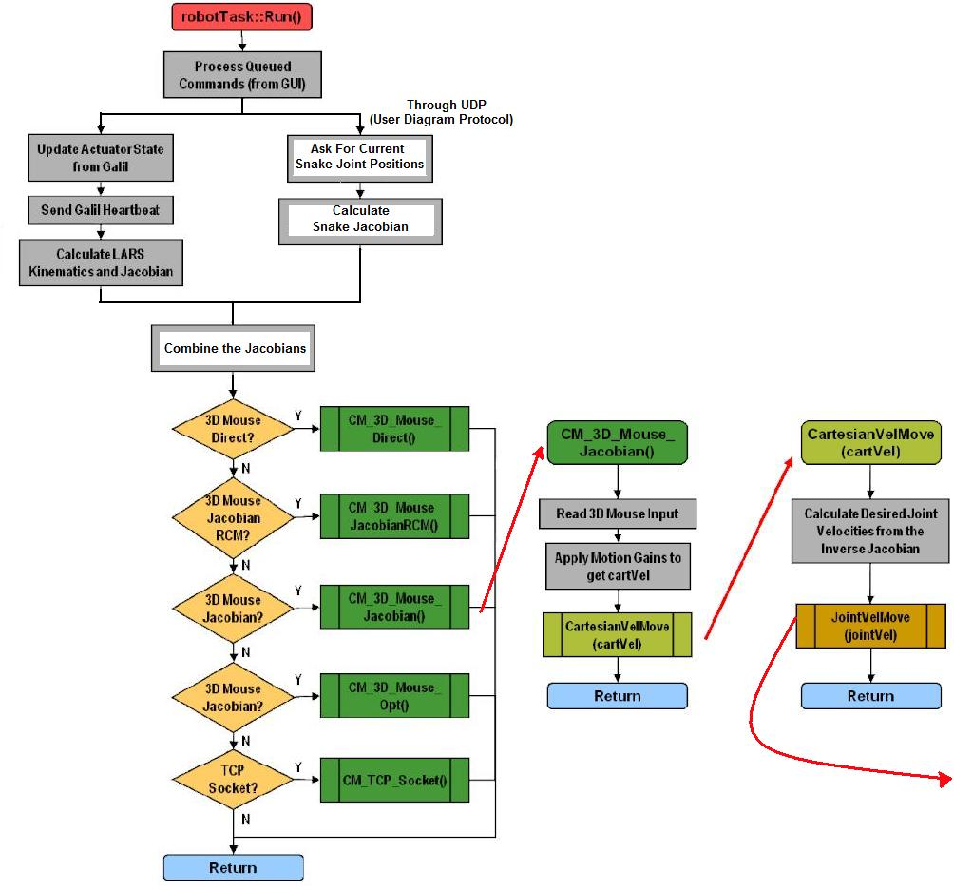
Example “run()”
Processing

Slide 7
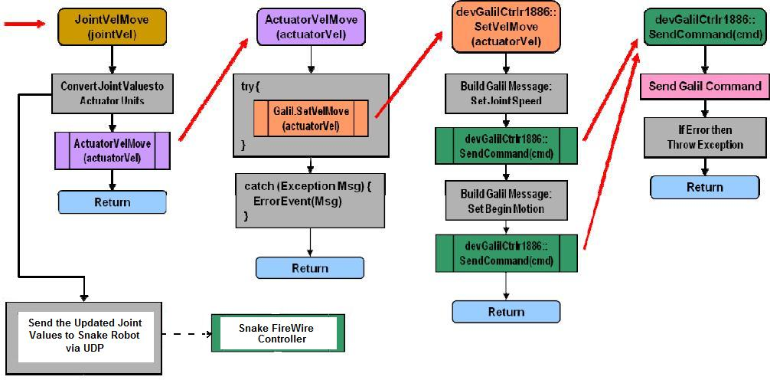
Example “run()”Processing cont’d

Slide 8
Dependencies
Paul will update some part of the Snake code considering the protocol being used.
Assembly of the system.
Paul will help the assembly.
Phantom Omni access.(if needed for the demo)
Marcin will help me on getting one.

Slide 9
Milestones and Progress
Milestone name: Kinematic analysis of the overall system
Planned Date: 03/28/2011
Milestone name: Software integration process.
Planned Date: 04/15/2011
Since the integration scheme is changed, the above two milestones are united such that the new expected date is still 15th of April.
Milestone name : Working demo with current approach
Planned Date: 04/22/2011
Expected Date: 04/22/2011
Milestone name : Working demo with partially updated snake code
Planned Date: 05/06/2011
Expected Date: 05/06/2011

Slide 10
Goals & Deliverables (updated)
Minimum
Working robot with separate snake computer as a "black box", so one can set the joints over the network but doesn't need to know what version of CISST it is using.
Expected
Working robot with “some” updated snake code.
Maximum
Working robot with full updated snake code.

Slide 11
Current Status
Come Speed with CISST Library
Come Speed Snake and LARS Robot Control
Devise Schemes of Integration
LARS Code is updated (Although this was not in the plan)
Kinematic and Software Integration of the Overall System
Communication between the computers is established
Joint values of the snake robot is obtained via UDP
Kinematic equations of both systems examined
Combining the Jacobians
Sending the calculated joint values to Snake Robot
System Debugging
Snake Code Update

Slide 12
THANK YOU FOR LISTENING!!
QUESTIONS??

