Slide 1
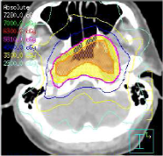
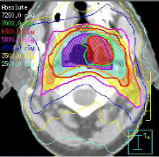
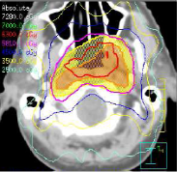
Data-Driven Strategy For Optimization Of Intensity Modulated Radiation Therapy (IMRT) Planning For Head And Neck Region Yang Wuyang Mentors: Dr. Todd McNutt; Prof. Russell Taylor
Goals:
Improve quality control of IMRT treatment plan for head and neck region
Significance:
Introduce a data-driven strategy package that has the potential of standardizing practice
Better treatment plans for patient
Results:
A package in python and SQL developed that can initiate optimized plans for patient.
Clinical workflow set up ready for use for head and neck planning on patients.
courtesy from Dr. Todd McNutt

Slide 2
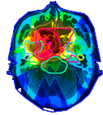
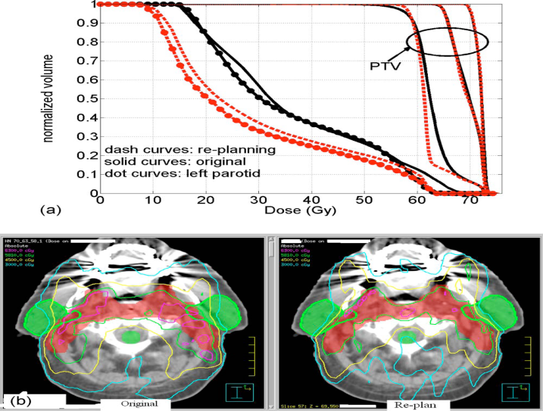
CIS Project
Parotid
Inner Ear
Cord
Data-Driven Strategy For Optimization Of Intensity Modulated Radiation Therapy (IMRT) Planning
Brain
General Overview Of Project
Result : Improved Plan
In IMRT, the intensity of every beam can be modulated to form a specific shape to specify target. The planning of IMRT can be very complicated. Current planning process rely on physician experience, causing practice variations, difficulties in evaluating planning quality and unintended burden in clinical workflow. We proposed a data-driven approach to solve this problem, using prior patient data to do real time evaluation and decision support of current patient planning
Method: Optimizing Workflow
Physician
experience
Planning System
Result
looping for about 30 times
Only loop about 2 times
goes first to the data driven planning system
Data Driven Planning
courtesy from Wu Binbin et al
* PTV stands for Planned Target Volume

