Slide 1
Ultrasound-based Visual Servoing
Group 8
Team Members: Michael Scarlett
Mentors: Bernhard Fuerst, Prof. Navab
March 31, 2015

Slide 2
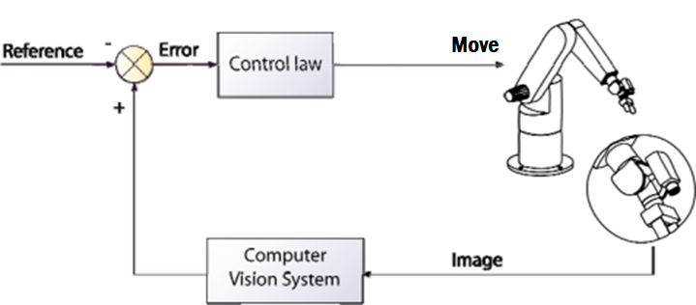
Topic – Ultrasound Visual Servoing
Automatic feedback control of robot as a function of input image and reference image
Use current ultrasound volume to automatically move robotic ultrasound probe to volume of interest
Current ultrasound volume
Volume of interest
Move
Current position
Final position

Slide 3
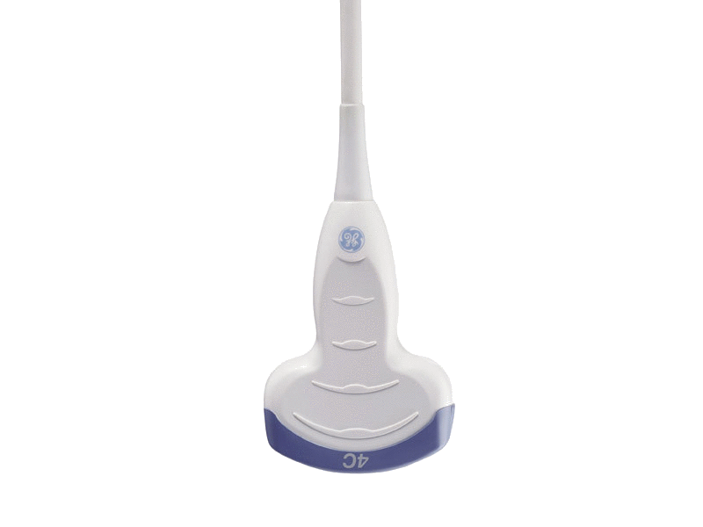
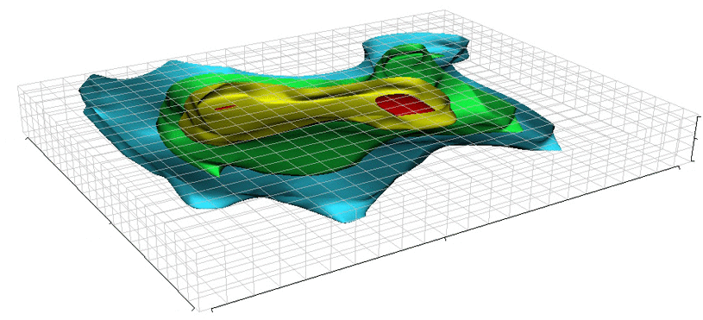
Topic – Ultrasound Visual Servoing
Doctor chooses volume of interest within reference image
Use current ultrasound volume to find transformation to volume of interest
Move ultrasound probe
Repeat 2-3 until error is small
Ultrasound probe
Volume of interest
R, t
Ultrasound volume
Reference image

Slide 4
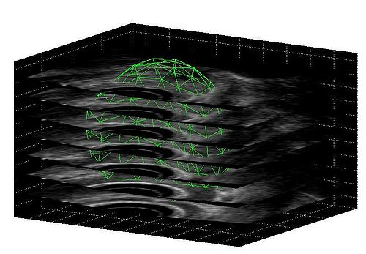
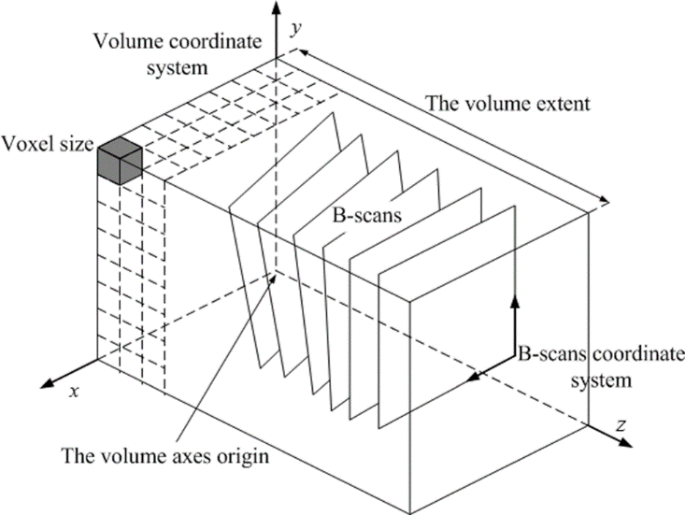
Motivation
During procedure, reference image differs from current anatomy due to deformations and organ movement
Robotic ultrasound provides superior dexterity relative to hand-held ultrasound and allows 3D reconstruction

Slide 5
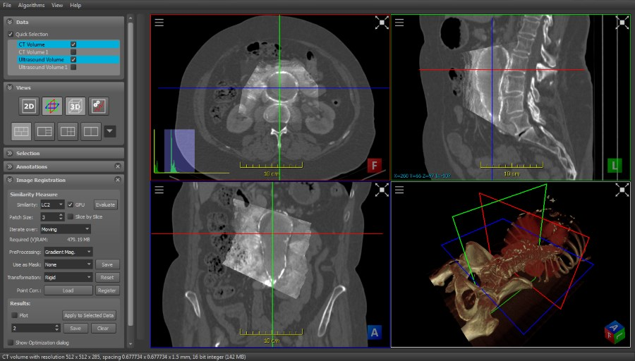
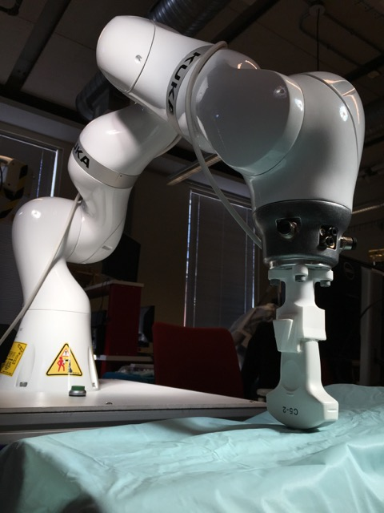
Project Goal
ImFusion plugin that uses visual servo control of KUKA robot to move ultrasound probe to volume of interest

Slide 6
System Setup
User interface
Select volume of interest
Workstation
Visual servo control of robot
KUKA robot
Movement of ultrasound probe and current position
Ultrasound probe
Acquire ultrasound image
Ultrasound phantom
Experimental testing and validation

Slide 7
Image Analysis (ImFusion)
A
A$≅$T(B)
Volume of interest
Similarity measure
Optimizer
B_{i}
“Tracked” ultrasound slices
B
$$T=\left[\begin{matrix}R & t \\ 0 & 1\end{matrix}\right]$$
T(B)
3D ultrasound image compounding
Interpolator
Transform
Robot communication (ROS and KUKA Sunrise)
Ultrasound probe
ROS core
ImFusion ROS node
no
Is |T| small?
Move KUKA
yes
KUKA Robot
Sunrise.Connectivity
Sunrise.Connectivity ROS node
END

Slide 8
Current progress – ROS
ROS acts as middleware that decouples software components and enables message passing between processes
ROS consists of master coordination node and publisher/subscriber nodes that post and receive messages
ROS core
Publisher: “Hello World”
Subscriber: I heard “Hello World”

Slide 9
Current progress – ROS
Need ROS to be compatible with ImFusion SDK, but Windows support for ROS is currently experimental
Compile ROS and its dependencies from source using WinRos

Slide 10
Current progress – ROS
A standard way is needed of communicating transformations
Use Pose message which consists of a 3D point and a quaternion

Slide 11
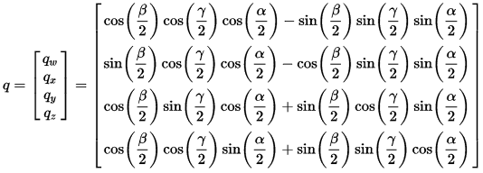
Current progress – ROS
3D rotation matrix can be represented as a unit quaternion
$$β=rotation around X axis$$
$$γ=rotation around Y axis$$
$$α=rotation around Z axis$$

Slide 12
Current progress – ROS
Currently working on ROS plugin for ImFusion
Collaborate with other students who are creating a ROS node for KUKA Sunrise which will accept a Pose message
ROS core
ImFusion ROS node
KUKA Sunrise

Slide 13
Deliverables
Minimum
ImFusion plugin for communication between ImFusion and KUKA robot
ImFusion plugin for automated registration of ultrasound volume with volume of interest to obtain transformation
Ultrasound probe
Transformation
ImFusion ROS node
ROS core
KUKA Sunrise
KUKA robot
Volume of interest

Slide 14
Deliverables
Expected
Given an initial location adjacent to phantom and volume of interest, move robotic ultrasound probe to location of volume of interest
Perform validation of path planning on different ultrasound phantoms
Evaluate performance of different registration techniques
Provide documentation of completed portions
Ultrasound probe
Transformation
Motion planning
ImFusion ROS node
ROS core
KUKA Sunrise
KUKA robot
Volume of interest

Slide 15
Deliverables
Maximum
Integrate Kinect sensor with visual servoing system
Given the volume of interest and initial location away from phantom, move robotic ultrasound probe to location of volume of interest
Kinect sensor
Ultrasound probe
Transformation
Motion planning
ImFusion ROS node
ROS core
KUKA Sunrise
KUKA robot
Volume of interest

Slide 16
Original timeline
Notes | Feb 13 | Feb 20 | Feb 27 | Mar 6 | Mar 13 | Mar 20 | Mar 27 | Apr 3 | Apr 10 | Apr 17 | Apr 24 | May 1 | May 8
Learn ROS
Make first ROS node
Set up ImFusion
Perform literature review
First control of robot from ImFusion
ImFusion plugin for robot control
First image transformation
ImFusion plugin for image transformation
First ultrasound image acquisition
System-level integration of modules
Obtain correct ultrasound volume given volume of interest and location adjacent to ultrasound phantom
System testing and validation
Integrate existing modules with Kinect sensor plugin
Obtain correct ultrasound volume given only volume of interest

Slide 17
Revised timeline
Notes | Feb 13 | Feb 20 | Feb 27 | Mar 6 | Mar 13 | Mar 20 | Mar 27 | Apr 3 | Apr 10 | Apr 17 | Apr 24 | May 1 | May 8
Learn ROS
Make first ROS node
Set up ImFusion
Perform literature review
First control of robot from ImFusion
ImFusion plugin for basic robot control
First image transformation
ImFusion plugin for image transformation
First ultrasound probe acquisition
System-level integration of modules
Obtain correct ultrasound volume given volume of interest and location adjacent to ultrasound phantom
System testing and validation
Integrate existing modules with Kinect sensor plugin
Obtain correct ultrasound volume given only volume of interest

Slide 18
Dependencies
Resolved
Ability to meet mentors
Workstation with ImFusion and KUKA robot
Ultrasound probe and phantoms
Kinect sensor
Additional
Collaborate with other students to create ROS node for KUKA Sunrise

Slide 19
Reading list
Abolmaesumi P, Salcudean SE, Zhu WH. Visual servoing for robot-assisted diagnostic ultrasound. Proc 22nd Annu Int Conf IEEE Eng Med Biol Soc (Cat No00CH37143). 2000;4:2532-2535. doi:10.1109/IEMBS.2000.901348.
Abolmaesumi P, Salcudean S, Sirouspour MR, DiMaio SP. Image-guided control of a robot for medical ultrasound. IEEE Trans Robot Autom. 2002;18(1):11-23. doi:10.1109/70.988970.
Bischoff R, Kurth J, Schreiber G, et al. The KUKA-DLR Lightweight Robot arm – a new reference platform for robotics research and manufacturing. In: Joint 41th Internatiional Symposium on Robotics and 6th German Conference on Robotics.; 2010:741-748.
Chaumette F, Hutchinson S. Visual Servo Control. IEEE Robot Autom Mag. 2007;1(March):109-118.
Chatelain P, Krupa A, Navab N. Optimization of ultrasound image quality via visual servoing. 2015.
Choset H. Principles of Robot Motion: Theory, Algorithms, and Implementation. (Choset HM, ed.). MIT Press; 2005:603. Available at: http://books.google.com/books?id=S3biKR21i-QC&pgis=1. Accessed October 27, 2014.

Slide 20
Reading list
Conti F, Park J, Khatib O. Interface Design and Control Strategies for a Robot Assisted Ultrasonic Examination System. Khatib O, Kumar V, Sukhatme G, eds. Exp Robot. 2014;79:97-113. doi:10.1007/978-3-642-28572-1.
Fuerst B, Hennersperger C, Navab N. DRAFT : Towards MRI-Based Autonomous Robotic US Acquisition : A First Feasibility Study.
Gardiazabal J, Esposito M, Matthies P, et al. Towards Personalized Interventional SPECT-CT Imaging. In: Golland P, Hata N, Barillot C, Hornegger J, Howe R, eds. Medical Image Computing and Computer-Assisted Intervention – MICCAI 2014.Vol 8673. Lecture Notes in Computer Science. Cham: Springer International Publishing; 2014:504-511. doi:10.1007/978-3-319-10404-1.
Janvier M-A, Durand L-G, Cardinal M-HR, et al. Performance evaluation of a medical robotic 3D-ultrasound imaging system. Med Image Anal. 2008;12(3):275-90. doi:10.1016/j.media.2007.10.006.
Krupa A. Automatic calibration of a robotized 3D ultrasound imaging system by visual servoing. In: IEEE International Conference on Robotics and Automation, 2006.Vol 2006.; 2006:4136-4141. doi:10.1109/ROBOT.2006.1642338.

Slide 21
Reading list
Nakadate R, Matsunaga Y, Solis J. Development of a robot assisted carotid blood flow measurement system. Mech Mach Theory. 2011;46(8):1066-1083. Available at: http://www.sciencedirect.com/science/article/pii/S0094114X11000607. Accessed August 25, 2014.
Schreiber G, Stemmer A, Bischoff R. The Fast Research Interface for the KUKA Lightweight Robot. In: IEEE Workshop on Innovative Robot Control Architectures for Demanding. ICRA; 2010:15-21.
Shepherd S, Buchstab A. KUKA Robots On-Site. McGee W, Ponce de Leon M, eds. Robot Fabr Archit Art Des 2014. 2014:373-380. doi:10.1007/978-3-319-04663-1.
Tauscher S, Tokuda J, Schreiber G, Neff T, Hata N, Ortmaier T. OpenIGTLink interface for state control and visualisation of a robot for image-guided therapy systems. Int J Comput Assist Radiol Surg. 2014. doi:10.1007/s11548-014-1081-1.

Slide 22
Thank You

