Slide 1
HMD-Based Navigation for Ventriculostomy - Checkpoint -
Group 15:
Mingyi Zheng
Yiwei Jiang
Mentor:
Ehsan Azimi
Prof. Peter Kazanzides

Slide 2
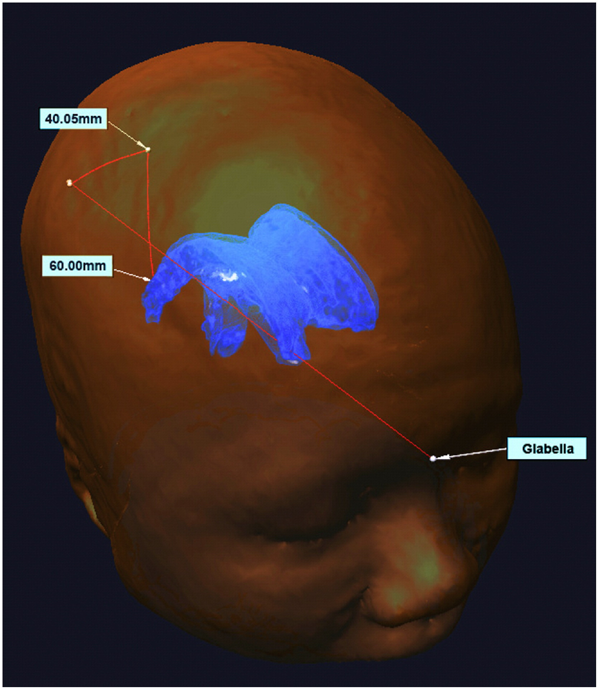
Project Goal
Catheter guide overlay(s)
The goal is to introduce image guidance via augmented reality on HoloLens
The image guidance is AR overlay of ventricle model from MRI image and catheter guide overlay.
Ventricle
Azimi, E., et al.: Can mixed-reality improve the training of medical procedures? In: IEEE Engineering in Medicine and Biology Conference (EMBC), pp. 112–116, July 2018

Slide 3
Technical Approach - Overview
MRI

Slide 4
Workflow and Software Design
PC
Translations and Eulerangles
from ZED to Markers
Preprocess of MRI images (If Applicable)
ZED_AR_Tracking.py
UDP_Sender.py
UDP Test, Camera Calibration
String
T_cam2tool
String
Without MRI Mode
With MRI Mode
MoveTip.cs
Unpack.cs
UDP_Communication.cs
Touch Anatomic Points
Touch Anatomic Points
T_cam2tool
T_cam2skull
P_tip_world
Overlay Two Spheres Representing Estimated Positions of Ventricle Center and Entry
Overlay Reconstructed Ventricle Model and Suggested Entry
DrawingManager.cs
Registration, Overlay
HoloLens
Notes:
Here are two flow charts showing the work flow of our navigation system and the communication between python and C# programs.
To begin with, the users are supposed to check the communication between holo and pc and perform the calibration process.
Then choose to enter either with MRI mode or without MRI mode depending on if MRI images have been pre-processed, in both cases, the user will touch three anatomic points (glabella and two temples) for registration, in without ct mode we Overlay two spheres representing Estimated positions of Ventricle center and Entry, while in with ct mode, we will overlay 3d reconstructed ventricle model and suggested entry on the skull phantom
We have a python program on PC , for AR marker tracking using ArUco package in OpenCV, it sends strings contain the markers transformation data with respected to ZED camera to HoloLens。
After received the string from pc, unpackUDP parse the string into transformation matrixs again, then sends them to Drawing Manager
Drawing Manager is the core script which has two main responsibilities.

Slide 5
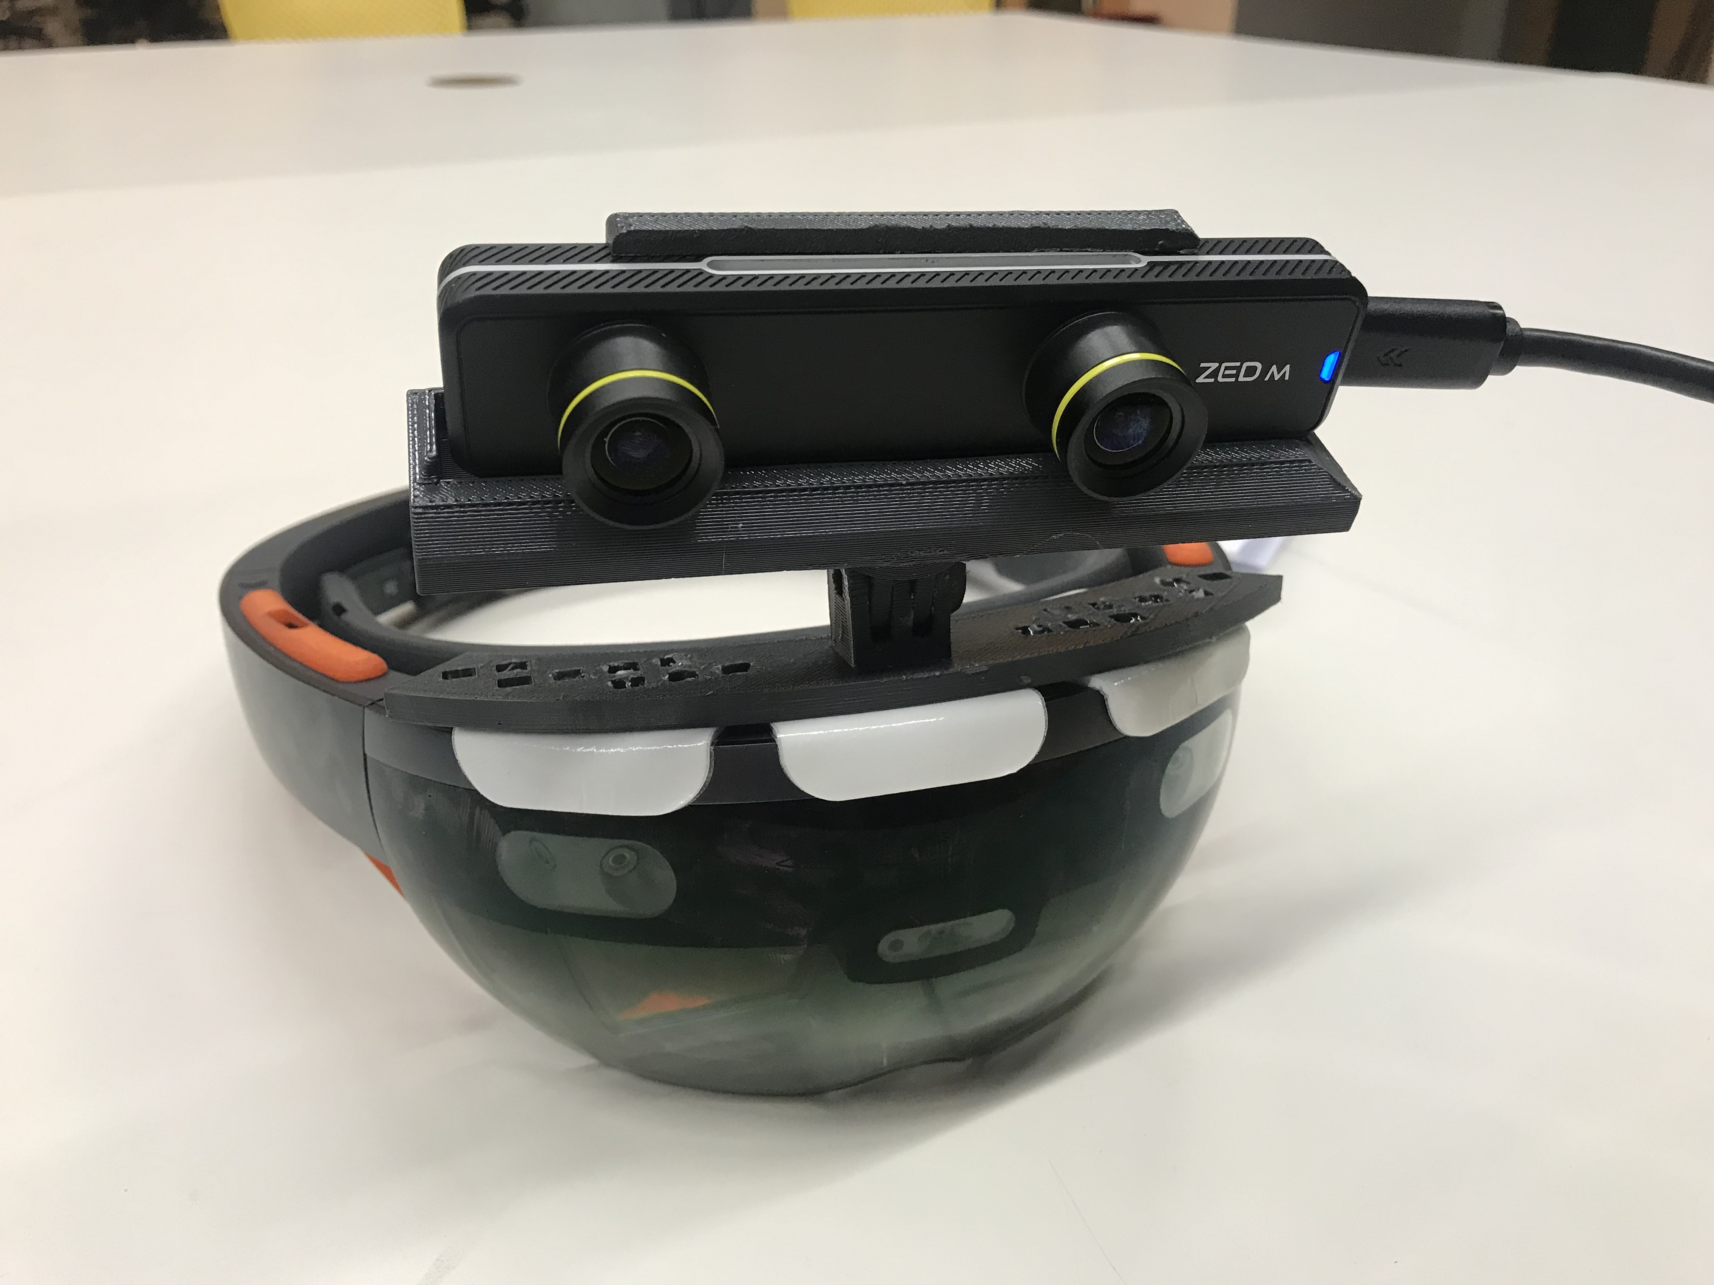
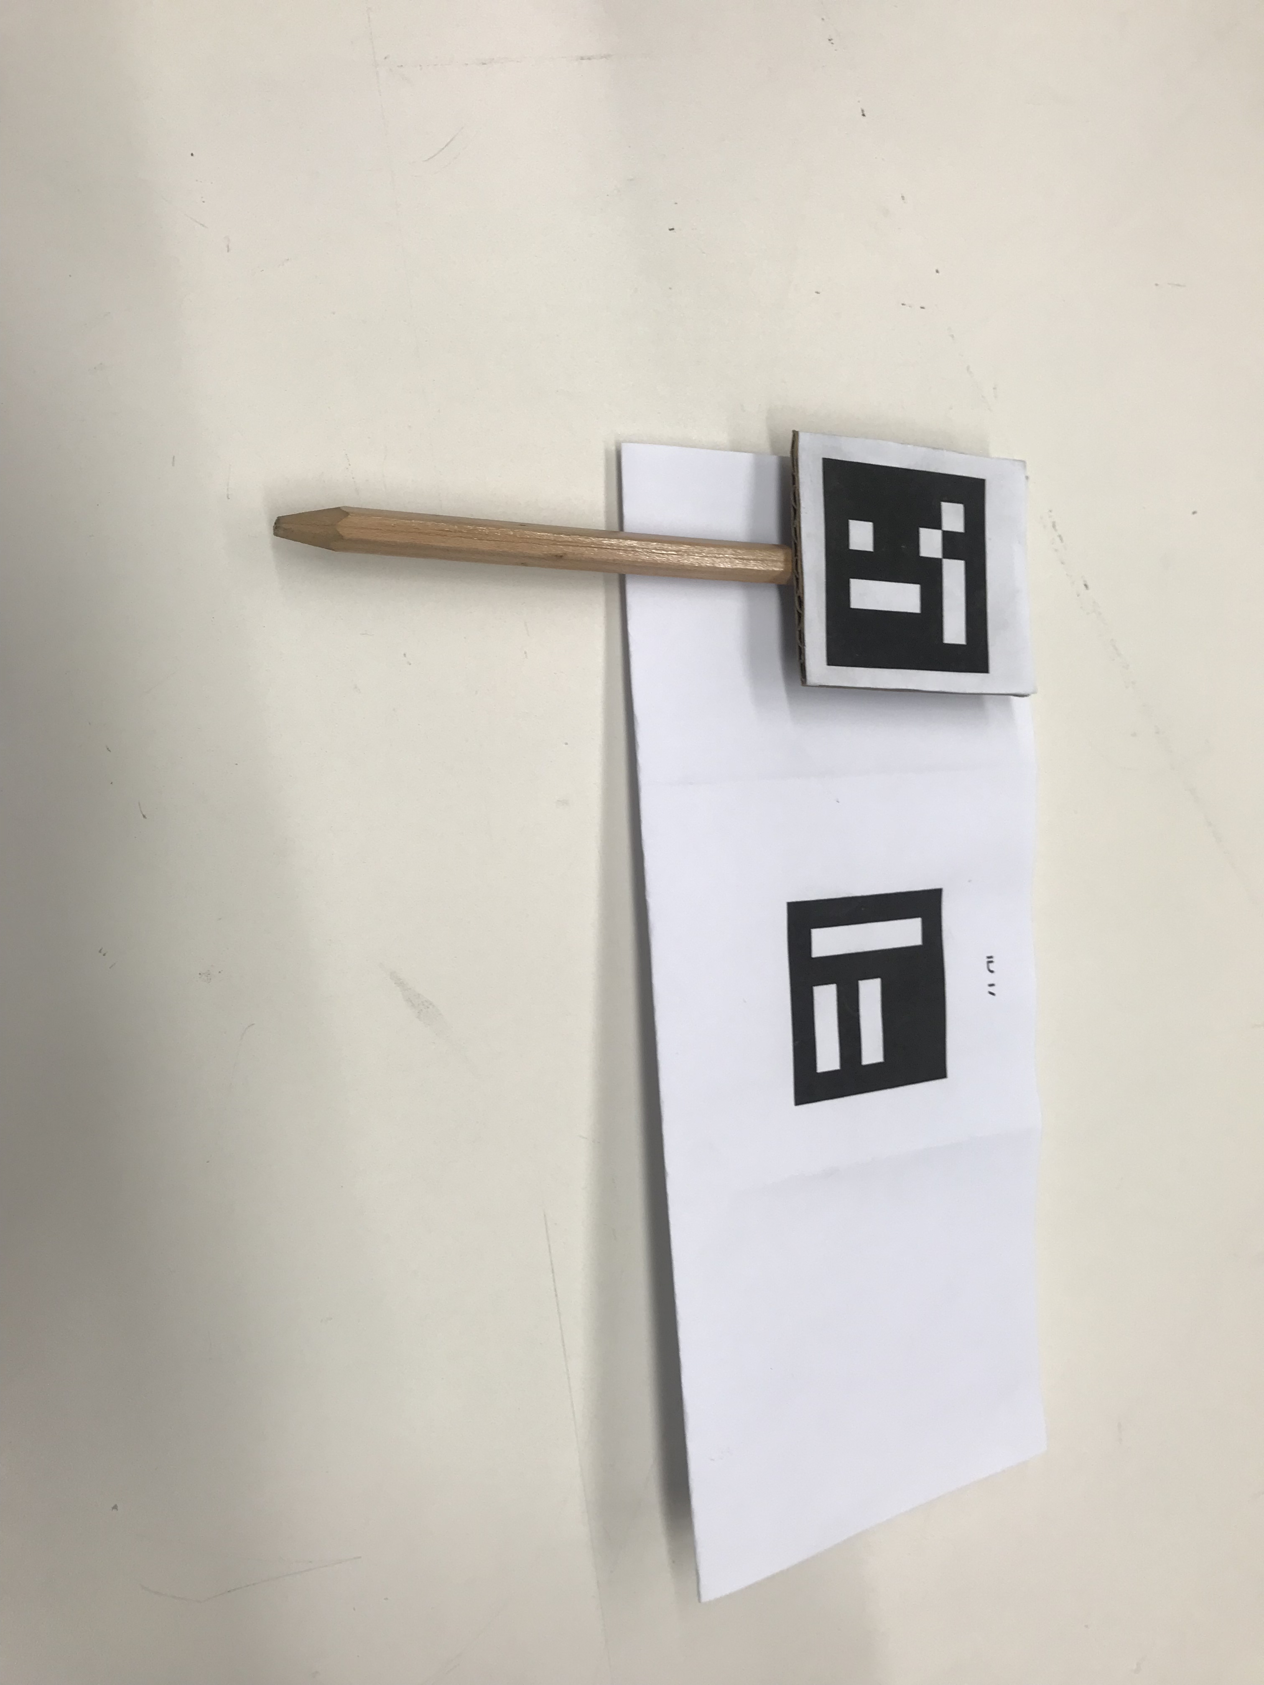
Technical Approach - Setup
ZED Mini
Pointing Tool
Connected to PC
Fixed to Skull Phantom
HoloLens
Notes:
We have a Microsoft HoloLens, and we have a ZED camera mounted to it. We have two ArUco markers, one is for locating the skull phantom, and another one is to locate the pointing tool, these markers are seen by ZED camera and

Slide 6
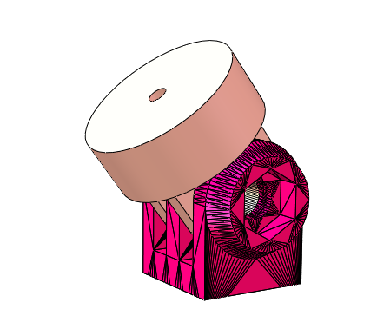
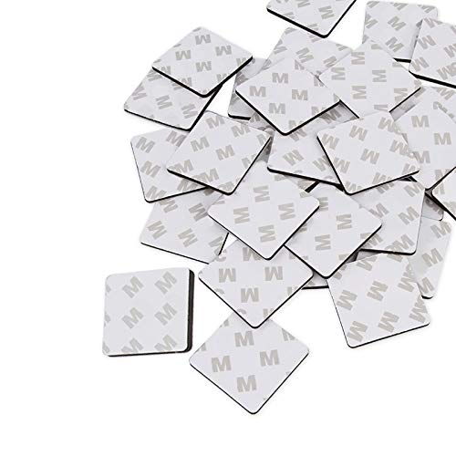
Technical Approach - CAD Design
Revolute Joint
Injecting Hot glue
Double-side Tape

Slide 7
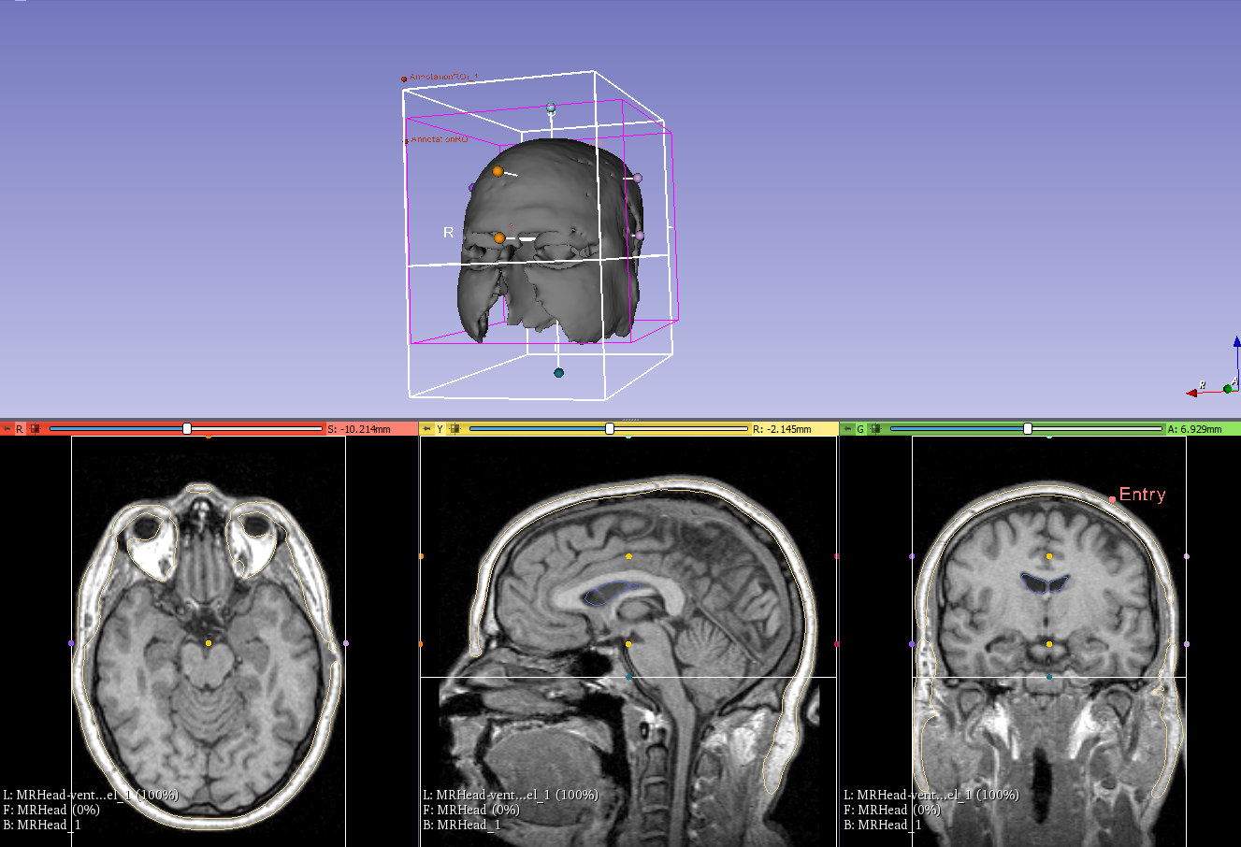
Technical Approach -Segmentation
Ventricle and Skull segmentation in 3D slicer
Thresholding
Select target object
Close holes
Smooth and mesh
Manually select anatomic point and entry point to get relative position

Slide 8
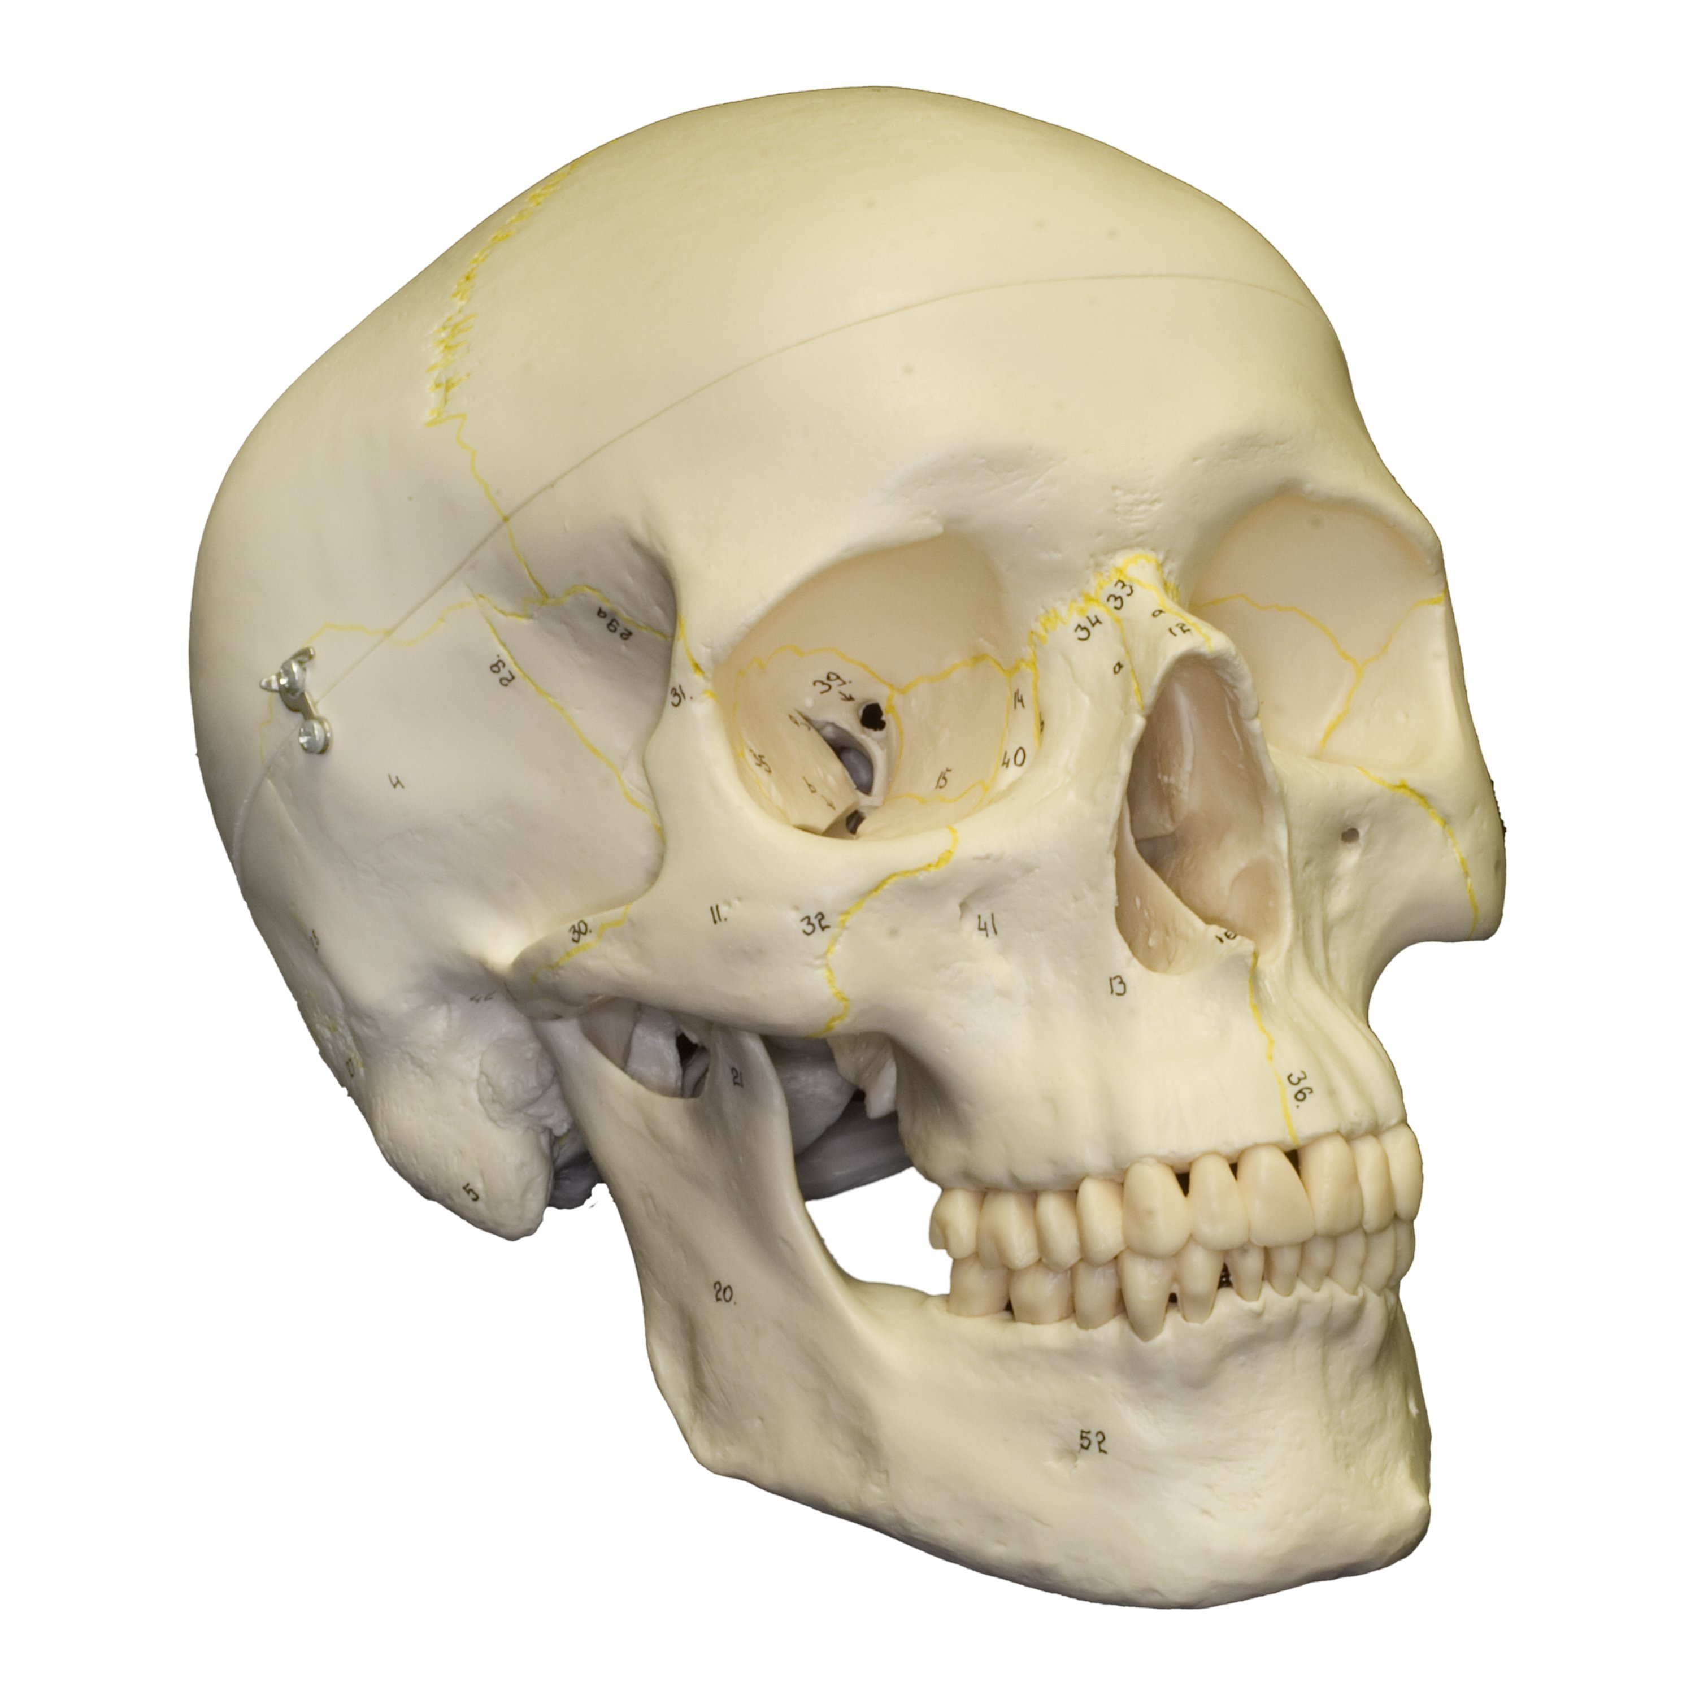
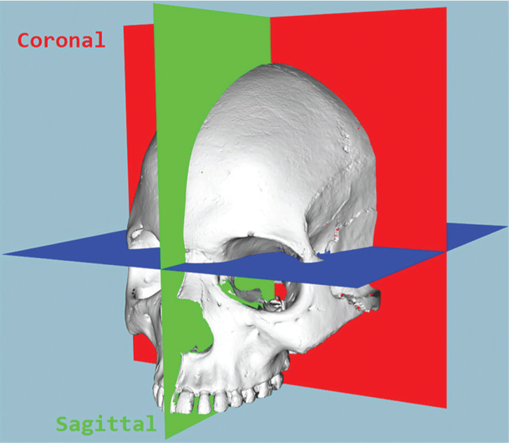
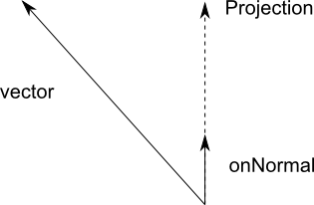
Technical Approach - Registration
Y’
O’
C
y
X’
B
V
A
Z’
x
O
z
CraMs: Craniometric Analysis Application Using 3D Skull Models
Vector3 Project(Vector3 vector, Vector3 onNormal);
Notes:
During this Registration process, the user will use a pointing tool to touch three anatomic points glabella and temples on both sides, once we have the coordinates of these three points in Unity World frame, we can have the right side anatomical frame reconstructed in unity.

Slide 9
Technical Approach - Overlay
Without MRI Mode
Overlay a 5cm sphere on the origin of the constructed frame;
Cast a ray from the origin, At a 45 degree angle to the x’o’y’ plane.
With MRI Mode
Overlay a 3D ventricle model on T_ventricleCenter_anatomical(x,y,z,R,P,Y) obtained from MRI;
Also overlay a 3cm sphere on P_entry_anatomical(x,y,z);
Cast a line from the center of ventricle to entry.
Video
Notes:
After registration, we need to overlay models
If we don’t have MRI information, a ground truth of where the ventricle, we will overlay a sphere at an estimated position, and cast a ray from it through out of the skull as a guidance.
If we know where the ventricle is in anatomical frame, and its pose, we can compute it position and pose in Unity world frame and overlay it on HMD

Slide 10
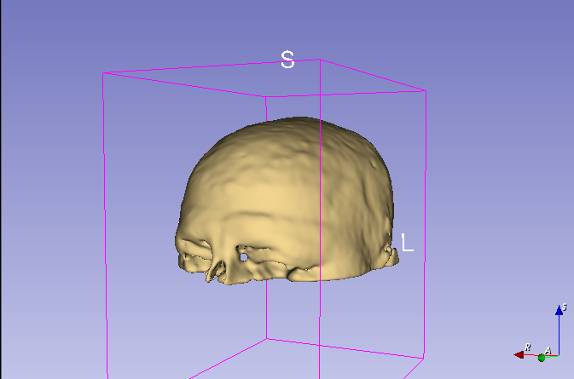
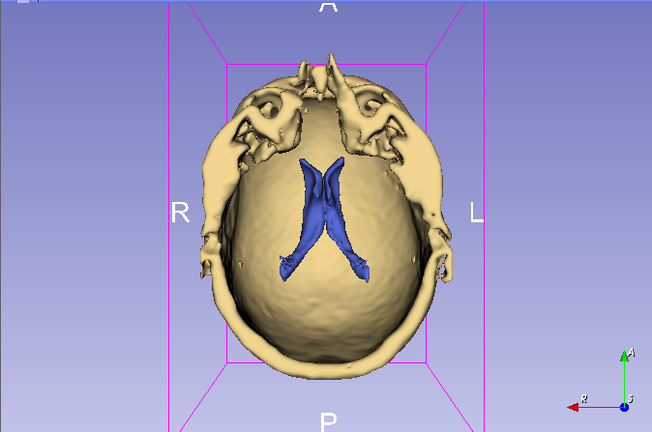
Technical Approach - Test
3D print top half part of segmented head
Print 2 parts, skull and ventricle
Skull
A hole for entry point for catheter insertion
Ventricle
A base with a post to connect ventricle
Test
User wear HoloLens to perform catheter insertion on the 3D-printed model 10 times, record the number of time that hit ventricle to evaluate success rate

Slide 11
Technical Approach -Catheter
RGB image to locate hand position as seed points with purple gloves
Mask the region around seed point with similar depth
Hough Transformation to find the catheter
Thresholding to get tip and scale lines
Calculate tip position and angle of catheter

Slide 12
Deliverables
Minimum
Documentation and Code for Navigation System 1.0 includes:
Anatomic points registration by AR Marker Anatomic points registration by tool with AR Marker in Zed mini camera
AR overlay system indicating ventricle centroid and catheter guidance based on anatomic points
Report of accuracy test Video to demonstrate
Video demo for the workflow with Navigation System 1.0
Expected
Documentation and code for Navigation System 2.0 includes:
User interface with workflow instruction and voice command
Camera system integrated to HoloLens
Semi-automatic Ventricle segmentation program on 3D slicer
Report of accuracy test Camera mount design
Video demo for the workflow with Navigation System 2.0
Maximum
Documentation and Code for Navigation System 3.0 includes:
fully-automatic ventricle segmentation program
Catheter tracking system with guidance of insertion error and insertion depth
3D-printed skull with ventricle for performance test
Report of performance test
Video demo for the workflow with Navigation System 3.0

Slide 13
Dependencies
Dependency | Solution | Status
Access to SMARTS Lab | Need Prof. Kazanzides sign the form | Resolved
Software: Unity, ZED SDK, 3D Slicer, SOLIDWORKS, OpenCV | Download from official websites | Resolved
Microsoft HoloLens | Ehsan will share his HoloLens with us | Resolved
ZED Camera | Order from Internet | Resolved
ArUco Markers | Generate online and Print | Resolved
MRI Images | Get from Internet | Resolved
Prior Work Code | Get from Ehsan and Long | Resolved
3D Printer | Contact Long, use LCSR 3D Printer | Resolved
Skull Model | Get from SMARTS Lab | Due Mar. 12
Catheter | Use one in SMARTS Lab | Resolved

Slide 14
Schedule
 | Feb.19 | Feb.26 | Mar.5 | Mar.12 | Mar.19 | Mar.26 | Apr. 2 | Apr. 9 | Apr.16 | Apr.23 | Apr.30 | May.7
Get familiar with Unity, ARToolKit
finger Tracking ZED AR Tracking
Depoly Application to HoloLens
Navigation system 1.0 without MRI
Global camera setup Zed mini Camera Mount Design
Evaluate Accuracy Zed mini Camera Calibration
Skull and Ventricle segmentation with anatomic points
Navigation system 2.0 without MRI
Navigation system 3.0 with Catheter Tracking
Documentation
Evaluation of performance with skull phantom
Final Presentation and Report

Slide 15
Setbacks and Difficulties Solutions
Problem with deployment
ZED SDK, CUDA installation
Unity Version
Hardware
Accuracy
Latency
Notes:
Setbacks,
First of all, our project is mainly to develop a hololens app. However, in the first month, we keep having an error that doesn’t allow us to deploy any app to hololens, the only solution is reset HoloLens, since ehsan is sharing his hololens with us, he refused to let us reset ithowever, our mentor Ehsan reset it and he could deploy his app to hololens after reset and give it to me, but I still having that error, and he had that error too, at the third time, ehsan reset hololens and didn’t deploy any app to it and give it to me, finally I can use my pc to deploy app to hololens. It looks like our HoloLens can only accept one PC after each reset, it you try to deploy any apps from a different pc, it will break down.
Also we spend very long time on installation of ZED SDK because every time if the installation is not successful, my laptop broke down
And the prior code such as UDP communication and Calibration are implemented in an older version of unity, and they are somewhat not compatible now I have three versions of untiy on my laptop.
Their paper shows that Accuracy is up to 4mm， just one links, the surgeons want a target accuracy within 3mm,

Slide 16
Milestones
Milestones | Date
Segmentation and 3D reconstruction of Skull and Ventricle | 3/5 ✔
Deploy Application to HoloLens | 3/23 ✔
Navigation System Without-MRI Mode | 4/5 ✔
Navigation System With-MRI Mode | 4/10 ✔
ZED Camera Calibration | 4/13 ✔
Catheter Tracking | 5/3
Evaluation of Performance with Skull Phantom | 5/6
Final Report and Poster | 5/9
Feb 12
Implemented， but needed to be optimized
2019
2019
Mar 5
Apr 8
Need Tuning
May 2

Slide 17
Management Plan
 | Member Responsibility
Mingyi | Segmentation and Reconstruction Camera Mount Design， Skull Phantom Design Catheter Tracking Accuracy Evaluation
Yiwei | AR Tracking Unity Implementation, AR Overlay Registration Camera Setup, Communication, Calibration Accuracy Evaluation
Weekly Meetings with mentors
Wednesdays 3 pm
Team Meeting
Twice a week (Monday and Friday)
Code
GitHub repository
Documentation, Data and Reports
JH Box
Course Wiki page

Slide 18
Reading List
Azimi, E., Doswell, J., Kazanzides, P.: Augmented reality goggles with an inte- grated tracking system for navigation in neurosurgery. In: Virtual Reality Short Papers and Posters (VRW), pp. 123–124. IEEE (2012)
Azimi, E., et al.: Can mixed-reality improve the training of medical procedures? In: IEEE Engineering in Medicine and Biology Conference (EMBC), pp. 112–116, July 2018
Sadda, P., Azimi, E., Jallo, G., Doswell, J., Kazanzides, P.: Surgical navigation with a head-mounted tracking system and display. Stud. Health Technol. Inform. 184, 363–369 (2012)
Chen, L., Day, T., Tang, W., John, N.W.: Recent developments and future chal- lenges in medical mixed reality. In: IEEE International Symposium on Mixed and Augmented Reality (ISMAR), pp. 123–135 (2017)
Qian, L., Azimi, E., Kazanzides, P., Navab, N.: Comprehensive tracker based dis- play calibration for holographic optical see-through head-mounted display. arXiv preprint arXiv:1703.05834 (2017)
Saucer, F., Khamene, A., Bascle, B., Rubino, G.J.: A head-mounted display system for augmented reality image guidance: towards clinical evaluation for imri-guided nuerosurgery. In: Niessen, W.J., Viergever, M.A. (eds.) MICCAI 2001. LNCS, vol. 2208, pp. 707–716. Springer, Heidelberg (2001).
Azimi, Ehsan, et al.: Interactive Training and Operation Ecosystem for Surgical Tasks in Mixed Reality. OR 2.0 Context-Aware Operating Theaters, Computer Assisted Robotic Endoscopy, Clinical Image-Based Procedures, and Skin Image Analysis. Springer, Cham, 20-29.(2018).

Slide 19
Thank You! Any Questions?

