Slide 1
Project 9 Data Integration During Robotic Ultrasound-Guided Surgery
Team Members
Vineeta Khatuja, Andrew Wang, Tifany Yung
Mentors
Michael Choti MD MBA, Colin Lea, Theodoros Katsichtis, Russell Taylor PhD

Slide 2
Overview
Project summary
Deliverables
Progress
Milestones
Dependencies

Slide 3
Laparoscopic Ultrasound
minimally invasive procedure in abdominal cavity
augment with ultrasound probe
Applications
Biopsy, ablation
Liver and kidney scanning and staging
Lesion detection
European Eurology, http://www.eurohifu.com/sona600i.htm
Notes:
Laparoscopies are minimally invasive procedures in the abdominal cavity which use only a few small incisions as opposed to one large one in an open surgery. These laparoscopies can be augmented with ultrasonography which provides real-time imaging to update the preoperative data.

Slide 4
Advantages
provides real-time imaging
enhances perception
improve manipulability
minimally invasive procedures
C.M. Schneider '10
Notes:
Ultrasonography enhances the surgeon's perception beyond the stereo cameras which are limited to exposed cavities. This way, the surgeon will be better able to maneuver through soft tissue and locate points of interest from the preoperative data.

Slide 5
We propose the development and utilization of a novel Da Vinci interface, integrating and displaying live intraoperative ultrasound as well as additional preoperative data to improve the ergonomy and efficacy of robotic procedures.

Slide 6
Block diagram

Slide 7
Deliverables (minimum)
1. Acquire software dependencies, Mock OR access. – Complete.
2.Ultrasound images save and browse on console. – Complete.
3. Preliminary nonclincial study design in mock OR. – Complete.
4. Preoperative image viewer. - Complete.
5. Masters as Mice implementation. - Complete.
6. Maximize/minimize/zoom in windows for easier viewing. – Reprioritized, surgeon feedback required to determine if necessary.

Slide 8
Deliverables (expected)
1. Clinical study design. - Complete.
2. Contact surgical collaborators for clinical study. – In progress: with Dr. Choti.
3. Have participating surgeons scheduled and confirmed. – Not expected: IRB required, but several surgeons have already expressed interest in participation.
4. Perform test and deployment of software in the mock OR. – Complete.
5. Changes to software after nonclinical testing. – In progress.

Slide 9
Deliverables (maximum)
1. Complete clinical study of software at the hospital with actual surgeons and patients. – Not expected.
2. Features/changes requested from clinical tests. – Not expected.
3. Tool to measure lesion size on the ultrasound image. – Not expected.
4. Use 3D fiducials to show previously viewed areas. – Not expected.
5. Build 3D model of anatomical structures from CT. – Not expected.
6. Provide flexible view manipulation of 3D models. – Not expected.

Slide 10
Progress (clinical)
IRB approved.
Formula created to mimic physiological properties of lesions (agarose/glycerol).
Gelatin phantom cast, deployed in mock OR.
Software taken to the mock OR and tested on da Vinci and ultrasound setup.
Notes:
Masters as Mice controls mouse even while clutch not held (while surgeon is moving tools).
Tabs to be implemented with click, not mouse-over, so current ultrasound not lost if accidentally slip over a tab.

Slide 11
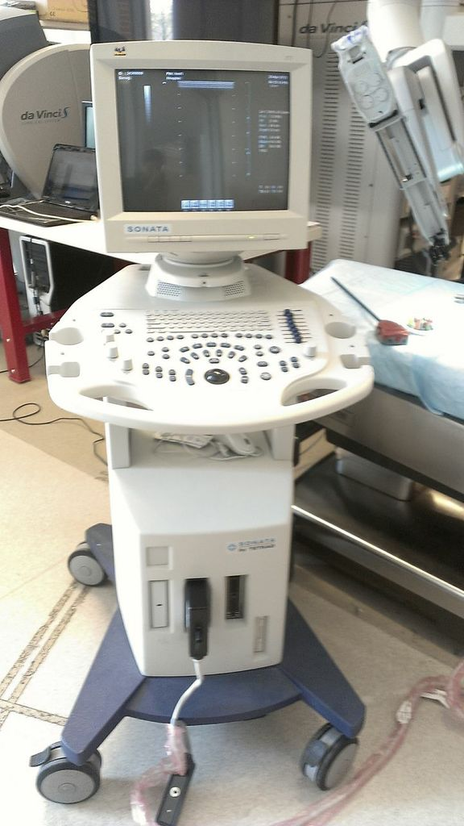
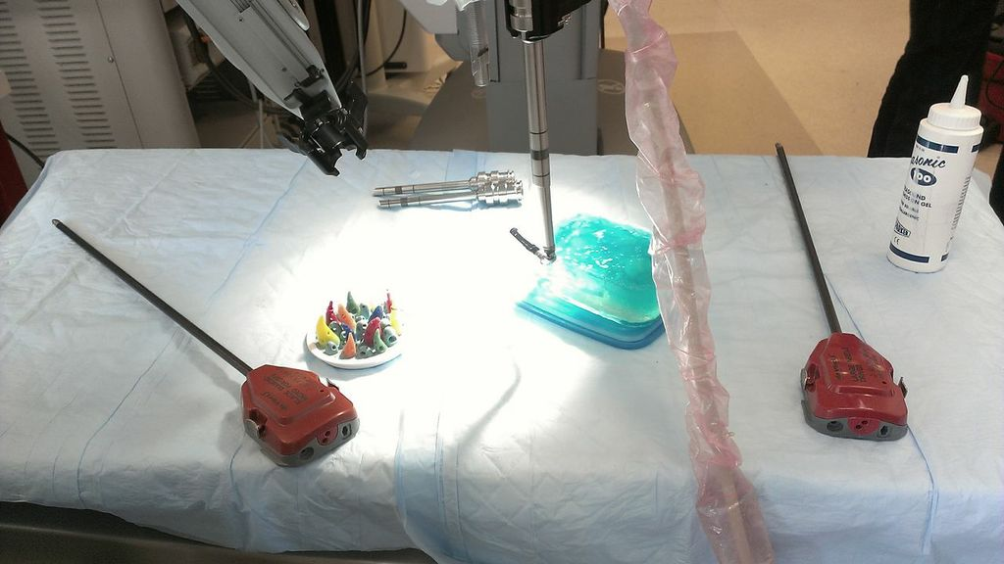
Progress (clinical)

Slide 12
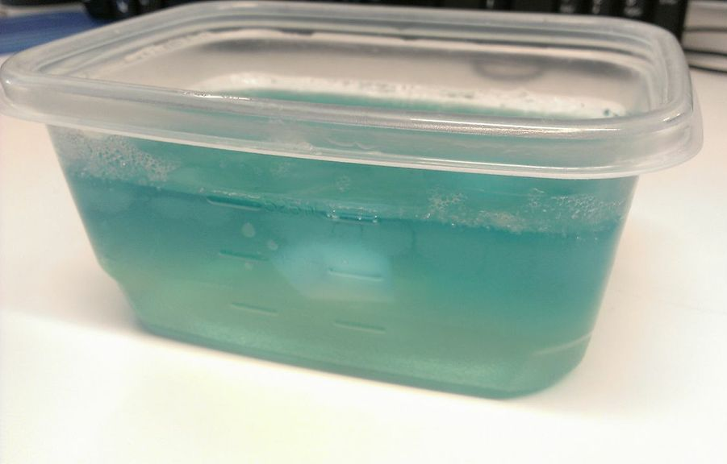
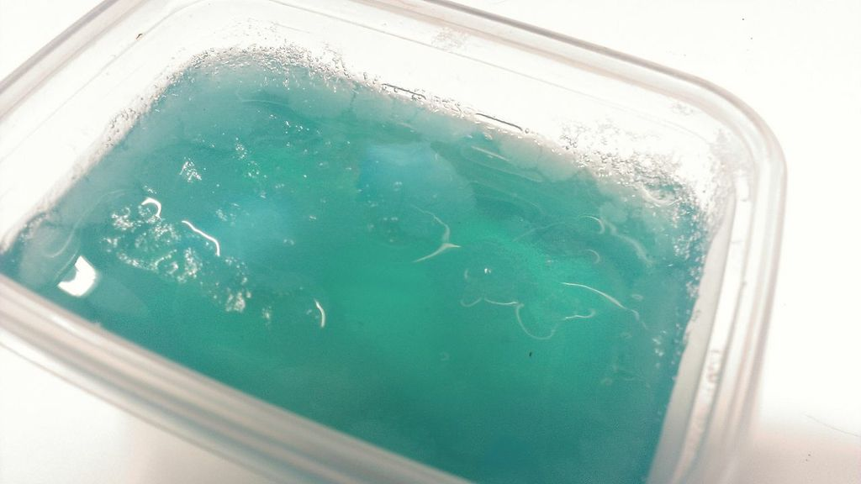
Progress (clinical)

Slide 13
Progress (software)
OLD Interface
Notes:
10 16

Slide 14
Progress (software)
`
In Progress

Slide 15
Progress (software)

Slide 16
Progress (software)
http://www.youtube.com/watch?v=sDhxqwwBTvA&feature=youtu.be

Slide 17
Progress (software)
Masters as Mice(MAM) implemented.
-Trigger the MAM mode left
Black background helps images stand out more.
Widgets re-arranged to make use of most whitespace.

Slide 18
DR. CHOTI’s Feedback
* Annotate (add text) to the saved US images from the Laptop intraoperatively. * Make the CT images bigger * Increase the size of the US image viewer

Slide 19
Dependencies (Software)
Software Environment Set Up.
Install the video grabber. – Resolved.
QT Creator IDE. – Resolved.
CISST – Resolved.
Intuitive API. – Resolved.
LapUS code. – Removed/resolved.

Slide 20
Dependencies (Clinical)
Possible IRB proposal already written by Theodore and Dr. Choti. – Resolved.
Gelatin liver phantom. – Resolved (cast and contains imitation lesions).
Surgical/clinical collaborators. – In progress.
Mock OR and Da Vinci robot access. – Resolved.

Slide 21
Milestones
 |  | February |  | March |  |  |  |  | April |  |  |  | May
 |  | 15 | 22 | 1 | 8 | 15 | 22 | 29 | 5 | 12 | 19 | 26 | 3
Minimum Software Deliverables
Software dependencies, mock OR access. | Everyone |  |  |  |  |  |  | ✓
Operative field measurement tool. | Vineeta |  |  |  |  |  |  | ✓
Save and browse US images on console. | Vineeta |  |  |  |  |  |  | ✓
Implement Masters as Mice | Vineeta
Window Manipulation | Vineeta
Minimum Clinical Deliverables
Preliminary clinical study design. | Andrew, Tifany |  | ✓
Contact surgical collaborators for clinical study. | Andrew, Tifany |  |  |  |  |  | ✓
Schedule and confirm participating surgeons. | Andrew, Tifany
Testing of baseline interface. | Andrew, Tifany |  |  |  |  |  |  |  |  |  |  | ✓
Clinical study design for enhanced interface. | Andrew, Tifany |  |  |  |  |  |  |  |  |  | ✓
Testing of enhanced interface. | Andrew, Tifany
Maximum Software Deliverables
Real-time measurement of tool for US images. | Vineeta
Manipulate a 3D model of a lesion or organ. | Everyone
Implement placeable virtual 3D fiducials. | Everyone

Slide 22
Reading List
Bartosz F. Kaczmarek, S. S., Firas Petros, Quoc-Dien Trinh, Navneet Mander, Roger Chen, Mani Menon, Craig G. Rogers (2012). “Robotic ultrasound probe for tumor identification in robotic partial nephrectomy: Initial series and outcomes.” International Journal of Urology.
Caitlin M. Schneider, B. P. D. P., MD; Russell H. Taylor, PhD; Gregory W. Dachs II, MS; Christopher J. Hasser, PhD; Simon P. DiMaio, PhD; Michael A. Choti, MD, MBA, FACS Surgical Technique: Robot-assisted laparoscopic ultrasonography for hepatic surgery.
Caitlin M. Schneider, G. W. D. I., Christopher J. Hasser, Michael A. Choti, Simon P. DiMaio, Russell H. Taylor Robot-Assisted Laparoscopic Ultrasound, Johns Hopkins University; Johns Hopkins Medicine; Intuitive Surgical, Inc.
Craig G. Rogers, M. R. L., MD; Akshay Bhandari, MD; Louis Spencer Krane, MD; Daniel Eun, MD; Manish N. Patel, MD; Ronald Boris, MD; Alok Shrivastava, MD; Mani Menon, MD (2009). “Maximizing Console Surgeon Independence during Robot-Assisted Renal Surgery by Using the Fourth Arm and TilePro.” Journal of Endourolgy 23(1): 115-121.
Francesco Volonté, N. C. B., François Pugin, Joël Spaltenstein, Boris Schiltz, Minoa Jung, Monika Hagen, Osman Ratib, Philippe Morel (2012). “Augmented reality to the rescue of the minimally invasive surgeon. The usefulness of the interposition of stereoscopic images in the Da Vinci robotic console.” The Internation Journal of Medical Robotics and Computer Assisted Surgery.
Joshua Leven, D. B., Rajesh Kumar, Gary Zhang, Steve Blumenkranz, Xiangtian (Donald) Dai, Mike Awad, Gregory D. Hager, Mike Marohn, Mike Choti, Chris Hasser, Russell H. Taylor DaVinci Canvas: A Telerobotic Surgical System with Integrated, Robot-Assisted, Laparoscopic Ultrasound Capability, The Johns Hopkins University; Intuitive Surgical, Inc.

Slide 23
Thank you!
Questions?

