Slide 1
Craniofacial Reconstruction with PMMA Customized Cranial Implants
Alex Mathews
Paper Presentation
Computer Integrated Surgery 2
Spring 2015

Slide 2
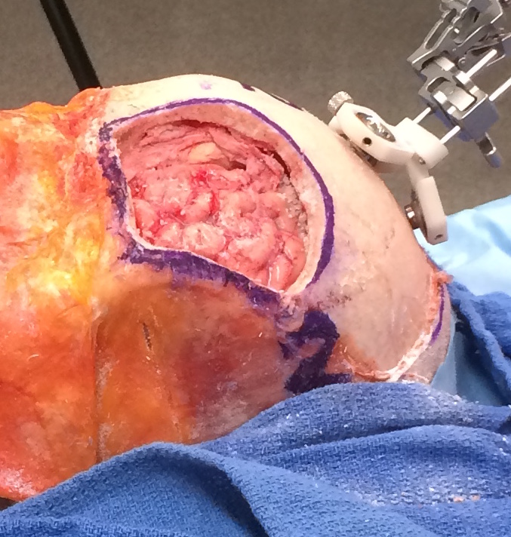
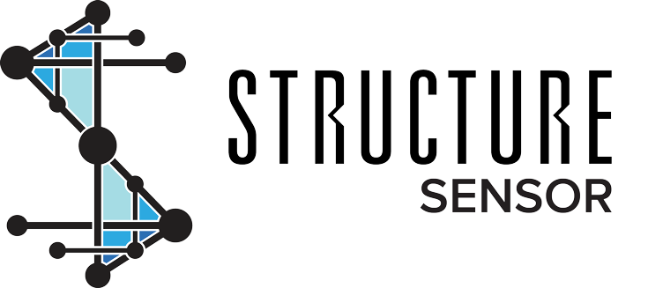
3D Scanning Cranioplasty Application
Implementing a 3D scanner to identify a defect interaoperatively during cranioplasty procedures
Mentors
Dr. Chad Gordon, D.O.
Dr. Mehran Armand
Dr. Ryan Murphy

Slide 3
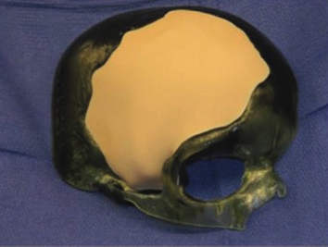
Paper Selection
Craniofacial Reconstruction with PolyMethyl-Methacrylate Customized Cranial Implants
Huang, Zhong, Susarla, Swanson, Huang, Gordon
Study at Johns Hopkins Medical Institute
Technology supported by Stryker
Abbreviations:
PMMA – Polymethylmethacrylate
CCI – Customized Cranial Implants
PTH – Persistent Temporal Hollowing
Notes:
PMMA - history
CCI – prefabricated implants usually designed and manufactured well before operation date
Temporal hollowing is a depression within the soft tissues overlying the temporal fossa, sometimes seen after surgical dissection for access to the facial skeleton

Slide 4
The Cranioplasty Procedure
The cranioplasty procedure is key to recovery from craniectomies
Craniectomy Indications:
Trauma
Tumor
Aneurysm
Custom Cranial Implants provide cerebral protection and correct deformities
Video from Neurosurgery Journal, ‪Reconstructive Pericranial-Onlay Cranioplasty (Gordon, et al 2014)
Notes:
Explain craniectomy
Explain cranioplasty using video
Specifically when the boneflap that was removed is contraindicated, and cannot be used to cover the hole
Implant design process using CAD technology and CT scans to determine optimal structure for cranial reconstruction, where symmetry is improtant
Important area is temporal region which is a key dterminant of gender identification

Slide 5
Sample Case
Video from Neurosurgery Journal, ‪Reconstructive Pericranial-Onlay Cranioplasty, (Gordon, et al 2014)
Notes:
To truly appreciate the importance of the cranioplasty procedure lets take a look at a real procedure
Reconstruction is important to public perception

Slide 6
Paper Background
This paper studies CCI’s made of PMMA
PMMA offers lower infection rates and better tissue adherence
Alternatives to PMMA CCI’s
Bone flap replacements
Liquid PMMA Molding
Polyetheretherketone (PEEK) CCI’s
Liquid PEEK Molding
Titanium Mesh
PMMA CCI’s are not well studied: exploration is required
Notes:
20 consecutive patients
2 year period

Slide 7
Problem, Experiment
Problem: Are PMMA CCI’s effective for cranial reconstruction?
Sample size: 20 patients at Johns Hopkins University Hospitals
Each patient underwent a CCI cranioplasty
Implants were designed by Stryker Cranio-maxillofacial using preoperative CT Scans
Defects were all larger than 5 cm²
Follow ups 4– 80 weeks after surgery
Notes:
Inclusion criteria :
unilateral boneflap loss
assymetric crania
no open scalp woulds
3 months after infection clear
Defects were larger than 5cm2

Slide 8
Key Results
Total Number of Patients | Number of Minor Complications | Number of Major Complications
20 | 1 | 2*
 | 4.5% | 9%
* Two cases of PTH; PTH is usually not considered a Major Complication
No incidences of post-operative infection, new-onset seizures, chronic pain, hematoma, seroma, scalp erosion, implant migration
0% incidence for 22 procedures
2 procedures were repeated due to PTH revisions
Notes:
Seroma – post surgical build up of fluid around procedure site
Hematoma – collection of blood around surgical site
Diplopia – double vision
Skin
Connective tissue
Aponeurosis
Loose areolar connective tissue
pericranium
Persistent temporal hollowing
Patients were dissatisfied
Required revision of the original CCI design
“our team believes that PTH his a complication and when severe shoould be classified as major since some require revision surgery.”
PTH can cause distress and clearly denotes previous neurosurgery to the public

Slide 9
Significance of Results
Implant Type | N | Complications (%) | Implant Revisions (%) | Infection (%) | Notes
PEEK (Rosenthal, ‘14) | 63 | 12.7 | 9.5 | 7.9 | 3 cases of Hematomas, Frequent incidence of PTH
PMMA (CCI) (Jaberi, ‘13) | 78 | 24 | 8 | 13 | 14 patients suffering from Chronic Pain 10 Hematomas, 1 Implant Extrusion
PMMA + non-PMMA (Stephens, ‘10) | 108 | 24 | N/A | 12 | 7 new incidences of seizure, 7 Hematoma, 1 Death
PMMA + non-PMMA (Lee, ’14) | 243 | 25.9 | 6 | 9 | 15 new incidences of seizure, 2 Hemorrhage
PMMA (CCI) (Huang, ‘14) | 20 | 9 | 5 | N/A | 2 Incidences of PTH
Notes:
Even when including PTH the study had significantly lower complication rates than other methods

Slide 10
Significance of Results
Material | Benefits | Disadvantages
Liquid PMMA | Nonabsorbable, Inert, Radiolucent, Easily Moldable | Exothermic Reaction upon molding, intraoperative preparation, requires artistic skill, toxic fumes
Titanium Mesh | Combined well with cement, low infection risk | Implant extrusion risk, difficult to shape, cannot be used with poor skin viability
Solid PEEK CCI | Inert, Pliable, Mechanically sound | Requires in-house sterilization, smooth surface
Solid PMMA CCI | No intraoperative preparation, easy to contour, no exothermic reaction, delivered sterile, textured surface | Limited Experience
Notes:
Liquid PMMA’s most significant disadvantage is the exothermic reaction upon setting, which can cause damage to cells around the surgical site
Peek’s smooth surface can cause increased sermoas

Slide 11
Personal Assessment
Determined the benefits of PMMA CCI’s over other methods
Implications for facial reconstruction
PMMA CCI’s offer significant advantages
Limitations
Small sample size
Only one surgical team
Only one method for cranioplasty was used, with very specific patient criteria
Did not take into account the added time/costs of preoperative design
Notes:
Small sample size – hard to say whether or not the good numbers were luck
Could have just been one really great hopkins surgical team
Only used one methodoogy for plasty -> made up for this by comparing to prior papers

Slide 12
Project Implications
Validation of the technology being improved
Clear need for PMMA CCI’s
Point out anesthesia time
Partially due to Pericranial Onlay technique
Mainly comes from intraoperative modification of implant
Imaging and projection guidance has the opportunity to significantly reduce surgical time
Initial tests show reduction to minutes rather than an hour
Anesthesia Time:
260 ± 54
minutes

Slide 13
Conclusions
The significance of Polymethylmethacrylate Customized Cranial Implants
Improved health outcomes
Better quality of life
Comparison to other forms of cranioplasty
Clear need for reduction in surgical times

Slide 14
Craniofacial Reconstruction with PMMA Customized Cranial Implants
Alex Mathews

