Slide 1
Force Feedback of Dual Force-sensing Instrument for Retinal Microsurgery Paper Seminar
Group 8 - Can Wang
Woo Yang, Seo-Im Hong
Xingchi He, Dr. Iulian Iordachita, Dr. Russell Taylor

Slide 2
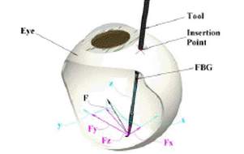
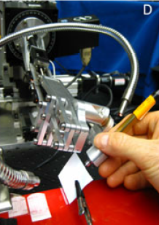
Project Summary
Simulate a typical procedure in retinal microsurgery, epiretinal membrane (ERM) peeling, with JHU Steady Hand Eye Robot & eye phantom
Use fiber Bragg grating (FBG) micro force sensor to sense micro forces on the tip & sclera
Develop & test multiple force feedback methods to find an optimal mode
(Analyze operation time, mean and variance in forces, surgeon feedback, etc)

Slide 3
Paper Selection
“Micro-force sensing in robot assisted membrane peeling for vitreoretinal surgery,”
M. Balicki, A. Uneri, I. Iordachita, J. Handa, P. Gehlbach, and R. Taylor,
International Conference on Medical Image Computing and Computer-Assisted Intervention, pp. 303–310, 2010.
Similar experimental setup (Eye Robot + FBG force sensor)
Similar surgical procedure (membrane peeling)
Discussed multiple robot control feedback modes
Investigated the effect of additional auditory feedback
Reason

Slide 4
Motive
Traditional approach to retinal microsurgery:
Manipulate a (peeling) instrument at very low velocity (0.1-0.5mm/s) without robot aid
Visually monitor the local surface deformation that may indicate undesirable forces
Retract tool and use an alternative approach in case of undesirable forces
What’s wrong?
Requires very precise visuomotor reflexes
Extremely difficult to master due to near imperceptible visual cues
Hand tremor, fatigue contributes to unstable manipulation
Relatively easy to dramatically increase undesirable forces
Risks of retinal hemorrhage and tearing, furthermore irreversible damage that results in vision loss

Slide 5
Robotic Assistant – Steady Hand Eye Robot
Remote center-of-motion mechanism (RCM)
improves the general stability of the system by reducing range of motion and velocities in the Cartesian stages
5-DOF robot control system with 6-DOF force/torque sensor mounted at the tool holder
senses forces exerted by the surgeon on the tool, for use as command inputs to the robot
Provide steady-hand motion
by inherently filtering physiological hand tremor and low-frequency drift
Integrated fiber Bragg grating (FBG) sensors
optical sensors capable of detecting changes in strain, without interference from electrostatic, EM or RF sources
3 optical fibers placed along the tool shaft
Calculate force by measuring the bending of the tool
Resolution: 0.25 mN (Good for measuring forces from 0-10mN)
Micro-Force Sensor

Slide 6
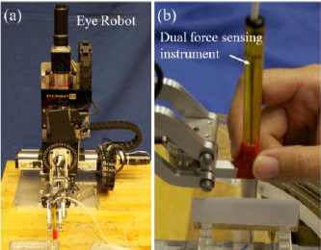

Slide 7
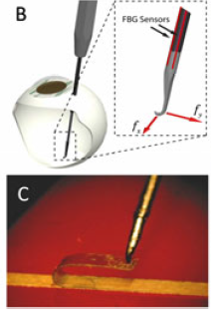
Surgical Procedure Simulation
Peeling procedure:
grasping or hooking a tissue layer and slowly delaminating it, often in a circular pattern
tool velocities: 0.1– 0.5 mm/s
retinal tissue manipulation forces: <7.5 mN
Phantom:
19 mm Clear Bandages – sliced to 2 mm wide strips
can be peeled multiple times from its backing
increase of peeling force with increased peeling velocity
flexible but strong enough to withstand breaking pressures at the hook attachment site
B: Force sensor tool
C: Peeling sample &
hooked tool tip

Slide 8
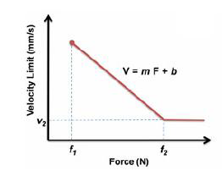
Robot Control Methods
Proportional Velocity Control (PV):
$\dot{x}=αF_{h}$, $α=1($mm/s)/N
F_{h}: input force at the handle
Linear Force Scaling Control (FS):
$\dot{x}= α(F_{h}+ γF_{t})$, $α=1($mm/s)/N, $γ=500$
F_{t}: input force at the tip
Proportional Velocity Control with Limits (VL):
m = -180, b = 0.9

Slide 9
Auditory Feedback
Visual feedback requires significant experience and concentration
Auditory feedback: clearer, less expertise required
modulates the playback tempo of audio “beeps” in 3 force level zones
0-3.5mN: safe - none
3.5-7.5mN: cautious – increasing tempo
>7.5mN: dangerous – constant high tempo
4 feedback modes were developed, each was performed with and without auditory feedback
Freehand Proportional Velocity
Linear Force Scaling PV With Limits

Slide 10
Typical Recordings
Blue: w/o auditory feedback
Red: with auditory feedback

Slide 11
Results
Addition of auditory feedback improved results
Lower and more stable forces
Significantly longer time in FH & PV, slightly shorter time in FS & VL
Freehand
Forces: avg ~4mN, max ~8mN, SD ~ 1, due to tremor
Feedback modes:
Average force all ~3.5 mN, max & SD decresed significantly
Optimal mode: Force Scaling with Auditory Feedback
The lower
The better

Slide 12
Critique
Good explanation of motive and significance
Clear description of experimental set up and instruments involved, thorough background details
Clear description of algorithms used
Provides very good template for similar experiments (like our project, thanks to the author(s))
Details on the phantom were not very clear, therefore, we do not know how closely it models the human eye and how realistic it is compared to the actual surgery
Reason for choosing the various algorithms were not explained, would have provided great insights
Results only included digital data, human feedback would have been very informative
Overall, the paper started out stronger than it finished

Slide 13
Conclusions and Future Work
Overall, a good paper to refer to for experiments involving the Eye Robot (provided great help to our project)
Outcomes are encouraging
Author’s belief:
concentrate on in-vivo experiments
improve the tool to 3-DOF sensing
My suggestions:
gain more information on how different control feedback algorithms and alternative feedback methods can improve the outcomes
Gain surgeon feedback
Improve phantom (more realistic circular peeling)

