Slide 1
Photoacoustic Imaging of Prostate Brachytherapy Seeds in Ex Vivo Prostate
N. Kuo, H.J. Kang, T. DeJournett, J. Spicer, and E. Boctor
Proc. SPIE 7964, 796409 (2011); doi:10.1117/12.878041
Steven Su
Department of Biomedical Engineering
3/15/11

Slide 2
Update on Project Status
Completed Milestone 1:
Calibrated Pulse Laser Setup (PLS)
Synchronized PLS, Ultrasound, and DAQ
Collected Sample Data using 1064 nm light source
Up Next: Milestone 2
One point registration using 532 nm light source
Write Matlab Scripts/Functions for Registration Process
Completion Date: Week after Spring Break
Overall Status: Project is On Time

Slide 3
Outline of Talk
Motivation for Paper Selection
Background
Introduction
Methods
Results
Criticisms

Slide 4
Motivation for Paper Selection
Experimental setup is very similar to what our project will use
Key Differences In Setup:
No brachytherapy seeds
532 nm light source
Transducer directly in line with plane of laser
Showed photoacoustic imaging is possible with this setup
Authors: Nathanael Kuo and Emad Boctor

Slide 5
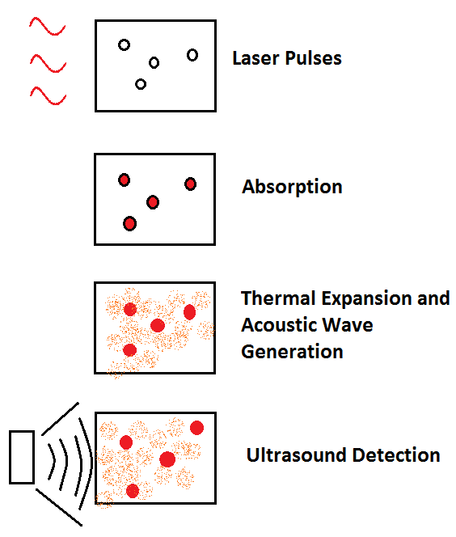
Background: Photoacoustic Effect
When matter is exposed to high frequency pulses of light, most of the light’s energy will be absorbed by the molecules in the incident matter.
As the energy from the light is converted to heat, the molecules become thermally excited.
Heat waves will then radiate away from the matter causing sound waves due to pressure variations in the environment around the medium.
These sound waves can then be detected by acoustic devices such as ultrasound (US).

Slide 6
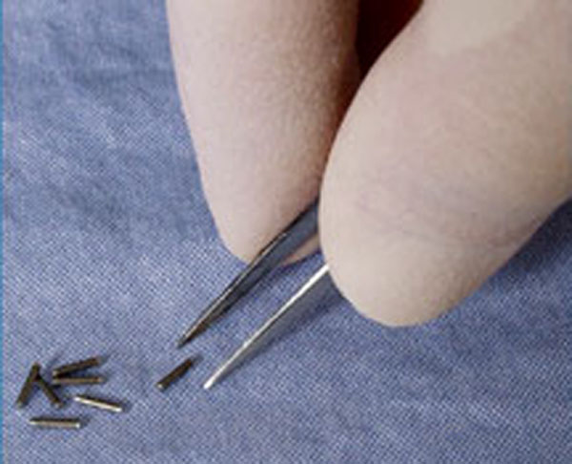
Introduction: Prostate Brachytherapy
Low Dose Rate (LDR) Prostate Brachytherapy is common treatment for prostate cancer
Implant small radioactive seeds in tumor site via needle injection
Over weeks and months, level of radiation decreases
Seeds permanently left in site with no lasting effects
Image From: http://en.wikipedia.org/wiki/Brachytherapy

Slide 7
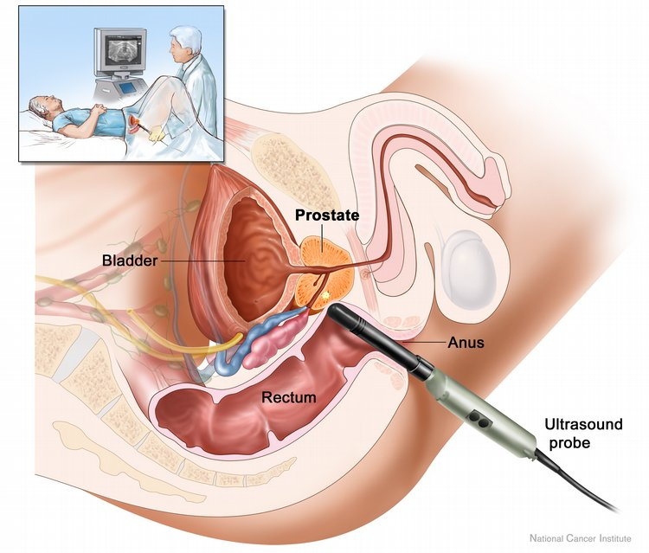
Introduction: Intraoperative Treatment Planning
Pre-surgery: plan for placement of seeds
Intraoperative Treatment Planning (ITP): strategy of creating and continuously optimizing seed placement plan
During surgery seed locations deviate from plan due to patient edema or seed migration
Suboptimal Dose Distribution
Currently Transrectal Ultrasound (TRUS) used for pre-surgery plan and LDR needle guiding
Poor seed visualization, precludes ITP
Image From: http://www.yourcancertoday.com/Cancers/Prostate-Cancer/78

Slide 8
Introduction: Why Photoacoustic Imaging?
Allows for visualization of seeds
Intraoperatively a plan can be updated accordingly
Seeds cannot be removed once implanted
Compensation for deviations in seed position is possible
Better overall treatment
Simpler setup than X-ray/TRUS combination
CHEAP!

Slide 9
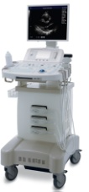
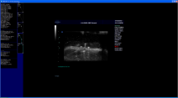
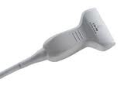
Methods
Hardware: Surelite II Laser, Sonix CEP Ultrasound, Sonix DAQ (Data Acquisition)
Software: DAQControl Software, SONIX RP, Matlab Software
SonixRP
Software
Sonix CEP
Ultrasound system
L14-5W
Transducer
SonixDAQ
Module
DAQControl
Software
Phantom
Surelite II
Laser system
MATLAB
Software
Image From: N. Kuo et al.

Slide 10
Methods: Hardware
Laser: 1064 nm wavelength, 40 mJ/cm² density
Ultrasound: 60 mm linear array transducer with 128 elements (sensors)
Wave emission off
Wave detection on
SonixDAQ: Data Acquisition for up to 128 elements with 12-bit sampling
Sonix CEP
Ultrasound system
L14-5W
Transducer
SonixDAQ
Module
Phantom
Surelite II
Laser system
Image From: N. Kuo et al.

Slide 11
Methods: Software
SonixRP: Operates ultrasound
DAQControl: Operates SonixDAQ
Matlab Software: Process raw RF pre-beamformed data into pre-beamformed and standard delay and sum B-mode images
SonixRP
Software
Sonix CEP
Ultrasound system
L14-5W
Transducer
SonixDAQ
Module
DAQControl
Software
Phantom
Surelite II
Laser system
MATLAB
Software
Image From: N. Kuo et al.

Slide 12
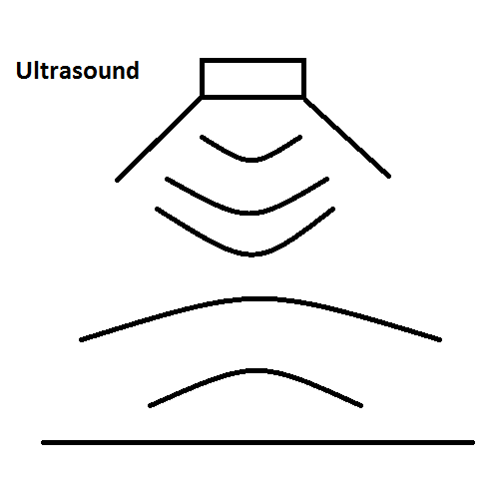
Methods: Ultrasound Terminology
Raw Radio Frequency: Data recorded by transducer is radio frequencies
B-Mode Images: Linear array of transducers simultaneously scans a plane of the body that the ultrasound displays as a 2D image on the screen
Beamformation: Signal processing technique used by ultrasound machine to produce B-mode images

Slide 13
Methods: Procedure
3 Experiments:
Phantom with 1 seed
Phantom with 4 seeds
Ex vivo dog prostate with 4 seeds
Used actual decayed palladium-103 bracytherapy seeds encased in titanium shells (TheraSeed, Theragenics Corporation)
Seeds implanted at surface of phantom (except for dog prostate)
Laser fired directly at seeds on surface
Ultrasound array was perpendicular to direction of laser firing
Phantom
Surelite II
Laser system
Image From: N. Kuo et al.

Slide 14
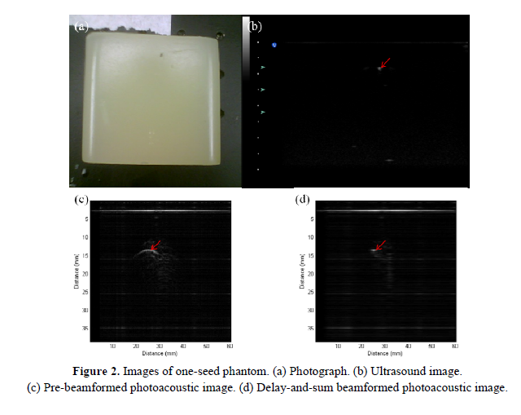
Results: One Seed Phantom
Some noise and artifacts
Consistent horizontal line artifact caused by SonixDAQ
Seeds appear as arcs before beamformation and as condensed masses after beamformation
Image From: N. Kuo et al.

Slide 15
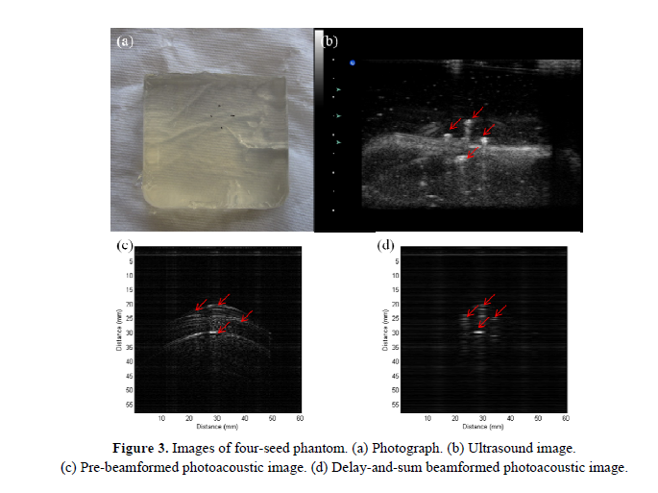
Results: Four Seed Phantom
Horizontal line artifact still present
Arcs before beamformation, masses after beamformation
Image From: N. Kuo et al.

Slide 16
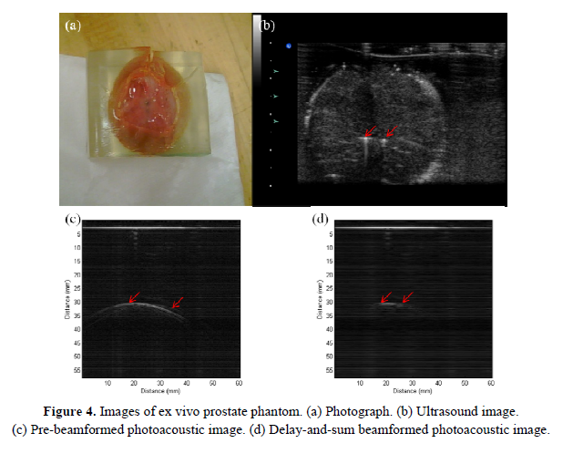
Results: Ex Vivo Dog Prostate
Only two seeds show
Inconsistent seed implantation depths due to difficult of precise seed implantation
Horizontal line artifact still present
Image From: N. Kuo et al.

Slide 17
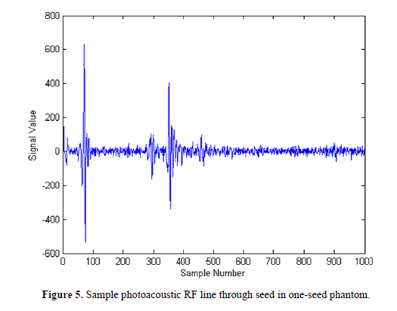
Results: Analysis
For one seed phantom, signal to noise ratio (SNR) of the RF line through the single seed was calculated
Maximum signal value of 406, minimum signal value of -340
Total signal value of 746
Root Mean Squared Noise Value of 16
SNR=46
Image From: N. Kuo et al.

Slide 18
Criticism
Very qualitative
Did not explain why PA better than US
Did not compare PA images to US images
SNR of 46? Good? What about US images?
SNR analysis very vague
Background information lacking
Needed to look up terminology

Slide 19
Conclusion, Significance, Possible Further Work
Key Result: prostate brachytherapy seeds can be visualized using photoacoustic imaging
Significance: ITP may be possible in the future because of ability to visualize seeds
Further improvements in signal processing algorithms for better image quality
Setup of system can be improved

Slide 20
Thank You! Questions?

