Slide 1
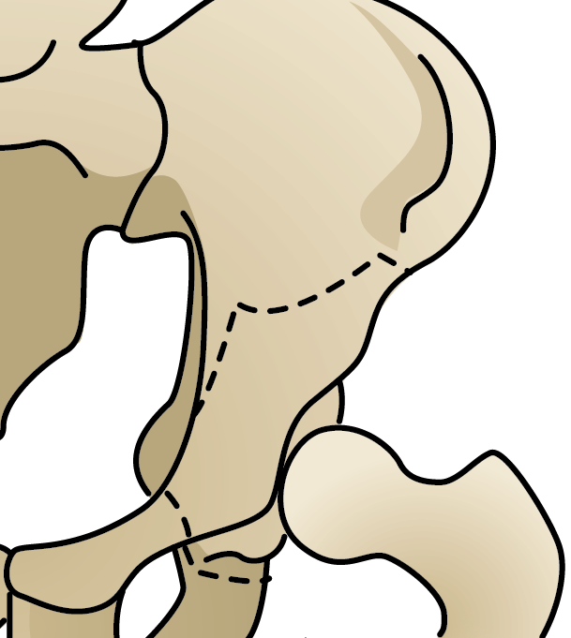
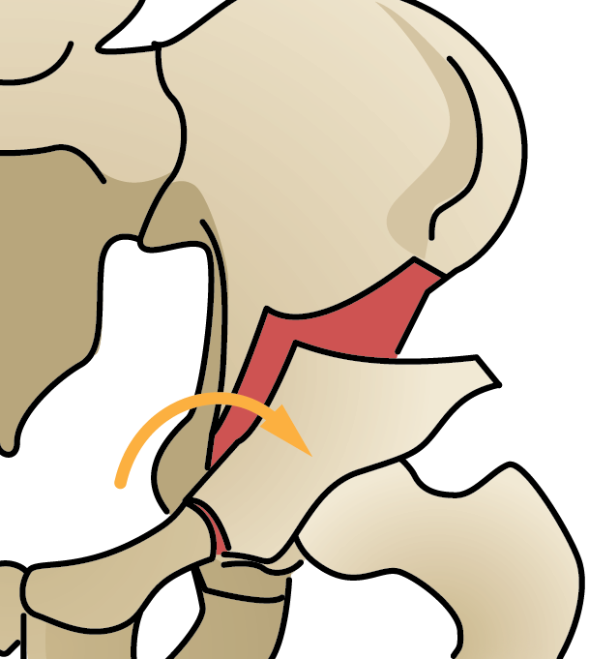
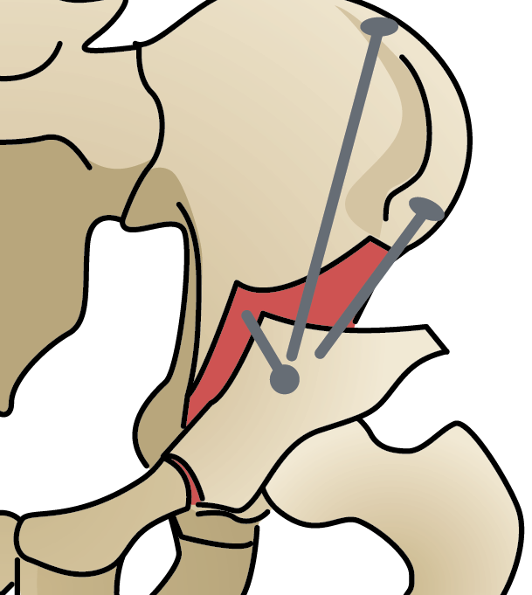
Tool Tacking for Periacetabular Osteotomy using CamC
Significance: One of the challenges of Peri-acetabular osteotomy (PAO) is to reduce the number of x-ray shots during chiseling. Furthermore, our previous work involves tracking the fragment to perform biomechanical analysis to ensure surgical goals are obtained. Accuracy of reconstructing the fragment geometry, will significantly improve the tracking and, therefore, surgical outcome analysis.
Objectives:
Track the osteotom tool (curved chisel) with respect to the pelvis using camera-augmented C-Arm (CAMC).
Update the preplanned osteotomy fracture lines, via 3D tracking of the osteotom within the pelvis
!
Images taken from: https://hipdysplasia.org/adult-hip-dysplasia/adult-treatments/hip-preservation-surgery-for-adult-hip-dysplasia/

Slide 2
Tool Tacking for Periacetabular Osteotomy using CamC
What Students Will Do:
Use the existing algorithms for 3D/2D registration of CT to intra-op. X-ray
Devise tracking algorithm to track the osteotom in RGBD
Update pre-op. CT based fracture lines using osteotom tracking
Deliverables:
C++ source code
Code documentation
Report describing the methods and achievements
Size group: 2-3 (if larger group: learning-based tracking)
Skills: Experience with C++ and Transformations desired
Mentors:
Mathias Unberathunberath@jhu.edu, Robert Grupp, Prof. Armand
Clinical collaborator: Prof. John Tis.

