Slide 1
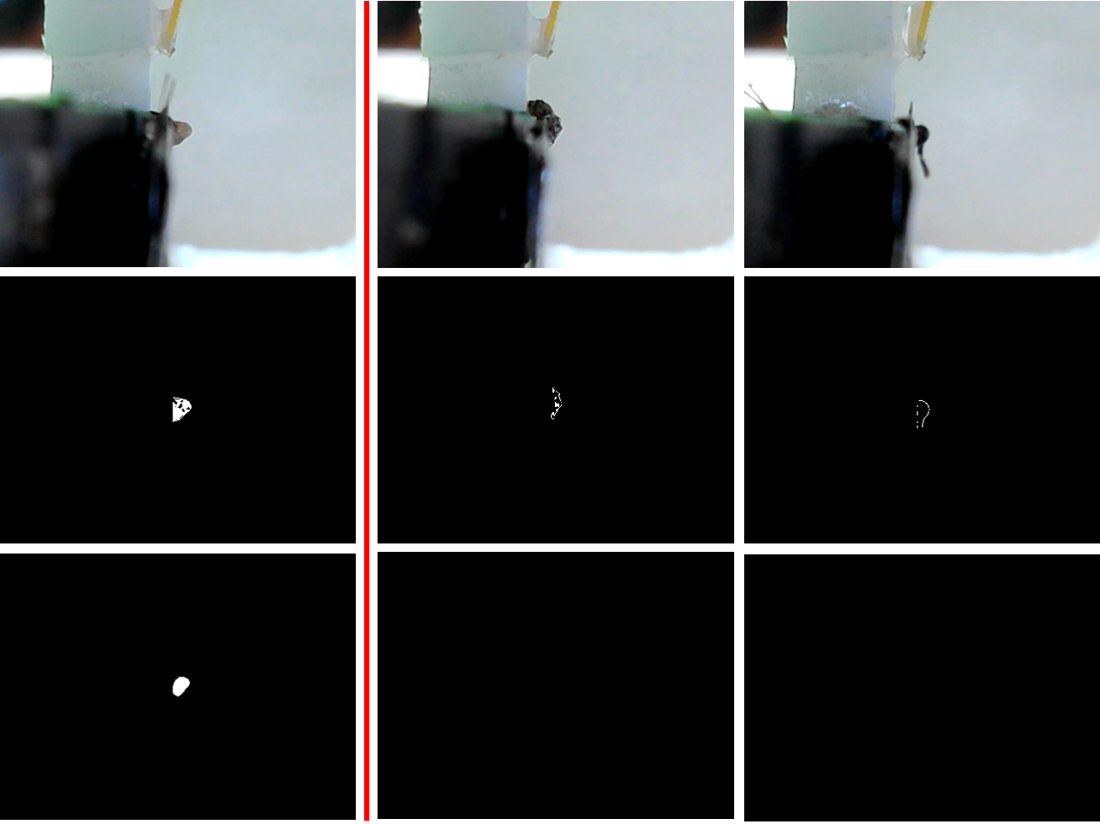
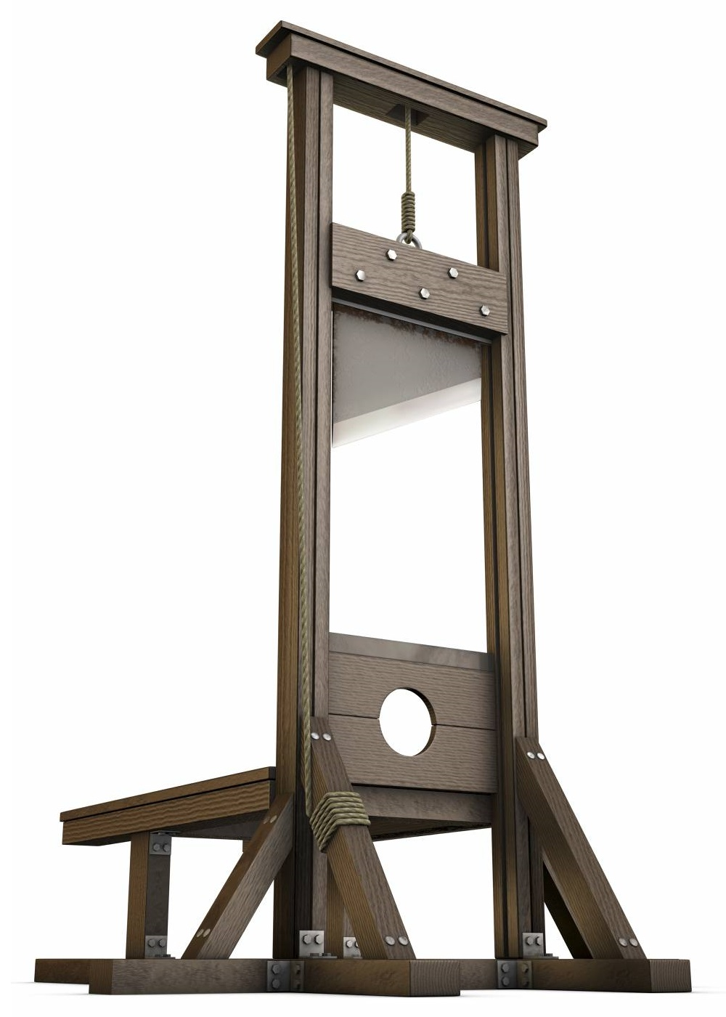
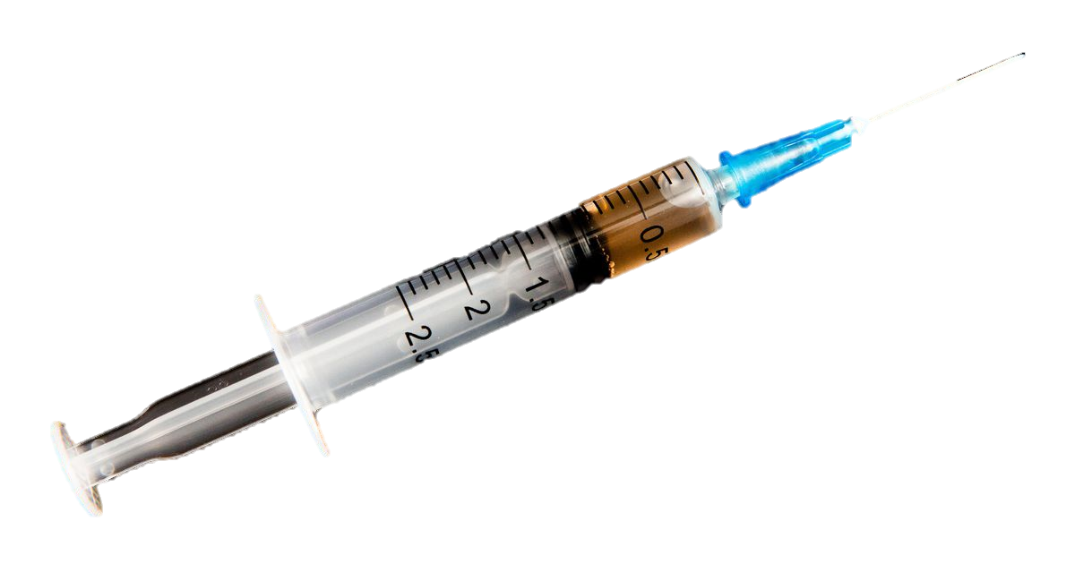
Vision Guided Mosquito Dissection for the Production of Malaria Vaccine Computer Integrated Surgery II Spring, 2021 Nicholas Greene | Mentors: Balazs Vagvolgyi, Alan Lai, Parth Vora
Introduction
Sanaria has developed practical and effective malaria vaccines which could be critical in the global fight against malaria [1] [5]
Currently, production of malaria vaccine is heavily bottlenecked by manual extraction of mosquito salivary glands
Ongoing development of an automated robot system for the mosquito salivary gland extraction
Significance
The computer vision methods are essential for reliable and efficient operation of the system
Very useful for analysis and monitoring of the system for as a way to benchmark
The system could eventually lead to significantly higher production of malaria vaccine to fight malaria globally
Tasks
Turntable Cleaning Detection
Gripper Cleaning Detection
Exudate Segmentation
Methods – Turntable Slot Cleaning
Classical Method
Convert Image to HSV color space
Set value channel to 100%
Convert back to RGB,
Threshold by color to segment mosquito
Specular Reflection Segmentation
Perform a brightness threshold and subtract from mosquito segmentation previous result
98% accurate on dataset
Deep Learning Method
Transfer learning with VGG16 pretrained on ImageNet
Dataset Size was about 300
100% accuracy on the Test set
98.6% accuracy on the entire dataset
False positive rate was 0.6%
False negative rate was 0.6% over the whole dataset.
Cutting Station
Squeezing Station
Cleaning Station
Mosquito Dissection System
Methods – Gripper Cleaning Detection
Classical Method
Two subtasks: classification and segmentation
Both subtasks completed with color thresholding and median blur filtering
Exudate Volume Estimation
System Integration
The vision algorithms will be integrated with the existing system through the use of ROS Services.
ROS Service will be implemented in C++
for OpenCV and Python for PyTorch
PyTorch
OpenCV
Camera
image
Network
image
image
Robot System
Computer
Ros Service Request
Vision Computer
output
output
Actuators
commands
Ros Service Response
final result
Compare and Validate
Future Work
There are many more vision tasks to be completed in the system
The tasks I implemented with classical methods have clear ways to be improved regarding ROIs
Deep learning methods could be trained on more information than just “clean” or “not clean”
Lessons Learned
Everything takes a very a longer than expected on a real system
Use the simplest methods possible at the outset
Turntable Cleaning Classical Pipeline
Credits
Nick Greene – Project Group 5
Balazs Vagvolgyi, Alan Lai, Parth Vora – Mentors and for existing code framework
Methods – Gripper Cleaning Detection
Deep Learning Method
VGG16 transfer learning model was used
Dataset size was about 600
95.4% accuracy on the test set
98.3% accuracy over the entire dataset
0.6% false positive rate
1.05% false negative rate
Support by and Acknowledgements
Thank you to Sanaria and JHU for providing the opportunity to work on a system like this
Thanks you to my mentor Balazs
Gripper Cleaning
Training Images
Engineering Research Center for Computer Integrated Surgical Systems and Technology

Slide 2
