Slide 1
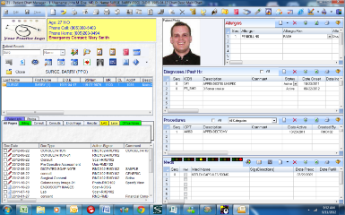
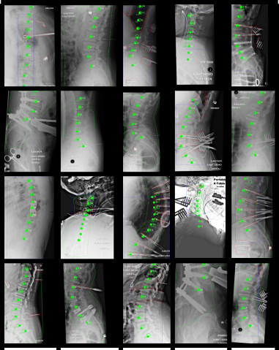
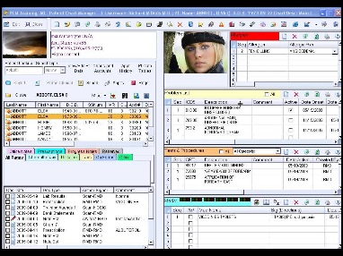
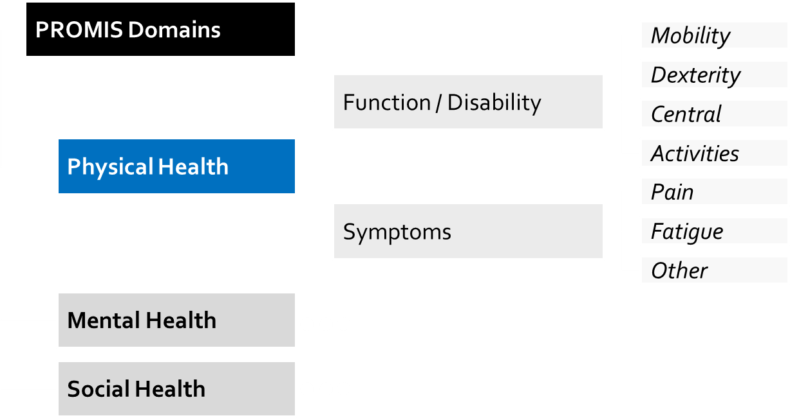
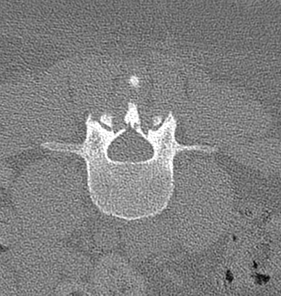
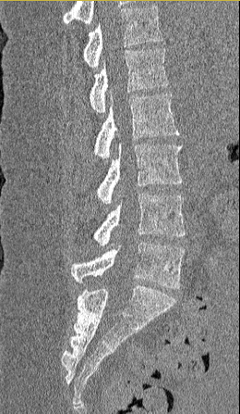
Auto-Segmentation of Spine CT for Data-Intensive Analysis of Surgical Outcome
Motivation: We are developing a big data approach fueled by advanced image registration and analytics to discover the physical and biological factors underlying the high variability in spine surgery outcomes.
Challenge: A major component of “Spine Cloud” is a large database of annotated spine CT images based on accurate, automatic segmentation.
What Students Will Do: Develop and test the “max-flow/min-cut” segmentation method for spine CT images.
Extend initial algorithm to a form suitable for automatic segmentation in a large dataset
Evaluate accuracy vs. parameter selection.
Investigate automatic parameter selection.
Evaluate segmentation accuracy in a large dataset.
Identify methods to overcome errors presented by spine instrumentation.
Spine
Cloud
Patient Outcome

Slide 2
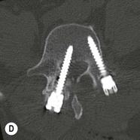
Auto-Segmentation of Spine CT for Data-Intensive Analysis of Surgical Outcome
Deliverables:
Minimum: Max-flow / Min-cut implementation extended to spine CT
Expected: Analysis of parameter sensitivity
Expected: Evaluation of segmentation accuracy
Expected: Generation of a large (N=200) segmented dataset
Maximum: Methods for patient-specific parameter selection
Maximum: Methods to contend with spine instrumentation
Size group: 2 or 3
Skills: 3D image data. Matlab, C++, ParaView.
Mentors:
Jeff Siewerdsen and Tharindu De Silva
jeff.siewerdsen@jhu.edu

