Slide 1
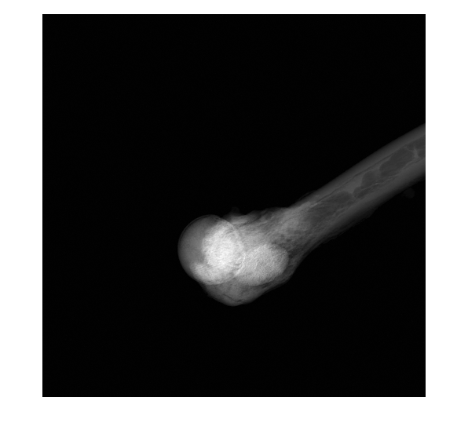
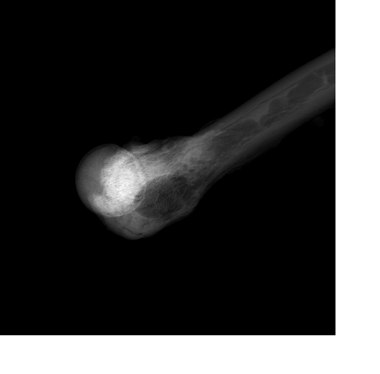
Dual Energy Material Decomposition Cong Gao Mentors: Mathias Unberath, Mehran Armand, Russell Taylor
Goals:
Decompose femur and injected cement using dual energy X-ray.
Significance:
Accurate decomposition using physics in 2D X-rays will help monitor 3D reconstruction shape of the injected cement.
Results:
We proposed an innovative learning-based optimization pipeline explicitly including the physics model and constraints.
Achieved significant improvement on real X-ray cement decomposition
Dual energy X-ray
Bone
Cement
Fig 1. Illustration of dual energy X-ray material decomposition.

Slide 2
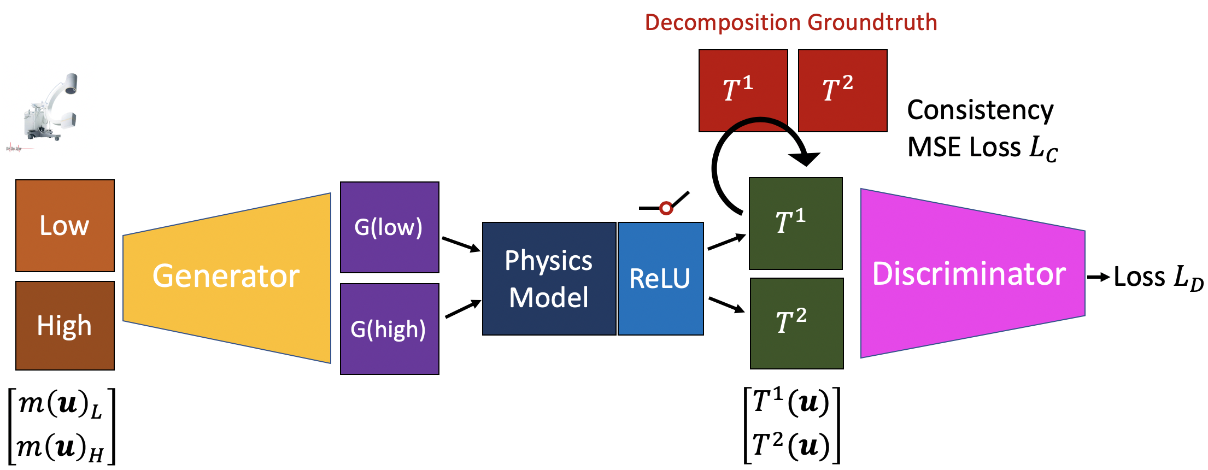
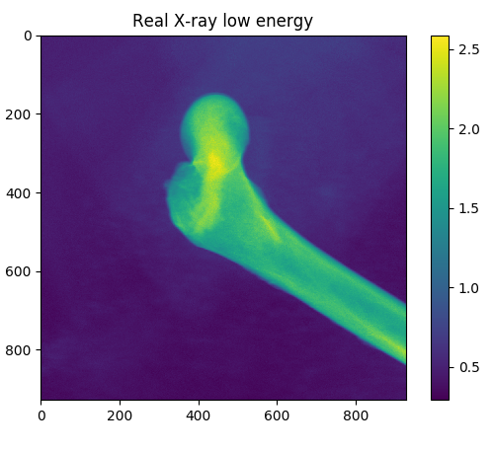
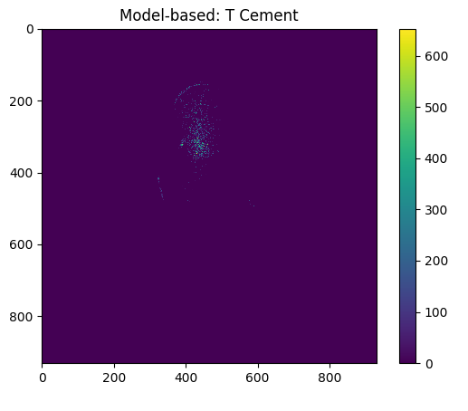
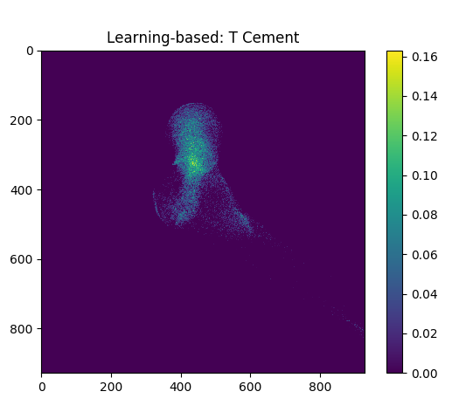
Real X-ray
Traditional Model-based
Our result

