Slide 1
Robotic Ultrasound Needle Placement and Tracking: Robot-to-Robot Calibration
Computer Aided Medical Procedures
Project Checkpoint
Project 17: Christopher Hunt & Matthew Walmer
Mentors: Bernhard Fuerst, Javad Fatouhi, Risto Kojcev, Nassir Navab

Slide 2
Background
In medicine and industry⁷, there is a need for flexible multi-robot platforms that allow for independent placement of multiple robotic manipulators.
Background | Plan | Dependencies | Deliverables | Calibrations | Validation | Time Table
Friday, 29. August 14

Slide 3
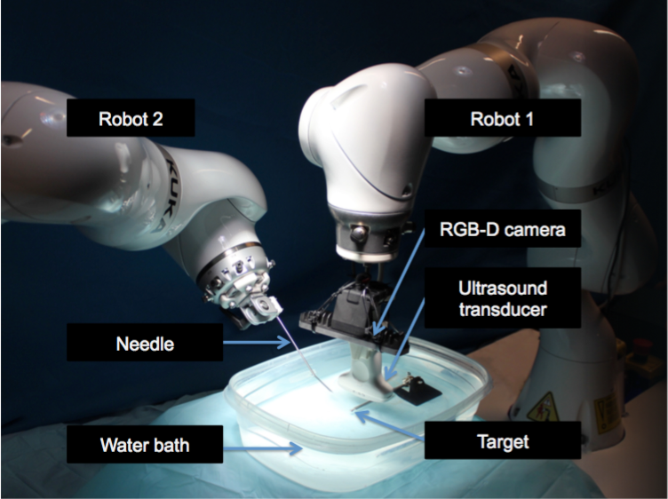
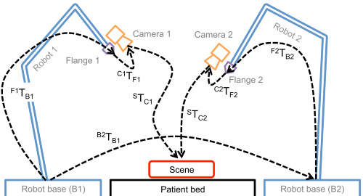
Background
CAMP lab has designed a novel multi-robot platform.
This mobile platform provides flexibility in the operating room environment.
For multi-robot surgical procedures, precise coordination is key.
Base to base calibration must be done frequently, because the platform is mobile.
We need an efficient method to precisely calibrate multiple robots.
Objective
Explore a variety of robot-to-robot calibration methods and validate their efficacy for use in dual-robotic surgeries and experiments.
From Dual-Robot Ultrasound-Guided Needle Placement ⁵
^{B2}T_{B1} = ^{F2}T_{B2}⁻¹ ^{C2}T_{F2}⁻¹ ^{S}T_{C2}⁻¹ ^{S}T_{C1} ^{C1}T_{F1} ^{F1}T_{B1}
Background | Plan | Dependencies | Deliverables | Calibrations | Validation | Time Table
Friday, 29. August 14

Slide 4
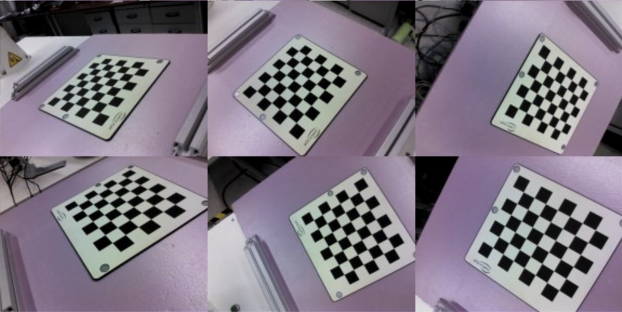
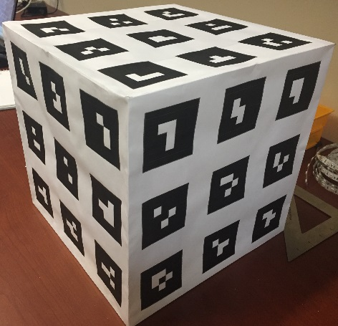
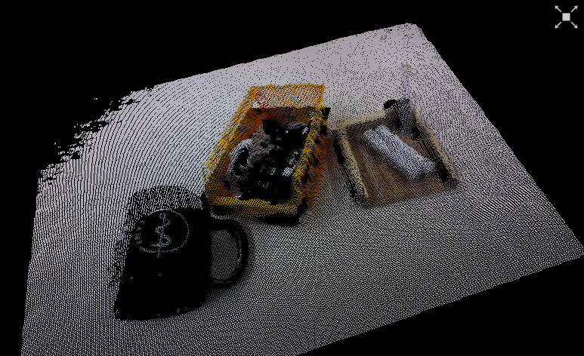
Plan Overview
1. Checkerboard Calibration
2. Visual Marker Tracking Calibration
3. RGB-D Features and Depth
4. RGB-D Depth-Only
Background | Plan | Dependencies | Deliverables | Calibrations | Validation | Time Table

Slide 5
Dependencies
Type | Dependency | Status
Hardware | KUKA iiwa Dual Robotic System | ✓
 | 3D-Printed Intel Camera Mounts | ✓
 | Access to Mock OR and Robotorium | ✓
 | Calibration Checkerboard | ✓
 | ARToolKit Markers | ✓
 | Feature Calibration Objects | ✓
 | Improve KUKA Pointer | Mentor
Software | ImFusion, PCL, ARToolKit | ✓
 | KUKA Sunrise | ✓
 | Intel RGB-D Camera SDK | ✓
Other | Risto’s Needle Tracking Algorithm | ✓
 | Tissue Sample for Ultrasound Testing | Mentor or Butcher
Background | Plan | Dependencies | Deliverables | Calibrations | Validation | Time Table

Slide 6
Deliverables
Complete In Progress Low Priority
Minimum | Fully documented hand-eye calibration program that produces the transformation from a rigidly attached camera to the robot’s end-effector, ^{g}He
 | Fully documented checkerboard calibration program that produces the transformation from the second robot base to the first robot base, ^{b1}Hb2
 | Validation experiment protocol and report of results
Expected | Fully documented ARToolKit calibration program that produces the transformation from the second robot base to the first robot base, ^{b1}Hb2
 | Fully documented RGB-D features and depth calibration program that produces the transformation from the second robot base to the first robot base, ^{b1}Hb2
 | Report of validation experiment results
Maximum | Fully documented RGB-D depth-only calibration program that produces the transformation from the second robot base to the first robot base, ^{b1}Hb2
 | Report of validation experiment results
 | Needle targeting in real tissue experiment results
Background | Plan | Dependencies | Deliverables | Calibrations | Validation | Time Table

Slide 7
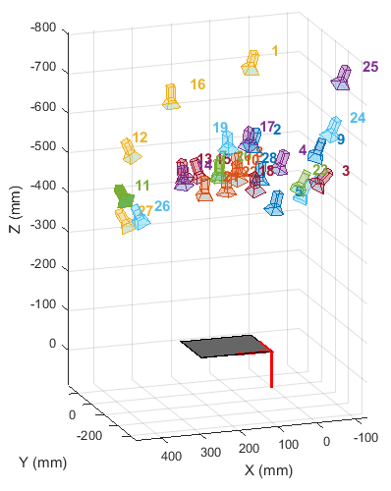
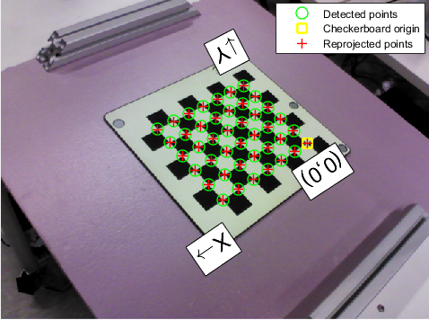
Camera Calibration
Objective
Given a set of images of a calibration object with known dimensions (i.e. checkerboard), determine the intrinsic and extrinsic matrices of the camera.
Background | Plan | Dependencies | Deliverables | Calibrations | Validation | Time Table

Slide 8
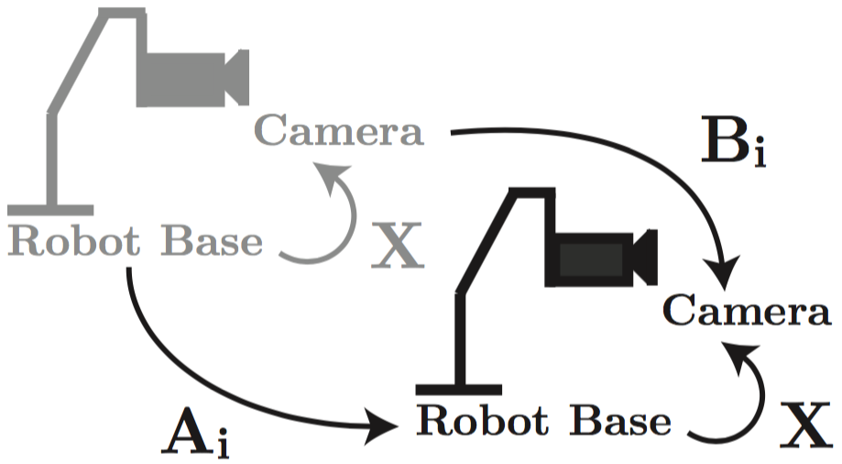
Hand-Eye Calibration
Objective
Given a set of robot calibration states and the corresponding images of a known calibration object, produce the transformation from the camera space to the robot’s end-effector space.
Tsai's Least-Squares Method
Command the robot to N predefined states. Each state should be oriented such that the camera is facing the calibration object.
Acquire a photo of the calibration object at each state.
Generate the camera’s position relative to the calibration object in each frame.
Solve the equation AX = XB, where A is the transformation between camera poses, B is the transformation between robot end effector poses, and X is the transformation ^{g}He.
From An Overview of Robot-sensor Calibration Methods for Evaluation of Perception Systems ³
Background | Plan | Dependencies | Deliverables | Calibrations | Validation | Time Table

Slide 9
Checkerboard Calibration
Camera Extrinsics
Hand-Eye Calibration
Hand-Eye Calibration
Forward Kinematics
Forward Kinematics
Base to Base Calibration
^{B2}T_{B1} = ^{F2}T_{B2}⁻¹ ^{C2}T_{F2}⁻¹ ^{S}T_{C2}⁻¹ ^{S}T_{C1} ^{C1}T_{F1} ^{F1}T_{B1}
Pseudo-Code
Input: sq_sz, jerry_files, dash_files
[g1He1, b1Hw] = calibrate_handeye( jerry_files, sq_sz )
[g2He2, b2Hw] = calibrate_handeye( dash_files, sq_sz )
b1Hb2 = b1Hw * b2Hw⁻¹
Output: b1Hb2
Background | Plan | Dependencies | Deliverables | Calibrations | Validation | Time Table

Slide 10
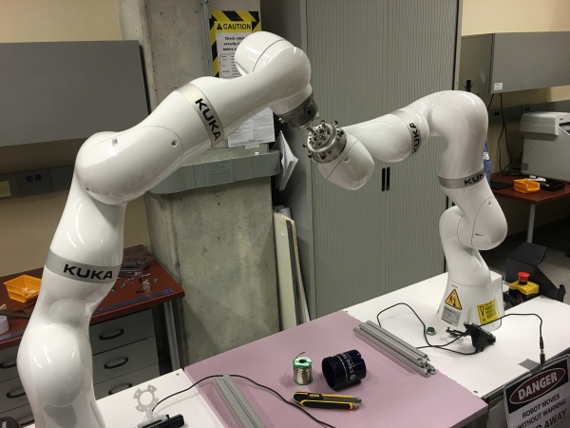
Calibration Error Analysis
Protocol
Manually position robots so calibrated pointer tips are touching. These points have zero linear distance between them and are considered the ground truth.
Transform the second robot’s points into the first robot’s base frame.
Measure the Euclidean distance between the point pair as the linear error.
Repeat this process at many points around the robots’ workspace.
Optional
To get Z-axis rotation error, compute
tangential error component for each
point and divide by distance from
workspace center.
Background | Plan | Dependencies | Deliverables | Calibrations | Validation | Time Table

Slide 11
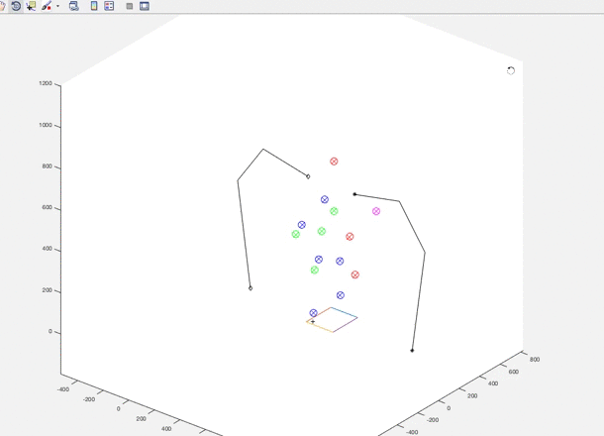
Calibration Error Results
Mean Linear Error: 2.7599 mm
StDev: 1.1598 mm
Mean Z-Axis Rotation Error: 0.7448˚
StDev: 0.4583˚
u Linear Error < 2mm
u Linear Error < 3mm
u Linear Error < 4mm
u Linear Error < 5mm
Background | Plan | Dependencies | Deliverables | Calibrations | Validation | Time Table

Slide 12
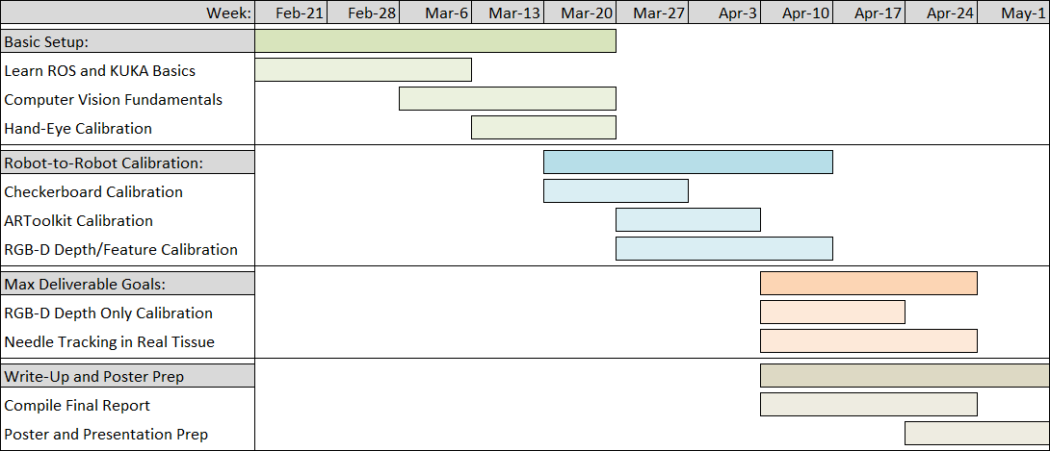
Time Table
Background | Plan | Dependencies | Deliverables | Calibrations | Validation | Time Table
Freitag, 26. Februar 2016

Slide 13
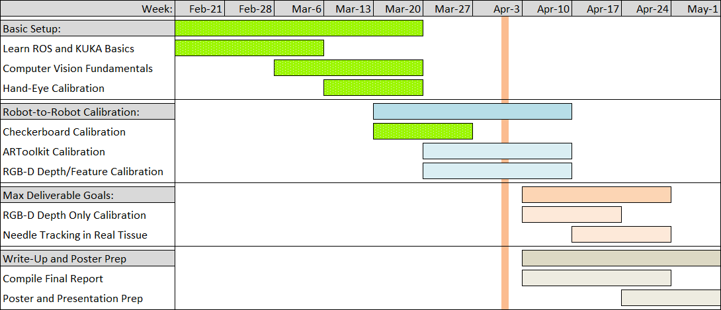
Time Table - Revised
Upcoming Checkpoints
April 12th: Maximum Deliverables Research
April 16th: ARToolKit Calibration Program
RGB-D Features and Depth Program
April 23rd: RGB-D Depth-Only Program
Background | Plan | Dependencies | Deliverables | Calibrations | Validation | Time Table
Freitag, 26. Februar 2016

Slide 14
Readings
B. Fuerst, J. Fotouhi, and N. Navab. "Vision-Based Intraoperative Cone-Beam CT Stitching for Non-overlapping Volumes." Lecture Notes in Computer Science Medical Image Computing and Computer-Assisted Intervention -- MICCAI 2015 (2015): 387-95. Web.
H. Bay, T. Tuytelaars, and L. Van Gool. "SURF: Speeded Up Robust Features." Computer Vision – ECCV 2006 Lecture Notes in Computer Science (2006): 404-17. Web.
M. Shah, R. D. Eastman, and T. Hong. "An Overview of Robot-sensor Calibration Methods for Evaluation of Perception Systems." Proceedings of the Workshop on Performance Metrics for Intelligent Systems - PerMIS '12 (2012). Web.
O. Zettinig, B. Fuerst, R. Kojcev, M. Esposito, M. Salehi, W. Wein, J. Rackerseder, B. Frisch, N. Navab, "Toward Real-time 3D Ultrasound Registration-based Visual Servoing for Interventional Navigation," IEEE International Conference on Robotics and Automation (ICRA), Stockholm, May 2015.
R. Kojcev, B. Fuerst, O. Zettinig, J.Fotouhi, C. Lee, R.Taylor, E. Sinibaldi, N. Navab, "Dual-Robot Ultrasound-Guided Needle Placement: Closing the Planning-Imaging-Action Loop," Unpublished Manuscript.
R. Tsai, and R. Lenz. "A New Technique for Fully Autonomous and Efficient 3D Robotics Hand/eye Calibration." IEEE Trans. Robot. Automat. IEEE Transactions on Robotics and Automation 5.3 (1989): 345-58. Web.
Y. Gan, and Xong Dai. "Base Frame Calibration for Coordinated Industrial Robots." Robotics and Autonomous Systems 59.7-8 (2011): 563-70. Web.
Background | Plan | Dependencies | Deliverables | Calibrations | Validation | Time Table
Freitag, 26. Februar 2016

Slide 15
Questions?
Background | Plan | Dependencies | Deliverables | Calibrations | Validation | Time Table

