Slide 1
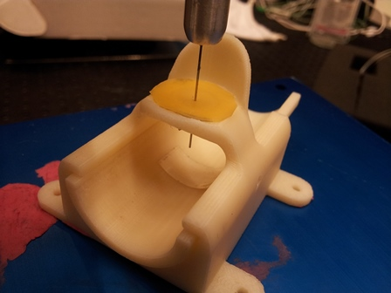
Force Feedback of Dual Force-Sensing Instrument for Retinal Microsurgery Seo-Im Hong, Can Wang, Woo Yang Mentors: Xingchi He, Dr. Iulian Iordachita, Dr. Russell Taylor
Goals:
To develop and assess different force feedback methods for a dual force sensing instrument for retinal microsurgery
Significance:
Assist with retina microsurgery that require accurate and precise movements
Better understanding of which feedback method is most efficient in alerting surgeons
Results:
50 mm radius of curvature and straight insertion was the best

Slide 2
Project Summary
Delicate manipulation of retinal tissue
Very low interaction forces (below human perception threshold)
Need for a force-sensing surgical instrument to measure forces of the tool tip during surgery
Challenges: Force feedback for tool shaft and tip force

Slide 3
Background
Importance of Force Feedback
Limitations to current robotic surgery (including eye microsurgey)
Surgeons cannot "feel" the surgery itself
Loss of depth perception, dexterity, sense of touch, straightforward hand-eye coordination
Desirable to have force feedback to assist with vision feedback
Force feedback: counter pressure / movement, or alarm system to the force applied by the surgeon
image taken from http://www.eng.uwaterloo.ca/~fhaque/

Slide 4
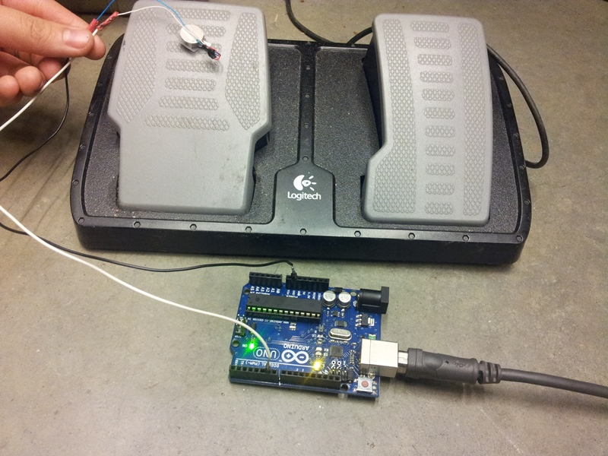
Vibrotactile Motor

Slide 5
Background
Force Feedback Methods
Auditory feedback: alarm surgeons if tool force extends beyond threshold
Reduce chance of retinal damage
Haptic feedback: exert opposing force to surgeon's hand
Increase safety of the operation
Images of the eye robot from(3) credits to ICRA

