Slide 1
Anomaly detection for contour integrity in treatment planning for radiotherapy
Goal: To improve the integrity of contoured anatomy in radiotherapy by identifying potentially erroneous contours with learned anomaly detection methods
What Students Will Do:
Detect errant contours utilizing the database of hundreds of anatomical contours as a norm
Apply data augmentation methods to simulate errant contours and extend the data
Develop various methods representing the ways in which contours can be bad (missing slice, surface anomaly, size variation)
Set controls in the augmentation to adjust the sensitivity of the detection
Determine feature extraction methods suitable for model training
e.g. 2D images generated from projections of the 3D contour
Explore machine learning and artificial intelligence methods (e.g. CNN) to detect anomalies
Deliverables:
The overall framework for errant contour detection
Data augmentation, feature generation and model training methods
Documented API for developing data augmentations and training methods
Size group: 1-3
Skills:
3D shapes, Volumetric Image Segmentation
Machine learning in the Microsoft Azure Cloud
Programming experience (Python, AI and ML methods)
Mentors:
Todd McNutt (tmcnutt1@jhmi.edu)

Slide 2
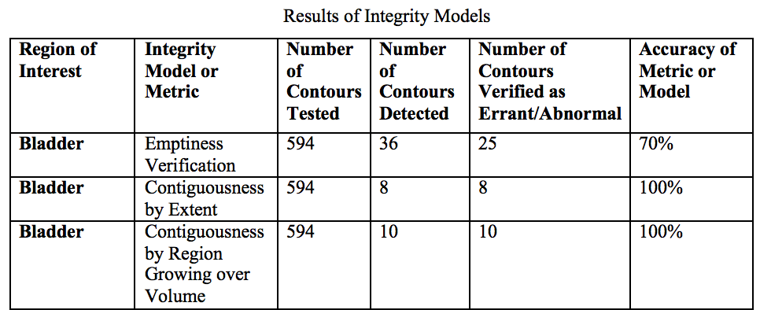
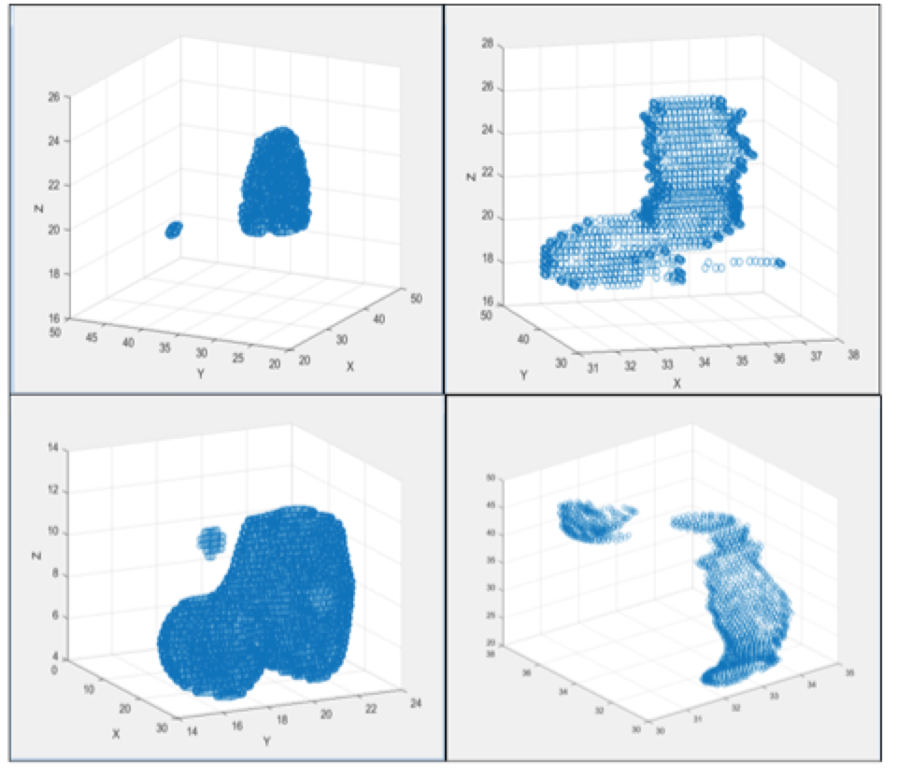
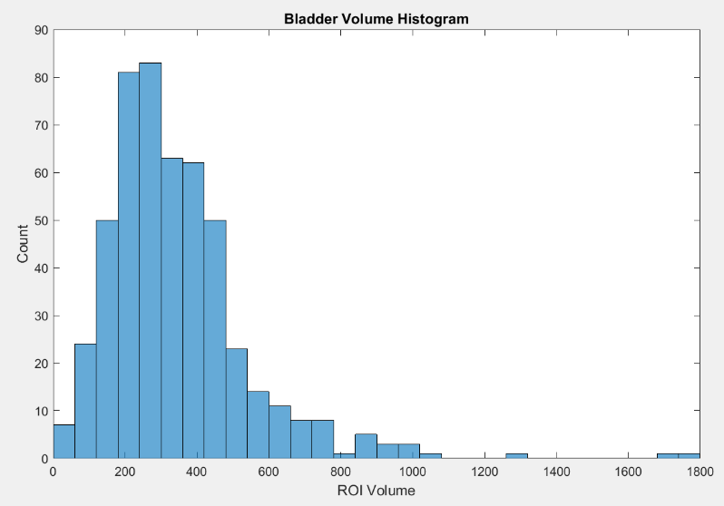
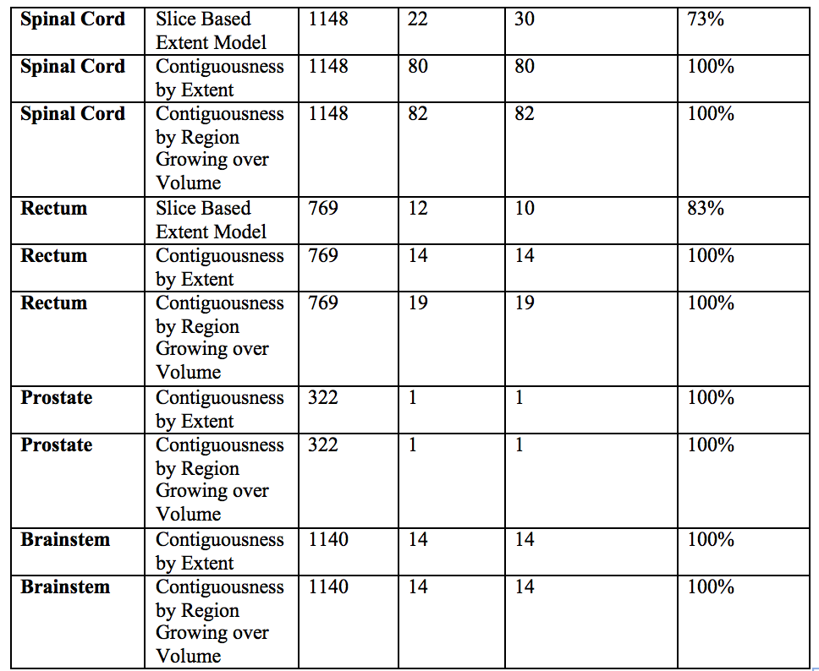
Example detection
Discontinuity
Statistical outlier (volume)
Projections of sample data augmentations

