Slide 1
3D Scanning Applications for Intraoperative Cranioplasty Implant Modification
Alex Mathews ∙ Joshua You
Computer Integrated Surgery 2015
Mentors: Dr. Armand, Dr. Gordon, Dr. Murphy, Captain Grant

Slide 2
Team Members
Alex Mathews
Joshua You
Mentors
Dr. Armand – JHU APL
Dr. Gordon – JHMI
Dr. Murphy – JHU APL
Captain Grant – Walter Reed

Slide 3
Overview
Project Summary
Progress
Dependencies
Milestones
Deliverables
Timeline
Upcoming Milestones

Slide 4
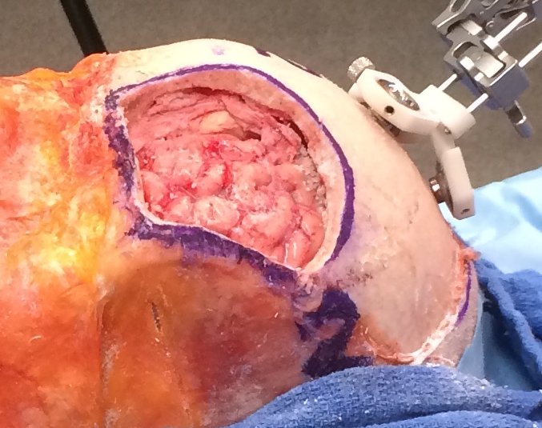
Project Summary
Implementing the iPad mounted Structure Sensor to intraoperatively scan a patient’s head during a cranioplasty procedure
Key goals:
Reduce operation time
Improve accuracy and fit of CCI
Key topics:
3D Scanning
3D Mesh Segmentation
Notes:
CCI = Customized Cranial Impant

Slide 5
Progress
Dependencies, Milestones

Slide 6
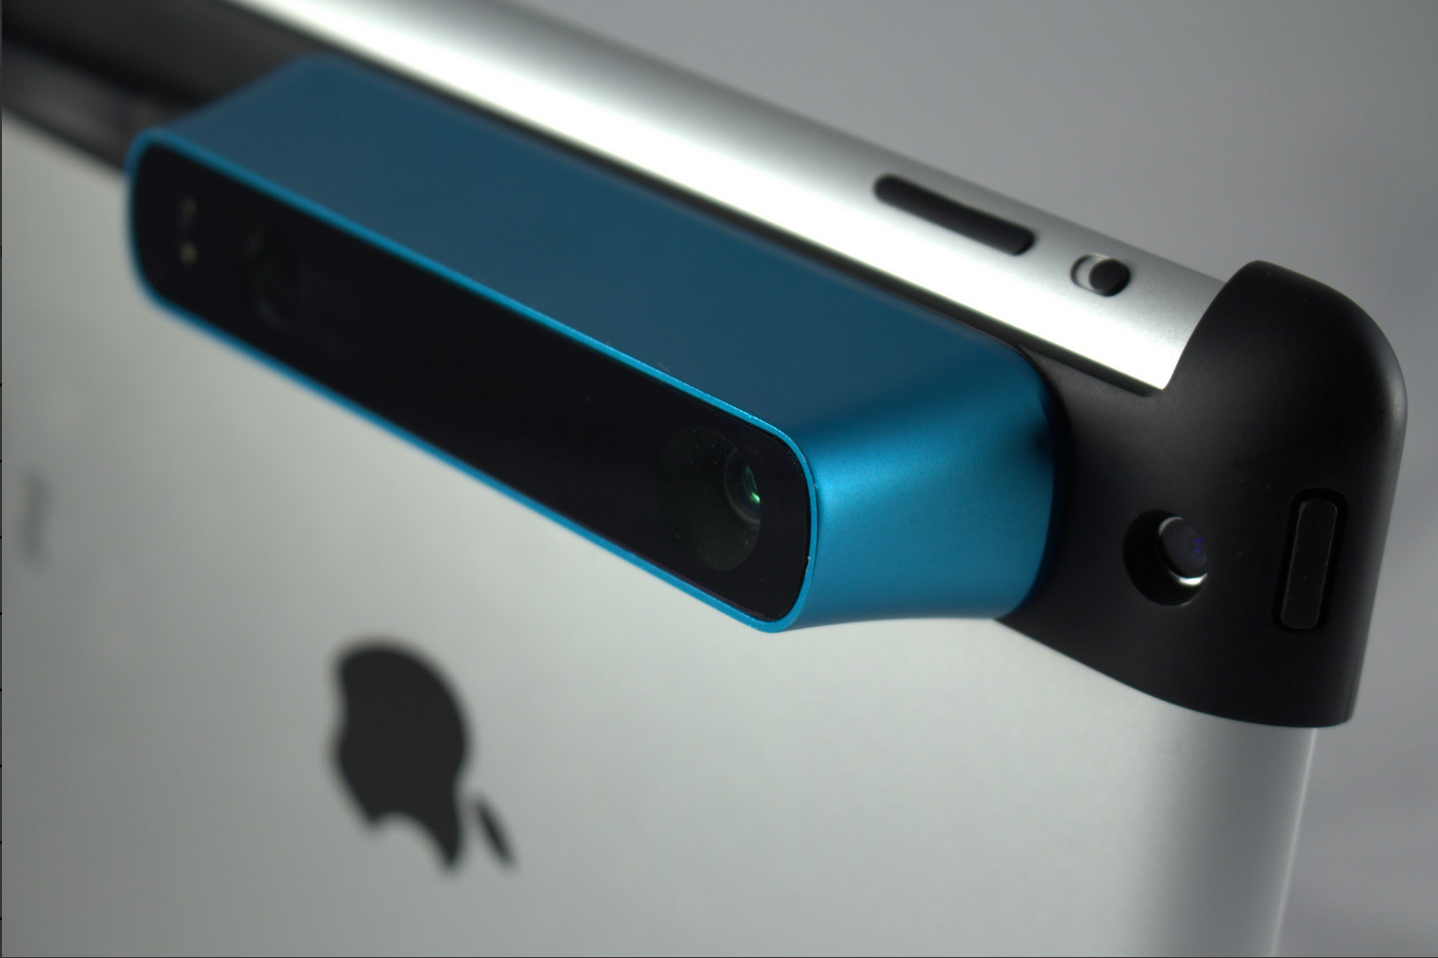
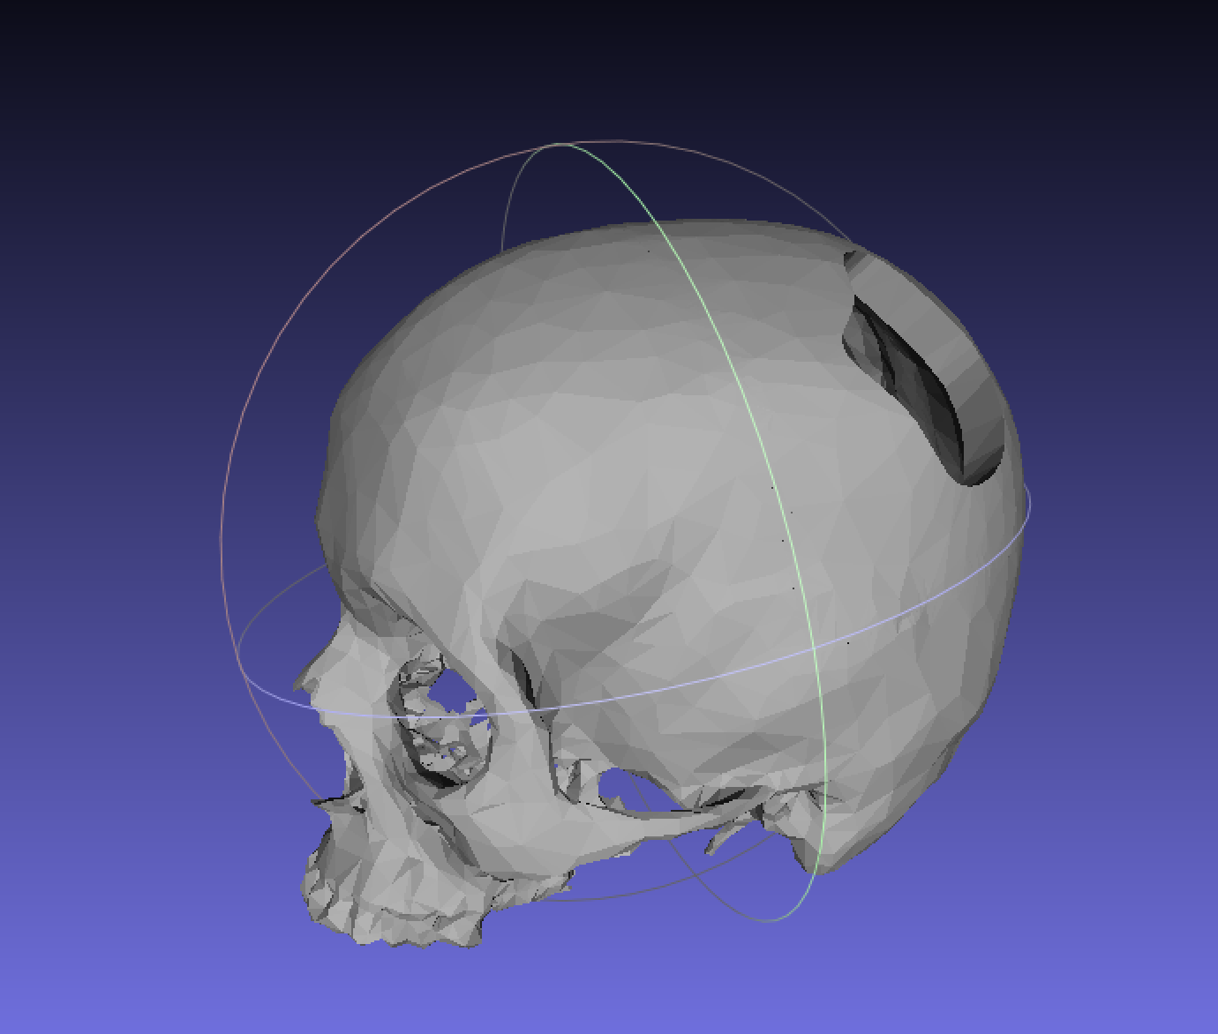
Dependencies
Structure Sensor - Completed ✓
Purchased by Dr. Armand
Mock Operations - Completed ✓
Once a month with Dr. Gordon
Test Objects - Completed ✓
Calibration objects and Phantom Skull
Printed at the DMC and by Dr. Ryan Murphy
iPad - Completed ✓
Personal iPad

Slide 7
Milestones
Date | Milestone | Status
Feb 28 | Color Segmentation algorithm completed | ✓
Mar 14 | .obj area of interest algorithm completed | ✓
Mar 28 | Phantom skull testing | ✓
Apr 4 | Mock Operation: Test scans in surgical environment (Completed March 7) | ✓
Apr 2 | Checkpoint presentation | ––
Apr 18 | Complete Procedure Integration | ––
May 2 | Mock Operation: Test integration modules | ––

Slide 8
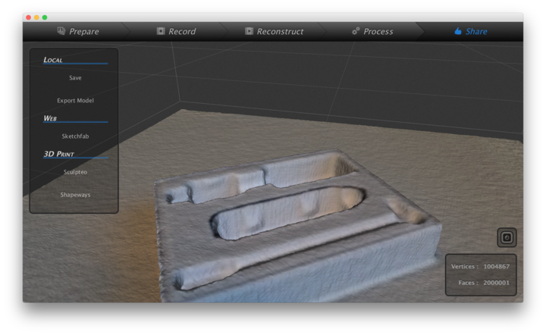
✓ Scanning and Color Segmentation
Scanner is used in uplink mode
Skanect
Implements Structure Sensor
File is imported into modules using the .obj format
ASCII file type
Vertices with RBG color data
Colors are segmented during import of .obj file

Slide 9
✓ Phantom Skull Testing
Ground Truth Skull
*Defect colored to provide contrast in this presentation
Scanner Output
*Note colored dots placed on skull
Notes:
Ground truth skull was generated from compilation of CT data

Slide 10
–– Integration – Surgical Workflow
Before Surgery
Surgery Prep
Surgery
Intraoperative Processing
Preoperative CT Scan
Head Shaved
Skull Fragment Removed
Registration to CT Surface Model**
CT Surface Model Built
Reflective Markers
Intraoperative 3D Scan
Crest Identification
Implant Designed
Preoperative 3D Scan*
Defect CT Coordinates
Identified
Implant Fabricated
* Only necessary if required by CT surface model registration
** Requires Preoperative 3D Scan if facial structures hidden due to patient positioning

Slide 11
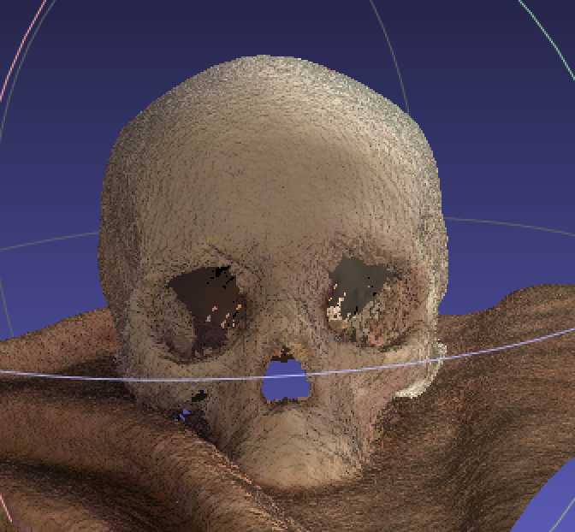
–– Integration – Registration
Scan to CT Surface Model Registration
Implant is designed in CT coordinates
Registration required to determine defect coordinates in the CT space
Will use bony structures of the face to determine gross registration
Use ICP for refinement of transformations

Slide 12
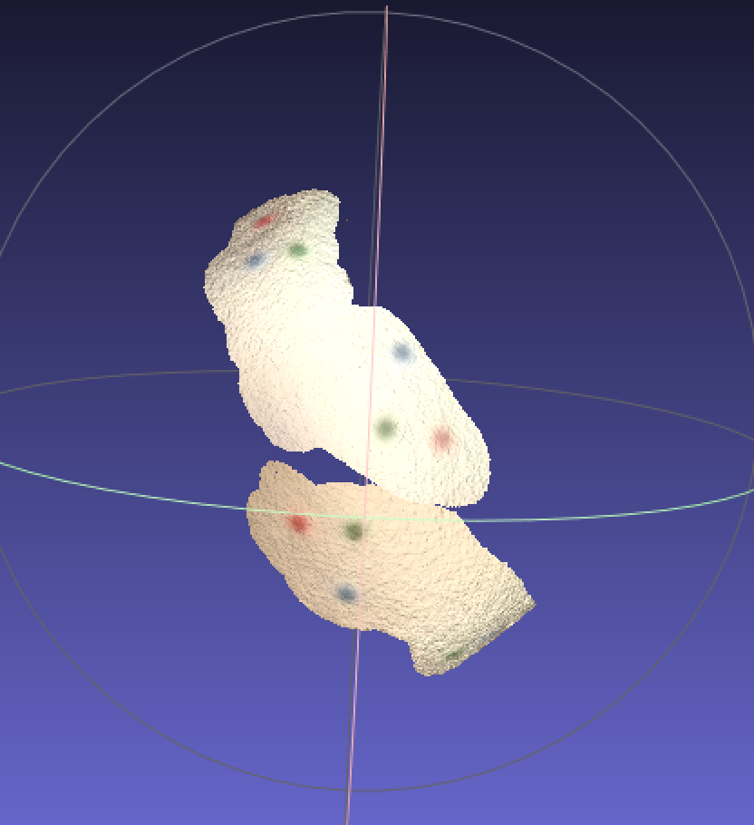
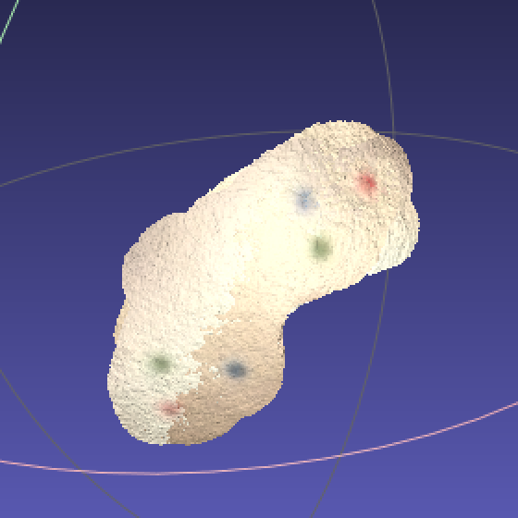
–– Integration – Registration
Scan to Scan Registration
Required if the face is not in view due to patient positioning
Use colored dots for gross registration ✓, ICP for refinement ––
Gross registration of isolated dots from two separate scans

Slide 13
–– Integration – Registration (cont.)
Next steps:
Use ICP to refine registration for Scan to Scan
Identify optimal bony structures for Scan to CT Surface Model registration
Use ICP for Scan to CT Surface Model registration
Looking into more radiant colored dots for segmentation
Validation steps:
Need to provide data on accuracy of scan and registration
Currently unknown, but should be within millimeter accuracy
Need to determine variation between scans

Slide 14
–– Integration – Crest Identification
Past Attempts - Using previously developed programs (Mayavi)
Issues
Still unsure if its possible to extract contour information
Orientation dependent
Past Attempts – Extracting contour lines using ring relationship based method
Issues
Threshold difficult to determine
Orientation dependent

Slide 15
–– Integration – Crest Identification (cont.)
Future Method #1
Use centroid of the mesh to determine the center of the defect
Use a collection of surrounding points to determine a normal vector to surface
Calculate normal vectors of all other points using surrounding points
Use angle of normal vectors to determine walls of defect
Worst Case Scenario – Manual Input
Surgical assistant manually selects points on the work station
Equivalent to digitizing defect using a pointer in the current procedure

Slide 16
Deliverables
Updates to project goals

Slide 17
Previous Deliverables
Minimum
Segmentation
Color
Depth
Mesh focusing algorithm through crest detection
Expected
Ability to use the scanner in uplink mode to workstation
Integration with laser projection modules
Maximum
Testing in the Mock Operation Room
Tablet application with 3D scanning and processing

Slide 18
New Deliverables
Minimum
Segmentation
Color ✓
Depth ✓
Mesh focusing algorithm through crest detection ––
Expected
Ability to use the scanner in uplink mode to workstation ✓
Integration with laser projection modules ––
Maximum
Testing in the Mock OR ✓––
Tablet workstation application with 3D scanning and processing

Slide 19
Timeline
Updates to project timeline

Slide 20
Previous Timeline
 | February |  |  | March |  |  |  | April |  |  |  | May
Segmentation Algorithm Development
Working with .obj file, decide on data structures for import
Color identification algorithm
Refocusing .obj file algorithm
Defect edge identification using depth algorithm
Bottom edge, top edge joining and mesh output
Imaging Development
Define procedure for obtaining scan with skannect
Build test object with defect
Use test object for scans and determine accuracy
Test algorithm on object
Test algorithm on phantom skull
Test at Mock Operation
Procedure Integration
Develop necessary modules for scanner communication
Test at Mock Operation
Application Development
SDK, OpenNI exploration
Prototype Application Development

Slide 21
New Timeline
 | February |  |  | March |  |  |  | April |  |  |  | May
Segmentation Algorithm Development
Working with .obj file, decide on data structures for import
Color identification algorithm
Refocusing .obj file algorithm
Defect edge identification using depth algorithm
Bottom edge, top edge joining and mesh output
Imaging Development
Define procedure for obtaining scan with skannect
Build test object with defect
Use test object for scans and determine accuracy
Test algorithm on object
Test algorithm on phantom skull
Test at Mock Operation
Procedure Integration
Develop necessary modules for scanner communication
Test at Mock Operation
Application Development (Workstation)
SDK, OpenNI Skannect exploration
Prototype Application Development

Slide 22
Upcoming Milestones
Completion of defect isolation using crest identification algorithm
Implementation of ICP for Scan to Scan registration
Testing and validation
Implementation of ICP for Scan to CT Surface Model registration
Testing and validation against ground truth skull

