Slide 1
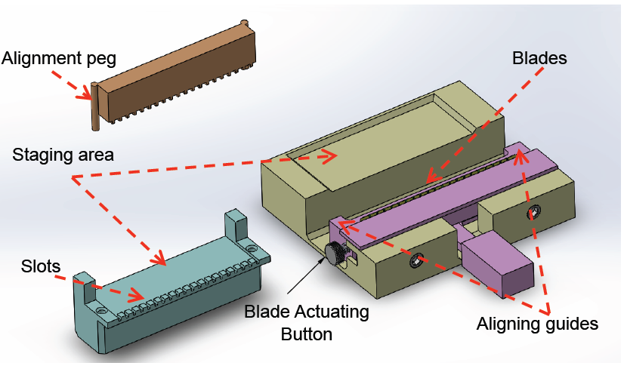
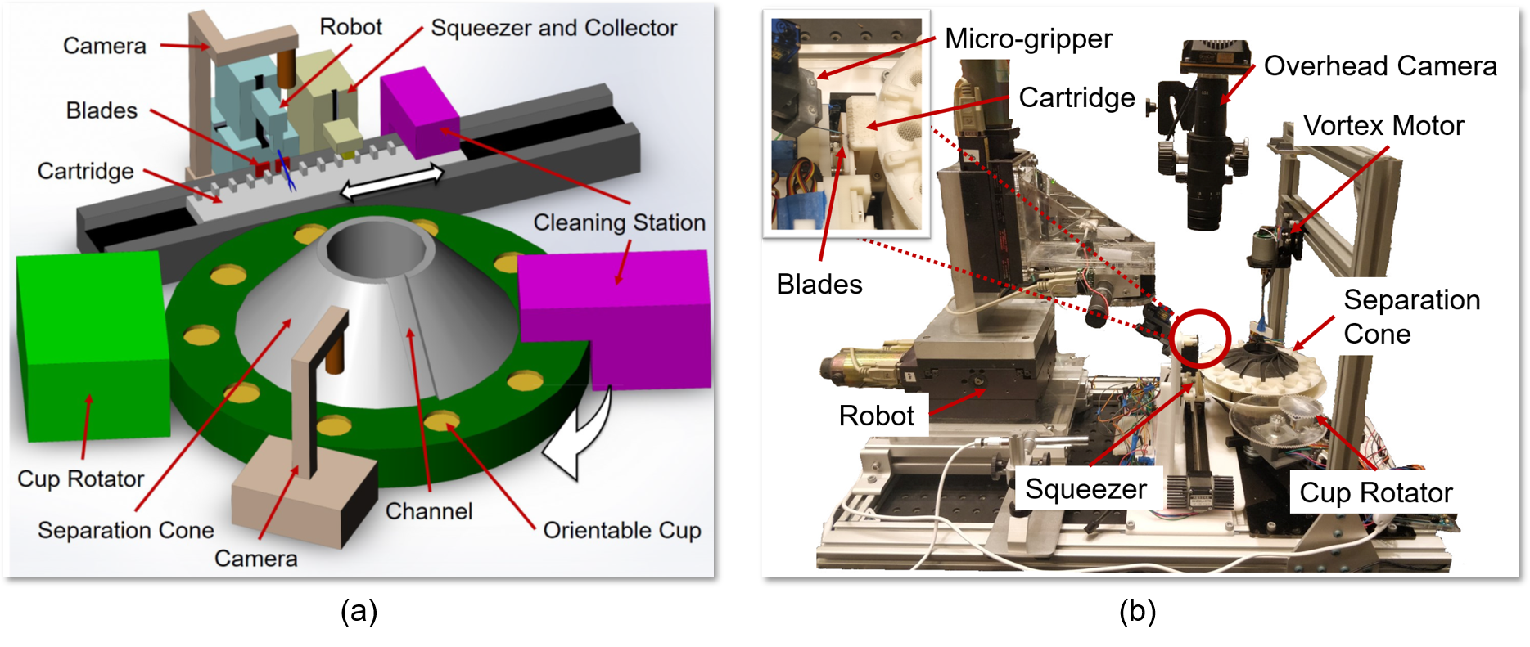
Automated Mosquito Dissection
Goal: Assist in the development of a robotic system to extract salivary glands from mosquitoes for malaria vaccine production
Background:
Malaria is an enormous global health problem
Sanari, Inc. (Rockville, Md.) has developed an effective live organism vaccine for malaria
Sanaria’s current production process requires one-at-a-time removal of salivary glands using tweezers and a hypodermic needle.
We have an ongoing collaboration with Sanaria to improve process
Fixturing for improved manual dissection
Robotic system (in development)
Fixturing Prototype
Robotic System Prototype

Slide 2
Automated Mosquito Dissection
What Students Will Do: Several possible projects
Real time vision for tracking mosquitoes
Software and system integration – (really need more here)
Mechanical design
Deliverables:
Working code, documentation, designs
Academic papers
Size group: 1-2 per project
Skills: Depends on particular project. Some subset of
Computer vision/deep learning
Software: Python, C++
Mechanical design and build
Mentors: Prof. Taylor, Simon Leonard (software/systems), Iulian Iordachita (mechanical engineering), Balazs Vagvolgyi (vision)

