Slide 1
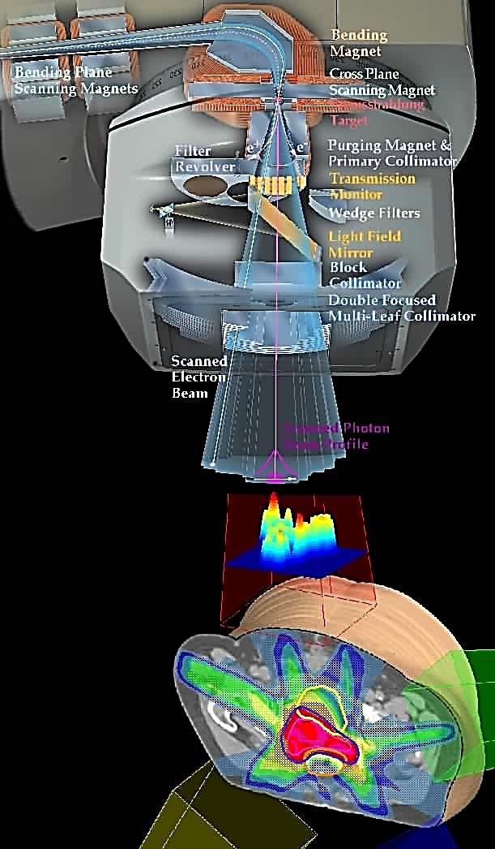
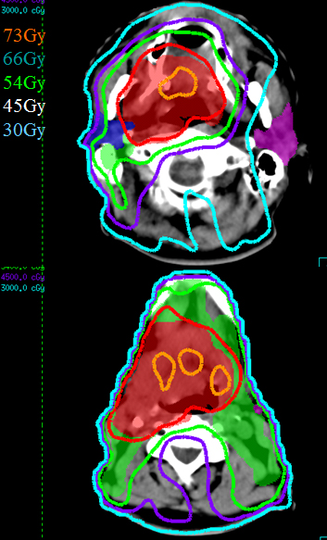
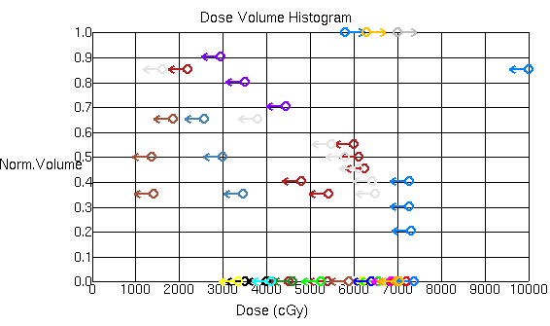
Radiation Planning For Head And Neck (Data-Driven Strategy For Optimization Of Intensity Modulated Radiation Therapy (IMRT) Planning For Head And Neck Region) Computer Integrated Surgery II Spring, 2011 Yang Wuyang M.D., under the auspices of Dr. Todd McNutt and Professor Russell Taylor
Introduction
We developed a package to implement a data-driven strategy for dynamic clinical decision support in IMRT planning for Head And Neck region. The package, which was built in python and SQl, pulls needed patient data from the “Oncospace” database, analyze the data to produce result for optimized patient planning, and goes directly into the planning system to set up beam parameters for actual planning.
The basic problem that drives us in doing this project is the unwarranted variation of practice in IMRT planning of the current clinical setting. Under the big schema of Evidence-Based-Medicine (EBM), such variation is considered as the presence of poor clinical practice and should be eliminated.
The Problem
Current IMRT planning procedure needs physician to provide guesses on constraints on doses of targeted volume, the process of guessing:
Produces great variations between planners
Extremely time consuming
Quality of plans can be very different between different planners even for the same patient.
The variation of practice, due to lack of evidence for greater clinical benefit, is considered to be the major reason for high cost-benefit ratio in health care.
Call for eliminating variation of practice motivated us to implement a data driven solution for producing high level evidence for standardizing IMRT planning practices.
Left: Concept of IMRT. Right: Head And Neck region radiation coverage (Iso-dose regions)
Courtesy from Dr. McNutt
Outcomes and Results
Planning Objectives And Results Generated:
Figure1.
The input of dose objectives into Pinnacle3 System, these objectives served as a practice evidence because they were generated from our database that represents the past knowledge/experiences of doctors
Figure2.
As Pinnacle3 calculates the dosage of the new patient can achieve, most of the lines on the left are the dosage of critical structures generated based on the objective constraint we put into the system. As one can see , most planning objectives were met.
The result shown here means that we created a planning objective that was evident based, implemented a clinical procedure that reached results in 10 minutes where it usually takes 1 week, and generated dosage plan for patients that is generally acceptable by IMRT planners(critical objectives met).
Future Work
A more detailed definition of “harder to plan” needs to be defined. The current strategy is very conservative.
Clinical effectiveness of the proposed strategy needs to be evaluated, which needs data input of patient toxicity measures and outcome measures, physician satisfaction, and other clinical related variables.
Figures showing 3D reconstruction of the beam setup for our planned patient
The Solution
The work to provide solution to solve the problem was to implement a modified algorithm (originally built in matlab) into a newly created software package in python and SQL for clinical workflow optimization.
Lessons Learned
Clinical information/Clinical Decision Support Information and engineering product integration is a future trend.
Being conservative is better than being aggressive in the beginning of designing a product
Physician
experience
Planning System
Result
looping for about 30 times
Only loop about 2 times
Support by and Acknowledgements
Core NSF CISST/ERC
Department Of Radiation Oncology, JHH
goes first to the data driven planning system
Data Driven Planning
Proposed Solution Workflow
Engineering Research Center for Computer Integrated Surgical Systems and Technology

