Slide 1
Accuracy Improvement of the da Vinci Robot
The da Vinci robot accuracy is affected by kinematic and non-kinematic errors such as instrument compliance. The goal is to model these errors, estimate parameters, and improve the accuracy
What Students Will Do:
Improve the accuracy of the da Vinci Research Kit (dVRK)
Deliverables:
Software for kinematic calibration (joint offsets)
Refine developed compliance model
Real-time accuracy correction based on measured motor currents and compliance model
Size group: 1-2
Skills: C++, Python, robot kinematics, data collection
Mentors: Peter Kazanzides (pkaz@jhu.edu), Anton Deguet (anton.deguet@jhu.edu)

Slide 2
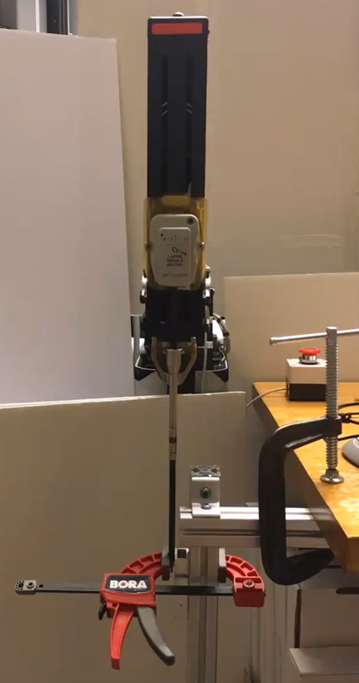
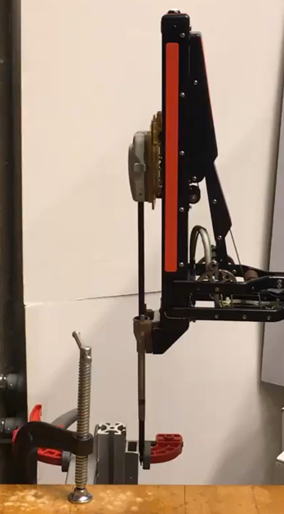
Accuracy Improvement of the da Vinci Robot
Joint 1
RCM
Joint 2
RCM
clamp
clamp
Measuring instrument compliance

