Slide 1
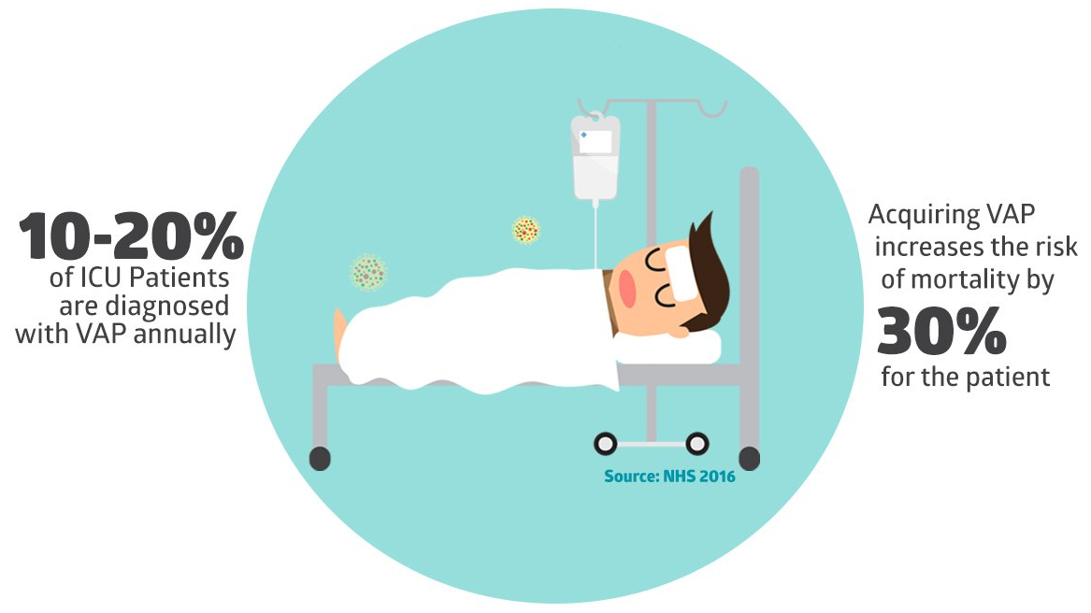
Assessing Ventilator-associated Pneumonia (VAP) in the PICU
VAP (particularly in PICU) is common and serious!
At Hopkins PICU: Bedside AP X-ray + continuous monitoring strategies to assess whether VAP occurs, improves, or worsens
NIH public dataset: Pediatric chest X-rays
JHU dataset: “Messy” chest X-rays and other time series data

Slide 2
Assessing Ventilator-associated Pneumonia (VAP) in the PICU
What Students Will Do & Deliverables:
Develop machine learning algorithms for automatic analysis of
Chest X-rays (first using the NIH database, then the JHU dataset)
Time series data (including X-ray and other monitors)
Long-term prospect: Develop learning-based algorithms to monitor onset, worsening or amelioration of VAP in the PICU → Ideally, a stand-alone tool for autonomous monitoring
Size group: 1-2, pref. 2
Skills:
Experience in ML, DL, and ConvNets (Python, Pytorch)
Ideal: Experience dealing with medical and time series data

Slide 3
Assessing Ventilator-associated Pneumonia (VAP) in the PICU
Mentors: Radiology Artificial Intelligence Lab (rail.jhu.edu)
Technical side:
Mathias Unberath (unberath@jhu.edu)
Clinical collaborators:
Jim Fackler (jim@jhmi.edu)
Ferdinand Hui, Haris Sair, Paul Yi

