Slide 1
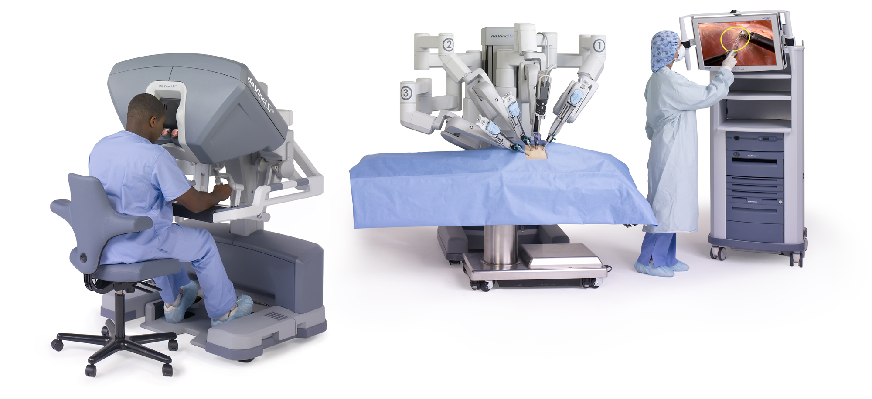
Objective Assessment of Robotic Surgery Skill
Robot-assisted minimally invasive surgery (RAMIS) is quickly becoming the prescribed method of treatment for many different routine and non-routine surgical procedures.
There is a need to ensure that all robotic surgeons have a minimal level of skill proficiency before they operate on patients.
Current methods of skill assessment rely almost exclusively on structured human grading (which relies heavily on the visual acuity of the grader).
The goal of this project is to develop an intelligent system that can objectively assess surgical skill using performance data about how surgeons move their hands and connected instruments, as well as how the instruments interact with the surgical workspace (i.e. anatomy).
© 2018 Intuitive Surgical, Inc.

Slide 2
Objective Assessment of Robotic Surgery Skill
What Students Will Do:
Develop a hardware + software platform using ROS (Python) that collects synchronous streams of motion and physical interaction data (forces and vibrations). This will combine two previously developed surgical skill assessment platforms.
Collect pilot training data from clinicians of various skill level on a da Vinci surgical robot
Analyze pilot data using standard statistical approaches to determine best approaches for finding patterns in data
(Optional) Develop experimental protocol for a large-scale data collection

Slide 3
Objective Assessment of Robotic Surgery Skill
Deliverables:
Hardware+software platform for surgical skill assessment based on robot motion and physical interactions,
Pilot data from clinicians of various skill level,
Analysis of pilot data and recommendations for best pattern recognition approaches to understand the data.
(Optional): Experimental protocol for large scale data collection
Size group: 2 (3 if optional deliverable is part of the proposal as well)
Skills: Python, ROS, C++, Mechatronics
Mentors: Jeremy Brown; Anand Malpani

