Slide 1
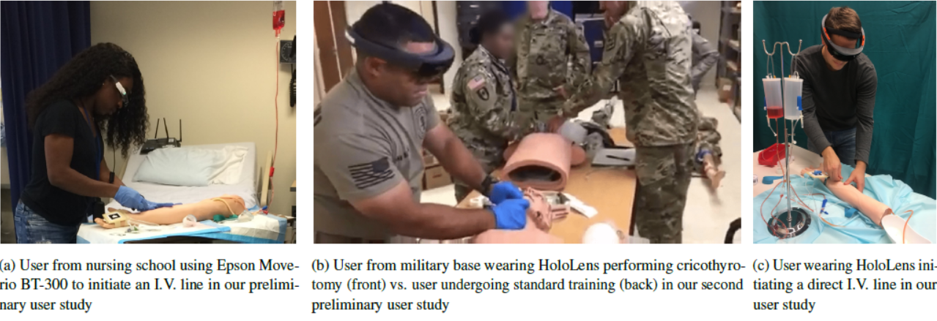
Content Generation for HMD Based Medical Training
With the increasing global interest for head mounted displays (OST-HMDs) across medical and educational settings, many systems with different capabilities have recently entered the market.
We recently evaluated the benefits of using HMDs for training of caregivers in an emergency medical environment.
Current methods of content creation are mostly manual and tedious. There is a need for an easier method to create content for such tasks.
The goal of this project is to semi-automatically generate the step by step training modules while a surgeon is performing the task with the HMD.
© 2018 Intuitive Surgical, Inc.

Slide 2
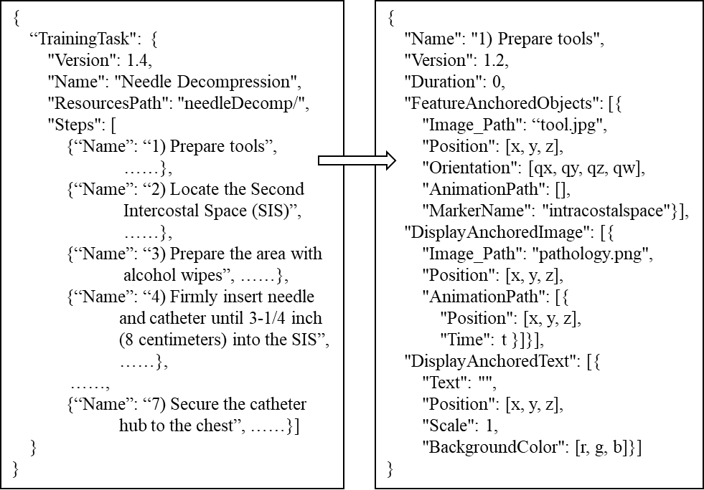
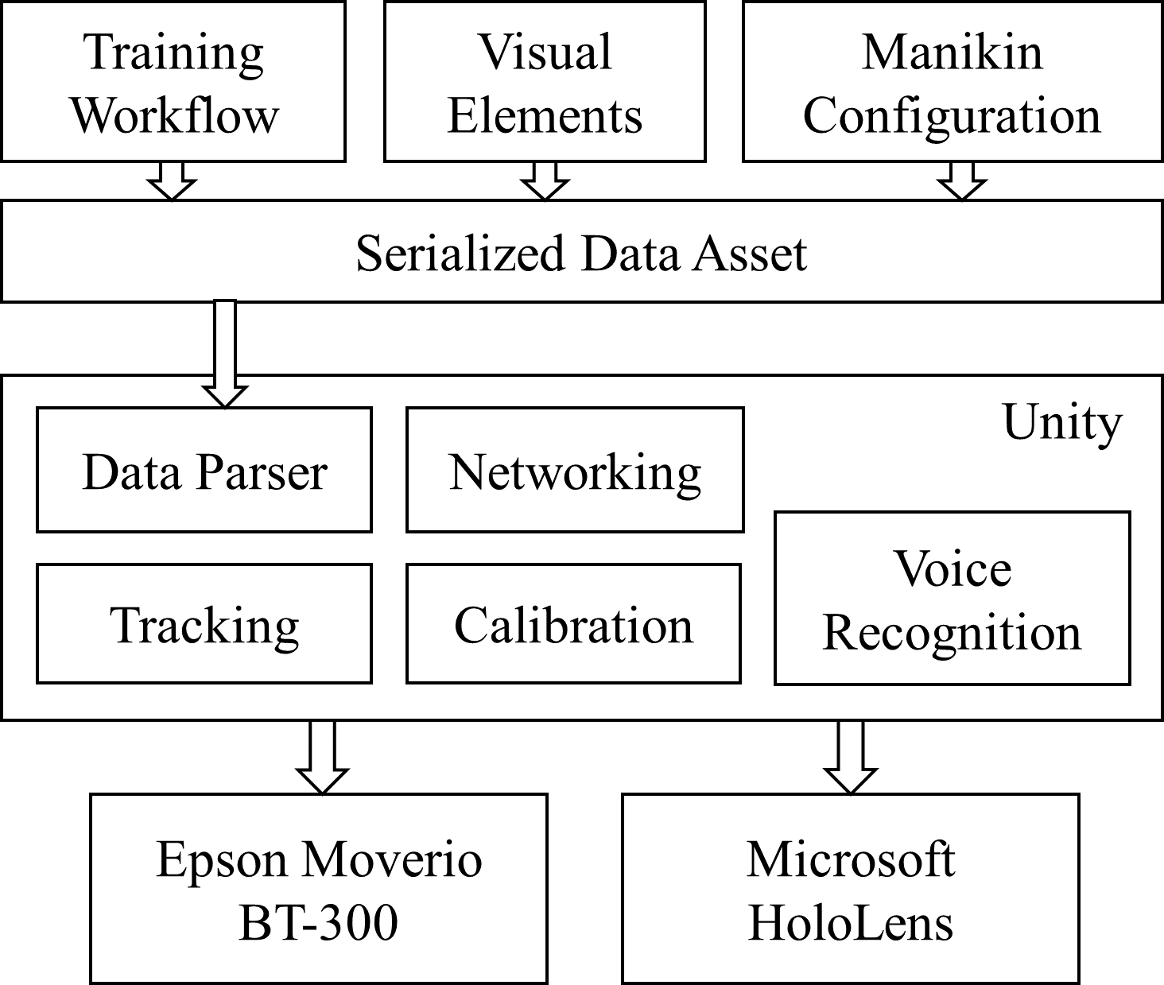
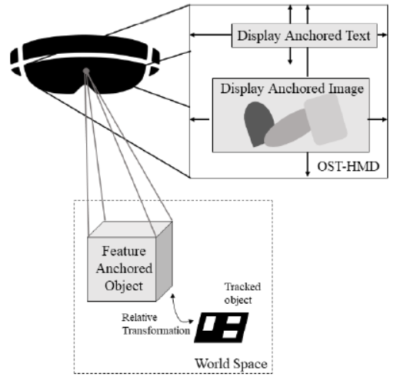
Content Generation for HMD Based Medical Training
What Students Will Do:
Develop software platform that generates step by step instructions in form of texts and graphics and serialize it in a compatible (json) format for HoloLens
First, the data can be extracted from an instructional video, and next from the HMD (Microsoft HoloLens) while surgeon is performing task
(Optional) Perform a user-study to assess the developed module
Sample step of the json file
System Architecture

Slide 3
Content Generation for HMD Based Medical Training
Deliverables:
Software that can extract instructions from a video and record the appropriate text, graphics, etc. in a compatible json file.
Software that creates the training module while the surgeon is performing a task, such as ventriculostomy training, and saves it in a compatible instruction file.
(Optional): A user study to evaluate the system
Size group: 2 (3 if user study is in the deliverables)
Skills: Experienced in at least one language: Python or C++ or C#, Unity3D
Mentors: Ehsan Azimi, Dr. Chien-Ming Huang, Dr. Peter Kazanzides, Dr. Camilo Molina (Clinical Collaborator)

