Slide 1
Mobile Telesurgery Platform in Mixed-Realty
Da Vinci surgeons currently use a bulky master console that is located remotely from the patient. The aim of this project is to design and implement an alternative teleoperation system that can be integrated with head-mounted display (HMD) to enable the robotic surgeon to be mobile and in the sterile field.​
What Students Will Do:
Implement a mobile input system for da Vinci teleoperation
Deliverables:
Finding a suitable alternative human interaction for robot teleoperation
Implementation of the interaction method and interface with the robot control module
Evaluation of the efficiency/accuracy of system vs. the existing setup
Size group: 2-3 students
Skills: Tracking, sensor fusion, mechanical design and prototyping, C++ or Python (for dVRK), Unity (for HMD)
Mentors: Ehsan Azimi (eazimi1@jhu.edu), Peter Kazanzides (pkaz@jhu.edu)

Slide 2
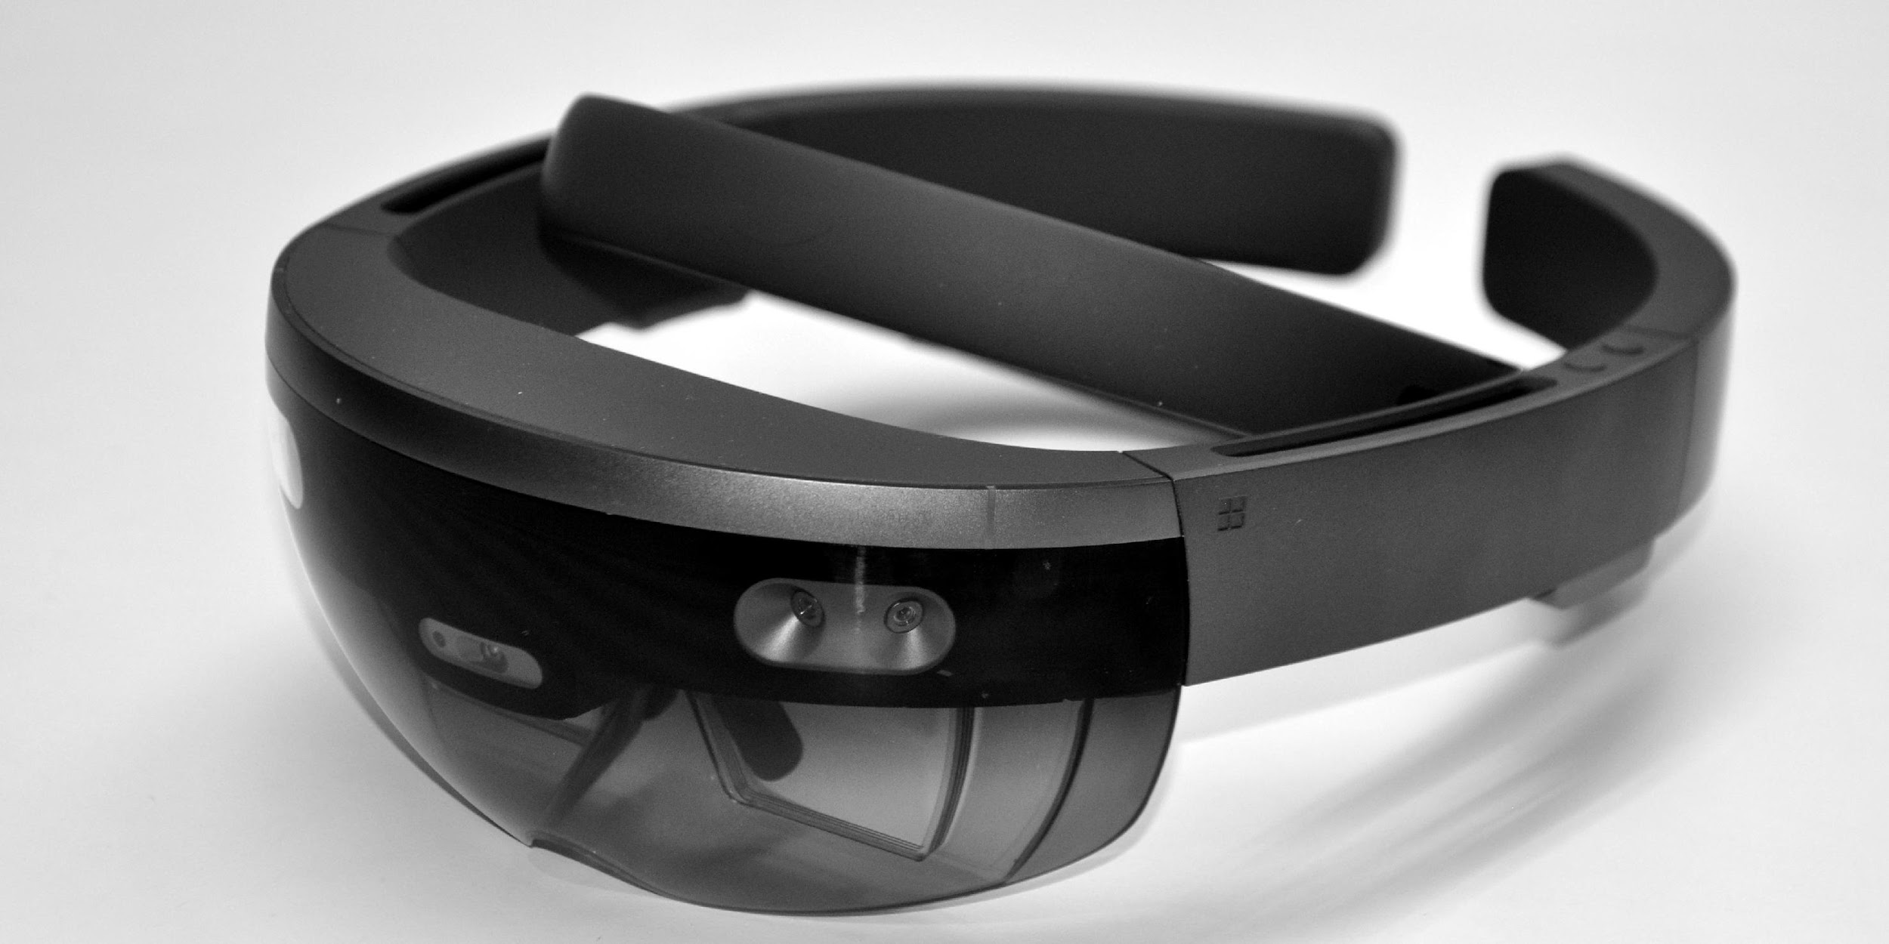
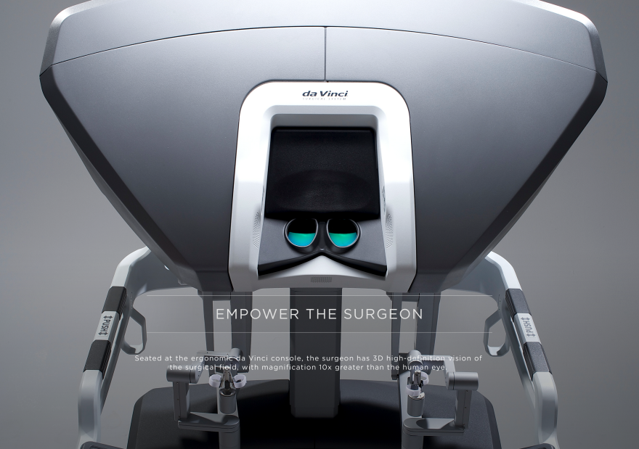
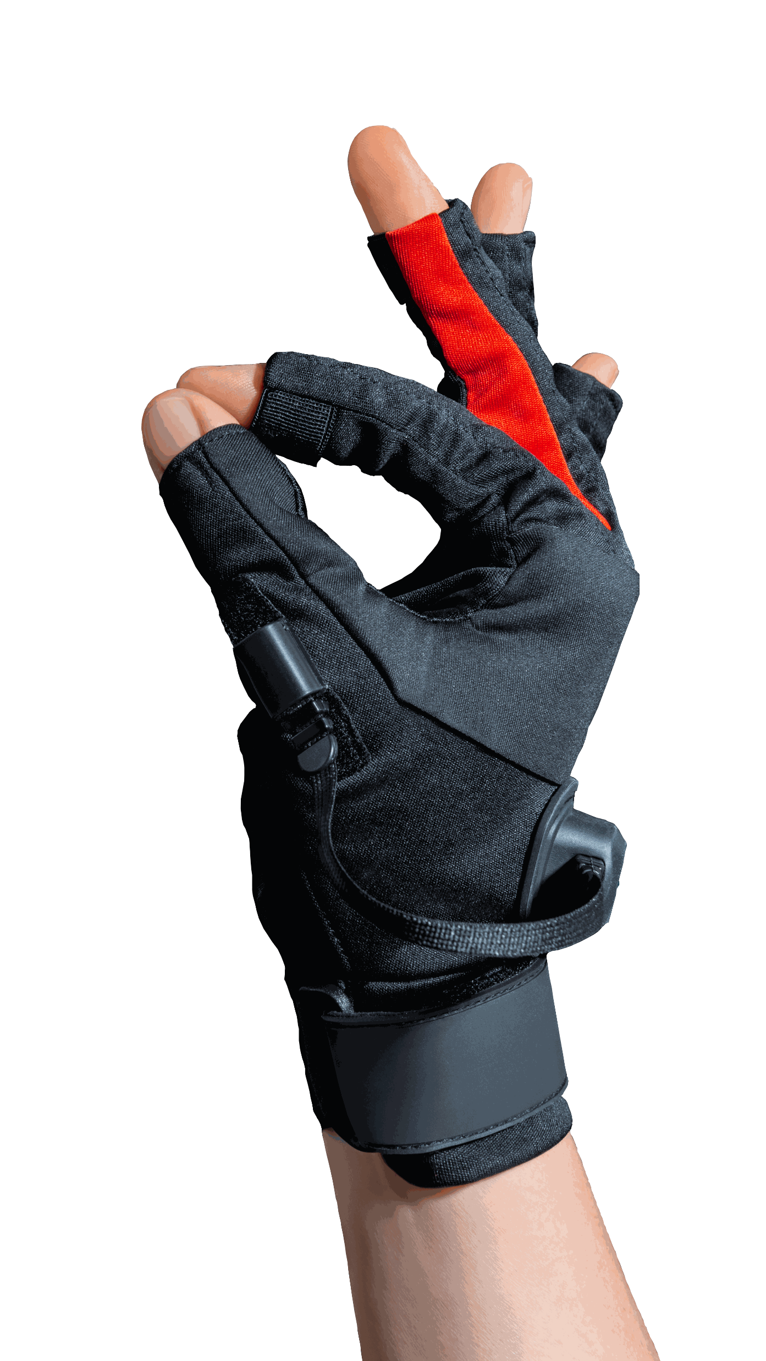
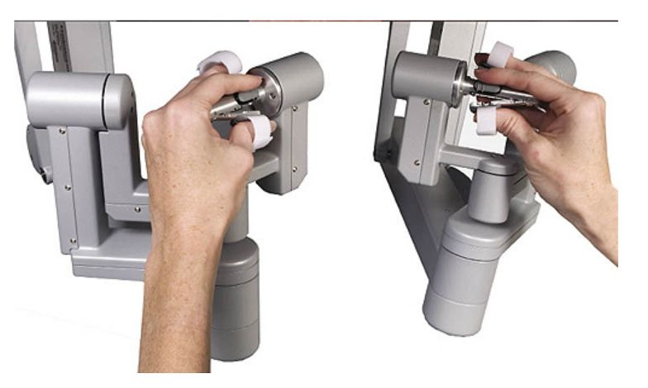
Mobile Telesurgery Platform in Mixed-Realty
Stationary – Not sterile – Contact
Mobile – Sterile – Noncontact

