Slide 1
Vision Guided Mosquito Dissection for the Production of Malaria Vaccine
Nick Greene
Project Group 5
Checkpoint Presentation
Mentors: Balazs Vagvolgyi, Alan Lai, Parth Vora

Slide 2
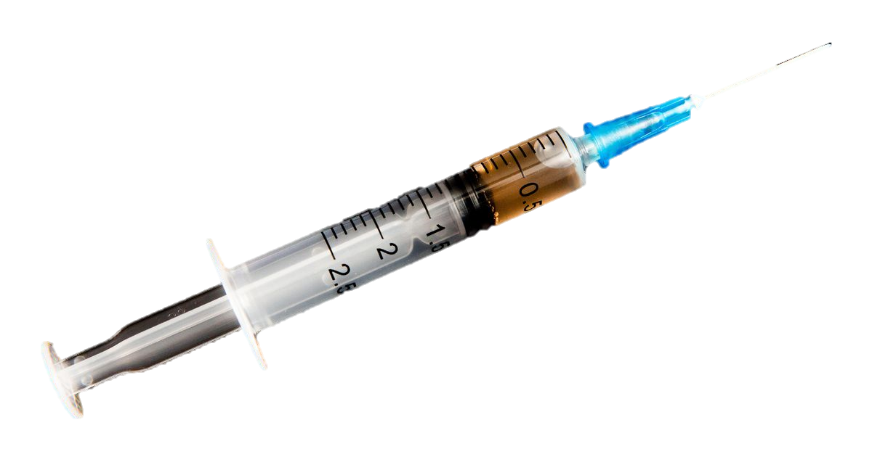
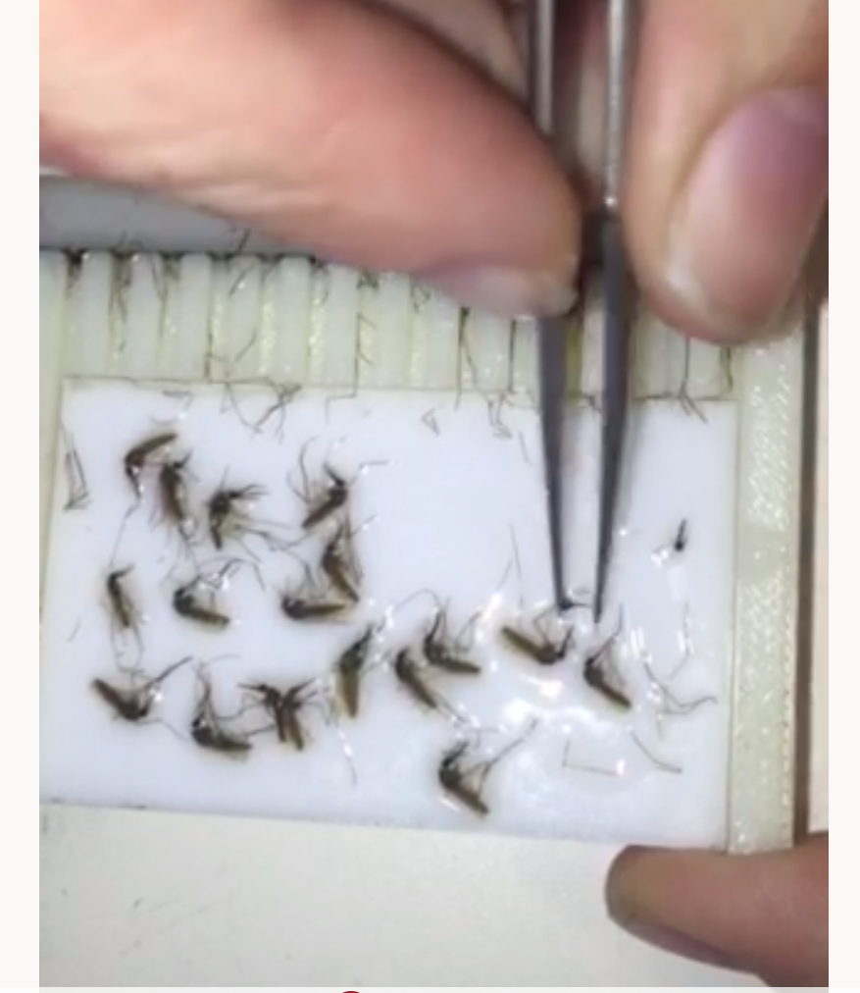
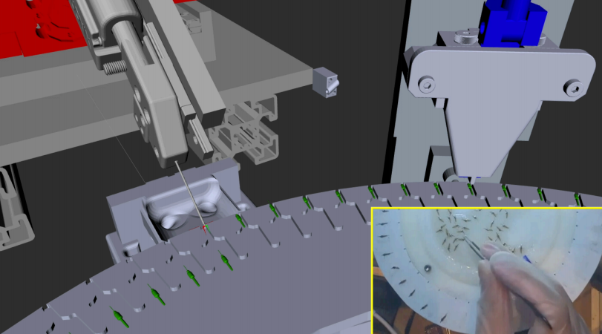
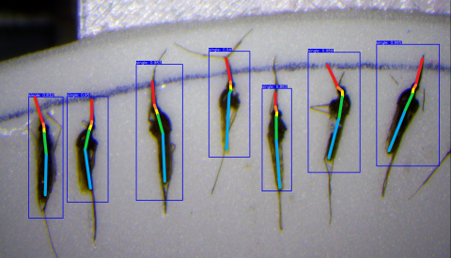
Backgound
image: CNET
Sanaria has developed practical and effective malaria vaccines which could be critical in the global fight against malaria [2] [3]
Currently, production of malaria vaccine is heavily bottlenecked by manual extraction of mosquito salivary glands
Ongoing development of an automated robot system for the mosquito salivary gland extraction
[7] Jongo et al. 2018
[8] Sanaria
All Images from JHU
except where noted
image: JHU

Slide 3
Goals
Implement vision algorithms with both machine learning and conventional image processing:
Tasks are:
Check if turntable cleaning was successful at the cleaning station
Check if gripper has mosquito parts stuck to it
Estimate the volume of the mosquito extrudate
Integrate these algorithms with the current system
All Images from JHU
except where noted

Slide 4
Machine Setup / Demonstration
Cutting Station
Squeezing Station
Cleaning Station
All Images from JHU
except where noted

Slide 5
System Integration
The vision algorithms will be integrated with the existing system through the use of ROS Services.
ROS Service will be implemented in C++
for OpenCV and Python for PyTorch
PyTorch
OpenCV
Camera
image
Network
image
image
Ros Service Request
Robot System
Computer
Vision Computer
output
output
Ros Service Response
final result
Compare and Validate
Actuators
commands
All Images from JHU
except where noted

Slide 6
Deliverables
 | Activity | Deliverable | Original Expected Deadline | Status | New Deadline
Min | Collect images of cleaning station and annotate | Annotated cleaning station dataset | 3/1 | Completed (Delayed) | n/a
 | Implement image processing method for cleaning station | Functioning image processing based code and high quality documentation in a wiki | 3/15 | Functional but Missing Documentation | 4/5
 | Develop and train a neural network on the cleaning station dataset | Trained parameters of a neural network classifier, along with code and high quality documentation in a wiki | 3/18 | Functional but Missing Documentation | 4/5
 | Integrate both with the rest of the system using ROS | Working ROS services which can be successfully interfaced with from the robot control computer, and thorough documentation for how to use them in a wiki page | 3/22 | In Progress | 4/7
Expected | Repeat for gripper cleaning | Same deliverables as for turntable cleaning station. | 4/7 | In Progress | 4/14
Max | Discuss with hardware team about collecting exudate data | Plan for collecting exudate ground truth data | 4/1 | Completed | n/a
 | Repeat for exudate volume estimation | Same deliverables as for previous two tasks. | 5/1 | Won’t reach full maximum deliverable in time | 5/1

Slide 7
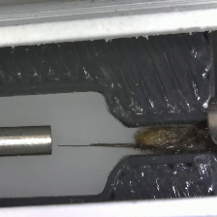
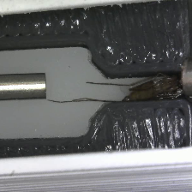
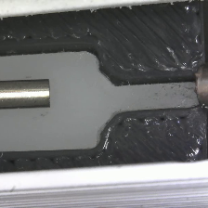
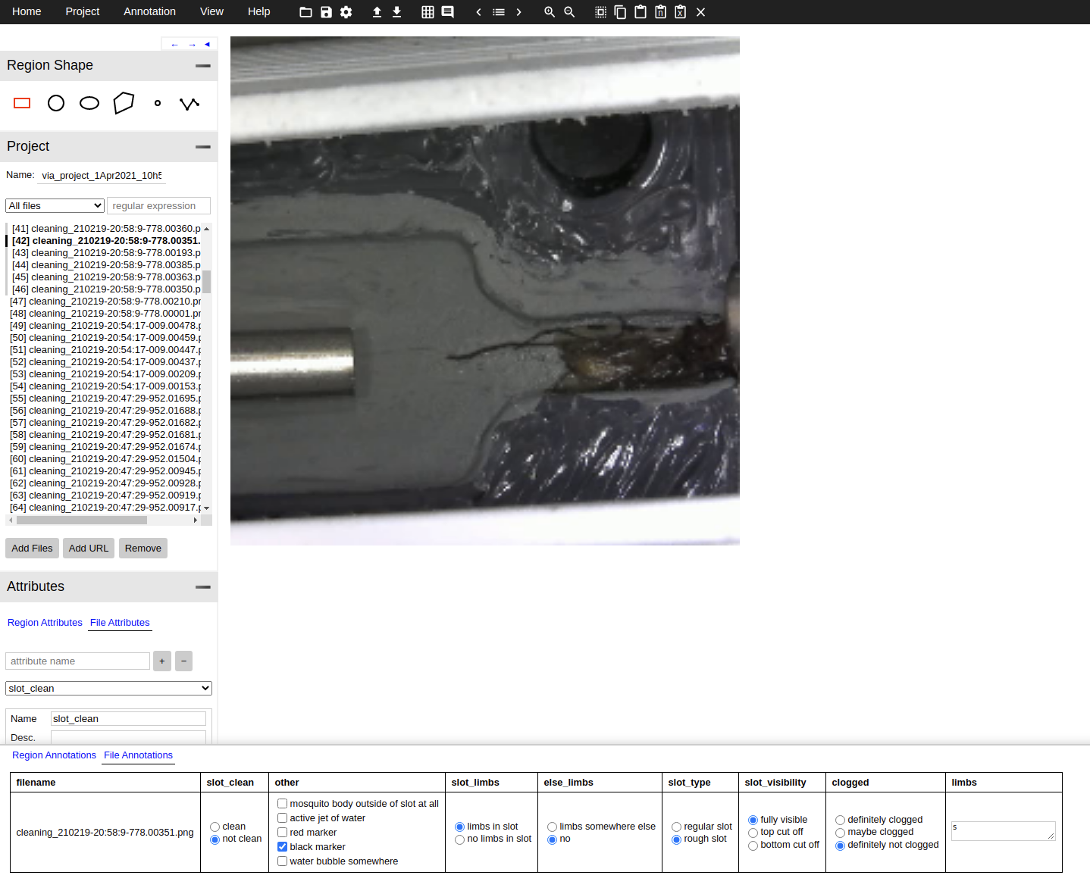
Progress – Dataset
Cleaning Station Dataset
All images annotated
293 in total
Gripper Dataset
All images acquired
All Images from JHU
except where noted

Slide 8
Progress – Image Processing
Image Processing method is 98% accurate on the dataset.
Mosquitos Segmented by filtering/thresholding
Pixel count determines if slot is clean
Working on a registration method
Will improve robustness and accuracy
All Images from JHU
except where noted

Slide 9
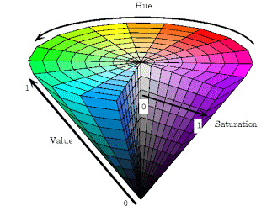
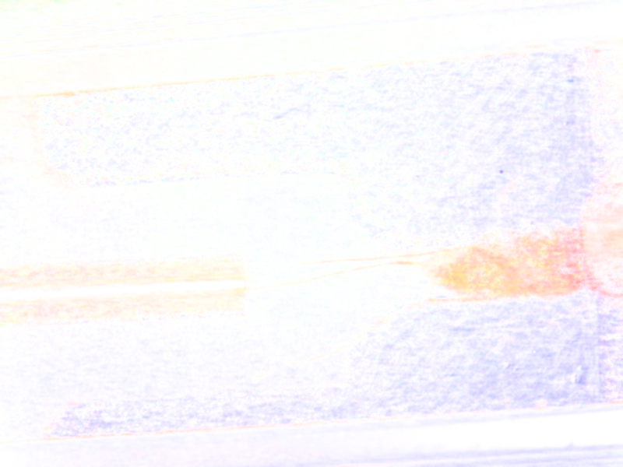
Segmentation – Image Processing
Convert Image to HSV color space
Set value channel to 100%
Convert back to RGB,
Threshold by color
Image Source: http://www.ece.northwestern.edu/
All Images from JHU
except where noted

Slide 10
Segmentation – Image Processing
Perform a brightness threshold and subtract from previous result
Remove specular reflections which interfere with the segmentation
Only consider predefined region of interest
Gaussian and Median filtering used to clean up the results more
All Images from JHU
except where noted

Slide 11
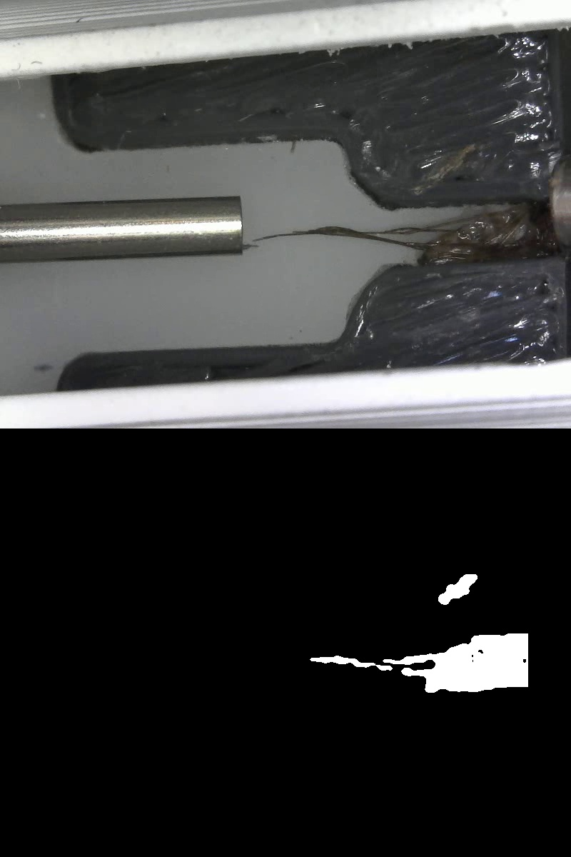
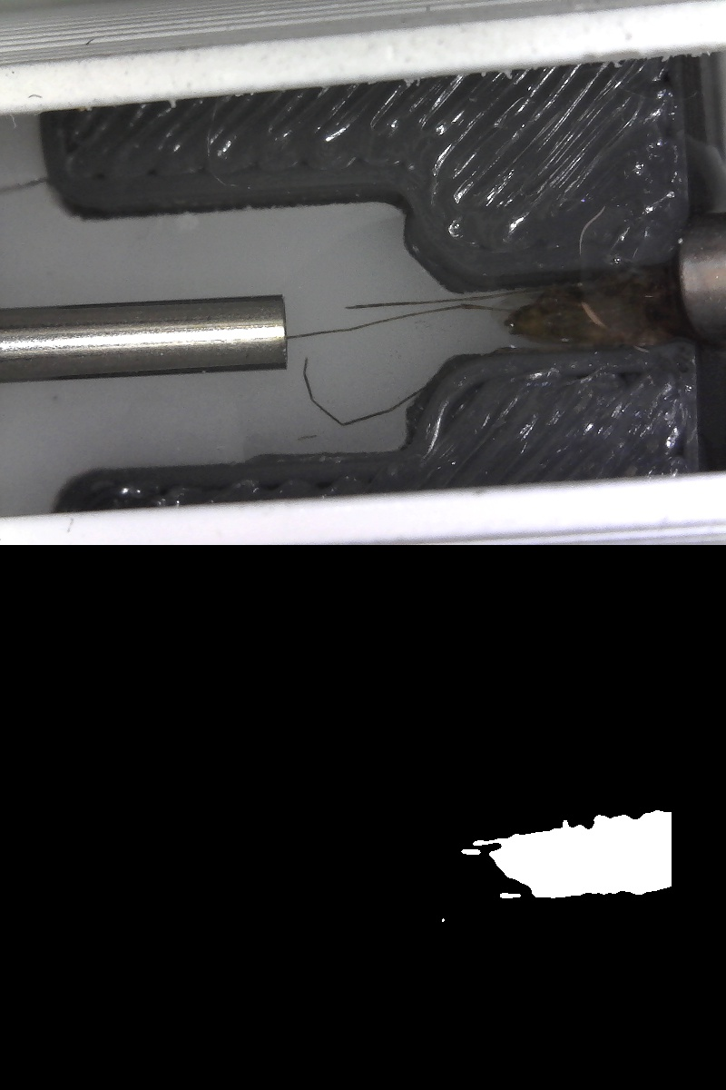
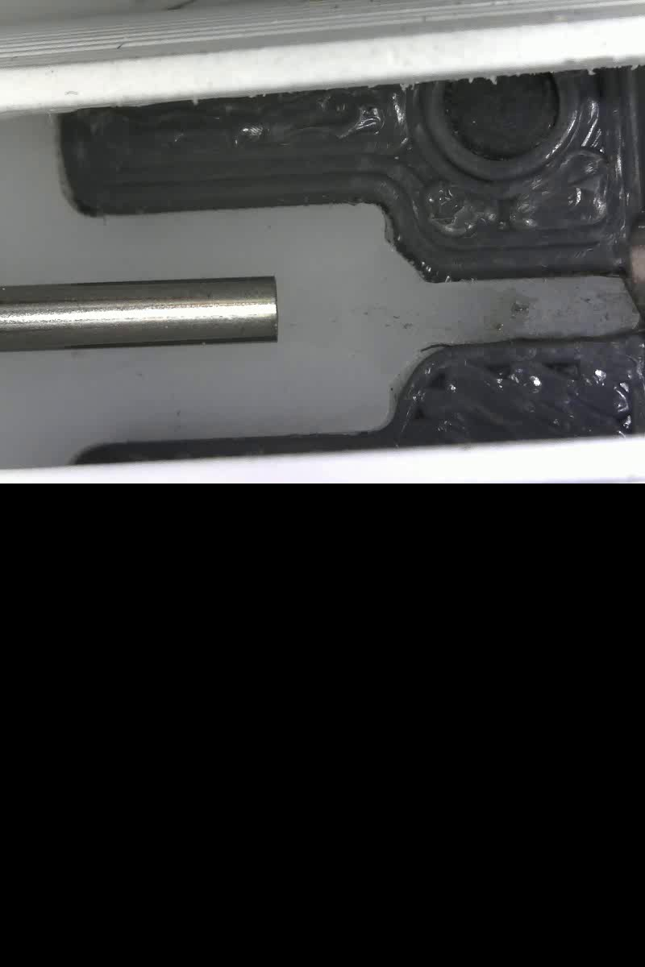
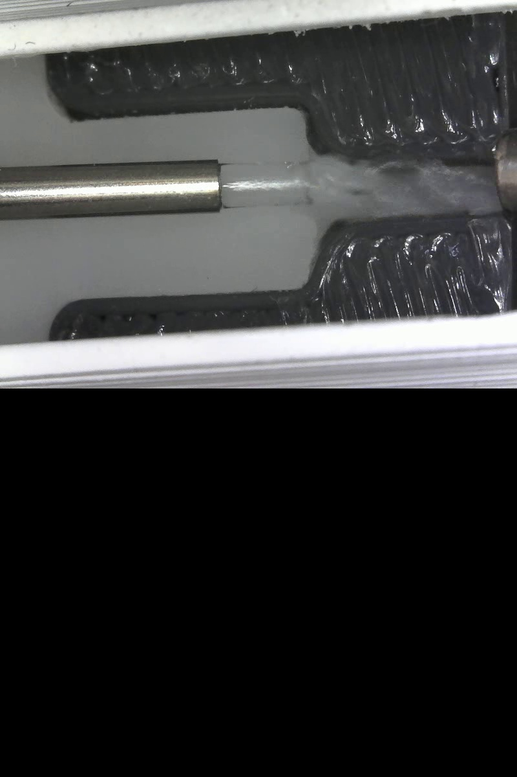
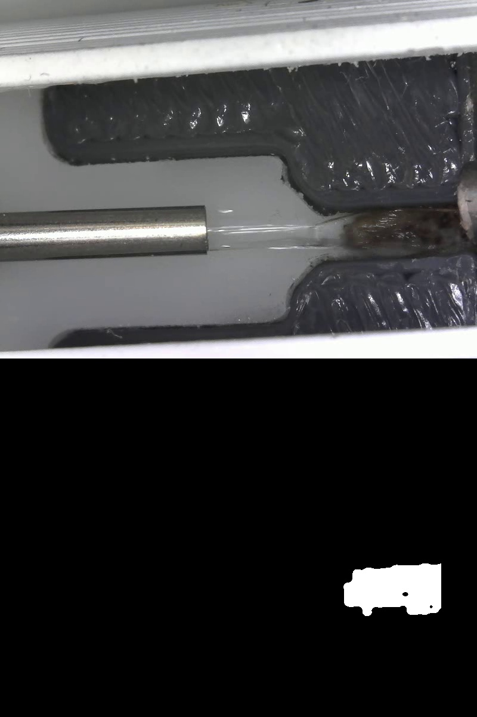
Segmentation Results – Image Processing
All Images from JHU
except where noted

Slide 12
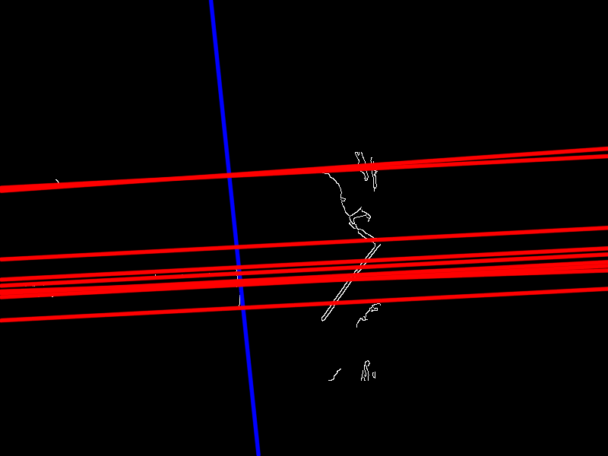
More Work – Image Processing
Camera can move significantly if bumped frame to frame making the region of interest less precise
Trying to detect features with a Hough Transform to register a more precise mask
Will wait to finish this because
All Images from JHU
except where noted

Slide 13
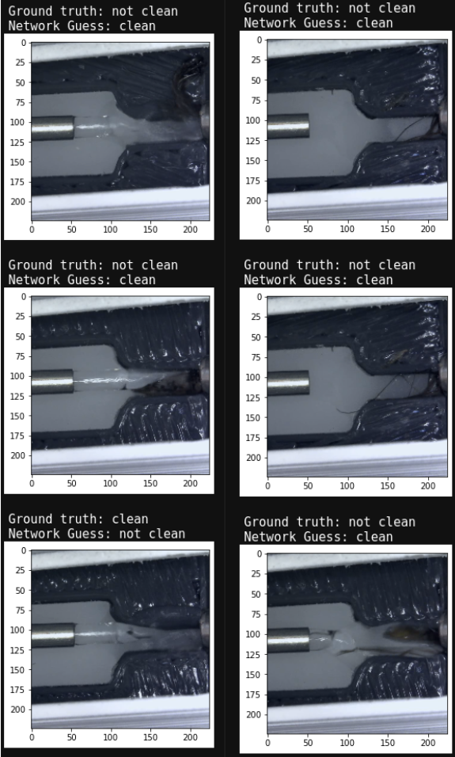
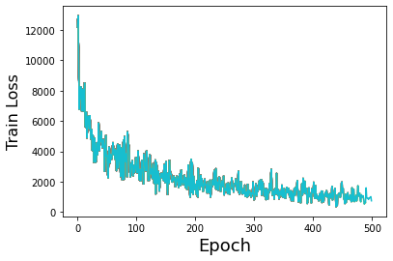
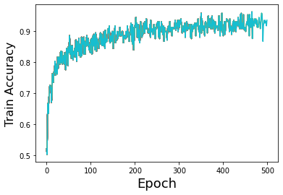
Deep Learning
Transfer learning with VGG16 pretrained on ImageNet
100% accuracy on the Test set
97% accurate over entire dataset
Did poorly when water was present
Network Failures

Slide 14
Deliverables
 | Activity | Deliverable | Original Expected Deadline | Status | New Deadline
Min | Collect images of cleaning station and annotate | Annotated cleaning station dataset | 3/1 | Completed (Delayed) | n/a
 | Implement image processing method for cleaning station | Functioning image processing based code and high quality documentation in a wiki | 3/15 | Functional but Missing Documentation | 4/5
 | Develop and train a neural network on the cleaning station dataset | Trained parameters of a neural network classifier, along with code and high quality documentation in a wiki | 3/18 | Functional but Missing Documentation | 4/5
 | Integrate both with the rest of the system using ROS | Working ROS services which can be successfully interfaced with from the robot control computer, and thorough documentation for how to use them in a wiki page | 3/22 | In Progress | 4/5
Expected | Repeat for gripper cleaning | Same deliverables as for turntable cleaning station. | 4/7 | In Progress | 4/14
Max | Discuss with hardware team about collecting exudate data | Plan for collecting exudate ground truth data | 4/1 | Completed | n/a
 | Repeat for exudate volume estimation | Same deliverables as for previous two tasks. | 5/1 | Won’t reach full maximum deliverable in time | 5/1

Slide 15
Dependencies
Dependency | Need | Contingency Plan | Planned Deadline | Hard Deadline | Status
Continued access to GPU | GPU for training neural network | I have a very capable personal GPU | Ongoing | Ongoing | Currently have access to the Diva computer and personal GPU
Cameras for collection of images of each task need to be mounted and integrated | To collect images for annotation | Use existing but less desirable views from the other existing cameras. | 3/14 | 3/22 (for remaining camera) | Completed
Hardware team | 300+ images of turntable cleaning station in progress with mosquitos. | Begin working on the image processing methods for the other tasks while waiting for additional training data collection. | 3/1 | 3/7 | Delayed but completed slightly after the hard deadline
Hardware team | 300+ images of gripper cleaning in progress with mosquitos. | Small Delay: Begin working “out of order” on the image annotation and image processing for the exudate estimation task Long Delay or Expected Failure: Change from the gripper cleaning task to one of the are many remaining vision tasks | 3/14 | 3/22 | Completed
Hardware team | Method for ground truth collection of mosquito exudate volume for training images | Abandon neural network approach and only do image processing for this task | 3/15 | 4/1 | Discussion completed however the neural network approach needs to be abandoned

Slide 16
Management
Weekly Monday meetings with the entire mosquito project team
Additional meetings as needed with the Vision team (likely approximately weekly)

Slide 17
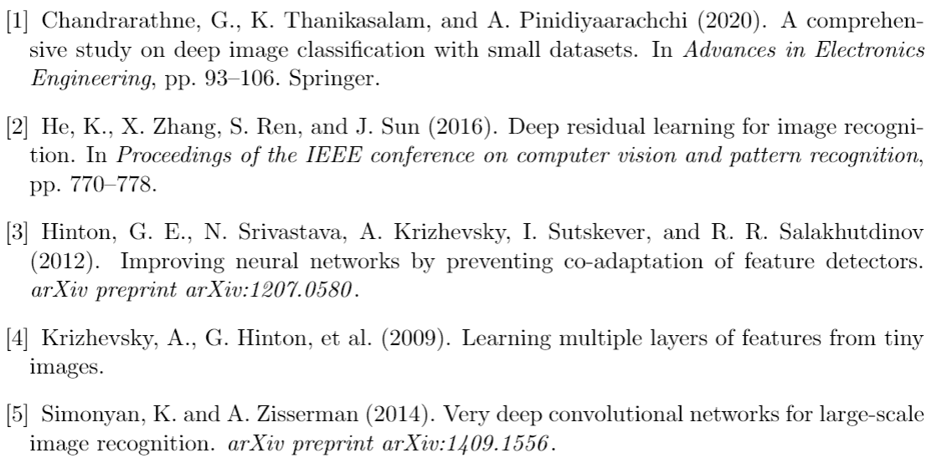
References
[6] WHO, 2019. World Malaria Report 2017. Geneva, Switzerland: World Health Organization.
[7] Jongo, Said A., Seif A. Shekalaghe, LW Preston Church, Adam J. Ruben, Tobias Schindler, Isabelle Zenklusen, Tobias Rutishauser et al. "Safety, immunogenicity, and protective efficacy against controlled human malaria infection of Plasmodium falciparum sporozoite vaccine in Tanzanian adults." The American journal of tropical medicine and hygiene 99, no. 2 (2018): 338-349.
[8] Sanaria, Sanaria.com.

