Slide 1
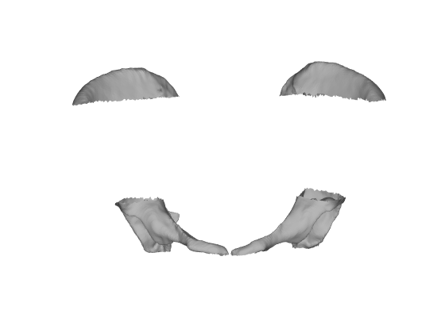
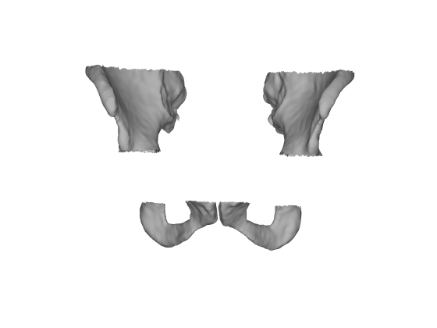
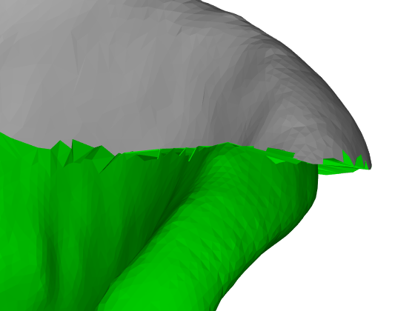
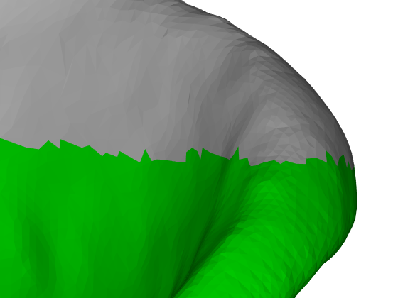
Smooth Extrapolation of Unknown Anatomy
Estimate a full model of a patient from partial anatomy for surgical planning and/or intraoperative navigation
Existing work is surface-based:
Statistical Shape Model
Projection
…
Incomplete Patient Surface
Estimated Structures
Copy & Paste Structure Replacement
Smooth Deformation of Estimated Regions
CT Image Source: JHU APL
Show in Slideshow mode for Animations

Slide 2
Smooth Extrapolation of Unknown Anatomy
What Students Will Do:
Extend the processing to extrapolate volume data (e.g. CT) in an efficient manner
This will allow for intraoperative X-Ray based navigation with incomplete CT
CT Image Source: JHU APL

Slide 3
Smooth Extrapolation of Unknown Anatomy
What Students Will Do:
Extend the processing to extrapolate volume data (e.g. CT) in an efficient manner
Evaluate the methods using traditional atlas criteria well as with a 2D/3D registration simulation
Deliverables:
C++ Source Code
Source Code Documentation
Report comparing the speed of execution and accuracy of the various approaches
Size group: 1-2
Skills:
C++, Image Processing, CIS 1 PA5
Mentors:
Robert Grupp (grupp@jhu.edu), Prof. Taylor

