Slide 1
Seminar Presentation
Group 12
Objective Assessment of Surgical Technical Skill and Competency in the Operating Room ^{[1]}
Student
Elif Bilgin
ebilgin1@jhu.edu
Mentors
Anand Malpani, PhD
amalpan1@jhu.edu
Molly O’Brien, BS
mobrie38@jhu.edu
[1] Vedula, Satyanarayana S et al. “Objective Assessment of Surgical Technical Skill and Competency in the Operating Room.” Annual
review of biomedical engineering 19 (2017): 301-325 .
601.456/601.656/601.356 CIS II Spring 2019
Johns Hopkins Malone Center for Engineering in Healthcare

Slide 2
Project Overview
Topic: Objective Surgical Skill Assessment of Computer-Aided
Hysterectomy Procedures
Using video footage from procedures at Johns Hopkins Hospital, as well as motion data from the da Vinci Surgical System.
Automatically assess skill in robot assisted hysterectomy procedures, particularly the colpotomy step.
601.456/601.656/601.356 CIS II Spring 2019
Johns Hopkins Malone Center for Engineering in Healthcare
Notes:
Hysterectomy is the process of the removal of the uterus.
Colpotomy is a specific step in the hysterectomy procedure during which the uterus is separated from the vaginal opening through a circular incision.

Slide 3
Paper Summary
From Johns Hopkins University, Malone Center for Engineering in Healthcare published in The Annual Review of Biomedical Engineering in 2017
This article reviews the available literature from 45 publications representing recent research in the domain of objective computer-aided technical skill evaluation (OCASE-T) for “scalable, accurate assessment; individualized feedback; and automated coaching of surgeons”.
601.456/601.656/601.356 CIS II Spring 2019
Johns Hopkins Malone Center for Engineering in Healthcare

Slide 4
Selection Motivation
Vedula, Satyanarayana S et al. “Objective Assessment of Surgical Technical Skill and Competency in the Operating Room.” Annual Review of Biomedical Engineering 19 (2017): 301-325.
Relevance to the Project
Puts into context the motivation for our project
As well as giving an overview of:
What has been done in the field
Where the field is lacking in research
Technical/Algorithmic approaches taken
Different types of data
601.456/601.656/601.356 CIS II Spring 2019
Johns Hopkins Malone Center for Engineering in Healthcare
Notes:
In a nutshell, the relevance of this paper to our project is that this paper puts into context why this project is necessary which I will be going into detail in the next slide
What has been done in the field
Where the field is lacking in research: for example, there are only a handful of papers published that are specifically about hysterectomy procedures
Technical/Algorithmic approaches taken: which gives us an idea on how to approach our problem, kind of provides a selection of algos we can choose to apply
Different types of data: which will be shown in upcoming slides

Slide 5
Background Information
“With increasing attention to the efficiency and effectiveness of health care, multiple factors are converging to make traditional methods of training combined with structured manual assessment untenable.”[1]
These factors are:
Cost and safety implications of teaching in the operating room
Desire for preventable technical error detection and minimization
Limited work hours vs. completion of training in robotic, open, laparoscopic and endoscopic domains
601.456/601.656/601.356 CIS II Spring 2019
Johns Hopkins Malone Center for Engineering in Healthcare
Notes:
All these factors combined with the fact that technological developments are enabling capture and analysis of large amounts of surgical data has led to the emergence of the field of surgical data science, and an increase in literature on objective computer-aided skill evaluation of surgical technical skill.

Slide 6
Image from: Vedula, Satyanarayana S et al. “Objective Assessment of Surgical Technical Skill and Competency in the Operating Room.” Annual review of biomedical engineering 19 (2017): 303.
601.456/601.656/601.356 CIS II Spring 2019
Johns Hopkins Malone Center for Engineering in Healthcare
Notes:
The paper contains the following table which breaks down each of the 45 publications based on the surgical site in question and the surgical technique that was assessed. It also presents the data sources used, the specific surgical tasks within the technique that were studied and the sample size of the study conducted.
As noted in the paper, the publications referred to “various surgical techniques and platforms such as traditional open surgery and minimally invasive techniques such as laparoscopy, robotic surgery, endoscopy, natural orifice transluminal endoscopic surgery, and endovascular interventions”. It is also important to note that most of the studies are from benchtop simulation (26), and virtual reality simulation (10).

Slide 7
The Paper’s Approach
Organization
Research Questions for OCASE-T
Sources of Data for OCASE-T
Data Representation for OCASE-T
Algorithms for OCASE-T
601.456/601.656/601.356 CIS II Spring 2019
Johns Hopkins Malone Center for Engineering in Healthcare
Notes:
The article is divided into the following sections: Research questions, sources of data, different representations of the data, and various algorithms.

Slide 8
The Paper’s Approach: Research Questions
Image from: Vedula, Satyanarayana S et al. “Objective Assessment of Surgical Technical Skill and Competency in the Operating Room.” Annual review of biomedical engineering 19 (2017): 306.
601.456/601.656/601.356 CIS II Spring 2019
Johns Hopkins Malone Center for Engineering in Healthcare
Notes:
This figure illustrates the resulting “closed-loop” system enabled by OCASE-T. Data captured in the skills training laboratory and in the operating room are at the core of OCASE- T. These data transform into an intermediate representation to extract pertinent information, which is then modeled using various data analytics algorithms for OCASE-T. The endpoint for OCASE-T is then feedback to surgeons through data products that rely on the algorithms, and the process repeats.

Slide 9
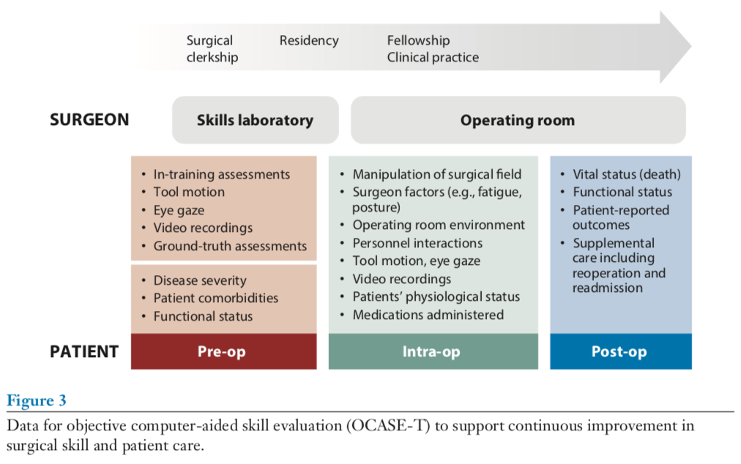
The Paper’s Approach: Data Sources
Image from: Vedula, Satyanarayana S et al. “Objective Assessment of Surgical Technical Skill and Competency in the Operating Room.” Annual review of biomedical engineering 19 (2017): 308.
601.456/601.656/601.356 CIS II Spring 2019
Johns Hopkins Malone Center for Engineering in Healthcare
Notes:
Here is another figure from the paper which puts forward the different types of data collected from the surgeon and the patient. For the surgeon, data can be collected from the skills lab or the operating room. For the patient, data can be collected during the pre-op, intra-op and post-op phases of surgery. The following table demonstrates the different types of raw data that has been collected.

Slide 10
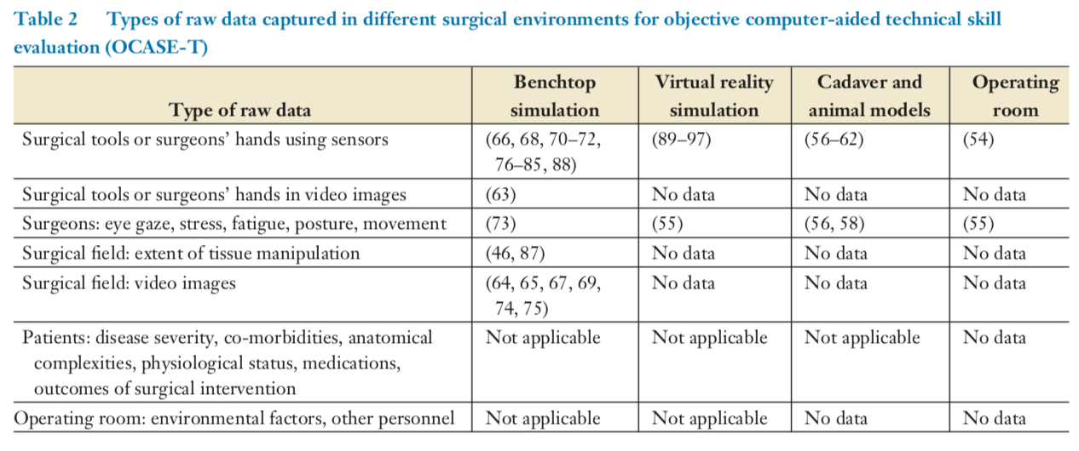
The Paper’s Approach: Data Sources
Image from: Vedula, Satyanarayana S et al. “Objective Assessment of Surgical Technical Skill and Competency in the Operating Room.” Annual review of biomedical engineering 19 (2017): 307.
601.456/601.656/601.356 CIS II Spring 2019
Johns Hopkins Malone Center for Engineering in Healthcare
Notes:
Here is a more specific representation of the different types of surgeon and patient raw data, and the various different surgical environments they have been collected from. A problem to note here that the researchers have found was that most of these data have not been systematically captured in that each data capture was done differently in various studies within the 45 studies.

Slide 11
The Paper’s Approach: Data Representation
Summary Features for Data Representation
Time-Series Data Representations
Dictionaries or Histogram-Based Representations
601.456/601.656/601.356 CIS II Spring 2019
Johns Hopkins Malone Center for Engineering in Healthcare
Notes:
In the paper, the researchers noted that there were 3 main ways data representation was done: summary features, time-series data, and dictionaries or histogram-based representations.
1- crisp vs. jittery hand movement, we calculated the standard deviation of the trial average mean value of jerk from the inertial measurement unit (IMU) mounted on the subject‘s right hand
2- eye gaze data in timeseries representation
3-timeseries data – build kind of their own language UUDL – have long strings of entire data, look for a specific string perhaps etc in expert vs novice datasets

Slide 12
The Paper’s Approach: Algorithms
Image from: Vedula, Satyanarayana S et al. “Objective Assessment of Surgical Technical Skill and Competency in the Operating Room.” Annual review of biomedical engineering 19 (2017): 311.
601.456/601.656/601.356 CIS II Spring 2019
Johns Hopkins Malone Center for Engineering in Healthcare
Notes:
This is a figure that pools together all the various algorithms that have been implemented for OCASE, and on which type of data.
Existing research on OCASE-T has focused exclusively on validation through relation to external variables, namely validity against criteria considered ground-truth skill assessments. Such validation was limited to surgeons’ appointment status, years in training or practice, experience, or OSATS-GRS as the ground truth.

Slide 13
Key Results Identified | Significance
Technological developments are enabling capture and analysis of large amounts of complex surgical data | The availability of data and the need for efficient surgical training provide a unique opportunity to augment surgical education
Identified a need to develop/improve: Technology for data capture in the surgical environment Techniques for transforming the data Algorithms for data analysis | This will allow for the assessment of skill and enable automated coaching/feedback through diagnosis of skill deficits, targeted assessments, or both.
Algorithms for OCASE-T have been developed mostly for benchtop and virtual reality simulation settings; research in the operating room has been limited to only two studies. | Future work in data based on the operating room data is necessary for a more in depth, realistic assessment approach
Existing methods for OCASE-T have produced promising results, but the approaches are highly varied. | A consensus being established on what the best approaches and benchmarks are necessary
Algorithms for OCASE-T have focused only on technical skill and not on competency. | Measuring competency would be the next step after technical skill evaluation algorithms are well established
601.456/601.656/601.356 CIS II Spring 2019
Johns Hopkins Malone Center for Engineering in Healthcare
Notes:
A skill is the learned capacity to carry out pre-determined results, it is proficiency one has at a task. A competency is more than just knowledge and skills it involves the ability to work independently without supervision.

Slide 14
Assessment
Pros
Cons
Comprehensive research of papers regarding OCASE-T from Inspec, Pubmed, Google Scholar and the Proquest database
Long list of references
Many tables that summarize information from 45 cases
Many shortcomings of the field put forward
No detail into the various “ground truths”
Lack of explanation of validation methods in some cases
Discussion was limited to instances in which the surgical tasks and metrics for validation were directly comparable
601.456/601.656/601.356 CIS II Spring 2019
Johns Hopkins Malone Center for Engineering in Healthcare
Notes:
PROS
Accumulated years of research into one neat summary
Really good source of references for anyone working in this area, very long list
Detailed table summaries
A lot of shortcomings are put forward which helps future researchers in determining direction for projects
CONS
They didn’t really talk about what was considered was the “ground-truth” in the studies, or how specifically the data was validated (in some cases)
Discussion is limited to instances in which the surgical tasks and metrics for validation are directly comparable (most of them had their own idea of the ground truth)

Slide 15
Assessment
Most Important Relevance to the Project
Emphasizes how OR based data and research is very important and is extremely lacking as there are only 2 studies that have done this in this 45-case study.
Azari DP, Frasier LL, Quamme SRP, Greenberg CC, Pugh CM, Greenberg JA, Radwin RG. Modeling Surgical Technical Skill Using Expert Assessment for Automated Computer Rating. Ann Surg. 2017 Sep 6; PMID: 28885509
Law H, Ghani K, Deng J. Surgeon Technical Skill Assessment using Computer Vision based Analysis. Proceedings of Machine Learning for Healthcare 2017 [Internet]. Boston, Massachuesetts; 2017.
601.456/601.656/601.356 CIS II Spring 2019
Johns Hopkins Malone Center for Engineering in Healthcare
Notes:
When this paper was published there has been a couple more papers published
Mentioned the ones in the chat ignore second one

Slide 16
Future Steps & Conclusions
In addition to technical skill assessment, future research can focus on technical competency assessment
Larger dataset collections that preferably are from OR data
Establishment of a consistent evaluation metric for systematic assessment of validity of approaches
Incorporate the concept of a learning curve to the automated skill assessment
601.456/601.656/601.356 CIS II Spring 2019
Johns Hopkins Malone Center for Engineering in Healthcare
Notes:
Overall, I found this paper to be very informative, especially for a novice person in the field such as myself. It gave me access to a lengthy list of new references to incorporate into my reading list, as well as referring to some papers I already had on my reading list. It also was helpful in deciding the direction we wanted to go with the project.

Slide 17
References
[1] Vedula, Satyanarayana S et al. “Objective Assessment of Surgical Technical Skill and Competency in the Operating Room.” Annual review of biomedical engineering 19 (2017): 301-325 .
601.456/601.656/601.356 CIS II Spring 2019
Johns Hopkins Malone Center for Engineering in Healthcare

