Slide 1
Tracheoesophageal Prosthesis Insufflator Checkpoint Presentation II Computer Integrated Surgery II, Project 13
Kevin Liu
Johns Hopkins University
May 2nd, 2013
Mentors: Dr. Russell H. Taylor, Dr. Jeremy Richmon

Slide 2
Overview
-- Summary
-- Status of Deliverables
-- Progress
-- Updated Schedule
-- Status on Dependencies
-- Questions

Slide 3
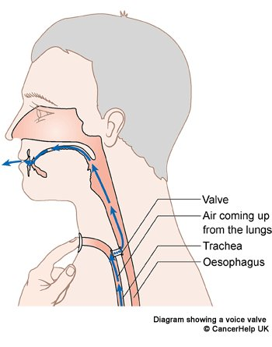
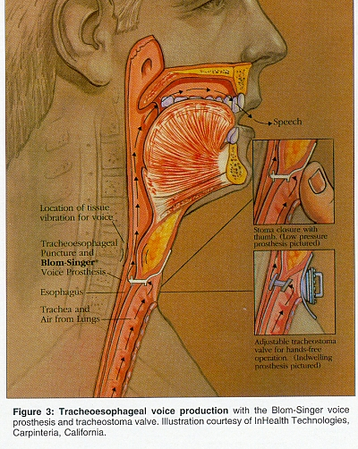
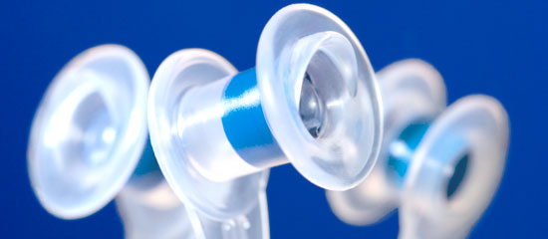
Project Mission
- Develop a portable insufflator that will deliver air through the TEP so that patient can circumvent direct blockage of stoma

Slide 4
Deliverables: Status
CAD/Pad sketch of components: Done/Done
Rough prototype of insufflator: Done
Improved prototype with custom-built parts: Delayed to 5/6
Testing of device: Delayed
Polish into sell-able condition: On track
World domination: Silly Idea
Minimum
Expected
Maximum

Slide 5
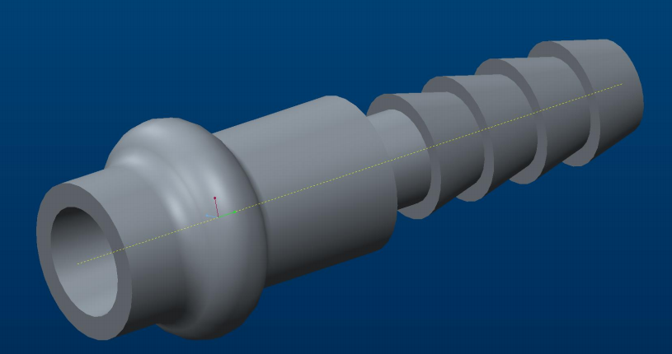
Progress: RP Parts
Silicone hose
TEP chamber

Slide 6
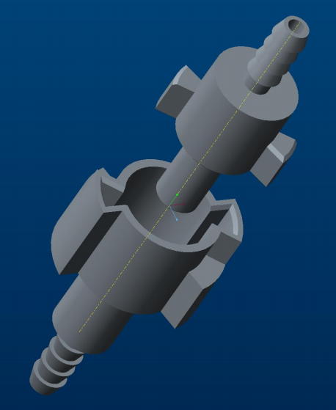
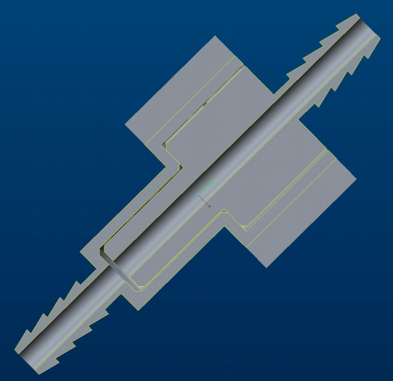
Progress: RP Parts
Quick-Detach: Separated
Male: To TEP
Twist Male CW to lock
Red: Male End
Female: To CO₂
Quick-Detach: Cross Section

Slide 7
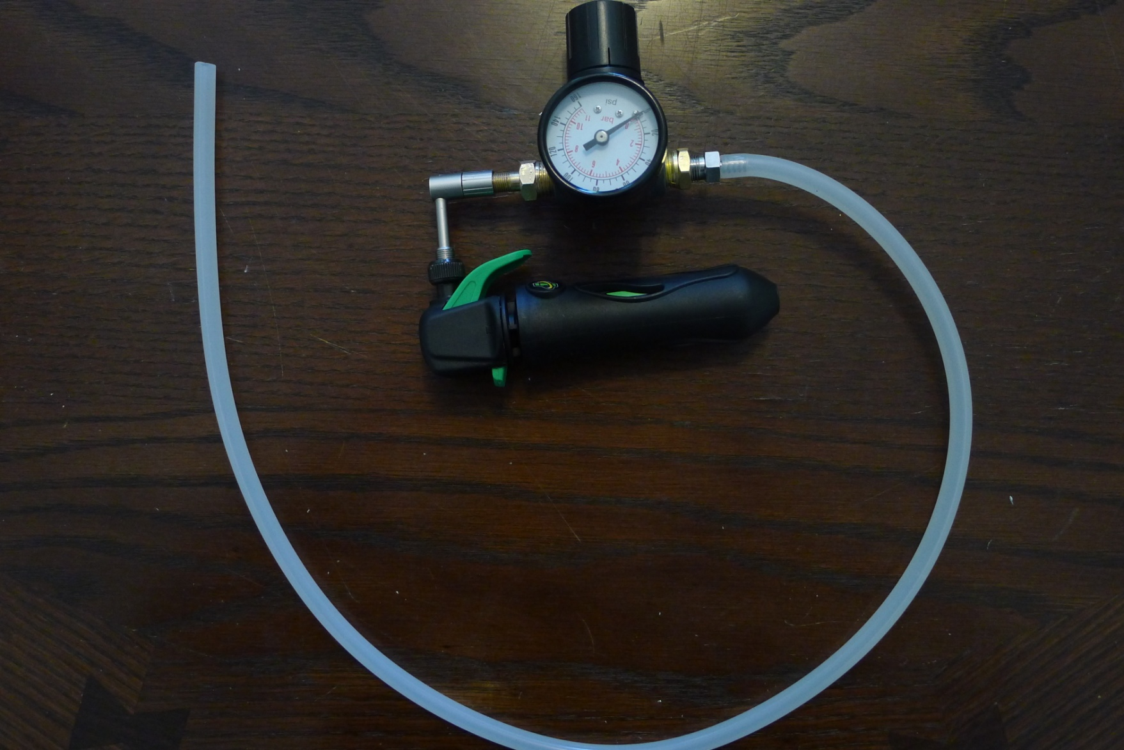
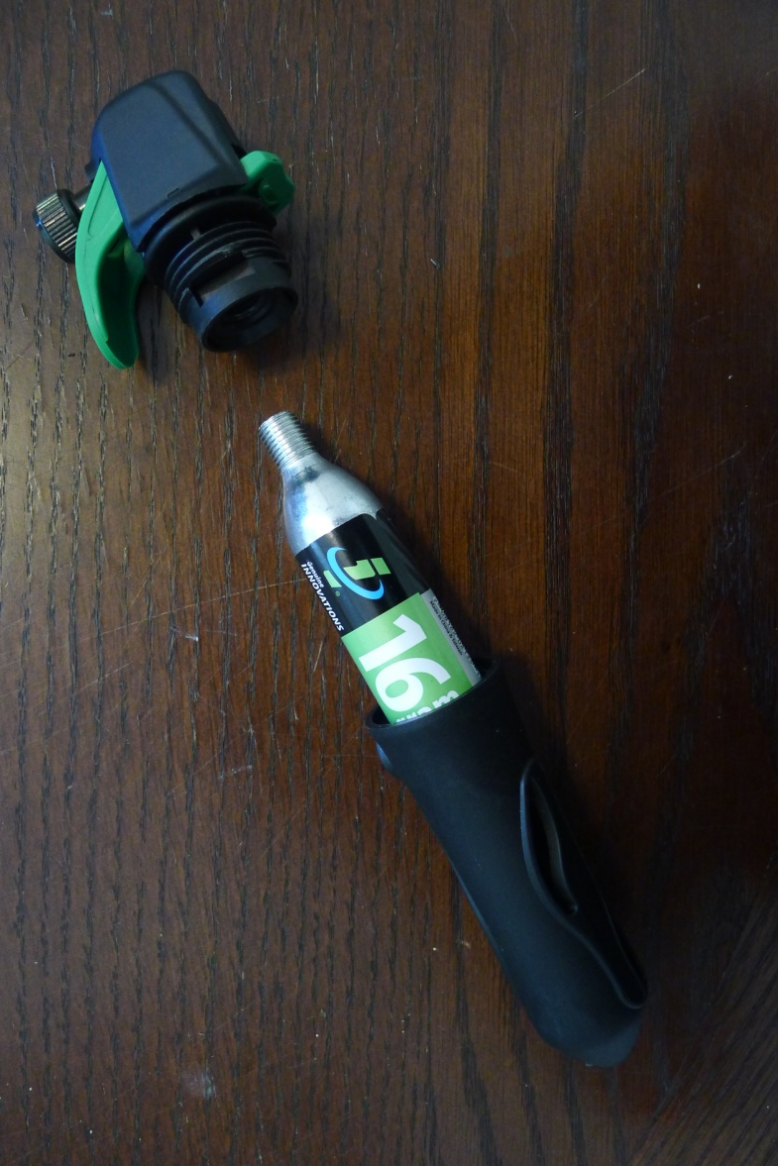
Progress: TEP Device
CO₂ source assembly
Pressure Regulator Valve
CO₂ source/Trigger
Medical-Grade Silicone Tubing

Slide 8
Progress: TEP Device
Video

Slide 9
Progress: TEP Device
Unexpected Encounters:
AIRTIGHT SEALS: Air will find path of least resistance, which is usually the joints, and leak
PUSH BUTTON VALVE: May need to be circumvented due to above reason
CANISTER LIFE SPAN: A single 16g CO₂ cartridge lasts shorter than expected. Begin debate of bigger canister against portability.
PRESSURE VALUES: According to Dr. Richmon, pressure through TEP is ~20 mmH₂O, or ~0.3 PSI. Smallest found commercial valve is 0-5 PSI.

Slide 10
Previous Schedule

Slide 11
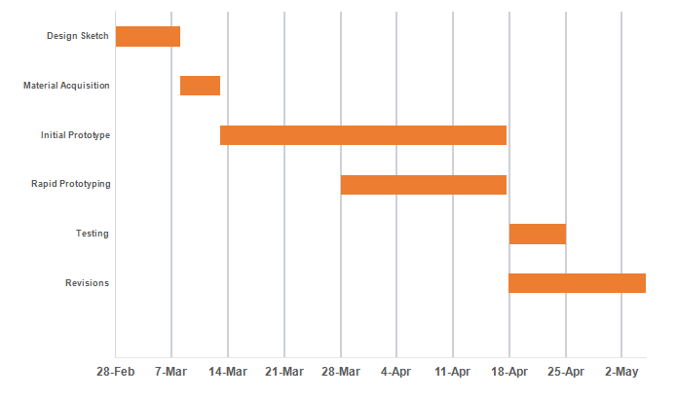
Revised Schedule

Slide 12
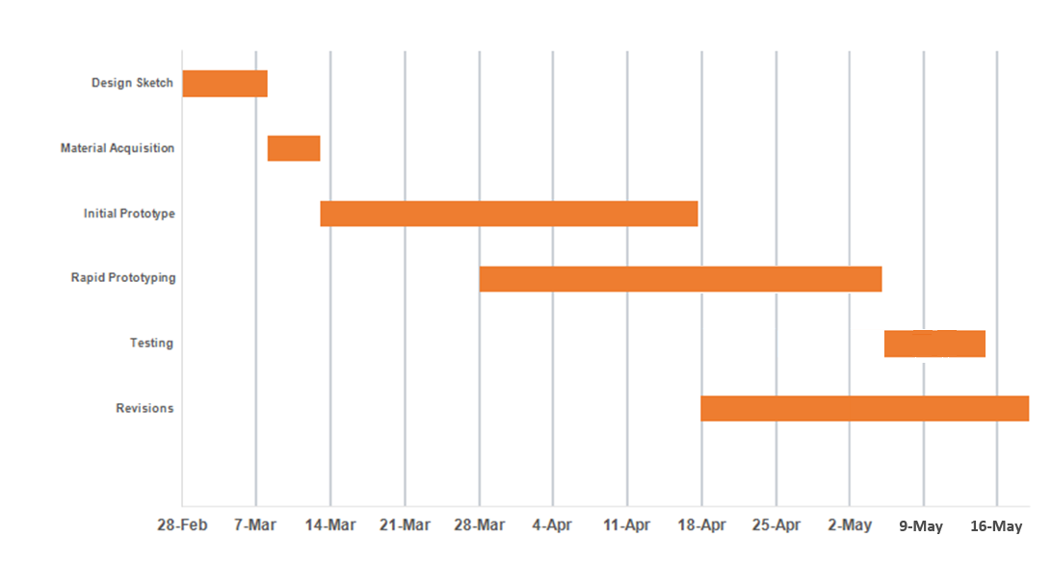
Final Schedule

Slide 13
Dependencies
Dependency | Reason for dependency | Impact | Resolution | Alternative
TEP device | Output tubing interface | No interface | Resolved | N/A
Rapid Prototyping | Costs, qualifications | Less streamlined design | Expected 5/6 | Do without
Voluntary Patient testing | Ethics | Cannot test device | Considering Alternative | Perform on model

Slide 14
Questions?
Be even more gentle.

