Slide 1
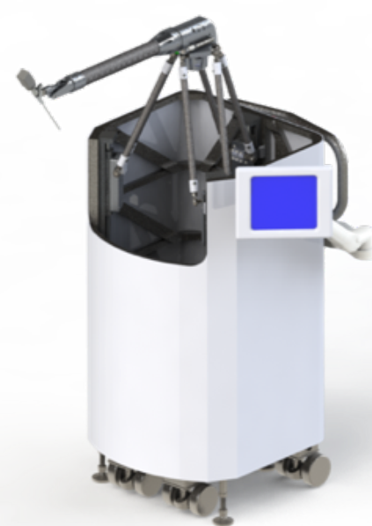
Characterization and Compensation of Stiffness/Deflection for the Galen Microsurgical Robot
What Students Will Do
Characterizing stiffness/deflections as a function of robot pose and forces applied to end effector
Force sensor at the robot’s EE for force measurements
Optical/laser tracker for pose measurements
Implementing a method to compensate for
deflections due to forces
Evaluating performance of the controller

Slide 2
Deliverables
Minimum: Characterize deflections as a function of robot pose and external forces
Expected: Implement an control method to improve positional accuracy in the presence of externally applied forces and torques
Maximum:
Demonstrate improved accuracy in a simple autonomous cutting task; or
Specify areas in the workspace with minimum deflection; or
Extend the method to account for dynamic forces
Group Size: 1-3
Skills: C++, ROS, knowledge of control systems, some design skills for simple attachments of measuring apparatus is a plus
Mentors: Dr. Mahya Shahbazi, Dr. Russell Taylor
Contact: mahya.sh@jhu.edu, rht@jhu.edu

