Slide 1
Interventional Photoacoustic Registration
4/26/11
Robert Kim, BME, AMS
Steven Su, BME, AMS
Saurabh Vyas, BME, EE
Mentors: Dr. Emad Boctor, Dr Russell Taylor, & Dr. Jin U. Kang
Special Thanks to: Nathanael Kuo

Slide 2
Outline of Talk
Background
Setup
Milestones
Deliverables
Timeline
Unresolved Dependencies
Results

Slide 3
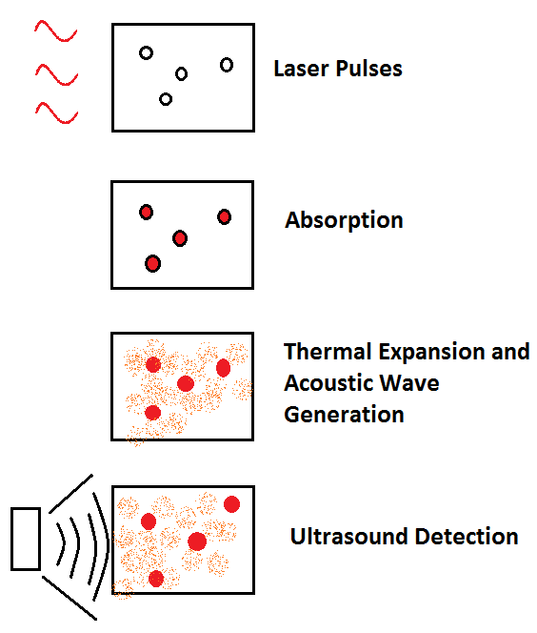
Background: Photoacoustic Effect
When matter is exposed to high frequency pulses of light, most of the light’s energy will be absorbed by the molecules in the incident matter.
As the energy from the light is converted to heat, the molecules become thermally excited.
Heat waves will then radiate away from the matter causing sound waves due to pressure variations in the environment around the medium.
These sound waves can then be detected by acoustic devices such as ultrasound (US).

Slide 4
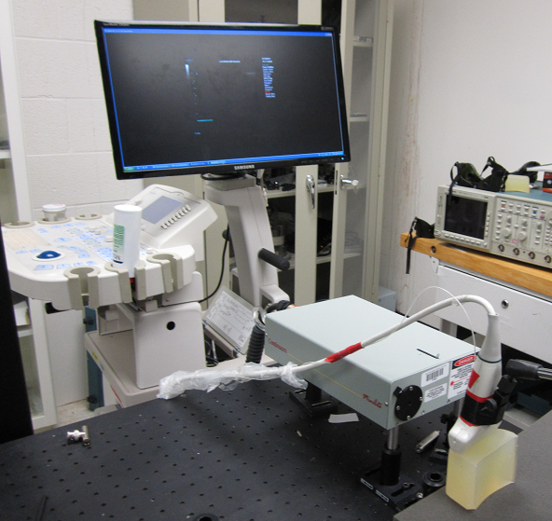
What is IPR all about?
Interventional Photoacoustic Registration (IPR)
Procedure:
Shoot laser onto tissue
Use ultrasound transducer to produce US image of PA signal
Use stereo camera to get image of points on exterior of tissue
Complete registration between camera and US image

Slide 5
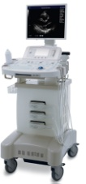
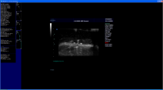
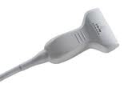
Current Setup
SonixRP
Software
Sonix CEP
Ultrasound system
L14-5W
Transducer
SonixDAQ
Module
DAQControl
Software
Phantom
Surelite II
Laser system
MATLAB
Software

Slide 6
Milestones
Milestone 1:
Calibrate and Synchronize Laser with US.
Build Phantoms.
Completion Date: 3/11
Completed 3/11
Milestone 2:
1064 nm one seed experiment.
1064nm three seed experiment.
Rigid transform from US-Model.
Completed 3/28
Milestone 3:
Setup 532 nm laser.
532 nm one point experiment.
532 nm three point experiment.
Expected Completion 4/22-DELAYED!
Milestone 4:
Integrate camera.
Registration between camera and US.
Expected Completion: 5/9
Milestone 5:
BMEStart competition.
Expected Completion 5/13
Currently Working On

Slide 7
Deliverables
Minimum: (Achieved)
Phantoms
B-mode images of 1064 nm one seed experiment
B-mode images of 1064 nm three seed experiment
Functioning setup of 532 nm laser source
Expected: (Almost Achieved)
B-mode images of 532 nm one point experiment
B-mode images of 532 nm three point experiment
Demonstration of integrated stereo camera
Maximum:
Video demonstration of registration of US to camera
Completed Documentation/Application for BMEStart Competition

Slide 8
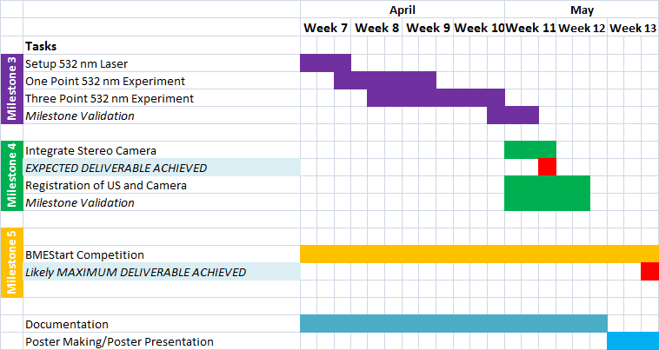
Timeline

Slide 9
Unresolved Dependencies
Dependency: Mirror setup to split laser
Resolution Plan: Dr. Boctor promised to bring this ASAP.
Resolve By: ASAP
Resolved: No
Fallback Plan: Buy one?
Affects: Milestone 3 and 4
Dependency: Stereo Camera
Resolution Plan: Dr. Boctor promised to bring this ASAP.
Resolve By: ASAP
Resolved: No
Fallback Plan: Ask Dr. Taylor if he has one.
Affects: Milestone 4

Slide 10
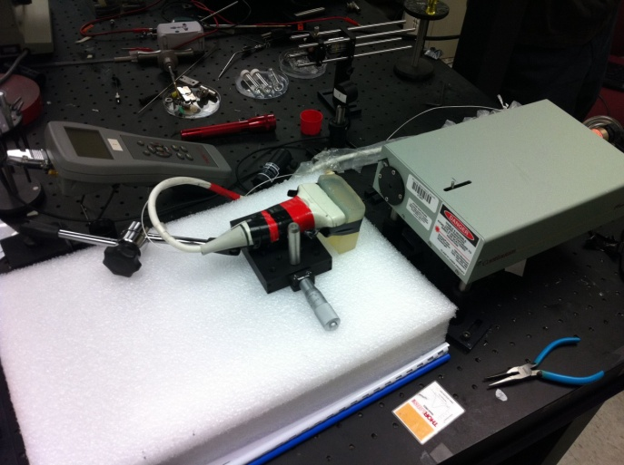
1064 nm One Seed

Slide 11
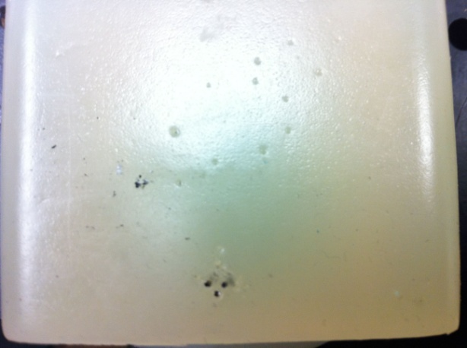
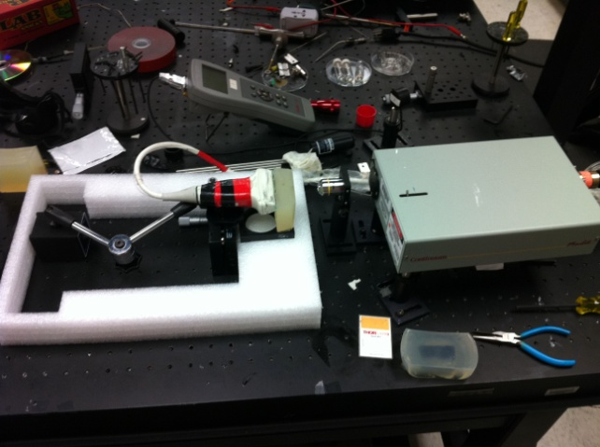
1064 nm Three Seeds

Slide 12
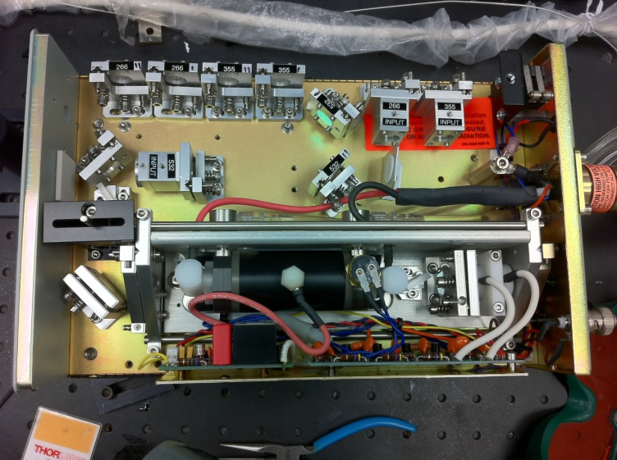
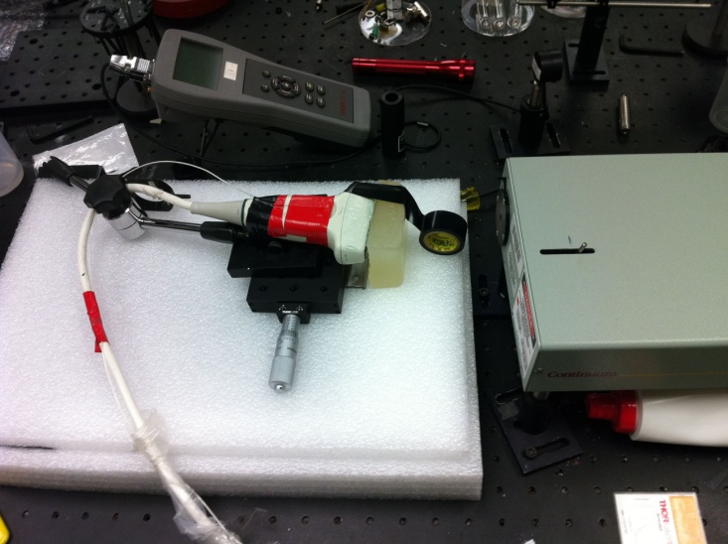
532 nm No Seeds (No Lens or Fiber)

Slide 13
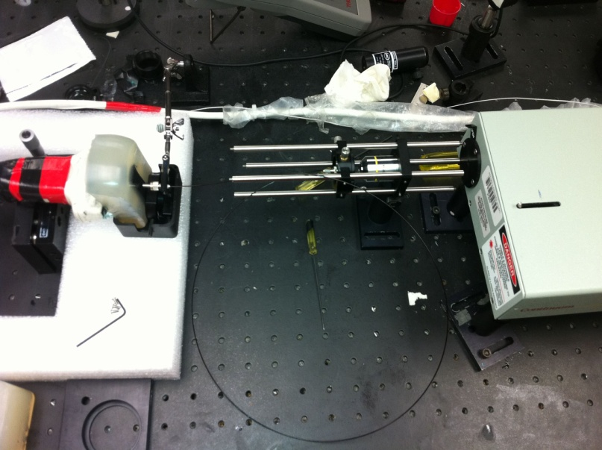
532 nm No Seeds (With Lens and Fiber)

Slide 14
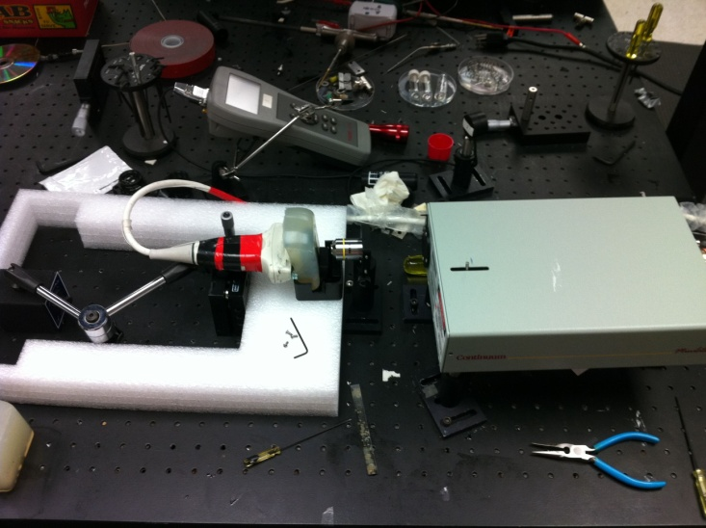
1064 nm No Seeds (With Lens)

Slide 15
Future Work
Figure out how to increase the power of the 532 nm laser
Proper Mirror Alignment within the laser source
Q-Switching?
Dynamic range adjustment of B-mode images.
Obtain mirror setup to split laser source.
Obtain stereo camera
Integrate the camera to perform registration
Finish BMEStart Competition portfolio (By: 5/13)

