Slide 1
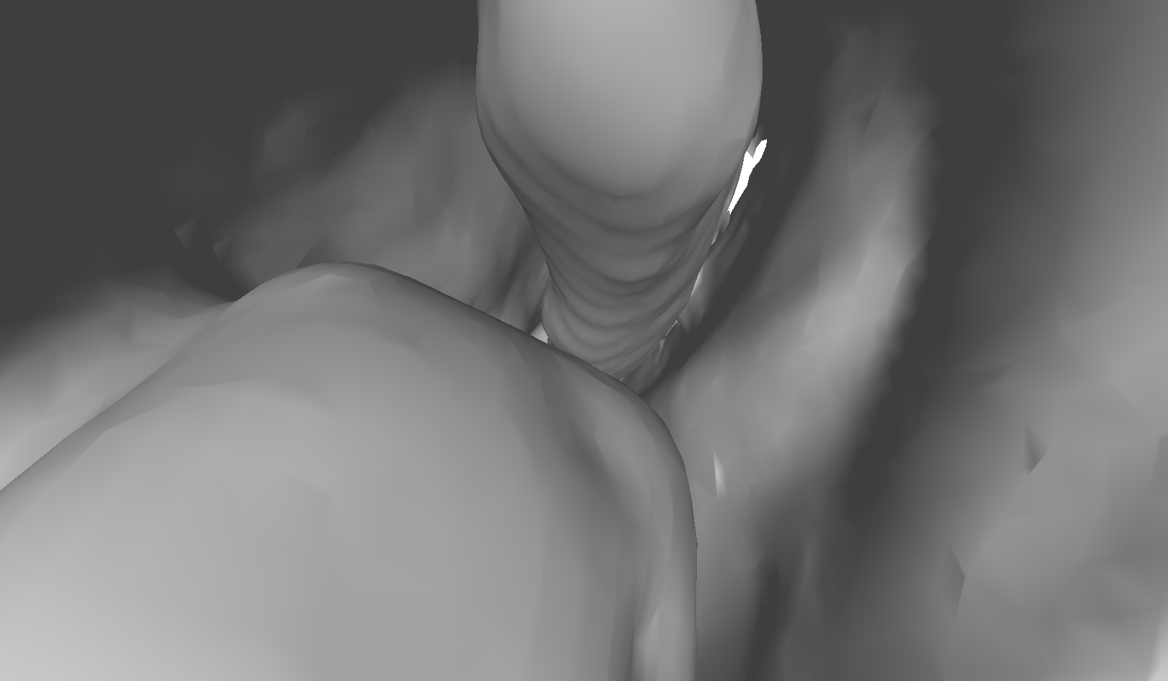
Auto-initialization using Deep Learning
Problem Statement:
Registration algorithms require an initial $F_{guess}$. Algorithms can be very sensitive to this initialization, and manual initializations can be time consuming.
Project Statement:
Automatically initialize registrations intelligently using deep learning for scene matching in medical images of different modalities (video frames and CT rendering)
Simulated video frame
Corresponding camera view in CT rendering

Slide 2
Auto-initialization using Deep Learning
What Students Will Do:
Work with both simulation data (with known truth) and real data
Work with available code that can train a neural network (NN) to learn camera transformations that produce a CT rendering that matches the video scene
Test NN on simulation data to see if the correct transformation can be recovered
Use transfer learning to test this automatic initialization NN on real data
Deliverables:
Can NN produce an $F_{guess}$ that matches the truth in simulation?
Perform registration starting from the predicted $F_{guess}$ using at least one established registration algorithm (e.g., ICP)
Produce an $F_{guess}$ using transfer learning that can be used to perform a successful registration in real data
Perform registration using multiple established registration algorithms to assess the quality of the initialization using different methods (including some new swanky deformable registration algorithms!)

Slide 3
Auto-initialization using Deep Learning
Size group:
No more than 2 students
Skills:
Deep learning (decent understanding)
Python (preferably)
Mentors:
Ayushi Sinha; asinha8@jhu.edu

