Slide 1
A Machine Learning Approach to Medical Physics Dosimetry
Fumbeya, Marungo, Hilary Paisley, John Rhee
Mentors: Dr. Todd McNutt, Dr. Scott Robertson

Slide 2
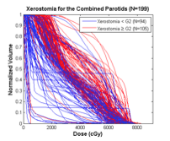
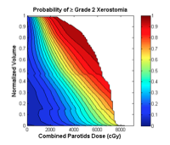
Summary of Project IX
Use “Big Data” techniques to create a toxicity risk model after irradiation of the parotid gland
Images courtesy of Dr. Todd McNutt,
Dr. Scott Robertson

Slide 3
Research Papers
Fayyad, et. al. From Data Mining to Knowledge Discovery in Databases. American Association for Artificial Intelligence, 1996.
Breiman, Leo. Random Forests. Machine Learning, 45, 5-32, 2001.

Slide 4
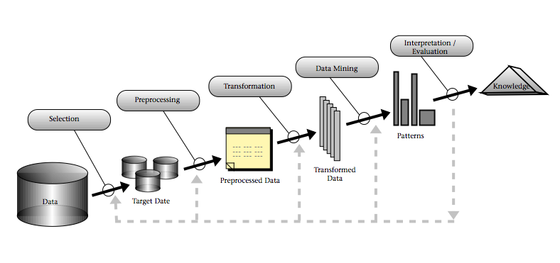
KDD Process
Knowledge Discovery in Databases (KDD)
Image courtesy of Fayyad, et. al.

Slide 5
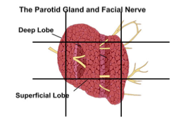
Understanding Application Domain
First must understand domain and goal of the KDD process
Our goal is to assess importance of specific voxels after parotid irradiation
Image courtesy of Dr. Todd McNutt,
Dr. Scott Robertson

Slide 6
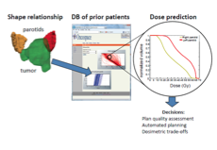
Create Target Data Set
Using the Oncospace data provided, we must find relevant data
Dosage
Voxel
Patient toxicity
Image courtesy of Dr. Todd McNutt,
Dr. Scott Robertson

Slide 7
Data Cleaning and Preprocessing
Cleaning involves removing noise, accounting for missing data fields, and being able to handle possible changes in data
A major problem in medical data is to account for possible movements in patient during irradiation and location error with several treatments

Slide 8
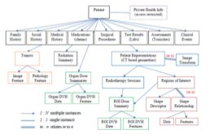
Data Reduction
Finding useful features to represent the data depending on the goal of the task
This will require extensive understanding/research of the database provided to us
Image courtesy of Dr. Todd McNutt,
Dr. Scott Robertson

Slide 9
Data Mining
Based on the goal of the KDD process, determine an appropriate data mining technique
We have decided to try a Random Forest

Slide 10
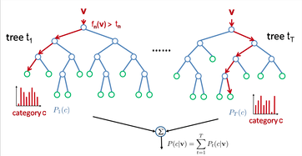
Random Forest
A random forest is a classifier consisting of a collection of tree-structures classifiers {h(x,Θ_{k}), k=1, …} where the Θ_{k} are IID random vectors and each tree casts a unit for the most popular class at input x

Slide 11
Tree Bagging Application
For each sample, select random subset of features
Train a decision tree on the samples
To predict, use averaging from the individual decision trees

Slide 12
Why Random Forest?
Computationally efficient
Convergence/Correlation
Easy to extract key features

Slide 13
Interpretation
If the data mining results are poor, return to any of the previous steps for reevaluation of the data
It is helpful to model the results of the data mining to better interpretation of success

Slide 14
Incorporation
Using the knowledge gathered for a greater use
Our goal is to integrate the methods/results to be used for different toxicities or different regions of interest

Slide 15
Potential Pitfalls for the Application
Overfitting – using a limited set of data
Solution: cross-validation, regularization
Changing data – continue to add/change data
Solution: incremental methods for updating the patterns
Noisy data – missing fields in medical data
Solution: identify hidden variables/dependencies and account for them

Slide 16
Relevance of Papers
Every step of the KDD process is vital to the success of our project (not just the data mining step)
Random forests may be a good method for the project

