Slide 1
Vendor independent PA Imaging System Enabled with Asynchronous Laser source
Group 2: Yixuan Wu
Mentors: Haichong “Kai” Zhang, Emad Boctor
Notes:
Vendor-dependent /ultrasound-agnostic
Vendor independent PA imaging system enabled with asynchronous laser source

Slide 2
1
Background, Specific Aims, and Significance
Photoacoustic Imaging
Advantage | Disadvantage
Deep penetration High resolution Safety | Hardware is expensive and vendor-variant
Differences between US and PA systems
Time-of-flight of the US wave
US scanners don’t have frame triggers and laser triggers
Laser
Transmitted ultrasound wave
How to implement PA imaging on US platforms
Received ultrasound wave
Laser beam
Monitor
Monitor
Light absorber
?
Ultrasound wave
Signal processor
Signal processor
Photoacoustic Imaging System
Ultrasound Imaging System
Notes:
Add two images to explain why PA is expensive (TOF) and why we want to use US probes
2

Slide 3
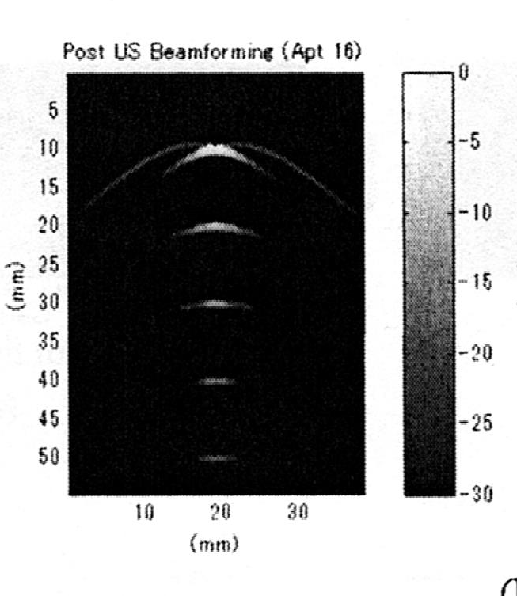
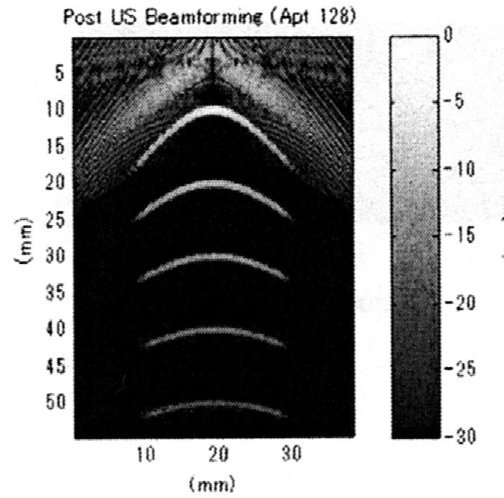
1
Background, Specific Aims, and Significance
Beamforming
Delay-sum ${\text{beamforming}}^{1}$
Time-of-flight (TOF)
Difference of time-of-flight (TOF)
Re-beamforming!
HAICHONG K. ZHANG,
MUYINATU A. LEDIJU BELL, etc.
Synthetic-aperture based PA
re-beamforming (SPARE) Approach
US
PA
$$r_{T}$$
$$r_{R}$$
$$r_{R}$$
$$TOF=\frac{r_{T}\text{+}r_{R}}{C}$$
$$TOF=\frac{r_{R}}{C}$$
1. Courtesy of http://beamforming-noise-cancellation.weebly.com/beamforming.html

Slide 4
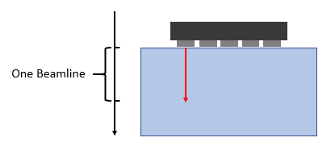
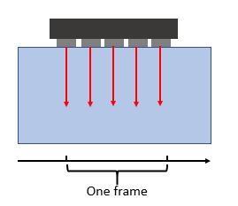
1
Background, Specific Aims, and Significance
Two Challenges
Synchronization
Real-time imaging
One beamline
One frame
Developed and Investigated by Group 13, CIS II, 2016
Phase varies
frequency is unknown
Phase of the laser pulse is unknown.
Frequency of the laser pulse is unknown.
Notes:
Stress what is Tpulse and Tframe
PRF
Phase of freq
Frequency of laser excitation
Variable 3. delay between frames. Reason1: electronics 2. delay 3 mode of US
4

Slide 5
1
Background, Specific Aims, and Significance
Aims
Algorithm: synchronize laser pulses and ultrasound waves
Algorithm: synchronize image frames
Use synchronized signals to implement real-time PA imaging.
PA imaging on US platform
Notes:
5

Slide 6
2
Technical Approach
Asynchronous PA imaging signal on US platform
Random-looking signal
“TV snowflake”
Laser frequency found
Depth of the object can’t be found
Laser phase found
Depth found, unfocused
Synthetic-aperture based PA
re-beamforming (SPARE) approach applied
Focused

Slide 7
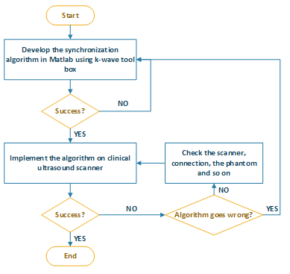
2
Technical Approach
Approaches
Workflow
Synchronization Algorithm:
Idea: Brute-force searching/Optimization problem
Procedure: 1. recover beamline trigger; 2. recover frame trigger
Validation: 1. ground truth data; 2. add noise
Real-time Imaging
Set up QT, OpenCV and Visual Studio
Use acquired code
Integration
Matlab simulation
Use Phantom on US platform
Clinical US data

Slide 8
3
Deliverables
Minimum | Set up the environment (including visual studio, c-Make, QS Creator, Ultrasonix and OpenCV) on laptop for US platform implementation. Achieve real-time PA imaging (Howard’s project last year) with US platform. Simulate in Matlab with k-wave tool box: develop a PA synchronization algorithm to recover beamline trigger and frame trigger, get ground truth data without noise first, then add noise.
Expected | Incorporate Matlab code in C++ and transplant it onto Ulterius. Utilize the Pseudo PA point target source (PZT element) to verify the algorithm
Maximum | Improve the algorithm to reach higher accuracy and efficiency. Use real high PRF laser to test the system Summary of PA imaging using clinical US scanners in a paper for submission. An in-class demo of PA imaging using clinical US scanners.
Notes:
Max: validation (pulse freq)

Slide 9
4
Dependencies
Software
Hardware
• Matlab k-wave tool box – for PA imaging simulation (Acquired)
• Visual studio 2010 (Acquired, but may reinstall)
• QT creator (Acquired)
• CMake (Acquired)
• OpenCV 2.4.11 (Acquired)
The Ultrasonix SonixTouch US imaging machine
Pseudo PA point target source (PZT element) (Acquired)
High PRF laser (Recently Acquired)

Slide 10
5
Timeline
Milestone Name | Date | Status
Acquire PA real time re-beamforming algorithm + US Imaging SDK. | Before 2/1 | Done
Reading on PA imaging and document methods and algorithms. | Before 2/1 | Done
k-wave installation and manual reading | 2/1 – 2/15 | In progress
Simulate and get ground truth data. | 2/10 – 2/24 | In progress
Develop brute-force searching algorithm to synchronize frames and laser pulses. Simulate PA imaging with k-wave tool box in Matlab. | 2/10 – 3/5 | In progress
Validate the algorithm and improve it. | 3/6 – 3/12 | Not started
Add noise to frames and beamlines, validate the algorithm. | 3/12-3/19 | Not started
Milestone.1 Simulation Completed
Milestone Name | Date | Status
Set up Ultrosonix SDK, QT creator, CMake and open CV. | 2/15 – 3/26 | In progress
Incorporate Matlab programs into C++ | 3/6 – 4/9 | Not started
Milestone.2 C++ algorithm Completed
Use phantoms to test the synchronization algorithm with clinical US scanner. | 4/9-4/16 | Not started
Validate the synchronization algorithm via clinical US data | 4/9 - 4/16 | Not started
Combine synchronization part and real-time part to achieve PA imaging on US platform | 4-16– 5/1 | Not started
Milestone.3 Integration of synchronization & real-time imaging
Prepare demo and final report/paper | 5/1 – 5/18 | Not started
Notes:
First get ground truth, then simulate, then add noise

Slide 11
5
Timeline
Simulation completed
3/19/2017
Combination of synchronization algorithm and real-time imaging
C++ algorithm incorporated
3/26/2017
5/1/2017
2017
Week 1
3
5
7
9
11
13
15
17
2017
Today
Backup plan:
1. If delays are encountered in milestone 1, keep focusing on developing the synchronization algorithm. Make incorporation of Matlab program in C++ as a maximum deliverable.
2. Hardware problems may occur on US platform. If delays occur in milestone 3, leave more time to tests and put off integration of synchronization and real-time imaging.
Acquire SPARE algorithm + US Imaging SDK
1/23/2017 - 2/1/2017
Reading and documentation
1/23/2017 - 2/1/2017
k-wave installation and manual reading
2/1/2017 - 2/5/2017
Develop/simulate brute-force searching algorithm in Matlab
2/10/2017 - 3/5/2017
8 days
Simulate and get ground truth data
2/10/2017 - 2/24/2017
8 days
Validate the algorithm and improve it
3/6/2017 - 3/12/2017
Add noise to frames and beamlines, validate in Matlab
3/13/2017 - 3/19/2017
3 days
Set up Ultrosonix SDK, QT creator and open CV
2/15/2017 - 3/26/2017
16 days
Incorporate Matlab programs into C++
3/6/2017 - 4/9/2017
Construct phantoms to test the synchronization algorithm on clinical US scanner
4/9/2017 - 4/16/2017
11 days
Validate the synchronization algorithm via clinical US data
4/9/2017 - 4/16/2017
5 days
Combine synchronization part and real-time part to achieve PA imaging on US platform
4/16/2017 - 5/1/2017
5 days
Prepare demo and final report/paper
5/1/2017 - 5/18/2017
28 days
25 days
5 days
5 days
11 days
14 days

Slide 12
6
Management Plan
Currently scheduling time with Dr. Boctor to set a standing meeting schedule.
Weekly meeting with mentor Kai.
Documentation on reading materials, programming diagrams, work status and so on.
Regularly check code and project status
Backup codes frequently

Slide 13
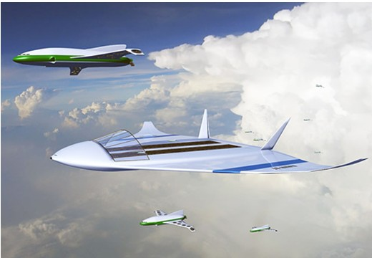
2.1
可能带来的不利影响 建立空中停机场
Thank you
航空母舰实现了海上移动机场，根据这个我设想在空中建立一种能让HAV停留补充能源的地方——浮空飞艇。我们可以将浮空飞艇固定于空中。并且浮空飞艇有太阳能电能转化转置。HAV可以在空中固定的一些位置与浮空飞艇相结合，让浮空飞艇将已经收集的太阳能转入HAV中（这对于高空长航时的定义有些偏差），实现HAV在大气层中永久性地运动（在工作寿命之内）。
未来的空中机场 飞行的航母
Notes:
13

